Slide 1
COT 4521: Introduction to Computational Geometry
Segment Intersection Line Sweep

Slide 2
Sweep Algorithm

Slide 3
Sweep Algorithm

Slide 4
Sweep Algorithm – Where do Events Occur?

Slide 5
Events
When do the events happen?
When the sweep is:
At an upper endpoint of the line segment;
At a lower endpoint of the line segment; or
At an intersection point of line segments
At each type, the status changes

Slide 6
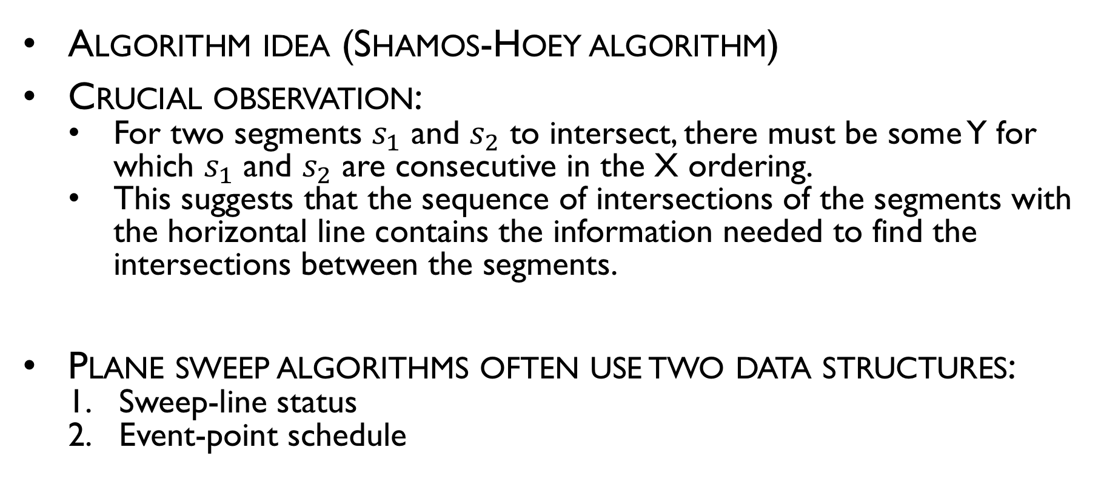
Intersection of line segments
Algorithm idea (Shamos-Hoey algorithm)
Crucial observation:
For two segments $s_{1}$ and $s_{2}$ to intersect, there must be some Y for which $s_{1}$ and $s_{2}$ are consecutive in the X ordering.
This suggests that the sequence of intersections of the segments with the horizontal line contains the information needed to find the intersections between the segments.
Plane sweep algorithms often use two data structures:
Sweep-line status
Event-point schedule

Slide 7
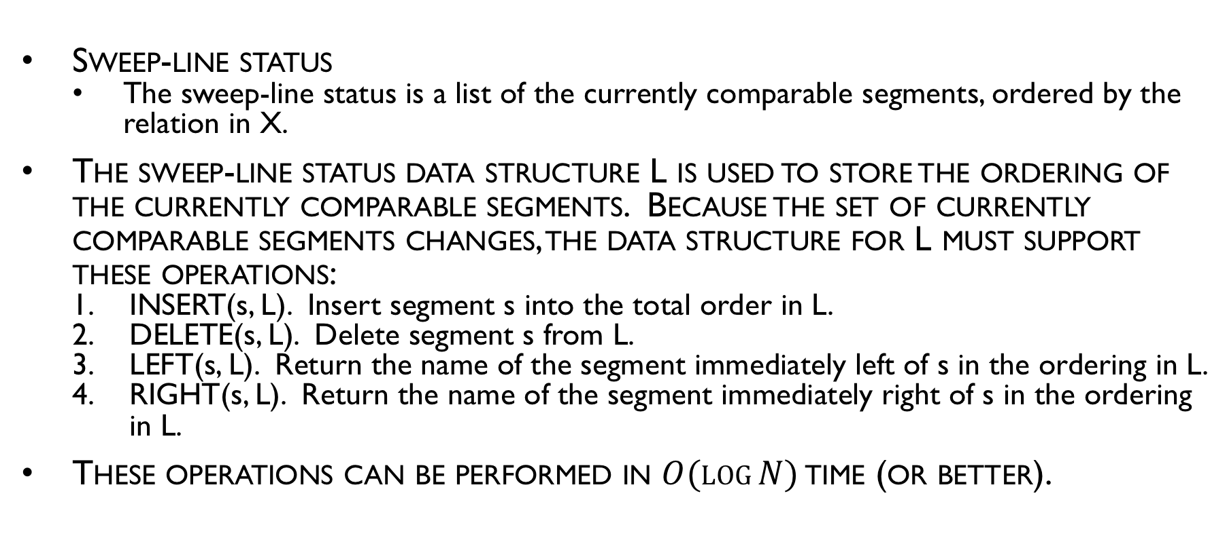
Intersection of line segments
Sweep-line status
The sweep-line status is a list of the currently comparable segments, ordered by the relation in X.
The sweep-line status data structure L is used to store the ordering of the currently comparable segments. Because the set of currently comparable segments changes, the data structure for L must support these operations:
INSERT(s, L). Insert segment s into the total order in L.
DELETE(s, L). Delete segment s from L.
LEFT(s, L). Return the name of the segment immediately left of s in the ordering in L.
RIGHT(s, L). Return the name of the segment immediately right of s in the ordering in L.
These operations can be performed in $O(log⁡N)$ time (or better).

Slide 8
Intersection of line segments
Event-point schedule
As the sweep-line is swept from top to bottom, the set of the currently comparable segments and/or their ordering by the relation of X changes at a finite set of y values; those are known as events.
The events for this problem are segment endpoints and segment intersections. The event-point schedule data structure E is used to store events prior to their processing. For E the following operations are needed:
MIN(E). Determine the smallest element in E (based on y), return it, and delete it.
INSERT(p, E). Insert abscissa p, representing an event, into E.
MEMBER(p, E). Determine if abscissa p is a member of E.
The priority queue data structure can perform all of these operations in O(log N) time.

Slide 9
Sweep Algorithm

Slide 10
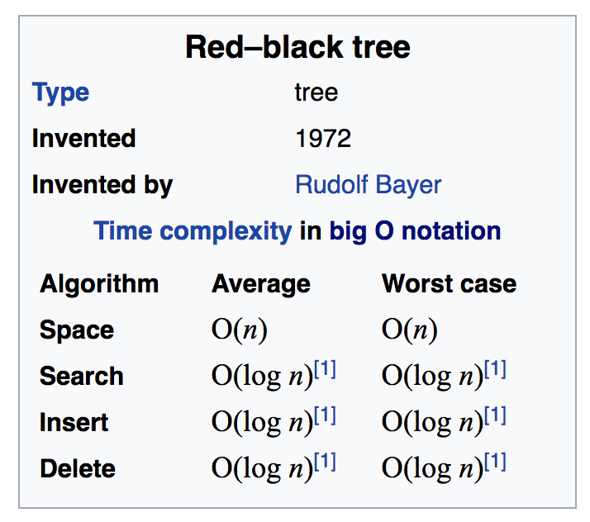
What Data Structures Should We Use?
Self-balancing trees (AVL, Red-black)

Slide 11
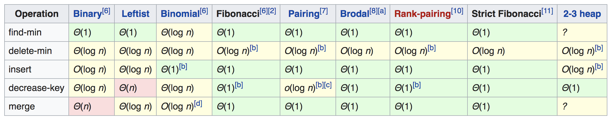
What Data Structures Should We Use?
Priority Queue

Slide 12
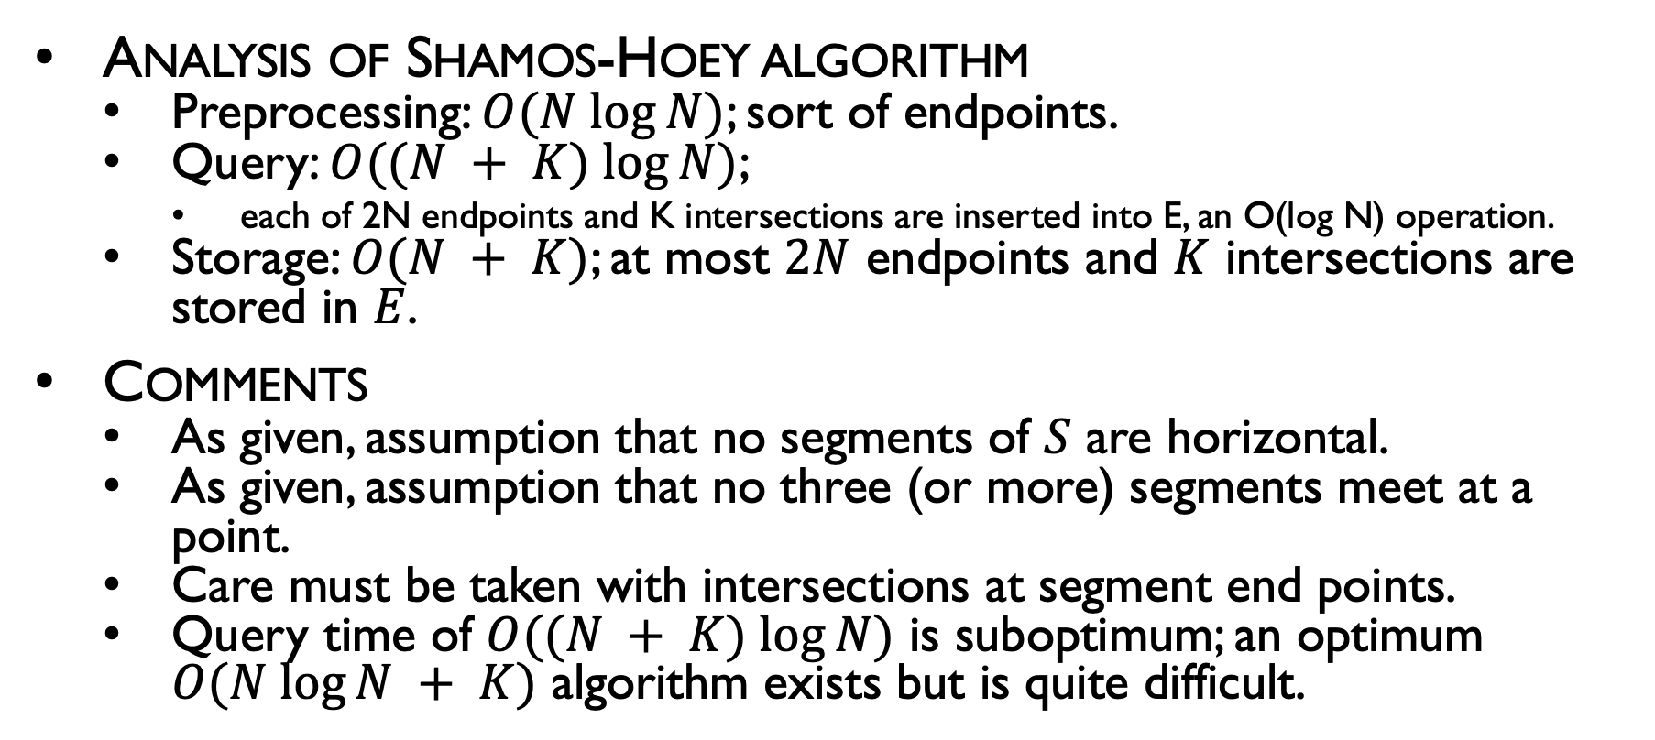
Intersection of line segment
Analysis of Shamos-Hoey algorithm
Preprocessing: $O(N log⁡N)$; sort of endpoints.
Query: $O((N + K) log⁡N)$;
each of 2N endpoints and K intersections are inserted into E, an O(log N) operation.
Storage: $O(N + K)$; at most $2N$ endpoints and $K$ intersections are stored in $E$.
Comments
As given, assumption that no segments of $S$ are horizontal.
As given, assumption that no three (or more) segments meet at a point.
Care must be taken with intersections at segment end points.
Query time of $O((N + K) log⁡N)$ is suboptimum; an optimum $O(N log⁡N + K)$ algorithm exists but is quite difficult.

