Slide 1
COT 4521: Introduction to Computational Geometry
Polygons

Slide 2
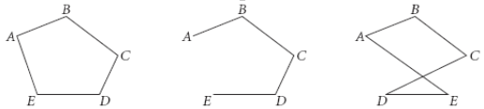
Polygon
Polygon is a region of a plane bounded by a finite collection of line segments forming a simple closed curve.
Boundary
Simple
Non-simple

Slide 3




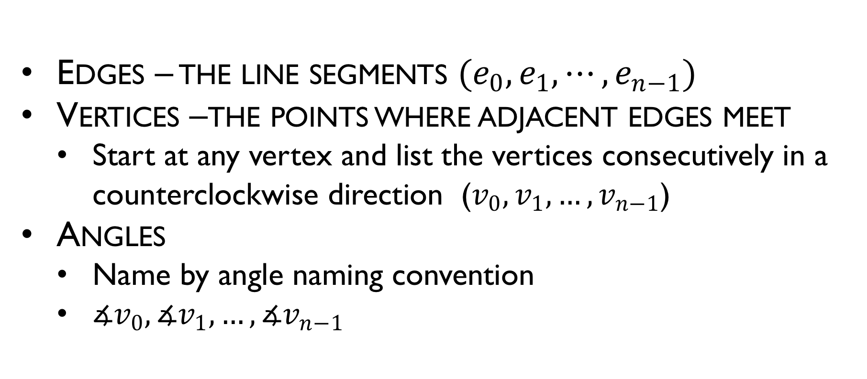






Polygon
Edges – the line segments $(e_{0}, e_{1},⋯,e_{n−1})$
Vertices –the points where adjacent edges meet
Start at any vertex and list the vertices consecutively in a counterclockwise direction ($v_{0},v_{1},…,v_{n−1}$)
Angles
Name by angle naming convention
$∡v_{0}, ∡v_{1},…, ∡v_{n−1}$
$$v_{2}$$
$$e_{1}$$
$$v_{1}$$
$$e_{2}$$
$$e_{0}$$
$$v_{3}$$
$$v_{0}$$
$$e_{3}$$
$$e_{4}$$
$$v_{4}$$

Slide 4
Properties of polygon
The line segments that make-up a polygon (called sides or edges) meet only at their endpoints, called vertices (singular: vertex) or less formally "corners"
Exactly two edges meet at every vertex
The number of edges always equals the number of vertices.
Two edges meeting at a corner are required to form an angle that is not straight (180°); otherwise, the line segments will be considered parts of a single edge

Slide 5
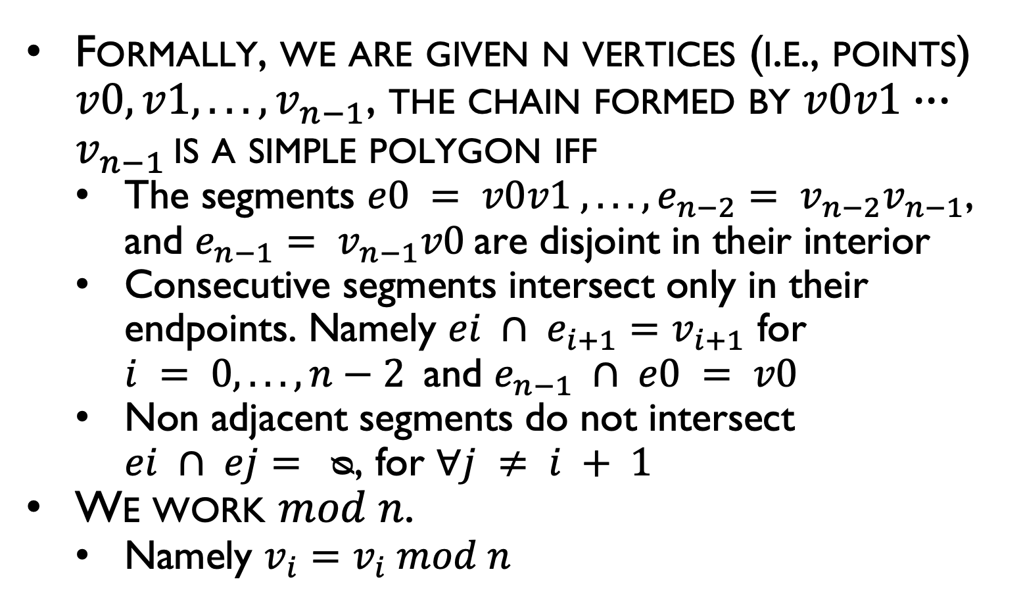
Formal Definition of a Simple Polygon
Formally, we are given n vertices (i.e., points) $v0, v1, . . . , v_{n−1}$, the chain formed by $v0v1∙∙∙v_{n−1 }$is a simple polygon iff
The segments $e0 = v0v1 , . . . , e_{n−2}= v_{n−2}v_{n−1}$, and $e_{n−1}= v_{n−1}v0$are disjoint in their interior
Consecutive segments intersect only in their endpoints. Namely $ei ∩ e_{i+1}=v_{i+1}$ for $i = 0, . . . , n−2$and $e_{n−1} ∩ e0 = v0$
Non adjacent segments do not intersect $ei ∩ ej= ᴓ$, for $∀j ≠ i + 1$
We work $mod n$.
Namely $v_{i}=v_{i} mod n$
$$v_{2}$$
$$e_{1}$$
$$v_{1}$$
$$e_{2}$$
$$e_{0}$$
$$v_{3}$$
$$v_{0}$$
$$e_{3}$$
$$e_{4}$$
$$v_{4}$$

Slide 6
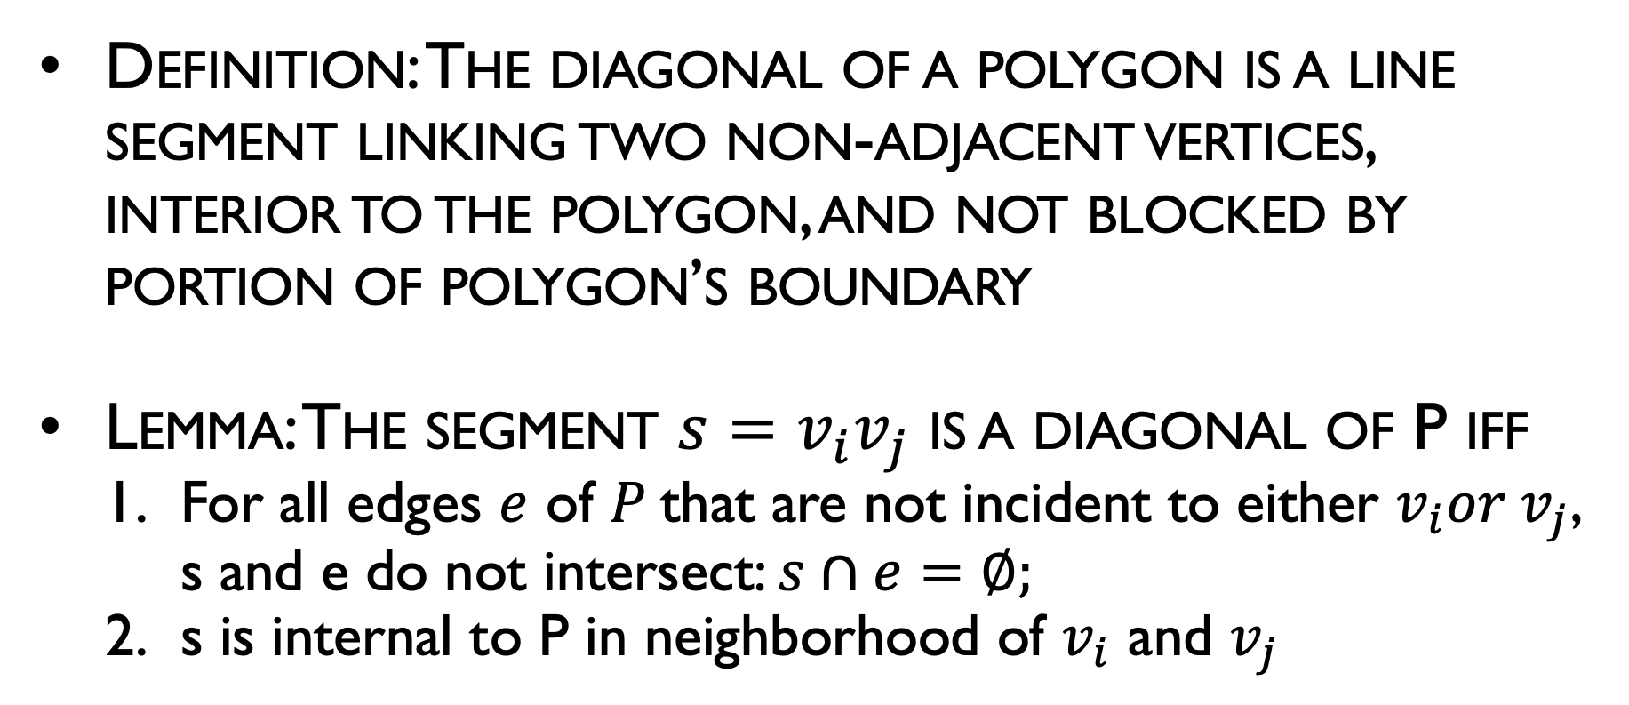
Diagonals
Definition: The diagonal of a polygon is a line segment linking two non-adjacent vertices, interior to the polygon, and not blocked by portion of polygon’s boundary
Lemma: The segment ${s=v}_{i}v_{j}$ is a diagonal of P iff
For all edges $e$ of $P$that are not incident to either $v_{i}{or v}_{j}$, s and e do not intersect: $s∩e=∅;$
s is internal to P in neighborhood of $v_{i}$ and $v_{j}$

Slide 7
Diagonals
Definition: The diagonal of a polygon is a line segment linking two non-adjacent vertices, interior to the polygon, and not blocked by portion of polygon’s boundary
Diagonal

Slide 8
Diagonals
Definition: The diagonal of a polygon is a line segment linking two non-adjacent vertices, interior to the polygon, and not blocked by portion of polygon’s boundary
which are legal diagonals?

Slide 9
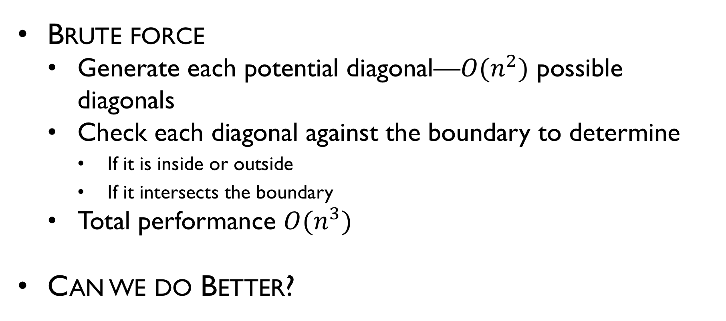
Efficient Diagonal Finding
Brute force
Generate each potential diagonal—$O(n^{2})$ possible diagonals
Check each diagonal against the boundary to determine
If it is inside or outside
If it intersects the boundary
Total performance $O(n^{3})$
Can we do Better?

Slide 10
Efficient Diagonal Finding
Variation on a sweep algorithm
From a given vertex, sweep both clockwise and counterclockwise, ordered by the distance of points
Retain a notion of “valid space” for diagonals

Slide 11
Efficient Diagonal Finding

Slide 12
Efficient Diagonal Finding

Slide 13
Efficient Diagonal Finding

Slide 14
Efficient Diagonal Finding

Slide 15
Efficient Diagonal Finding

Slide 16
Efficient Diagonal Finding

Slide 17
Efficient Diagonal Finding

Slide 18
Efficient Diagonal Finding

Slide 19
Efficient Diagonal Finding

Slide 20
Efficient Diagonal Finding

Slide 21
Efficient Diagonal Finding

Slide 22
Efficient Diagonal Finding

Slide 23
Efficient Diagonal Finding

Slide 24
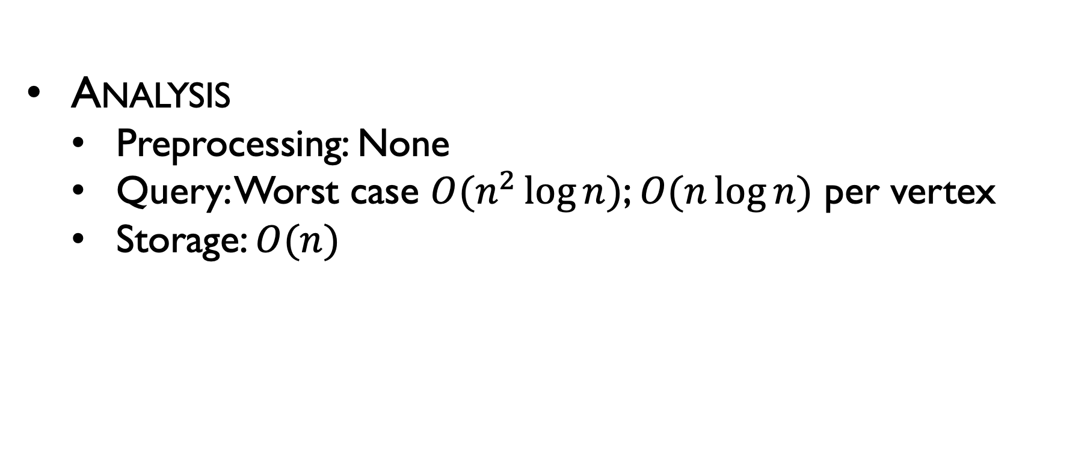
Efficient Diagonal Finding
Analysis
Preprocessing: None
Query: Worst case $O(n^{2}\log{n})$; $O(n\log{n})$ per vertex
Storage: $O(n)$

Slide 25
Triangulation Theory: Properties
Lemma: An internal diagonal exists between any two nonadjacent vertices of a polygon P if and only if P is convex polygon.
Proof: The proof consists of two parts, both established by contradiction.

Slide 26
Classification of Polygons by the Number of Edges
Most Common Polygons
Number of Sides | Name
3 | Triangle
4 | Quadrilateral
5 | Pentagon
6 | Hexagon
8 | Octagon
9 | Nonagon
10 | Decagon
12 | Dodecagon
n | n-gon

Slide 27

Sum of Angles
The sum of the internal angles of a polygon of n vertices is?
$$P$$

Slide 28
Sum of Angles
Use the Triangle Angle-Sum Theorem to find the sum of the measures of the angles of a polygon.
Triangle Angle-Sum Theorem
The sum of the measures of the angles of a triangle measure 180º

Slide 29
Sum of Angles
Theorem: The sum of the measures of the internal angles of an n-gon is (n - 2) *180.
Proof by induction

Slide 30
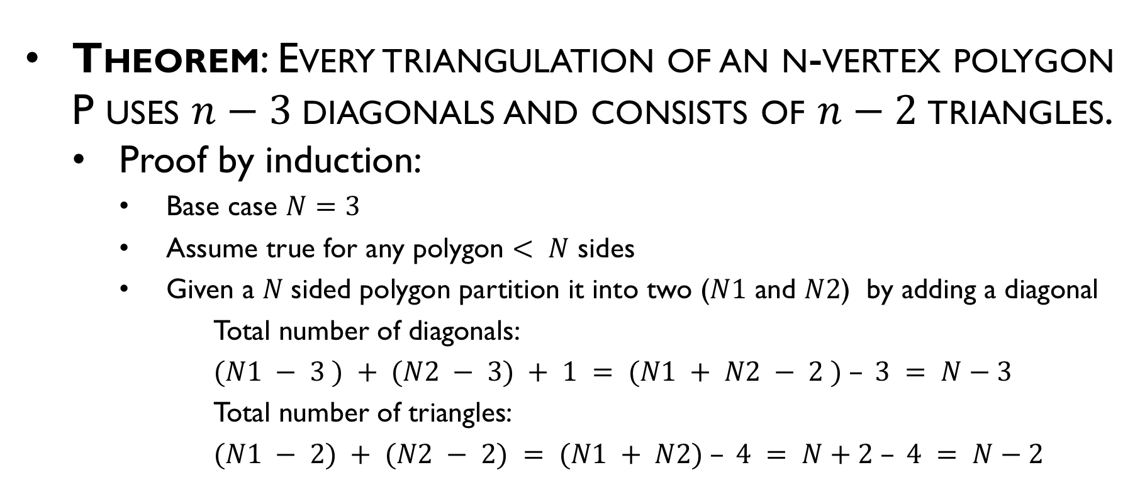
Triangulation Theory
Theorem: Every triangulation of an n-vertex polygon P uses $n−3$diagonals and consists of $n−2$triangles.
Proof by induction:
Base case $N=3$
Assume true for any polygon $< N$ sides
Given a $N$sided polygon partition it into two ($N1$ and $N2$) by adding a diagonal
Total number of diagonals:
$(N1 − 3 ) + (N2 − 3) + 1 = (N1 + N2 − 2 ) – 3 = N−3$
Total number of triangles:
$(N1 − 2) + (N2 − 2) = (N1 + N2) – 4 = N+2 – 4 = N−2$

Slide 31
Triangulation Example
9 vertices
7 triangles
6 diagonals

Slide 32
Area of a Polygon
What is the area of the polygon?

Slide 33








Area of a triangle
$$c$$
$$area=0.5\left|a−b\right|\left|c−d\right|$$
$$a$$
$$b$$
$$d$$
$$Z$$
$$area\left(blue+green\right)=\left|\left(\vec{b−a}\right)×\left(\vec{c−a}\right)\right|$$
$$X$$
$$Y$$

Slide 34
Sum of Areas
Area of the polygon can be found by adding the areas of a triangulation

Slide 35

Another way of computing area
$$Area (T)=Area(p,b,c)+Area(p,c,a)+Area(p,a,b)$$
c
b
a
p

Slide 36
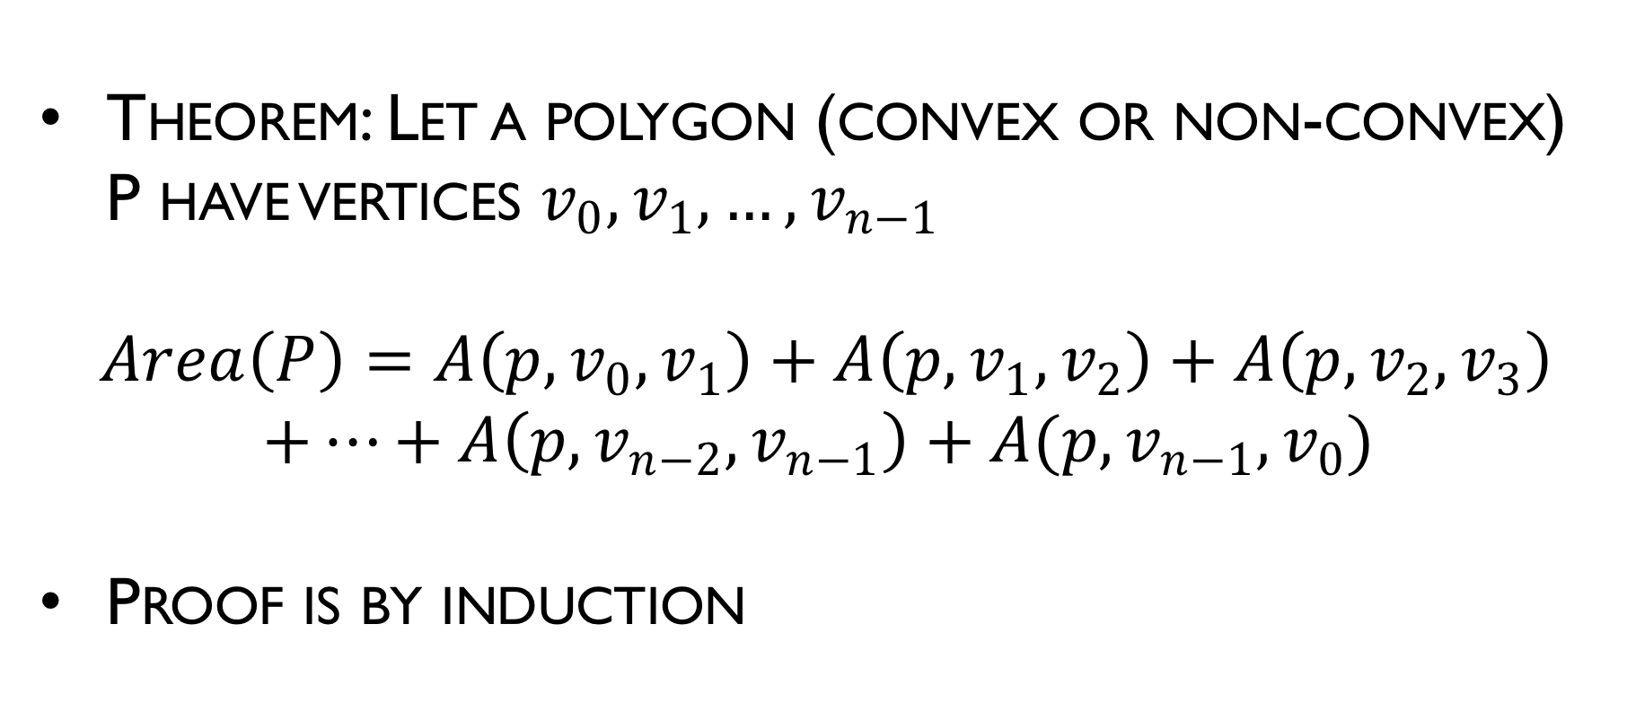
Area of Polygon
Theorem: Let a polygon (convex or non-convex) P have vertices $v_{0},v_{1},…,v_{n−1}$
$$Area\left(P\right)=A\left(p,v_{0},v_{1}\right)+A\left(p,v_{1},v_{2}\right)+A\left(p,v_{2},v_{3}\right)$$ $+…+A\left(p,v_{n−2},v_{n−1}\right)+A(p,v_{n−1},v_{0})$
Proof is by induction

Slide 37

Area of triangle
Heron’s formula:
$Area=sqrt\left(s\left(s−a\right)\left(s−b\right)\left(s−c\right)\right)$
where $s=\left(a+b+c\right)/2$ is the semiperimeter
A
b
c
C
a
B

Slide 38
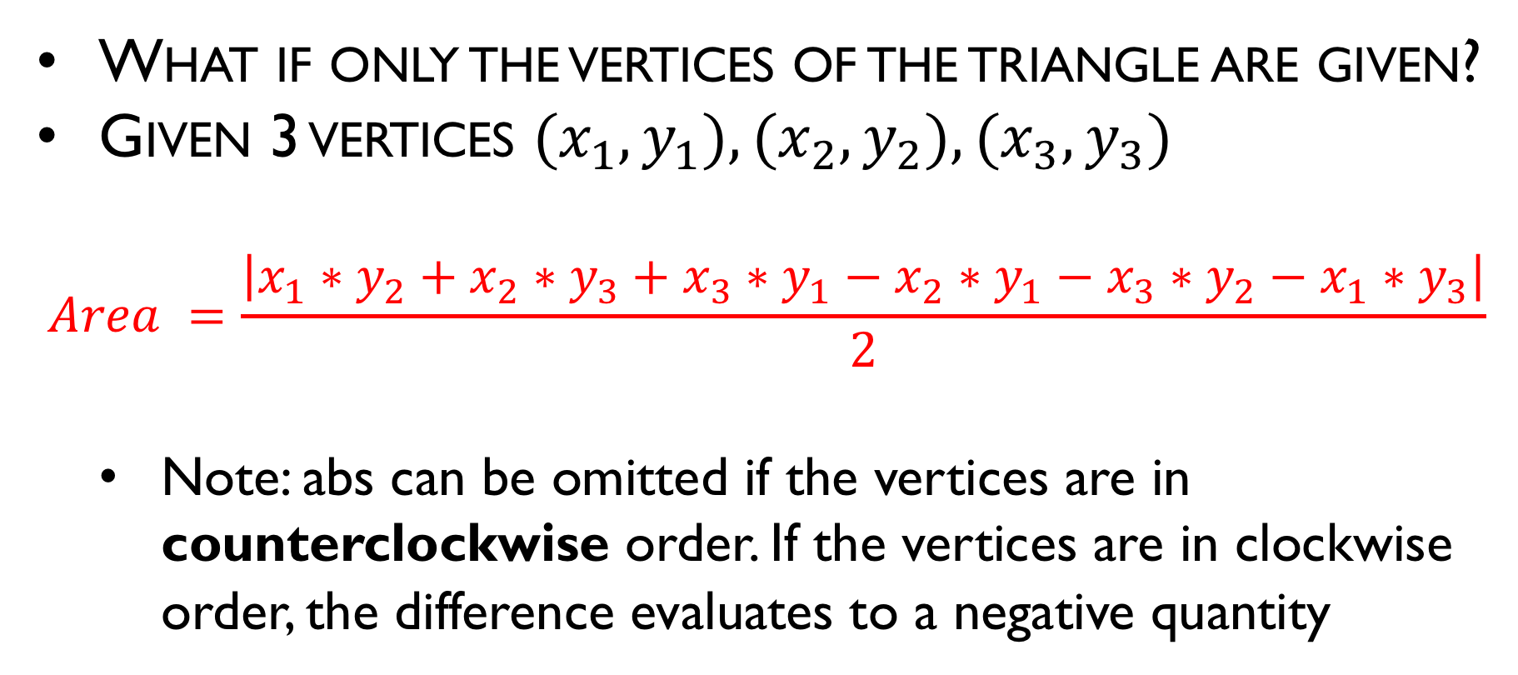
Area of triangle
What if only the vertices of the triangle are given?
Given 3 vertices $(x_{1}, y_{1}), (x_{2}, y_{2}), (x_{3}, y_{3})$
$$Area =\frac{\left|x_{1}∗y_{2}+x_{2}∗y_{3}+x_{3}∗y_{1}−x_{2}∗y_{1}−x_{3}∗y_{2}−x_{1}∗y_{3}\right|}{2}$$
Note: abs can be omitted if the vertices are in counterclockwise order. If the vertices are in clockwise order, the difference evaluates to a negative quantity

Slide 39
Area of triangle
That hard-to-memorize expression can be written this way:
Area = ½ *
-
x1 | y1
x2 | y2
x3 | y3
x1 | y1
+

Slide 40
Area of convex polygon
It turns out the previous formula still works!
Area = ½ *
x1 | y1
x2 | y2
x3 | y3
x4 | y4
x5 | y5
x1 | y1
-
(x3, y3)
(x4, y4)
+
(x2, y2)
(x5, y5)
(x1, y1)

Slide 41
Area of (non-convex) polygon
Miraculously, the same formula still holds for non-convex polygons!
Area = ½ * …

Slide 42
Point inside convex polygon?
Given a convex polygon and a point, is the point contained inside the polygon?
Assume the vertices are given in counterclockwise order for convenience
outside
inside
inside (definition may change)

Slide 43
Detour – Is polygon convex?
A quick question – how to tell if a polygon is convex?
Answer: It is convex if and only if every turn (at every vertex) is a left turn
Whether a “straight” turn is allowed depends on the problem definition
Our crossProd function is so useful

Slide 44
Point inside convex polygon?
Consider the turn p → p1 → p2
If p does lie inside the polygon, the turn must not be a right turn
Also holds for other edges (mind the directions)
p
p2
p1

Slide 45
Point inside convex polygon?
Conversely, if p was outside the polygon, there would be a right turn for some edge
p

Slide 46
Point inside convex polygon
Conclusion: p is inside the polygon if and only if it makes a non-left turn for every edge (in the counterclockwise direction)

Slide 47
Point inside (non-convex) polygon
Such a pain

Slide 48


Point inside a polygon test
How can we tell if point $A$ is inside of polygon $P$?
$$P$$
$$A$$

Slide 49
Point inside a polygon test
How can we tell if point $A$ is inside of polygon $P$?
$$P$$
$$A$$

Slide 50
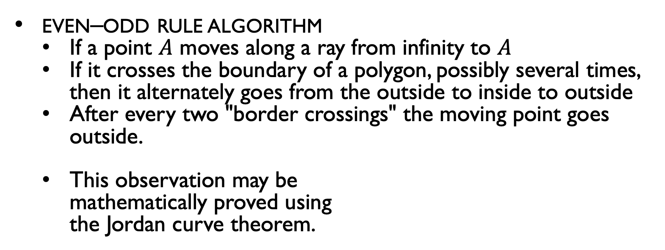
Point inside polygon
even–odd rule algorithm
If a point $A$ moves along a ray from infinity to $A$
If it crosses the boundary of a polygon, possibly several times, then it alternately goes from the outside to inside to outside
After every two "border crossings" the moving point goes outside.
This observation may be mathematically proved using the Jordan curve theorem.

Slide 51
Point inside polygon
Problematic cases: Degenerate intersections
Solution: Pick a random direction (i.e. random slope). If the ray hits a vertex of the polygon, pick a new direction. Repeat.

Slide 52
Point inside polygon
Solution: Pick a random direction (i.e. random slope). If the ray hits a vertex of the polygon, pick a new direction. Repeat.

