Slide 1
COT 4521: Introduction to Computational Geometry
The Art Gallery Problem

Slide 2
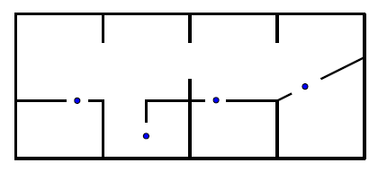
The Art Gallery Problem
The Art Gallery Problem: how many cameras we need to guard a given gallery so that every point is seen, and how we decide to place them?
In geometry terminology: How many points are needed in a simple polygon with n vertices so that every point in the polygon is seen?

Slide 3
The Art Gallery Problem
This problem was posed by Victor Klee in 1973
A guard of the gallery corresponds to a point on the polygonal floor plan.
Guards can see in every direction, with a full range of visibility
The optimization problem is computationally difficult

Slide 4
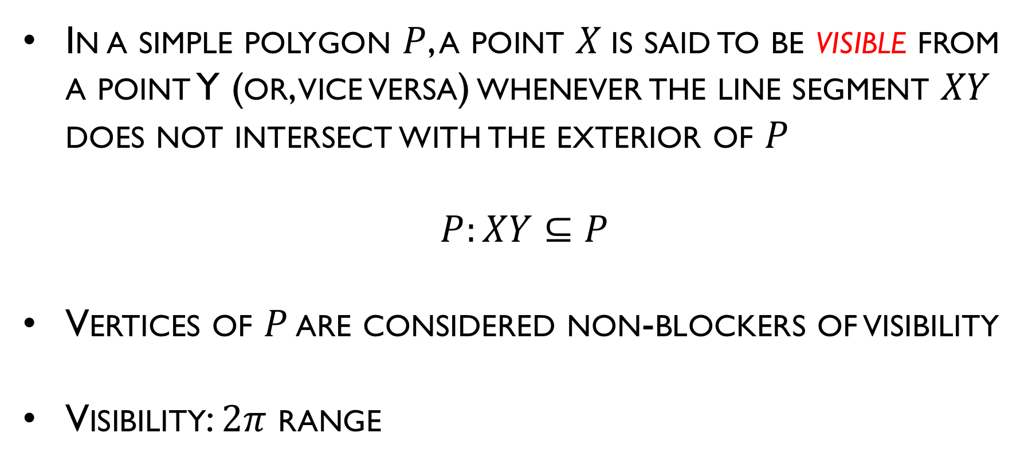
The Art Gallery Problems
In a simple polygon $P$, a point $X$is said to be visible from a point Y (or, vice versa) whenever the line segment $XY$ does not intersect with the exterior of $P$
$$P:XY⊆P$$
Vertices of $P$ are considered non-blockers of visibility
Visibility: $2π$ range

Slide 5
The Art Gallery Problems
Consider a room whose floor is polygon of N vertices, how many point lights (cameras) are needed to light the whole room?
A set of lights is said to cover a polygon if every point in the polygon is lighted.
Assume the lights themselves are not sources of shadows

Slide 6
Guarding a simple polygon
Given a simple polygon P with n vertices, find the minimum number of guards required for every point of P to be visible from some guard
Assume that every guard can view 360 degrees around it
How many lights we need to place to guard a simple polygon?
One guard is both necessary and sufficient for any convex polygon

Slide 7
Sufficient number of guards for any polygon of n vertices
How many guards are sufficient to cover any n-vertex simple polygon?
By placing a guard at every vertex, any n-vertex simple polygon can be trivially guarded with n guards — loose upper bound

Slide 8
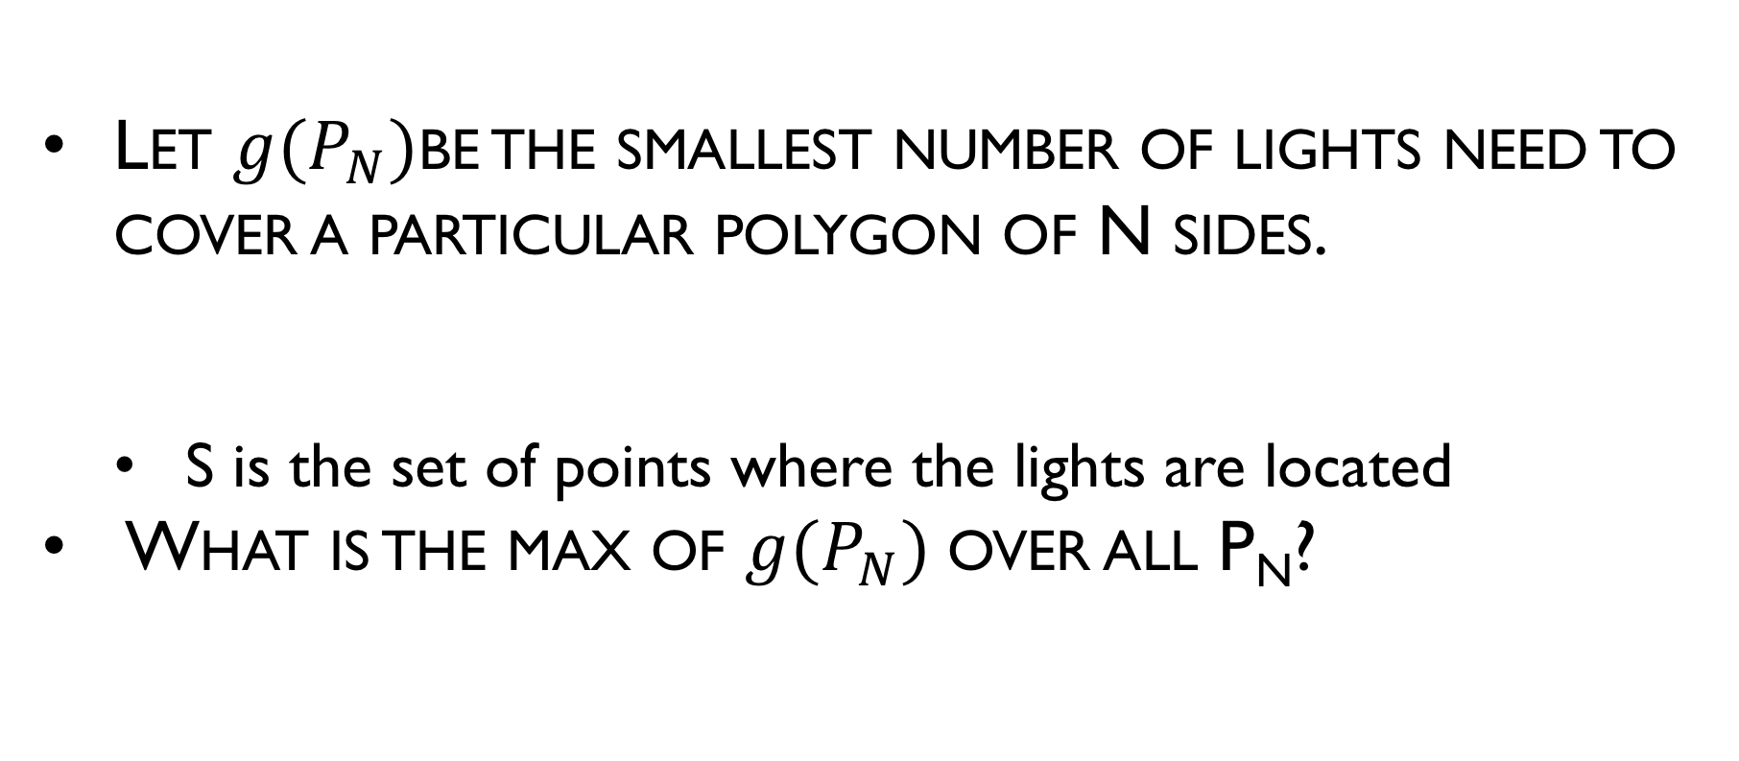
Maximum over minimum formulation Formal definition
Let $g(P_{N})$be the smallest number of lights need to cover a particular polygon of N sides.
S is the set of points where the lights are located
What is the max of $g(P_{N})$over all P_{N}?

Slide 9
How many lights are needed?
What is the maximum of
the minimum number of
lights needed to cover
a 12-sided polygon?

Slide 10
G(N) = ?

Slide 11
Maximum over minimum formulation
How many lights (cameras) needed (n=12)

Slide 12
Maximum over minimum formulation: Quiz
How many lights (cameras) needed (n=12)

Slide 13
Maximum over minimum formulation: Quiz
How many lights (cameras) needed (n=12)

Slide 14
Maximum over minimum formulation: Quiz
How many lights (cameras) needed (n=12)

Slide 15

G(N) = ….
Chvatal’s comb
G(12) = 4
Can it be that $G\left(N\right)=\left\lfloor \frac{N}{3}\right\rfloor$?

Slide 16
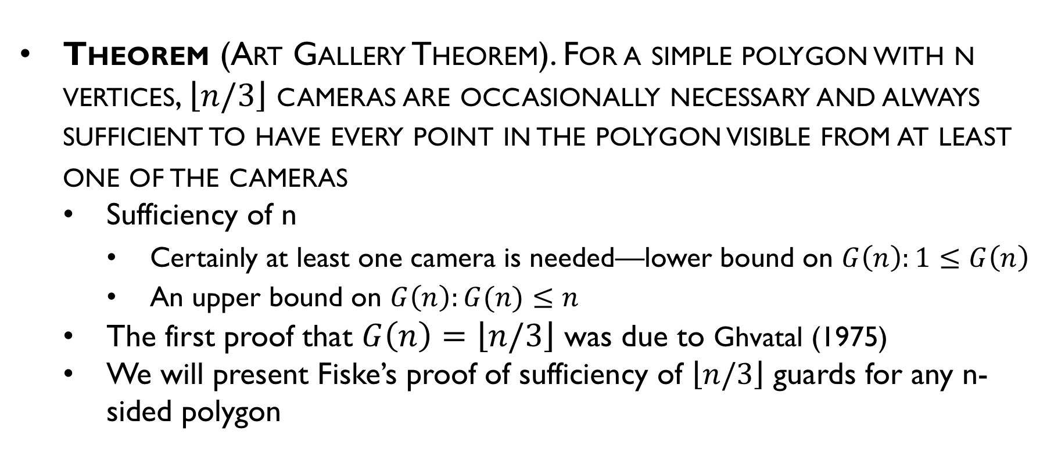
Maximum over minimum formulation
Theorem (Art Gallery Theorem). For a simple polygon with n vertices, $\left\lfloor n/3\right\rfloor$ cameras are occasionally necessary and always sufficient to have every point in the polygon visible from at least one of the cameras
Sufficiency of n
Certainly at least one camera is needed—lower bound on $G\left(n\right):1≤G\left(n\right)$
An upper bound on $G\left(n\right):G(n)≤n$
The first proof that $G\left(n\right)=\left\lfloor n/3\right\rfloor$ was due to Ghvatal (1975)
We will present Fiske’s proof of sufficiency of $\left\lfloor n/3\right\rfloor$ guards for any n-sided polygon

Slide 17
Fiske’ proof
Given arbitrary n-vertex P:
Triangulate P
Color the vertices of triangulation graph G
G can be 3-colored
Place lights at same colored nodes
Guaranteed to light the whole polygon P

Slide 18
Brute Force Triangulation
Triangulate P using a diagonal-based approach
Theorem: Every polygon P of n vertices can be partitioned into triangle by the addition of (zero or more) diagonals.
Complexity of diagonal-based algorithm:
O(n²) - # of diagonal candidates
O(n) testing each of neighborhoods
Repeating this O(n³) computation for each of the n-3 diagonals yields O(n⁴)

Slide 19
Triangulation Dual
The dual T of a triangulation is a tree, with each node of degree at most three.
Dual graph: each face gives a node; two nodes are connected if the faces are adjacent

Slide 20
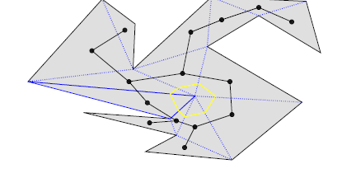
Properties of triangulations
Proof:
The degree three is immediate from the fact that every triangle have three sides.
If there is a cycle C in T it is easy to verify that...
There must be a vertex inside the polygon...

Slide 21
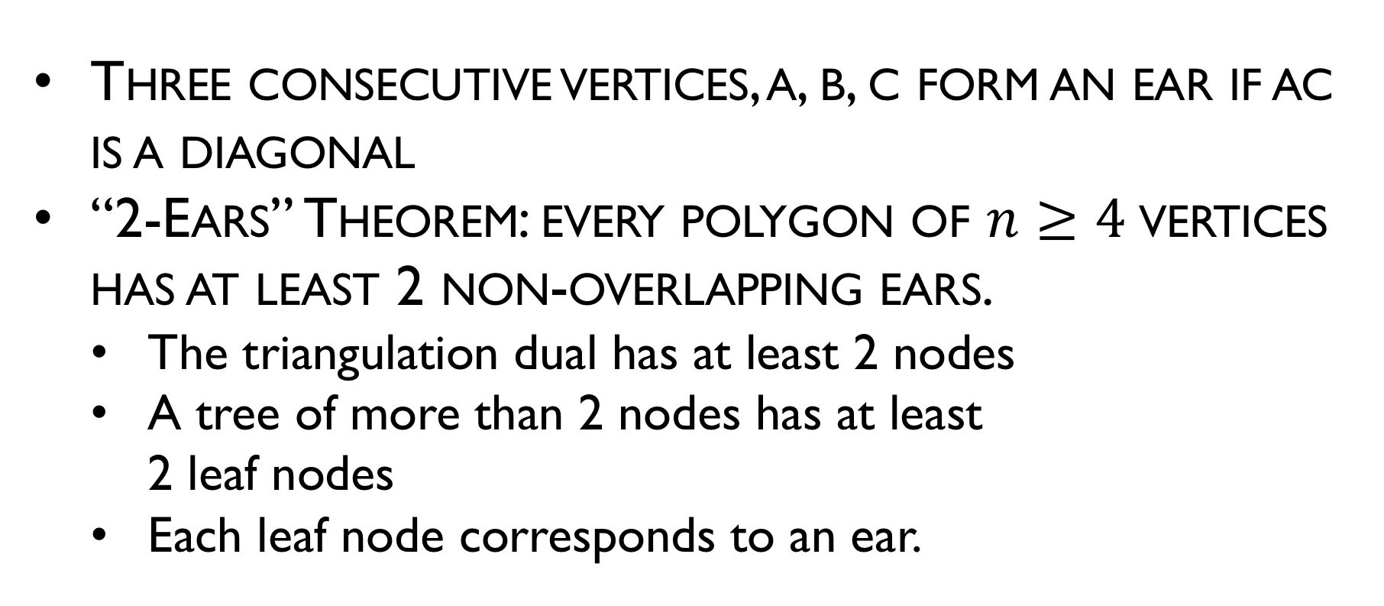
Meister’s Two Ears Theorem
Three consecutive vertices, a, b, c form an ear if ac is a diagonal
“2-Ears” Theorem: every polygon of $n≥4$vertices has at least 2 non-overlapping ears.
The triangulation dual has at least 2 nodes
A tree of more than 2 nodes has at least 2 leaf nodes
Each leaf node corresponds to an ear.
ear
ear

Slide 22
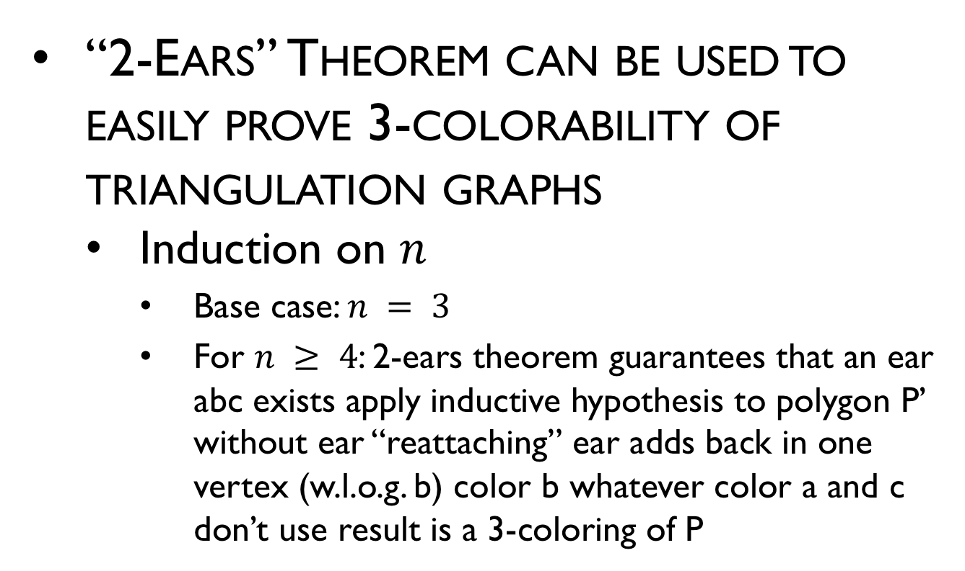
Triangulation Theory: 3-Coloring
“2-Ears” Theorem can be used to easily prove 3-colorability of triangulation graphs
Induction on $n$
Base case: $n = 3$
For $n ≥ 4$: 2-ears theorem guarantees that an ear abc exists apply inductive hypothesis to polygon P’ without ear “reattaching” ear adds back in one vertex (w.l.o.g. b) color b whatever color a and c don’t use result is a 3-coloring of P
a
b
c

Slide 23
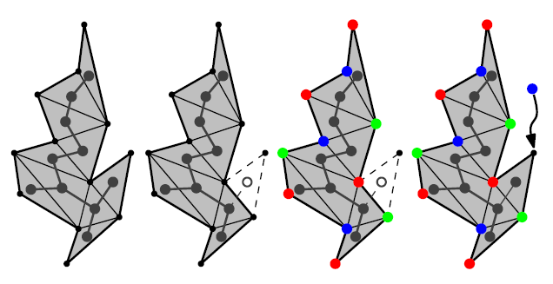
Fiske’ proof
3 colors

Slide 24
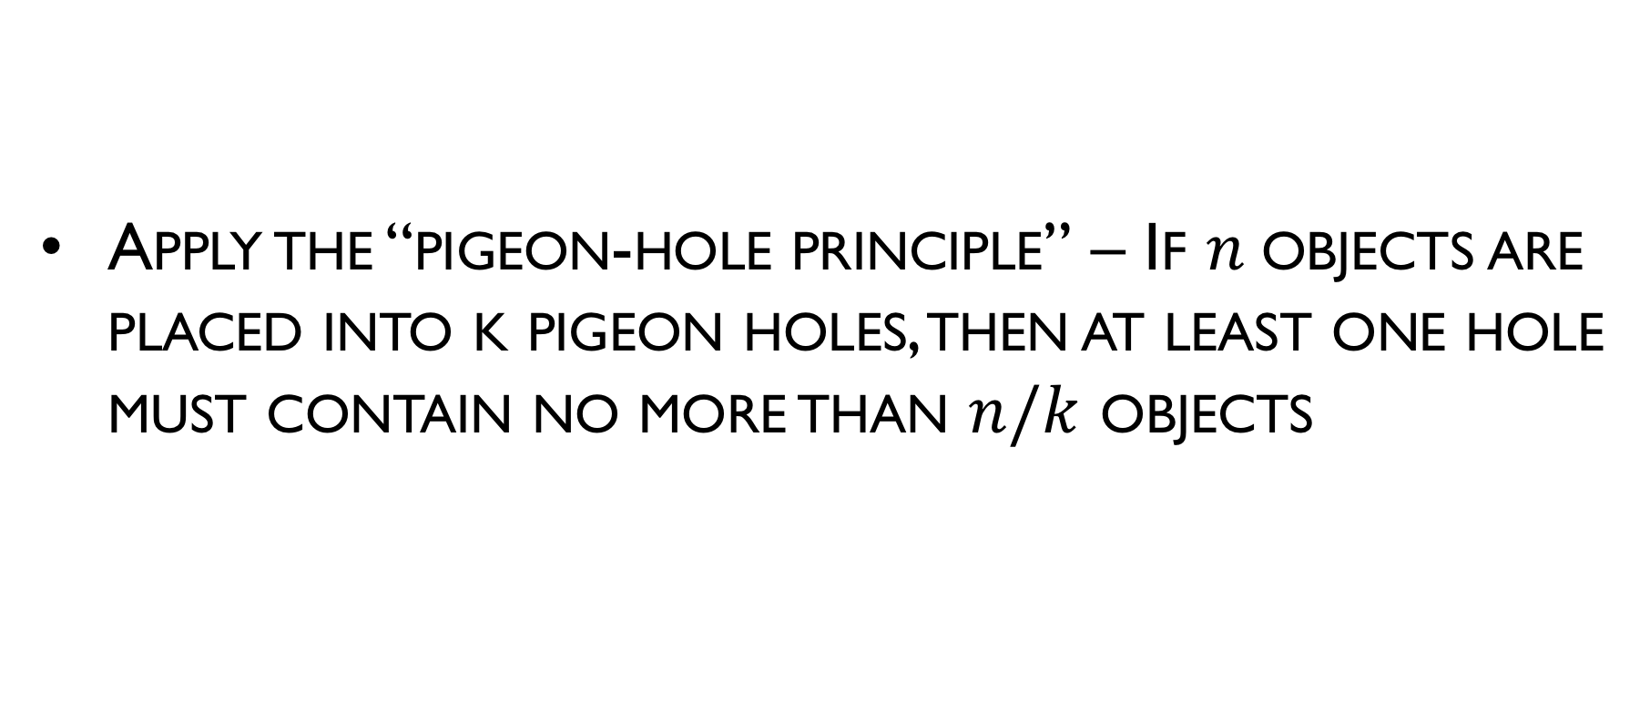
Fiske’ proof
Apply the “pigeon-hole principle” – If $n$objects are placed into k pigeon holes, then at least one hole must contain no more than $n/k$ objects

Slide 25
3 colors suffice…
5
4
5

Slide 26
3 colors suffice…
5
5
4

Slide 27
Pigeon Hole Principle
3 holes (colors) and 14 pigeons (vertices) to go into them.
There will always be one hole with less or equal to 14/3 pigeons
Generalizing: for 3 colors and N vertices there will be a color that is used at most N/3 times. Place the light at those colors.

Slide 28
Example

