Slide 1
COT 4521: Introduction to Computational Geometry
Polygon Triangulation

Slide 2
Triangulation of polygons
Decompose the polygon into shapes that are easier to handle: triangles
A triangulation of a polygon P is a decomposition of P into triangles whose vertices are vertices of P. In other words, a triangulation is a maximal set of non-crossing diagonals.
diagonal

Slide 3
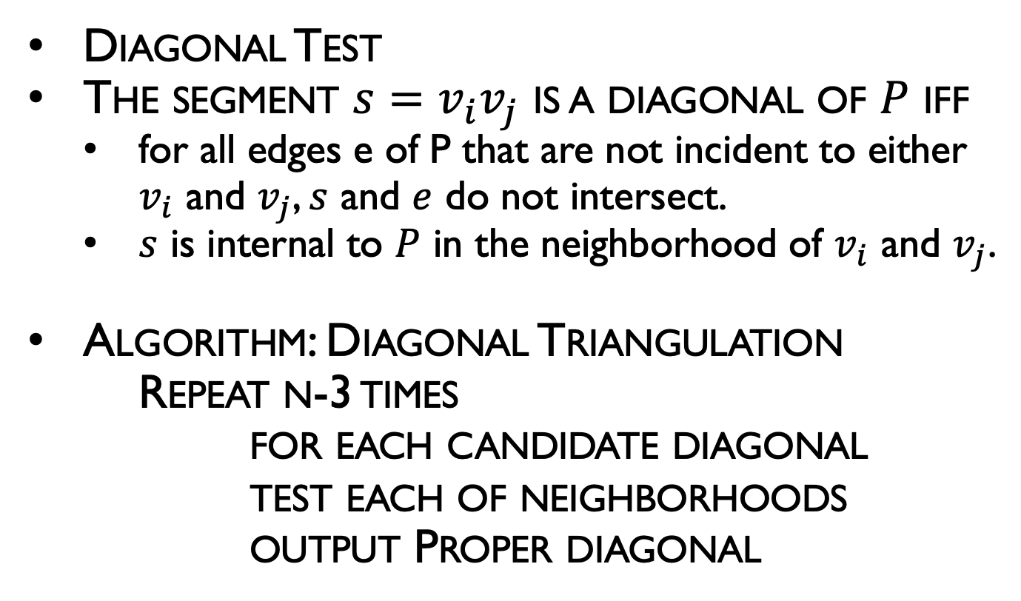
Diagonal-Based Triangulation
Diagonal Test
The segment $s=v_{i}v_{j}$ is a diagonal of $P$ iff
for all edges e of P that are not incident to either $v_{i}$ and $v_{j}$, $s$ and $e$ do not intersect.
$s$ is internal to $P$ in the neighborhood of $v_{i}$ and $v_{j}$.
Algorithm: Diagonal Triangulation
Repeat n-3 times
for each candidate diagonal
test each of neighborhoods
output Proper diagonal
5
4
1
3
2
0

Slide 4
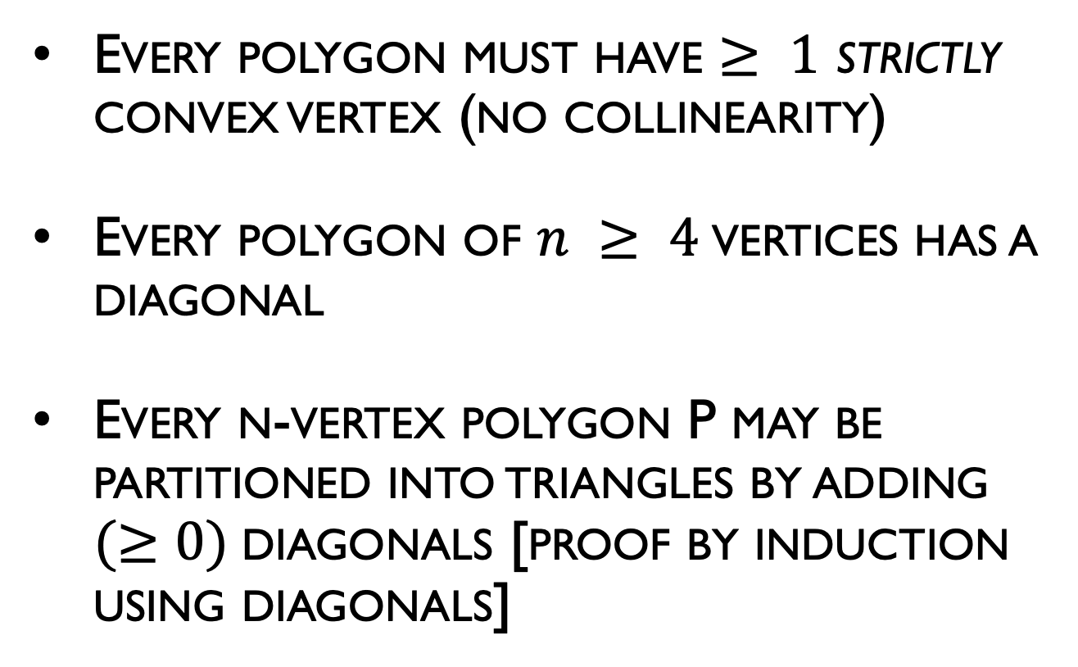
Triangulation Theory: Existence of a Diagonal
Every polygon must have $≥ 1$ strictly convex vertex (no collinearity)
Every polygon of $n ≥ 4$vertices has a diagonal
Every n-vertex polygon P may be partitioned into triangles by adding $(≥0)$diagonals [proof by induction using diagonals]

Slide 5
Triangulation Theory of Polygon
Lemma: Every polygon must have at least one strictly convex vertex.
Proof:
If the edges of polygon oriented in a counter-clockwise traversal, then a convex vertex is a left turn, and reflex vertex is right turn and interior of the polygon is always to the left
Let L is the line through the lowest vertex v (y-coordinate)
The interior of the polygon must be above
The edges following v must be above L
The walker make the left turn at v, thus v is convex
L
v

Slide 6
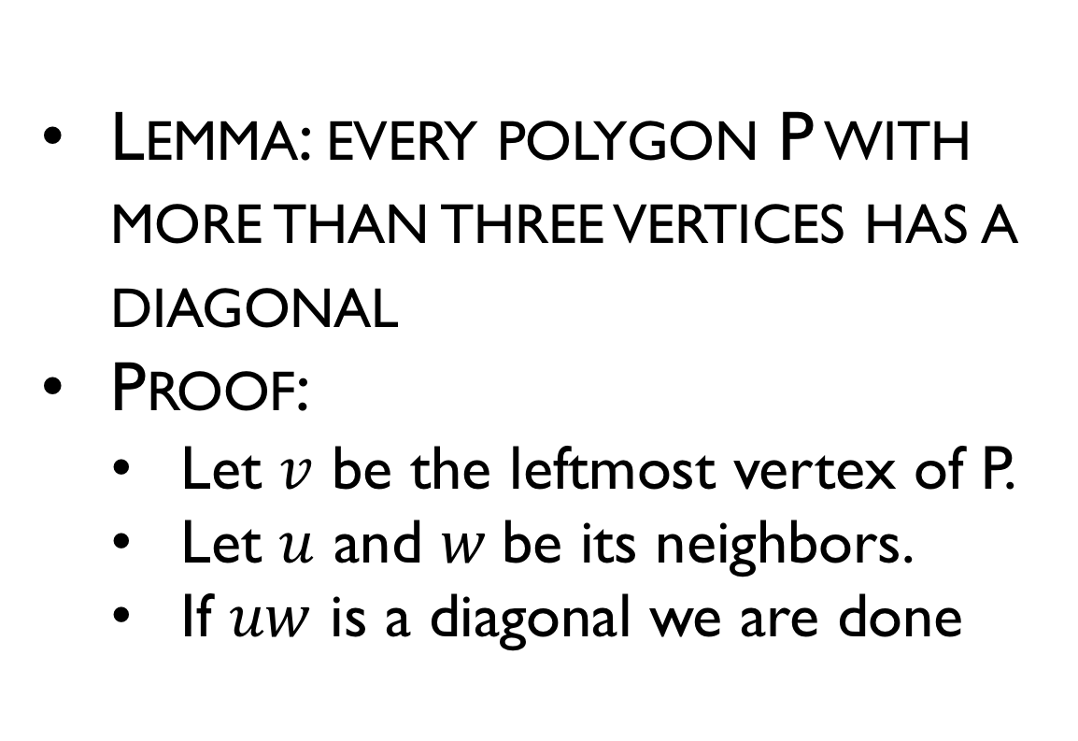
Existence of a Diagonal
Lemma: every polygon P with more than three vertices has a diagonal
Proof:
Let $v$ be the leftmost vertex of P.
Let $u$ and $w$be its neighbors.
If $uw$ is a diagonal we are done
w
v
u

Slide 7
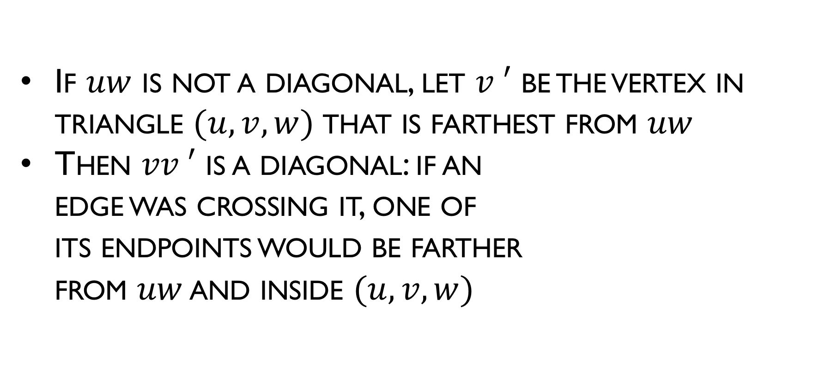
Existence of a Diagonal
If $uw$ is not a diagonal, let $v ′$ be the vertex in triangle $(u, v, w)$that is farthest from $uw$
Then $vv ′$ is a diagonal: if an edge was crossing it, one of its endpoints would be farther from $uw$ and inside $(u, v,w)$
w
v
v'
u

Slide 8
Triangulation Theory: Properties
Lemma: An internal diagonal exists between any two nonadjacent vertices of a polygon P if and only if P is convex polygon.
Proof: The proof consists of two parts, both established by contradiction.

Slide 9
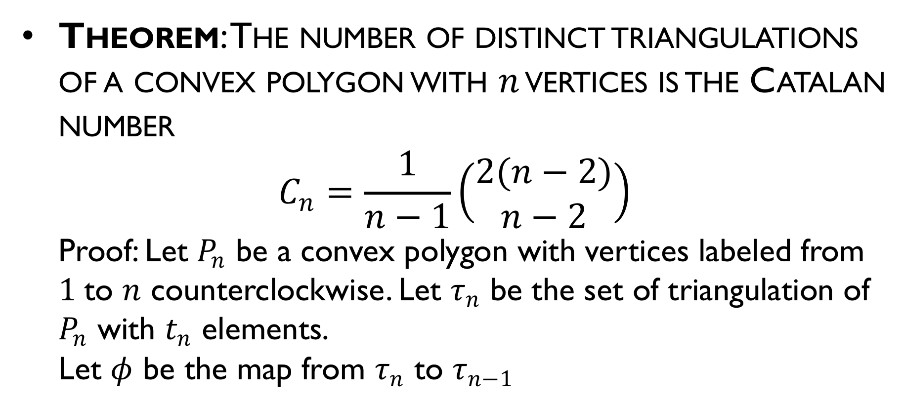
Triangulation Theory: Properties
Theorem: The number of distinct triangulations of a convex polygon with $n$ vertices is the Catalan number
$$C_{n}=\frac{1}{n−1}\left(\begin{matrix}2(n−2) \\ n−2\end{matrix}\right)$$
Proof: Let $P_{n}$ be a convex polygon with vertices labeled from $1$to $n$ counterclockwise. Let $τ_{n}$ be the set of triangulation of $P_{n}$ with $t_{n}$ elements.
Let $φ$ be the map from $τ_{n}$ to $τ_{n−1}$

Slide 10
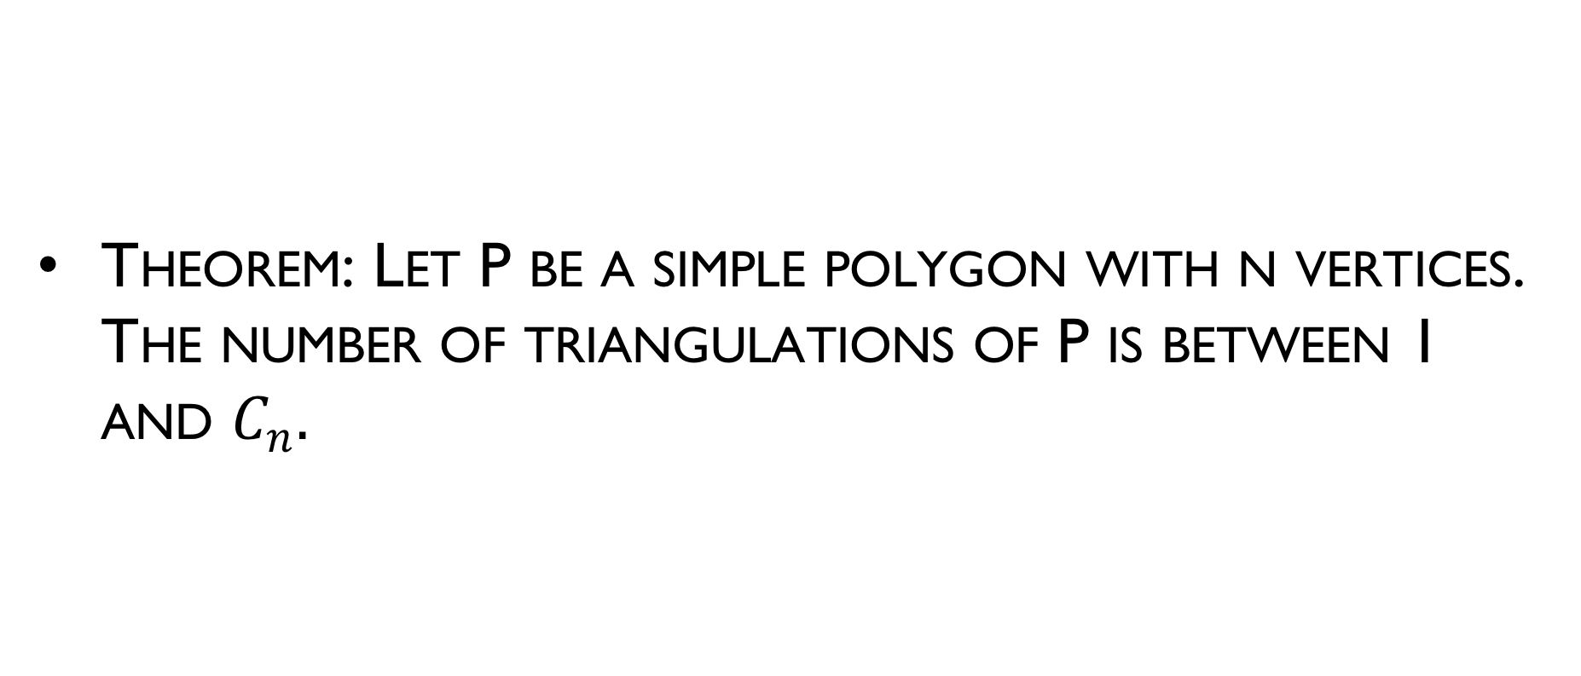
Triangulation Theory: Properties
Theorem: Let P be a simple polygon with n vertices. The number of triangulations of P is between 1 and $C_{n}.$

Slide 11
Triangulation Theory
Every polygon P of N vertices can be partitioned into triangles by the addition of zero or more diagonals. (Induction proof)
Base case: N = 3 (triangle)
Assumption: Let it be true for < N sided polygon
Any N sided polygon can be partitioned into two polygons of less then N sides each by adding a diagonal, each of which can be partitioned by using premise 2 above
Thus, it is true for all N.
Notes:
By induction, the two polygons can be triangulated using
m - 2 and n - m + 2 - 2 = n - m triangles. So the original
polygon is triangulated using m - 2 + n - m = n - 2
triangles

Slide 12
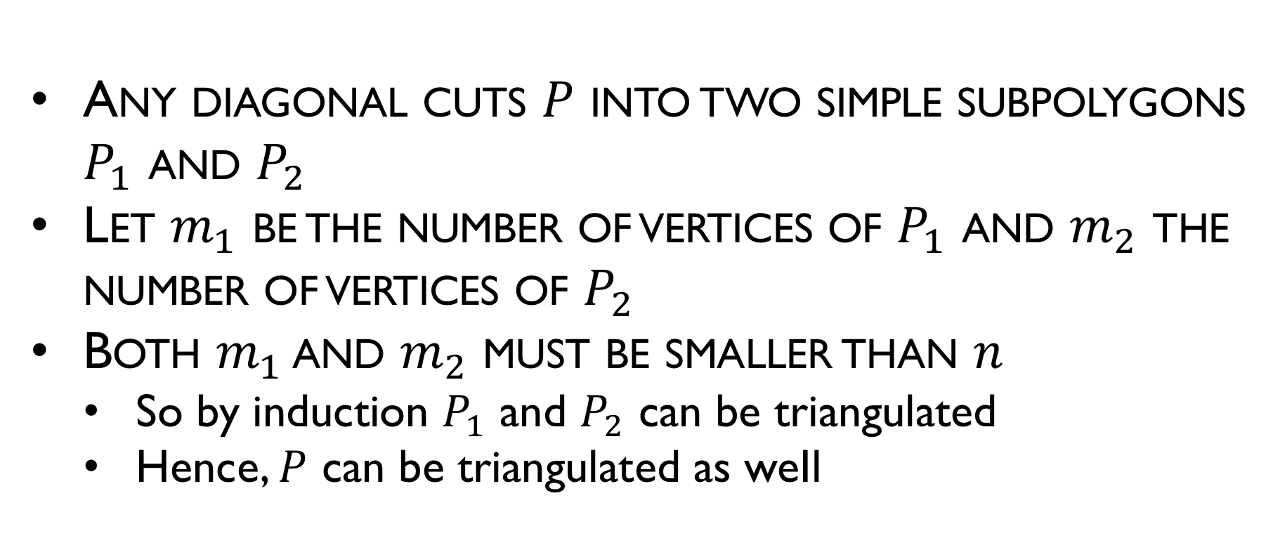
Triangulation Theory
Any diagonal cuts $P$ into two simple subpolygons $P_{1}$ and $P_{2}$
Let $m_{1}$ be the number of vertices of $P_{1}$ and $m_{2}$ the number of vertices of $P_{2}$
Both $m_{1}$ and $m_{2}$ must be smaller than $n$
So by induction $P_{1}$ and $P_{2}$ can be triangulated
Hence, $P$ can be triangulated as weIl

Slide 13
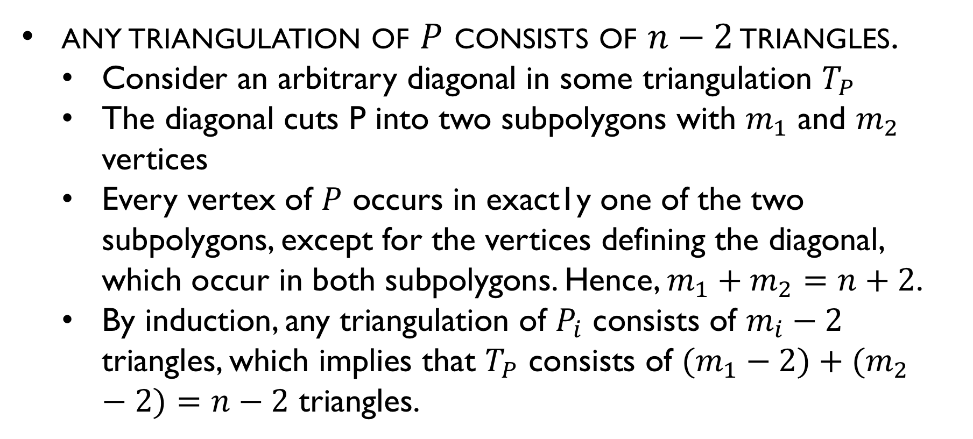
Triangulation Theory
any triangulation of $P$ consists of $n−2$ triangles.
Consider an arbitrary diagonal in some triangulation $T_{P}$
The diagonal cuts P into two subpolygons with $m_{1}$ and $m_{2}$ vertices
Every vertex of $P$ occurs in exact1y one of the two subpolygons, except for the vertices defining the diagonal, which occur in both subpolygons. Hence, $m_{1}+m_{2}=n+2$.
By induction, any triangulation of $P_{i}$ consists of $m_{i}−2$ triangles, which implies that $T_{P}$ consists of $(m_{1}−2)+(m_{2}−2)=n−2$ triangles.

Slide 14
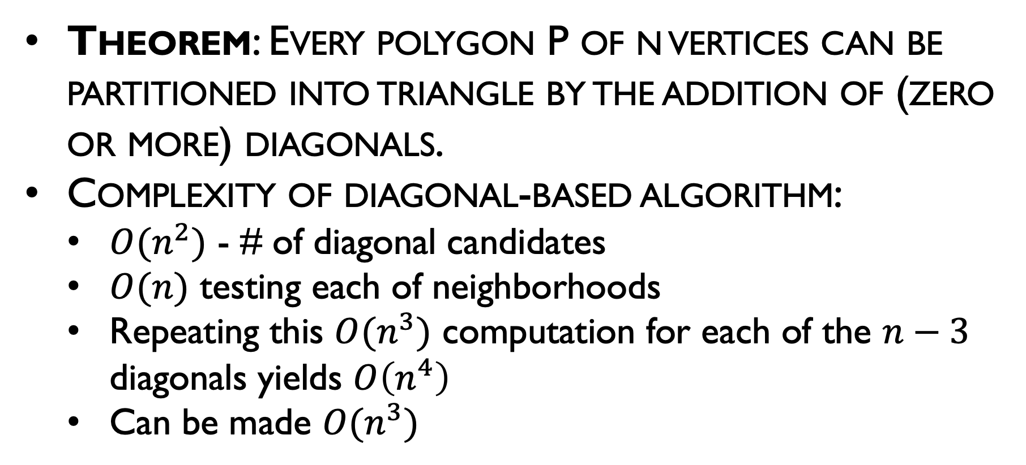
Brute Force Triangulation
Theorem: Every polygon P of n vertices can be partitioned into triangle by the addition of (zero or more) diagonals.
Complexity of diagonal-based algorithm:
$O(n^{2})$ - # of diagonal candidates
$O(n)$ testing each of neighborhoods
Repeating this $O(n^{3})$ computation for each of the $n−3$ diagonals yields $O\left(n^{4}\right)$
Can be made $O(n^{3})$

Slide 15
Ear Based Idea….
Locate an ear
Output diagonal
Clip the ear
Repeat until a triangle is left

Slide 16
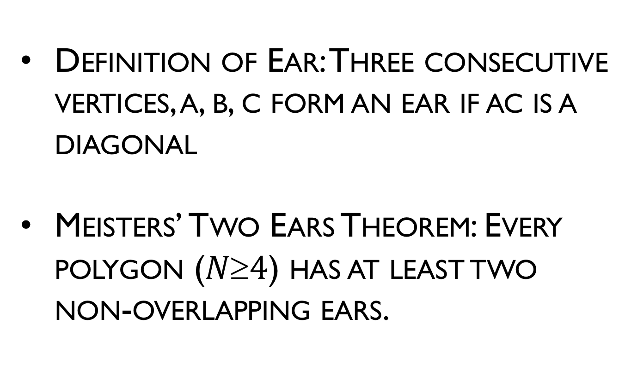
Ear Based Idea….
Definition of Ear: Three consecutive vertices, a, b, c form an ear if ac is a diagonal
Meisters’ Two Ears Theorem: Every polygon ($N4$) has at least two non-overlapping ears.

Slide 17
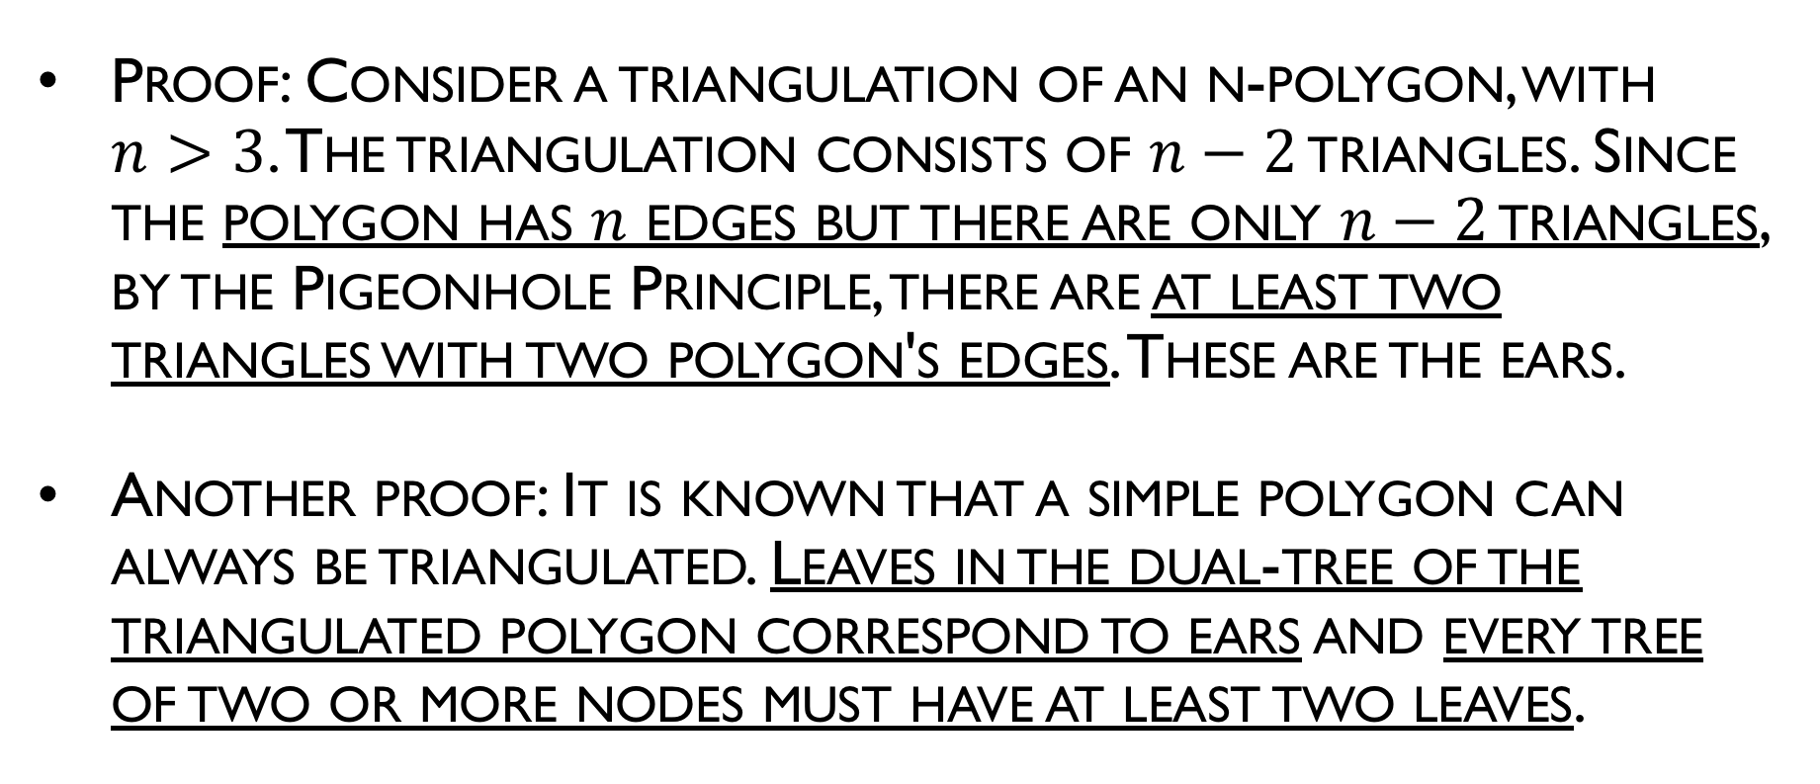
Ear Based Idea….
Proof: Consider a triangulation of an n-polygon, with $n>3$. The triangulation consists of $n−2$ triangles. Since the polygon has $n$ edges but there are only $n−2$ triangles, by the Pigeonhole Principle, there are at least two triangles with two polygon's edges. These are the ears.
Another proof: It is known that a simple polygon can always be triangulated. Leaves in the dual-tree of the triangulated polygon correspond to ears and every tree of two or more nodes must have at least two leaves.

Slide 18
Triangulation: Implementation
Algorithm: TRIANGULATION
Initialize the ear tip status of each vertex.
while n > 3 do
Locate an ear tip v₂.
Output diagonal v₁ v₃.
Delete v₂.
Update the ear tip status of v₁ and v₃.

Slide 19
Triangulation: Implementation
Algorithm: TRIANGULATION
Initialize the ear tip status of each vertex.
while n > 3 do
Locate an ear tip v₂.
Output diagonal v₁ v₃.
Delete v₂.
Update the ear tip status of v₁ and v₃.
O(n²)
+
O(n)
iterations
O(n)
iterations
O(n)
Total: O(n³)
Can be made: O(n²)

Slide 20
11
4
12
10
14
9
6
13
5
8
7
16
15
3
1
17
2
0

