Slide 1
COT 4521: Introduction to Computational Geometry
Polygon Partitioning

Slide 2
Monotone Partitioning
A chain is monotone with respect to a line L if every line orthogonal to L intersects the chain in at most 1 point
Polygon is monotone with respect to a line L if boundary of P can be split into 2 polygonal chains A and B such that each chain is monotone with respect to L
Monotonicity implies sorted order with respect to L
Monotone polygon can be (greedily) triangulated in O(n) time!

Slide 3
Monotone Polygon
l’
L
l’
l’
l’
Monotone w.r.t. line L
not monotone w.r.t. L
l’
l’
l’
l’

Slide 4
Monotone Polygon
l’
not monotone w.r.t. any line
l

Slide 5
Polygon triangulation
Algorithm: Polygon triangulation: monotone polygon with respect to y-line
Partition into monotone polygons
Triangulate each monotone polygon

Slide 6
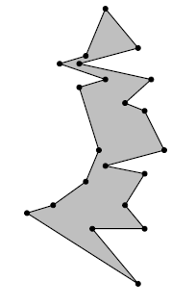
Monotone Polygon
A y-monotone polygon has a top vertex, a bottom vertex, and two y-monotone chains between top and bottom as its boundary

Slide 7
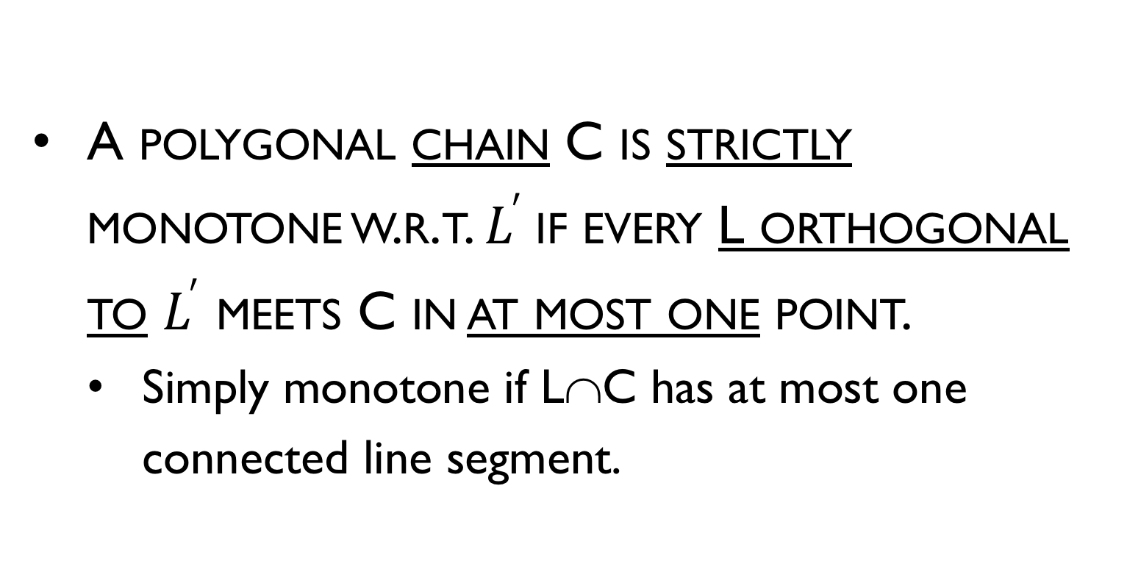
Monotone Polygon
A polygonal chain C is strictly monotone w.r.t. $L^{′}$if every L orthogonal to $L^{′}$ meets C in at most one point.
Simply monotone if L∩C has at most one connected line segment.

Slide 8
Monotone Polygon
A polygon P is said to be monotone w.r.t. a line L if ∂P can be split into two monotone chains w.r.t. L

Slide 9
Monotone Polygon
The following property is characteristic for y-monotone polygons:
If we walk from a topmost to a bottommost vertex along the left (or the right) boundary chain, then we always move downwards or horizontally, never upwards.

Slide 10
Triangulation of Monotone Polygon
The algorithm to triangulate a monotone polygon depends on its monotonicity.
Developed in 1978 by Garey, Johnson, Preparata, and Tarjan
described in both
Preparata pp. 239-241 (1985)
Laszlo pp. 128-135 (1996)
The former uses y-monotone polygons, the latter uses x-monotone.

Slide 11
What kind of vertices does a Non-Y-Monotone Polygon have with respect to sweep of y?

Slide 12
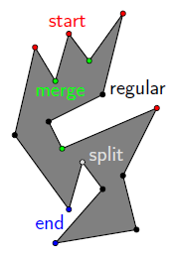
Properties of monotone polygon
If a polygon P has no interior cusps, then it is monotone
What types of vertices does a simple polygon have?
start
end
split
merge
regular

Slide 13
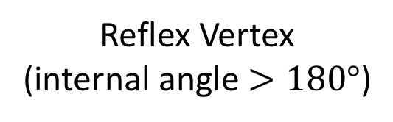
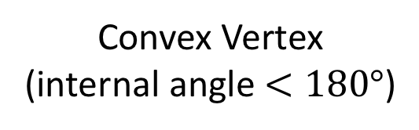
Reminder
Reflex Vertex (internal angle $>180°$)
Convex Vertex
(internal angle $<180°$)

Slide 14
Properties of monotone polygon
Reflex vertex whose adjacent vertices are either both at or above v, or both at or below it.
If a polygon has no interior cusps then it is monotone with respect to the vertical line
Interior cusps
Upward
Cusp (merge)
v
Downward cusp (split)
v

Slide 15
Properties of monotone polygon
Lemma: A polygon is y-monotone if it has neither split vertices nor merge vertices
Proof: If P is not monotone, there must exist a line l intersecting P in more than a single segment. Let [p,q] be its leftmost sub segment.
Follow the boundary of P starting at q, where P is on the left. At some point r we must cross l.
If r ≠ p then the highest vertex must be a split one.
split vertex
P

Slide 16
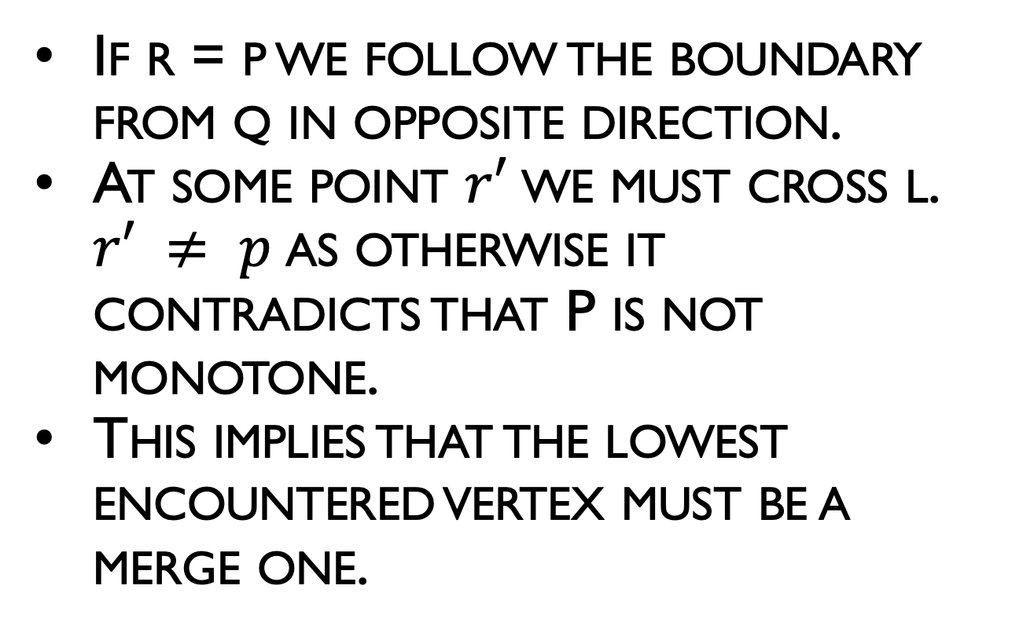
Properties of monotone polygon
If r = p we follow the boundary from q in opposite direction.
At some point $r′$we must cross l. $r′ ≠ p$as otherwise it contradicts that P is not monotone.
This implies that the lowest encountered vertex must be a merge one.
P
merge vertex

Slide 17
Polygon Triangulation
Algorithm: POLYGON TRIANGULATION: MONOTONE PARTITION
Partition into monotone polygons
Triangulate each monotone polygon
P

Slide 18
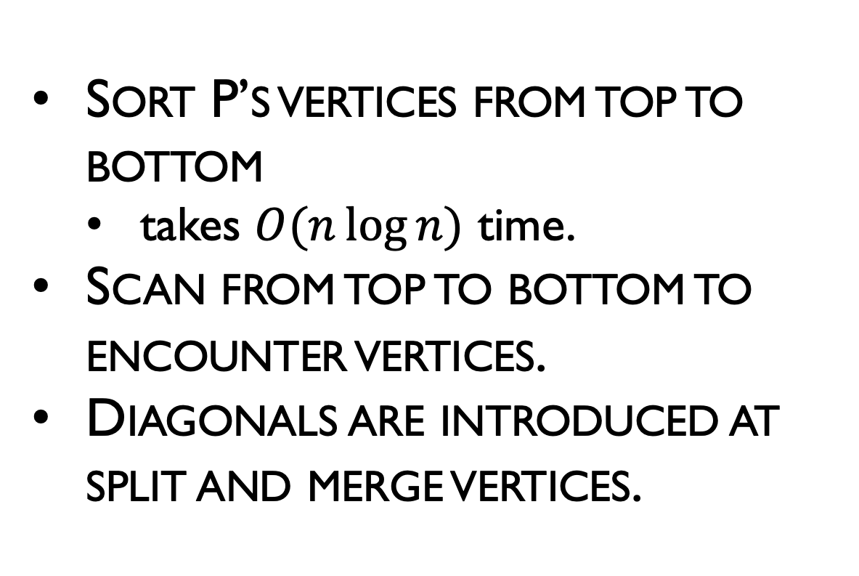
Getting Rid of Split and Merge Vertices
Sort P’s vertices from top to bottom
takes $O(n\log{n})$ time.
Scan from top to bottom to encounter vertices.
Diagonals are introduced at split and merge vertices.
P

Slide 19
Trapezoidalization
“Draw” horizontal line through each vertex
Consider only the connected segment inside the polygon containing the vertex
Two supporting vertices – top and bottom
If an “interior” supporting vertex is an interior cusp, break it
Connect downward for a upward cusp
Connect upward for an downward cusp
These connections partitions the polygon into monotone parts.
P

Slide 20
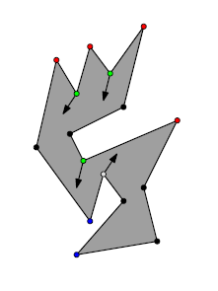
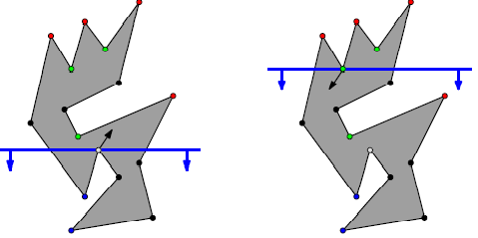
Sweep idea
Find diagonals from each merge vertex down, and from each split vertex up
A simple polygon with no split or merge vertices can have at most one start and one end vertex, so it is y-monotone

Slide 21
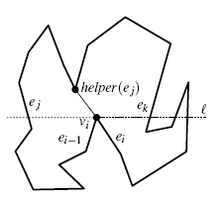
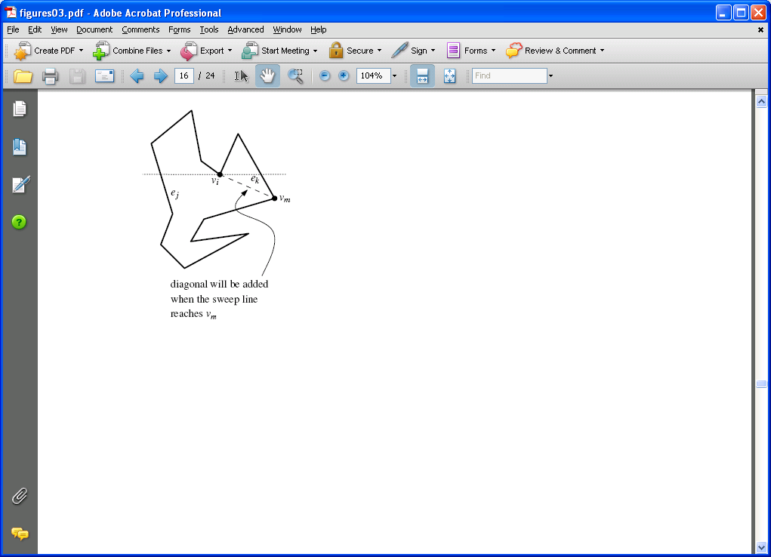
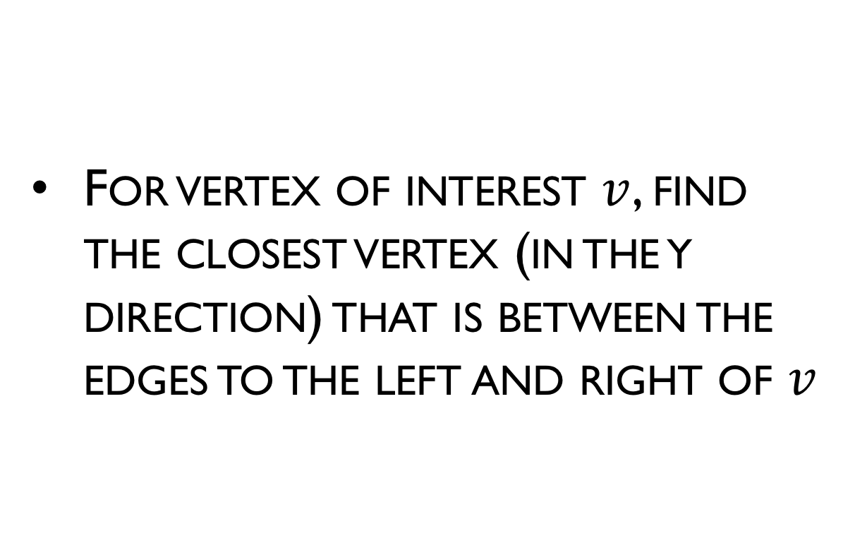
Sweep idea
For vertex of interest $v$, find the closest vertex (in the y direction) that is between the edges to the left and right of $v$

Slide 22
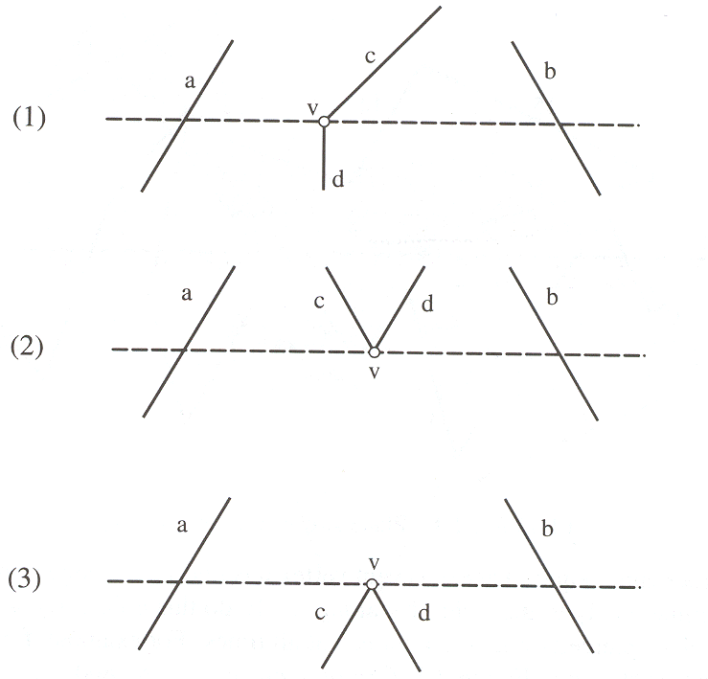
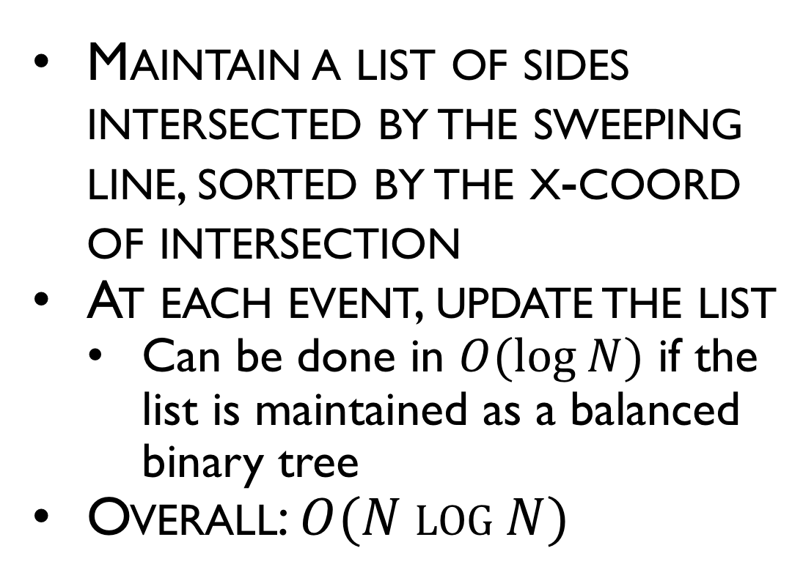
Forming trapezoids
Maintain a list of sides intersected by the sweeping line, sorted by the x-coord of intersection
At each event, update the list
Can be done in $O(log N)$ if the list is maintained as a balanced binary tree
Overall: $O(N log N)$

Slide 23
Line Sweep Example

