Slide 1
COT 4521: Introduction to Computational Geometry
Monotone Triangulation

Slide 2
Polygon Triangulation
Algorithm: POLYGON TRIANGULATION: MONOTONE PARTITION
Partition into monotone polygons
Triangulate each monotone polygon
P

Slide 3
Description of the processing triangulation of y-monotone polygons
The algorithm processes one vertex at a time in order of decreasing y coordinate, creating diagonals of polygon P.
The sweep line moves from top to down and stops at each vertex of polygon P
Each diagonal bounds a triangle, and leaves a polygon with one less side still to be triangulated

Slide 4
Description of the processing triangulation of y-monotone polygons
Sort the vertices top-to-down by a merge of the two chains
Initialize a stack. Push the first two vertices in the stack
Take the next vertex u, and triangulate as much as possible, top-down, while popping the stack
Push u onto the stack

Slide 5





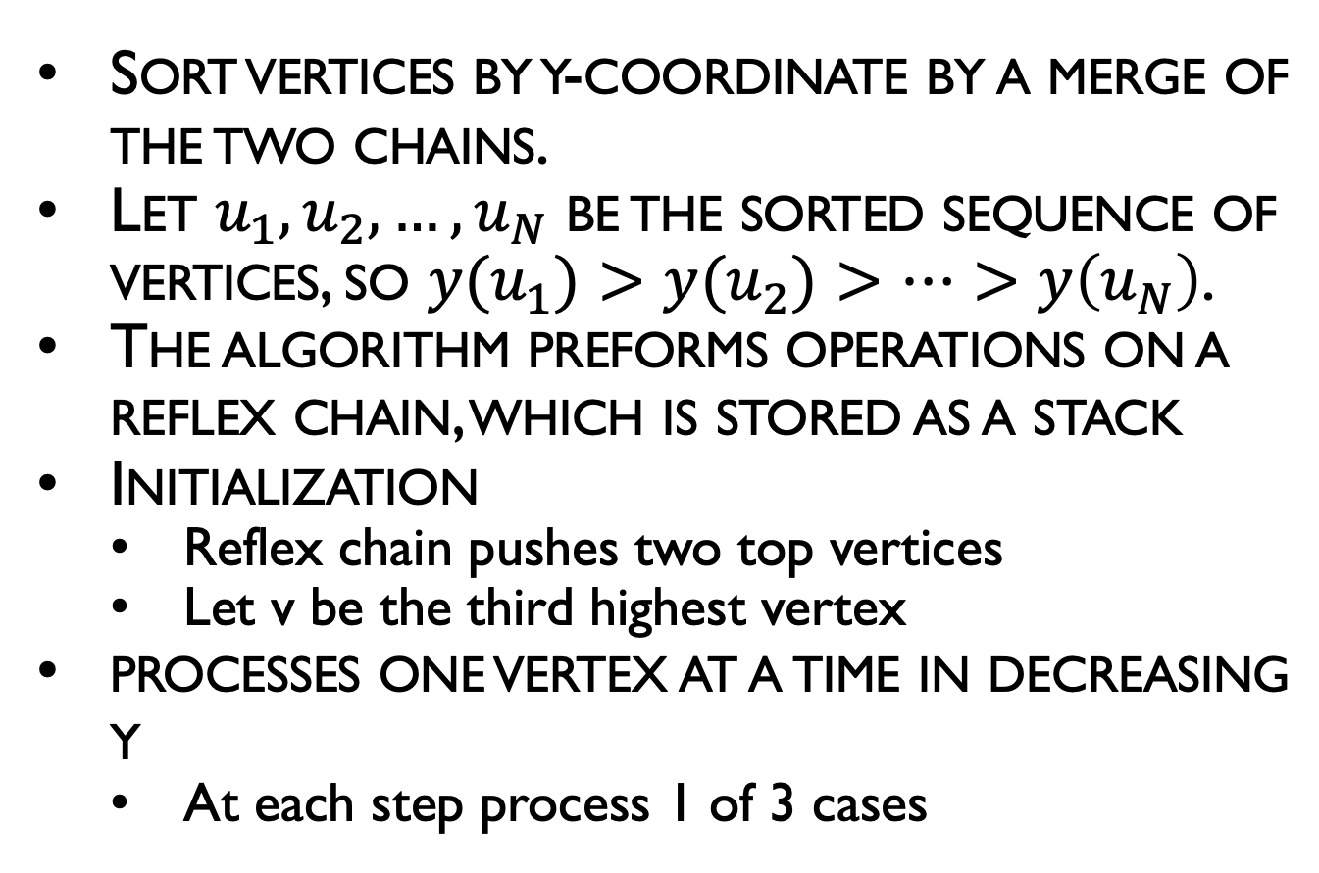









Triangulation of monotone polygon
Sort vertices by y-coordinate by a merge of the two chains.
Let $u_{1}, u_{2}, …, u_{N}$ be the sorted sequence of vertices, so $y(u_{1})>y(u_{2})>…>y\left(u_{N}\right)$.
The algorithm preforms operations on a reflex chain, which is stored as a stack
Initialization
Reflex chain pushes two top vertices
Let v be the third highest vertex
processes one vertex at a time in decreasing y
At each step process 1 of 3 cases
Reflex chain
$$u_{1}$$
$$v$$
$$u_{2}$$
$$u_{3}$$
$$u_{4}$$
$$u_{5}$$
$$u_{6}$$
$$u_{7}$$
$$u_{9}$$
$$u_{8}$$
$$u_{11}$$
$$u_{10}$$
$$u_{12}$$
$$u_{13}$$

Slide 6
Triangulation of monotone polygon
while v != lowest vertex do:
Case 1: v is on chain opposite reflex chain
Case 2: v is adjacent to bottom of reflex chain and v+ is strictly convex
Case 3: v is adjacent to bottom of reflex chain and v+ is reflex or flat

Slide 7





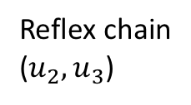

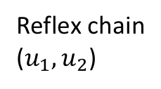
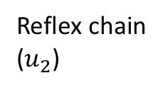





Triangulation of monotone polygon
Case 1: v is on chain opposite reflex chain
Draw diagonal from v to second vertex from top of chain
Remove top of chain
If chain has one element then add v, advance v
Reflex chain
($u_{1},u_{2}$)
$$u_{1}$$
$$v$$
$$u_{2}$$
$$u_{4}$$
$$u_{3}$$
$$u_{1}$$
$$v$$
Reflex chain
($u_{2}$)
$$u_{2}$$
$$u_{3}$$
$$u_{4}$$
$$u_{1}$$
$$v$$
Reflex chain
($u_{2},u_{3}$)
$$u_{2}$$
$$u_{3}$$
$$u_{4}$$

Slide 8


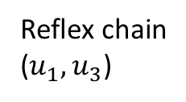

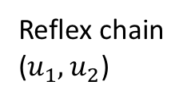




Triangulation of monotone polygon
Case 2: v is adjacent to bottom of reflex chain AND v+ is strictly convex
Draw diagonal from v to second vertex from bottom of chain
Remove bottom of chain
Add v to chain, advance v
Reflex chain
($u_{1},u_{2}$)
$$u_{1}$$
$$u_{2}$$
$$v$$
$$u_{3}$$
$$u_{4}$$
$$u_{1}$$
Reflex chain
($u_{1},u_{3}$)
$$u_{2}$$
$$u_{3}$$
$$u_{4}$$

Slide 9


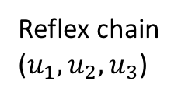
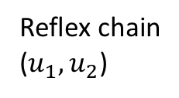



Triangulation of monotone polygon
Case 3: v is adjacent to bottom of reflex chain AND v+ is reflex or flat
Add v to bottom of reflex chain, advance v
Reflex chain
($u_{1},u_{2}$)
$$u_{1}$$
$$u_{2}$$
$$v$$
$$u_{3}$$
$$u_{4}$$
Reflex chain
($u_{1},u_{2},u_{3}$)
$$u_{1}$$
$$u_{2}$$
$$u_{3}$$
$$u_{4}$$

Slide 10









Triangulation of monotone polygon Example
$$u_{1}$$
$$u_{2}$$
$$u_{3}$$
$$u_{4}$$
$$u_{5}$$
$$u_{6}$$
$$u_{7}$$
$$u_{8}$$
$$u_{9}$$
$$u_{10}$$

Slide 11
Triangulation of monotone polygon Example
Case 1: v is on chain opposite reflex chain
Draw diagonal from v to second vertex from top of chain
Remove top of chain
If chain has one element then add v, advance v
$$u_{1}$$
Reflex chain
$$u_{2}$$
$$v$$
Case 2: v is adjacent to bottom of reflex chain AND v+ is strictly convex
Draw diagonal from v to second vertex from bottom of chain
Remove bottom of chain
Add v to chain, advance v
$$u_{3}$$
$$u_{4}$$
$$u_{5}$$
Case 3: v is adjacent to bottom of reflex chain AND v+ is reflex or flat
Add v to bottom of reflex chain, advance v
$$u_{6}$$
$$u_{7}$$
$$u_{8}$$
$$u_{9}$$
Case 3
$$u_{10}$$

Slide 12
Triangulation of monotone polygon Example
Case 1: v is on chain opposite reflex chain
Draw diagonal from v to second vertex from top of chain
Remove top of chain
If chain has one element then add v, advance v
$$u_{1}$$
$$u_{2}$$
Case 2: v is adjacent to bottom of reflex chain AND v+ is strictly convex
Draw diagonal from v to second vertex from bottom of chain
Remove bottom of chain
Add v to chain, advance v
$$u_{3}$$
$$u_{4}$$
$$u_{5}$$
Case 3: v is adjacent to bottom of reflex chain AND v+ is reflex or flat
Add v to bottom of reflex chain, advance v
$$u_{6}$$
$$u_{7}$$
$$u_{8}$$
$$u_{9}$$
$$u_{10}$$

Slide 13

Triangulation of monotone polygon Example
$$u_{1}$$
$$u_{2}$$
$$u_{3}$$
$$u_{4}$$
$$u_{5}$$
$$u_{6}$$
$$u_{7}$$
$$u_{8}$$
$$u_{9}$$
$$u_{10}$$

Slide 14
Analysis of triangulating a monotone polygon
The initial sort (merge) requires O(N) time.
Triangulation visits each of the N vertices and places on the stack exactly once, except when the while fails in case (ii).
This happens at most once per vertex, so that time can be charged to the current vertex.
⇒ The algorithm requires O(N) time to triangulate a monotone polygon, where N is the number of vertices of the polygon.

Slide 15
Putting it all together
Analysis of Triangulation of Simple Polygon
Sort vertices by y coordinates: O(N log N)
Perform plane sweep to partition polygons: O(N log N)
Triangulate each monotone polygon: O(N)
Overall: O(N log N)
N is the number of vertices of the polygon

Slide 16
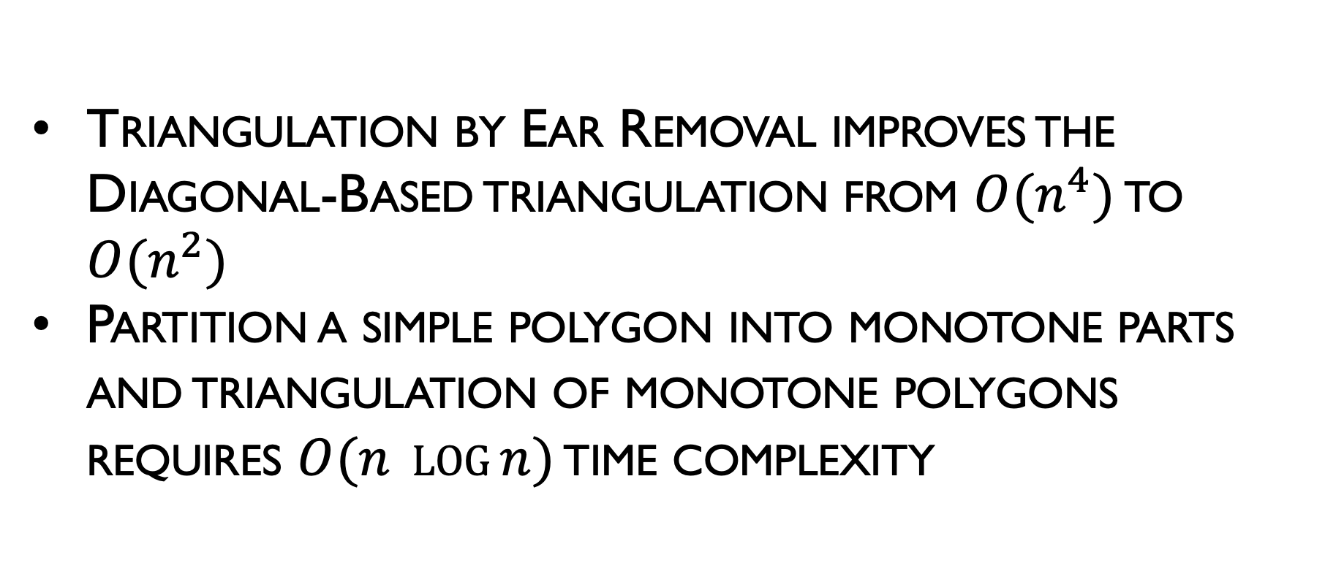
Summary
Triangulation by Ear Removal improves the Diagonal-Based triangulation from $O(n^{4})$ to $O(n^{2})$
Partition a simple polygon into monotone parts and triangulation of monotone polygons requires $O(n \log{n)}$ time complexity

Slide 17
Towards Linear-Time Triangulation
Year Complexity Authors

Slide 18
Linear-Time Triangulation
Chazelle’s Algorithm (High-Level Sketch)
Computes visibility map
Algorithm is like MergeSort (divide-and-conquer)
Partition polygon of n vertices into n/2 vertex chains
Merge visibility maps of subchains to get one for chain
Improve this by dividing process into 2 phases:
Coarse approximations of visibility maps for linear-time merge
Refine coarse map into detailed map in linear time

Slide 19
Convex Partitioning
Polygon partitioning is an important preprocessing step for many geometric algorithms
Partitioning a polygon means completely dividing the interior into nonoverlapping pieces.
Covering a polygon means that our decomposition is permitted to contain mutually overlapping pieces.
An issue associated with polygon decomposition is whether we are allowed to add Steiner vertices (either by splitting edges or adding interior points) or whether we are restricted to adding chords between two existing vertices.

Slide 20
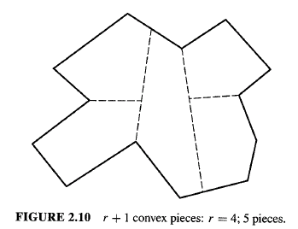
Convex Partitioning
Competing Goals:
minimize number of convex pieces
minimize partitioning time
Add (Steiner) points or just use diagonals and not add points?
Adding segments with Steiner points.
r = number of reflex vertices
Adding only diagonals.

Slide 21
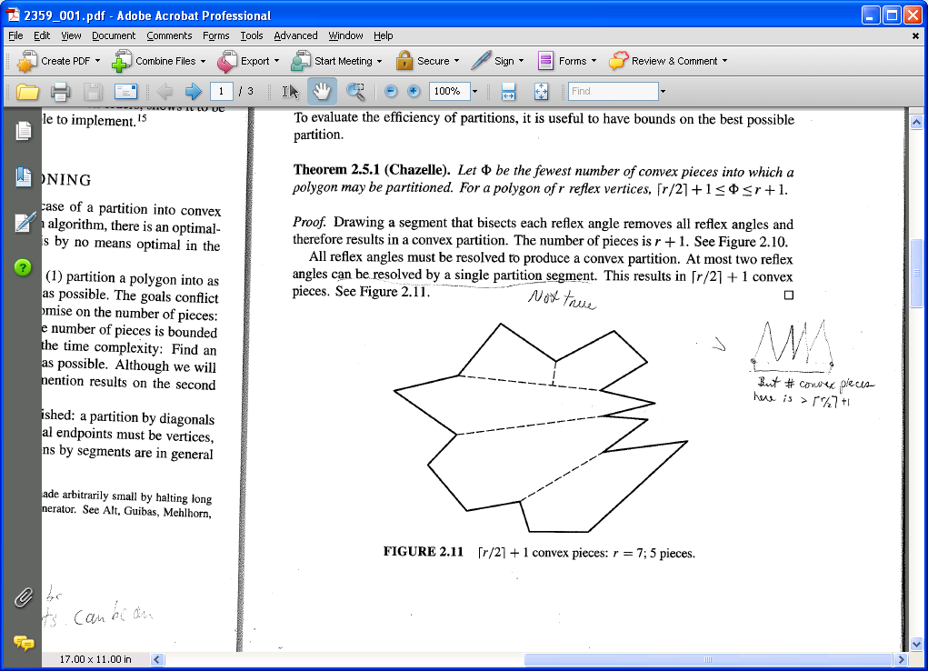
Convex Partitioning
Theorem (Chazelle): Let F be the fewest number of convex pieces into which a polygon may be partitioned. For a polygon of r reflex vertices:
Lower bound:
Must eliminate all reflex vertices. Single segment resolves at most 2 reflex angles.
Upper bound:
Bisect each reflex angle.

