Slide 1
COT 4521: Introduction to Computational Geometry
Voronoi Diagram - Fortune’s Algorithm

Slide 2
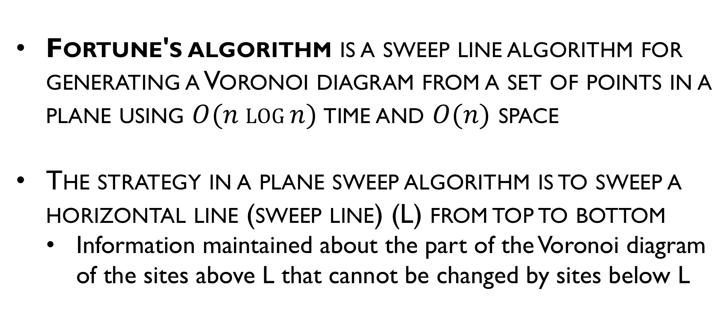
Fortune’s algorithm
Fortune's algorithm is a sweep line algorithm for generating a Voronoi diagram from a set of points in a plane using $O(n log⁡n)$time and $O(n)$ space
The strategy in a plane sweep algorithm is to sweep a horizontal line (sweep line) (L) from top to bottom
Information maintained about the part of the Voronoi diagram of the sites above L that cannot be changed by sites below L

Slide 3
Fortune’s Algorithm
The algorithm maintains both a sweep line and a beach line, which both move through the plane as the algorithm progresses.
Horizontal sweep line maintains order of construction
Beach line maintains portion of diagram, which cannot change due to sites below sweep line

Slide 4
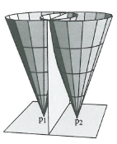
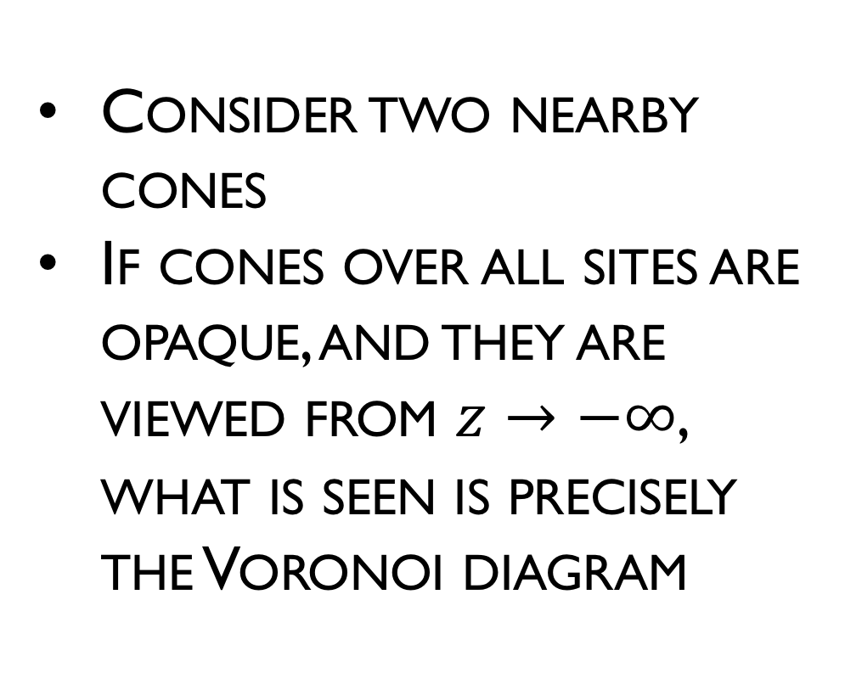


Fortune’s algorithm
$$+z$$
Consider two nearby cones
If cones over all sites are opaque, and they are viewed from $z→−∞$, what is seen is precisely the Voronoi diagram
$$−z$$

Slide 5
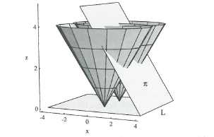

Fortune’s algorithm
Fortune’s idea: Sweep the cones with a plane $π$, slanted at ${45}^{°}$ to the xy-plane

Slide 6
Beach line
Which points are closer to a site above the sweep line than to the sweep line itself?
The set of parabolic arcs form a beach-line that bounds the locus of all such points
The beach line is monotone
Beach line
Equidistant
Sweep line

Slide 7
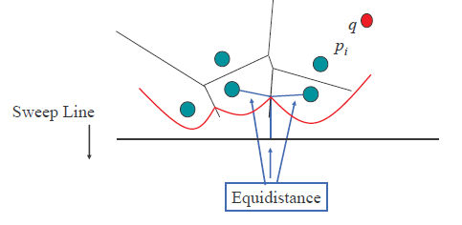
Edges
Breakpoints trace out Voronoi edges.
The only way in which a new arc can appear on the beach line is through a site event

Slide 8
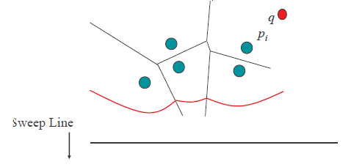
Edges
Arcs flatten out as sweep line moves down.

Slide 9
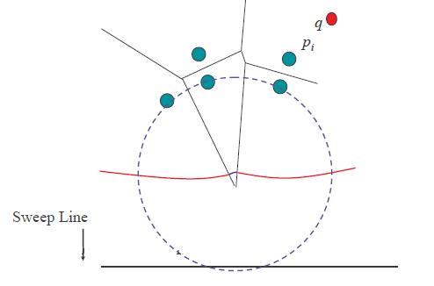
Edges
Eventually, the middle arc disappears.
The only way in which an existing arc can disappear from the beach line is through a circle event

Slide 10
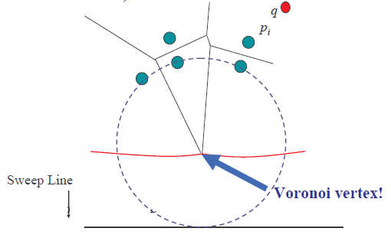
Circle Event
We have detected a circle that is empty (contains no sites) and touches 3 or more sites.

Slide 11
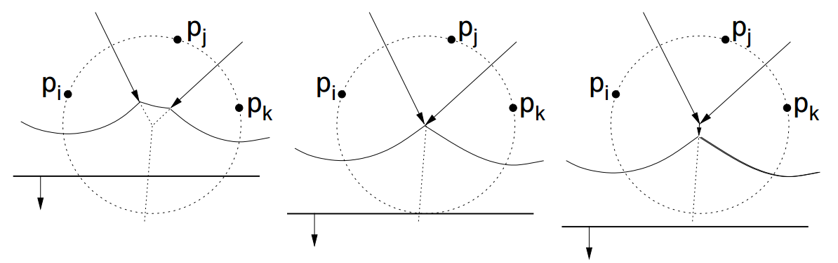
Circle Event
We have detected a circle that is empty (contains no sites) and touches 3 or more sites when the sweep line passes the lowest point in the circle.

Slide 12
Beach Line Properties
Voronoi edges are traced by the break points as the sweep line moves down.
Emergence of a new break point(s) (from formation of a new arc or a fusion of two existing break points) identifies a new edge
Voronoi vertices are identified when two break points meet (fuse).
Decimation of an old arc identifies new vertex

Slide 13
Data Structures
Current state of the Voronoi diagram
Doubly-linked list
The beach line is represented by a balanced binary search tree
The event queue is implemented as priority queue
Priority event queue sorted on decreasing y-coordinate

Slide 14
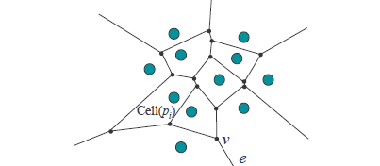
Doubly Linked List (D)
Goal: a simple data structure that allows an algorithm to traverse a Voronoi diagram’s segments, cells and vertices

Slide 15
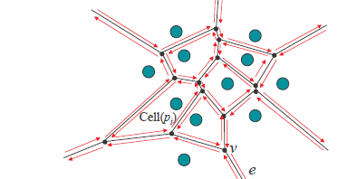
Doubly Linked List (D)
Divide segments into unidirectional half-edges
A chain of counter-clockwise half-edges forms a cell
Define a half-edge’s “twin” to be its opposite half-edge of the same segment

Slide 16
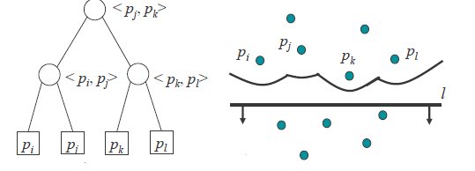
Balanced Binary Tree
A balanced binary search tree is used to maintain the status of the beach line.
Internal nodes represent break points between two arcs
Also contains a pointer to the D record of the edge being traced
Leaf nodes represent arcs, each arc is in turn represented by the site that generated it
Also contains a pointer to a potential circle event

Slide 17
Event Queue (Q)
An event is an interesting point encountered by the sweep line that makes discrete stops at events as it sweeps from top to bottom
Consists of:
Site Events – when the sweep line encounters a new site point
Circle Events – when the sweep line encounters the bottom of an empty circle touching 3 or more sites
Events are prioritized based on y-coordinate

Slide 18
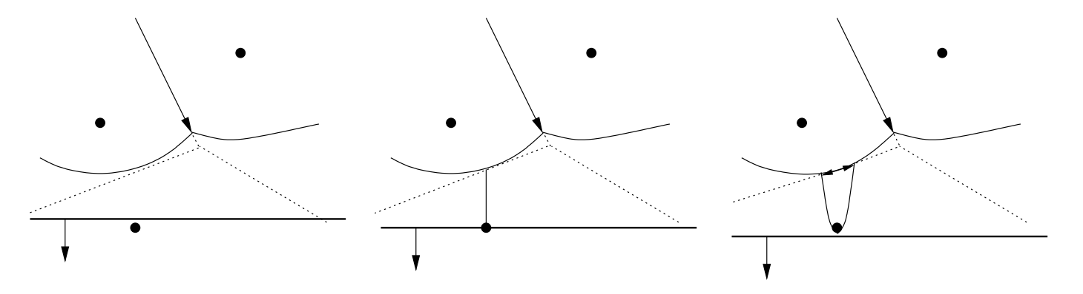
Site Event
A new arc appears when a new site appears.

Slide 19
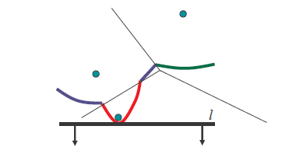
Site Event
Original arc above the new site is broken into two arcs
Number of arcs on beach line is O(n)

Slide 20
Site Event
Effects on Binary Tree
P1
E1
E1
E1
E2
P2
P2
P1
P2
E2
E3
P1
P3
P3

Slide 21
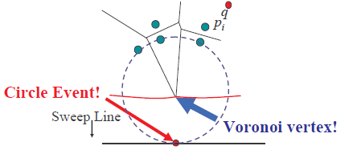
Circle Event
An arc disappears whenever an empty circle touches three or more sites and is tangent to the circle.
Sweep line helps determine that the circle is indeed empty.

Slide 22
Circle Event
Effects on Binary Tree
Other circle events will remove nodes from the tree
P1
E1
E1
E3
P2
E2
P2
E2
P2
E2
E3
P1
P3
P1
P3
P3

Slide 23
Event Queue Summary
Site Events are
given as input
represented by the (x,y)-coordinate of the site point
Circle Events are
represented by the (x,y)-coordinate of the lowest point of an empty circle touching three or more sites
computed on the fly (intersection of the two bisectors in between the three sites)
“anticipated”: these newly generated events may represented by the (x,y)-coordinate of the lowest point of an empty circle touching three or more sites; they can be false and need to be removed later
Event Queue prioritizes events based on their y-coordinates

Slide 24
Example

Slide 25
Summarizing Data Structures
Current state of the Voronoi diagram
Doubly linked list of half-edges, vertices, cell records
Current state of the beach line
Keep track of break points
Inner nodes of binary search tree; represented by a tuple
Keep track of arcs currently on beach line
Leaf nodes of binary search tree; represented by a site that generated the arc
Current state of the sweep line
Priority event queue sorted on decreasing y-coordinate

Slide 26
Degenerate Cases
Events in Q share the same y-coordinate
Can additionally sort them using x-coordinate
Circle event involving more than 3 sites
Current algorithm produces multiple degree 3 Voronoi vertices joined by zero-length edges
Can be fixed in post processing

Slide 27
Degenerate Cases
Site points are collinear (break points neither converge or diverge)
Bounding box takes care of this
One of the sites coincides with the lowest point of the circle event
Do nothing

Slide 28
Handling Site Events
Locate the leaf representing the existing arc that is above the new site
Delete the potential circle event in the event queue
Break the arc by replacing the leaf node with a sub tree representing the new arc and break points
Add a new edge record in the link list
Check for potential circle event(s), add them to queue if they exist
Store in the corresponding leaf of T a pointer to the new circle event in the queue
O(N log N)
O(1)
O(1)
O(1)

Slide 29
Handling Circle Events
Delete from T the leaf node of the disappearing arc and its associated circle events in the event queue
Add vertex record in doubly link list
Create new edge record in doubly link list
Check the new triplets formed by the former neighboring arcs form potential circle events
O(N log N)
O(1)
O(1)
O(1)

Slide 30
Total Running Time
Each new site can generate at most two new arcs beach line can have at most 2n – 1 arcs
Each “false circle event” can be changed to a real event O(n) events
Site/Circle Event Handler O(log n)
O(n log n) total running time

