Slide 1
COT 4521: Introduction to Computational Geometry
Searches

Slide 2

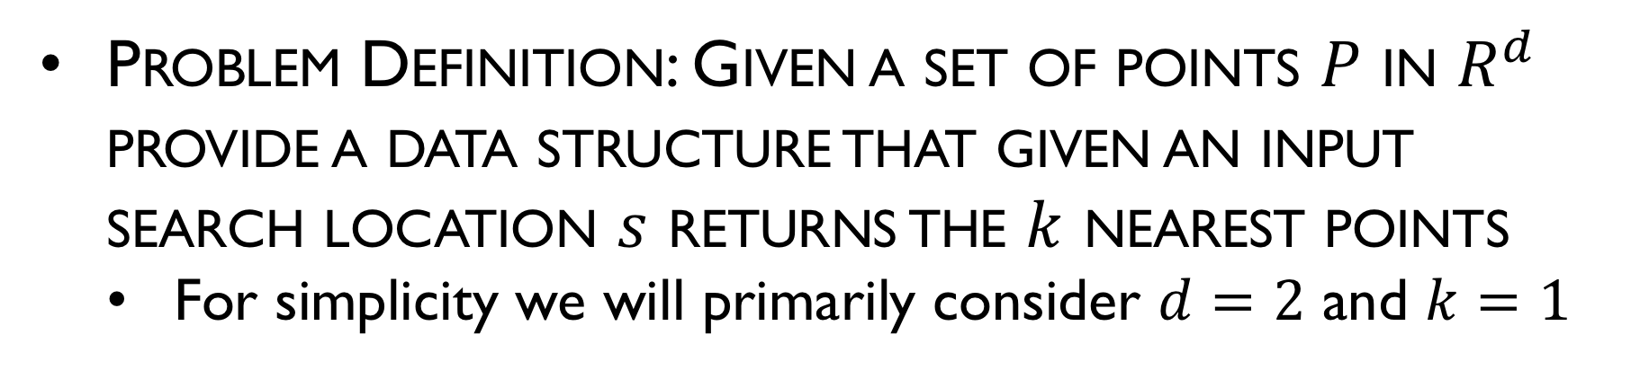

Point Searches
Problem Definition: Given a set of points $P$ in $R^{d}$ provide a data structure that given an input search location $s$ returns the $k$ nearest points
For simplicity we will primarily consider $d=2$ and $k=1$
$$P$$
$$s$$

Slide 3


Point Searches : Ideas?
$$P$$
$$s$$

Slide 4
Grids
$$P$$

Slide 5
Grid Algorithms
Construction
Find extrema
Divide space by predetermined number of size of interval
Place points into grid cells

Slide 6

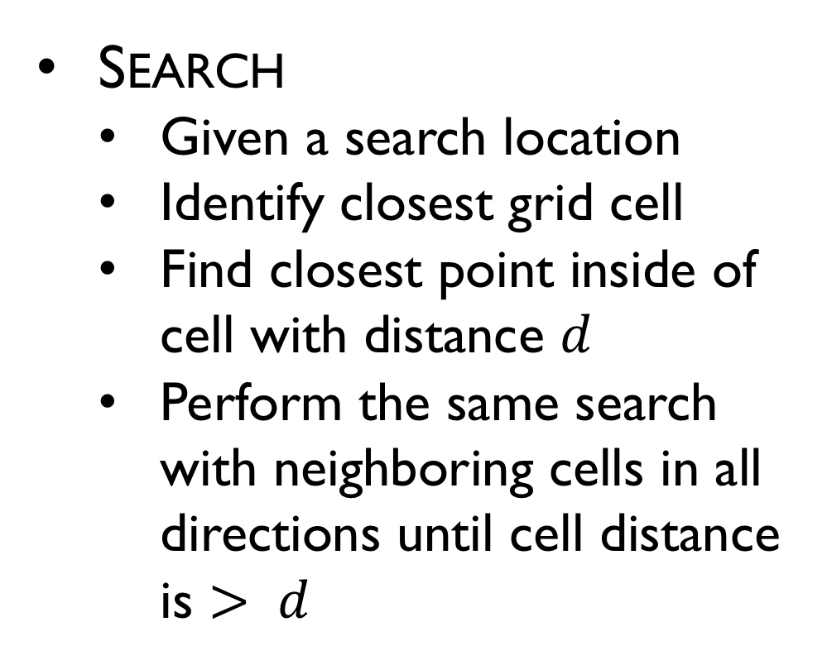

Grid Algorithms
Search
Given a search location
Identify closest grid cell
Find closest point inside of cell with distance $d$
Perform the same search with neighboring cells in all directions until cell distance is $> d$
$$P$$
$$s$$

Slide 7
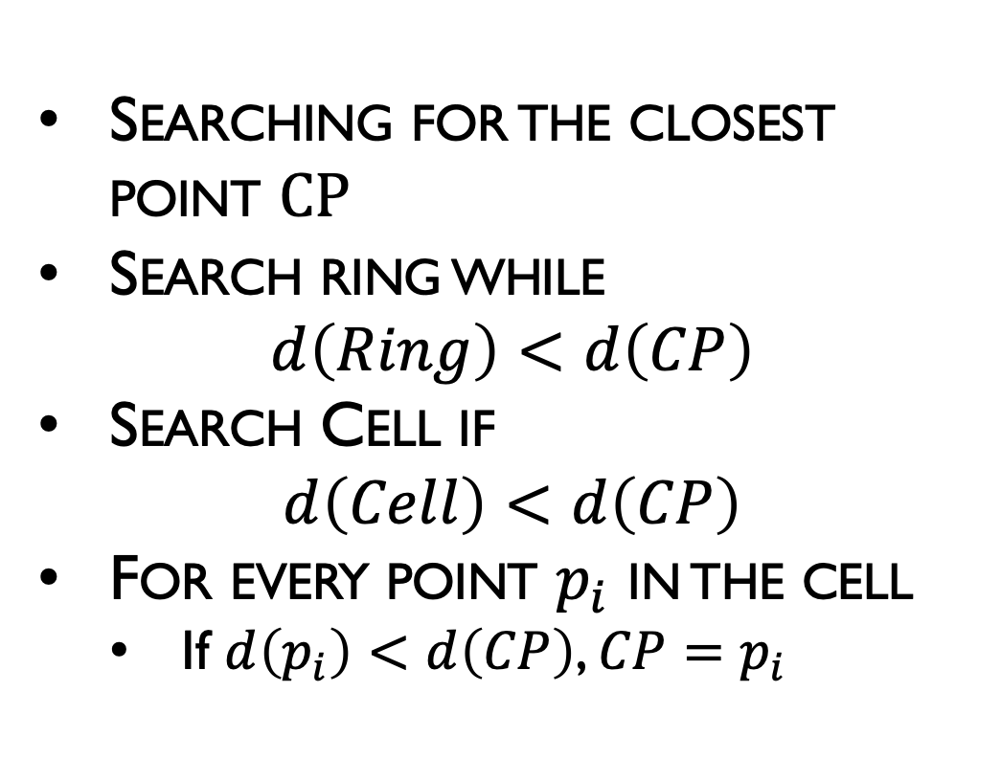
Grid Algorithms
Searching for the closest point $CP$
Search ring while $d\left(Ring\right)<d\left(CP\right)$
Search Cell if $d\left(Cell\right)<d\left(CP\right)$
For every point $p_{i}$ in the cell
If $d\left(p_{i}\right)<d\left(CP\right)$, $CP=p_{i}$
$$P$$
$$s$$

Slide 8
Finding Distance
Point-Point Distance?
Point-cell distance?
Point-ring distance?

Slide 9
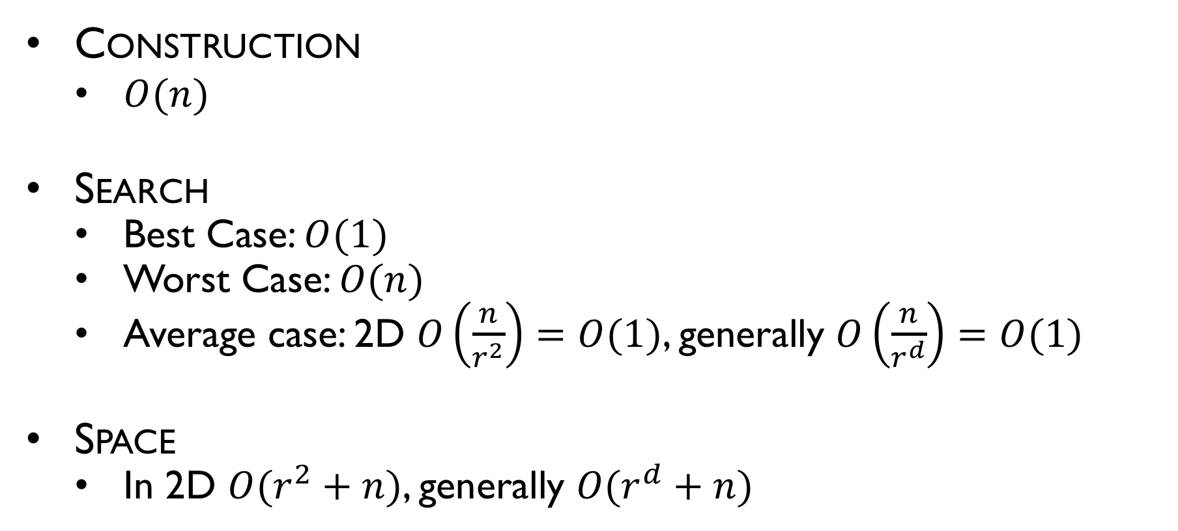
Grids
Construction
$O(n)$
Search
Best Case: $O(1)$
Worst Case: $O(n)$
Average case: 2D $O\left(\frac{n}{r^{2}}\right)=O(1)$, generally $O\left(\frac{n}{r^{d}}\right)=O(1)$
Space
In 2D $O(r^{2}+n)$, generally $O(r^{d}+n)$

Slide 10
Grids
Examples of failure cases?

Slide 11
Quadtrees
$$P$$

Slide 12
Quadtree Algorithms
Construction
Find extrema
Divide space in half both horizontally and vertically
Ideas?
Place points into appropriate quadrant
Recurse until termination condition
Ideas?

Slide 13
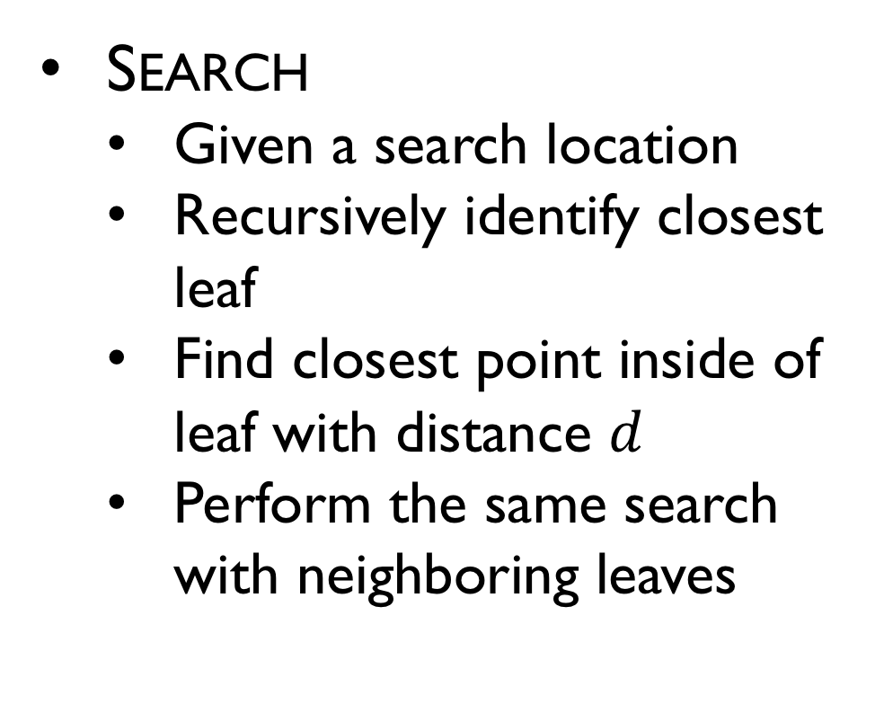
Quadtree
Search
Given a search location
Recursively identify closest leaf
Find closest point inside of leaf with distance $d$
Perform the same search with neighboring leaves
$$P$$

Slide 14
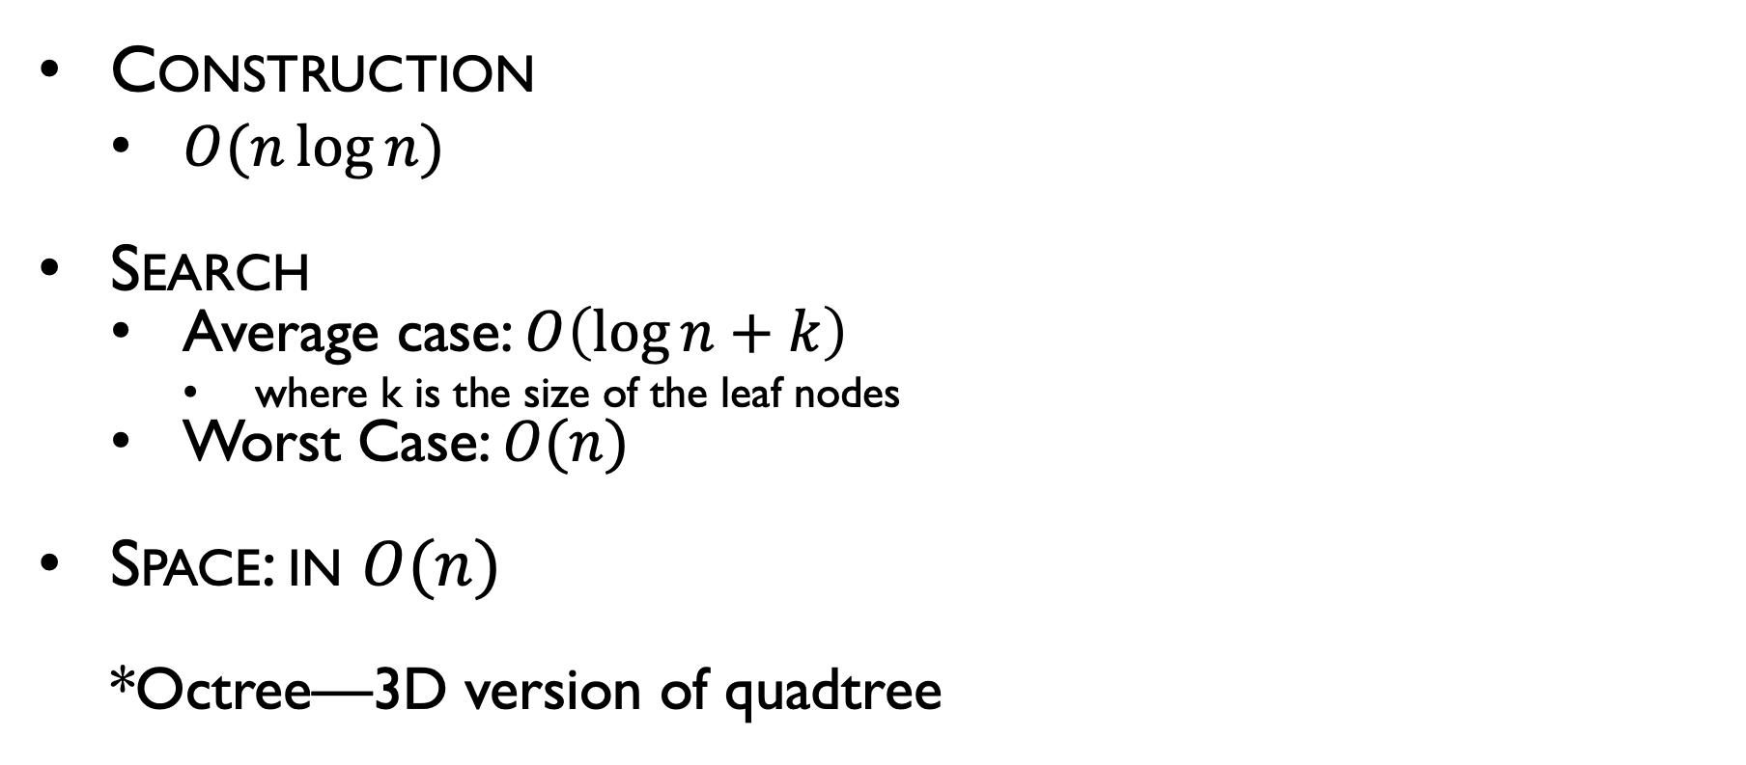
Quadtree
Construction
$O(n\log{n})$
Search
Average case: $O\left(\log{n}+k\right)$
where k is the size of the leaf nodes
Worst Case: $O(n)$
Space: in $O(n)$
*Octree—3D version of quadtree

Slide 15
Quadtrees
Examples of failure cases?

Slide 16
KD-Tree
$$P$$

Slide 17
KD-Tree Algorithms
Construction
Find extrema
Divide space in half
Ideas?
Place points into appropriate half
Recurse until termination condition
Ideas?

Slide 18

KD-Tree Algorithms
Search
Given a search location
Recursively identify closest leaf
Find closest point inside of leaf with distance $d$
Perform the same search with neighboring leaves
$$P$$
$$s$$

Slide 19
KD-Tree Search Example
a
b
c
d
a, b, e, f
c, d, g, h
a, b
e, f
c, d
g, h
e
f
g
h
a
b
e
f
c
d
g
h

Slide 20
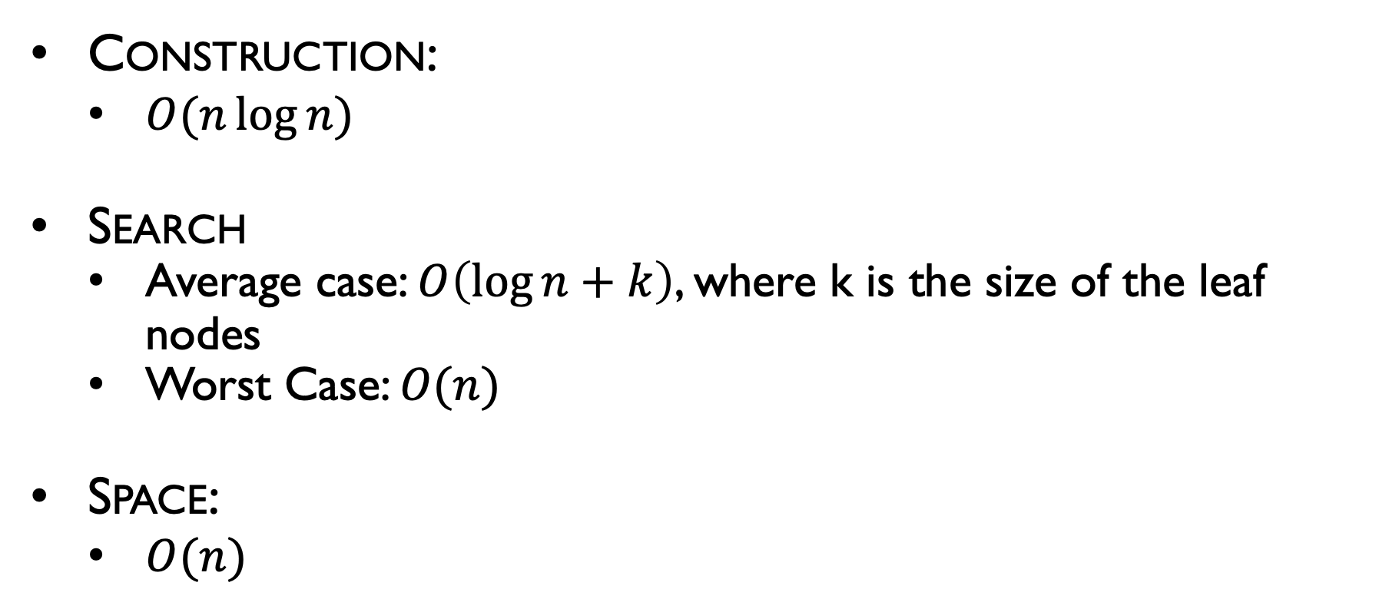
KD-Tree
Construction:
$O(n\log{n})$
Search
Average case: $O\left(\log{n}+k\right)$, where k is the size of the leaf nodes
Worst Case: $O(n)$
Space:
$O(n)$

Slide 21
KD-Tree
Examples of failure cases?

Slide 22
Binary Space Partition (BSP)
$$P$$

Slide 23
BSP Algorithms
Construction
Find extrema
Divide space in half
Place points into appropriate half space
Recurse until termination condition

Slide 24

BSP Algorithms
Search
Given a search location
Recursively identify closest leaf
Find closest point inside of leaf with distance $d$
Perform the same search with neighboring leaves
$$P$$

Slide 25
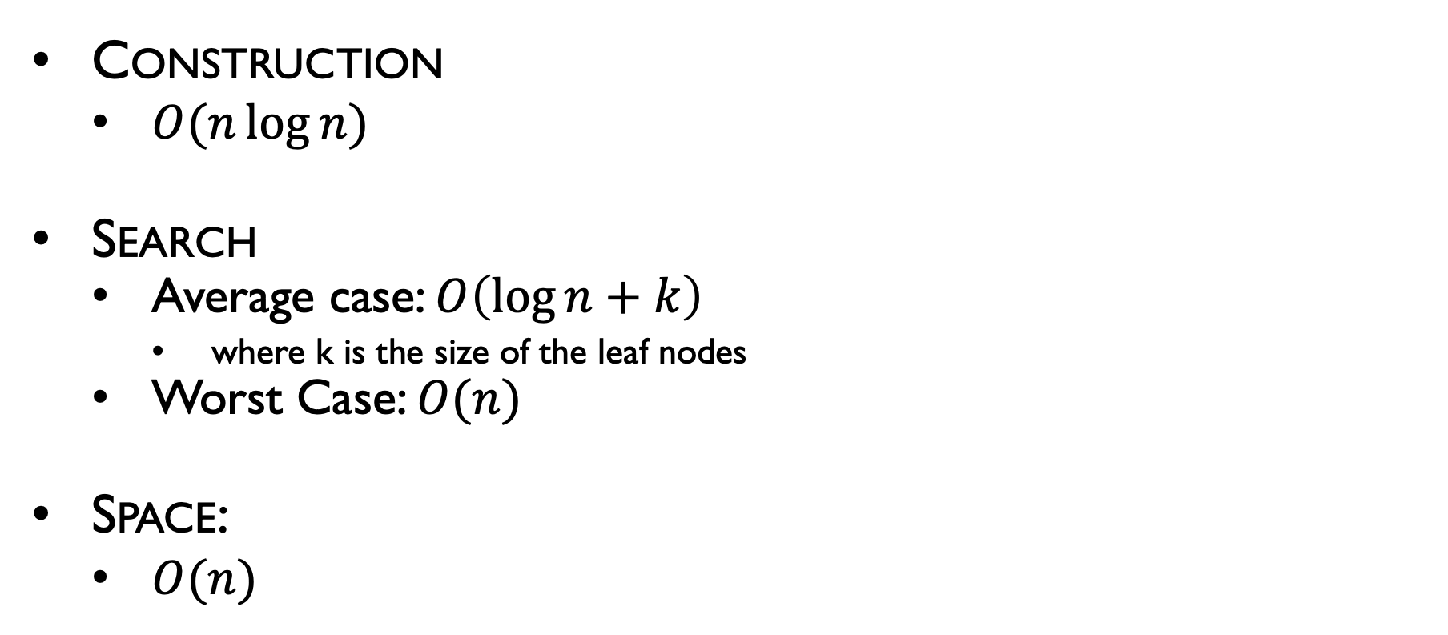
Binary Space Partition
Construction
$O(n\log{n})$
Search
Average case: $O\left(\log{n}+k\right)$
where k is the size of the leaf nodes
Worst Case: $O(n)$
Space:
$O(n)$

Slide 26
Binary Space Partition
Examples of failure cases?

Slide 27
Tasks
Closest Point Search
Task covered thus far
K-nearest neighbors Search (next)
Range Search
Clustering (we’ll talk about this next lecture)

Slide 28
K-nearest neighbor Search
Problem: Given a set of points P, find the k-nearest neighbors efficiently
Ideas?
$$P$$
$$s$$

Slide 29
K-nearest neighbor Search
Use spatial partitioning of your choice
Keep a list of k length for the closest points
Search performed similarly to closest point search, except that our stopping condition is on the furthest point in the list
How do we store the k points most efficiently?
$$P$$
$$s$$

Slide 30
K-nearest neighbor Search
Make the list efficient by keeping it sorted
use a balanced binary tree—O(log k) insertion costs
Or insertion sort—O(k) insertion cost
$$P$$
$$s$$

Slide 31
K-nearest neighbor Search
Problem: Given a set of points P, find the points within intervals in both directions efficiently
Ideas?
$$P$$
$$s$$

Slide 32
Range Search
Problem: Given a set of points P, efficiently find the set of points within a specified range
Ideas?
$$P$$

Slide 33
Bounding Volume Hierarchy
Variation on previous approaches that stores the volume covered at each level of the tree.
$$P$$

Slide 34
Bounding Volume Hierarchy
Variation on previous approaches that stores the volume covered at each level of the tree.
$$P$$

Slide 35
Bounding Volume Hierarchy
Variation on previous approaches that stores the volume covered at each level of the tree.
$$P$$

Slide 36
Bounding Volume Hierarchy
Variation on previous approaches that stores the volume covered at each level of the tree.
$$P$$

Slide 37
Range Search Bounding Volume Hierarchy
Variation on previous approaches that stores the volume covered at each level of the tree.
$$P$$

Slide 38
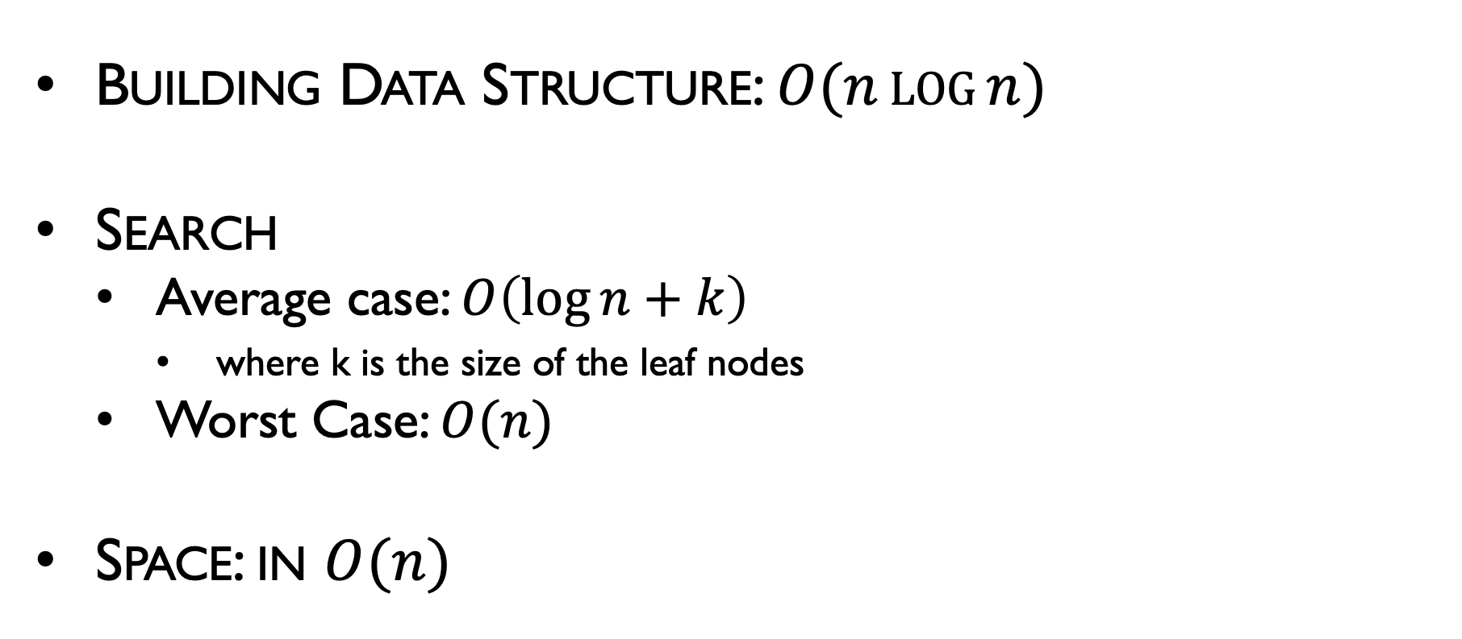
Bounding Volume Hierarchy
Building Data Structure: $O(n\log{n})$
Search
Average case: $O\left(\log{n}+k\right)$
where k is the size of the leaf nodes
Worst Case: $O(n)$
Space: in $O(n)$

