Slide 1
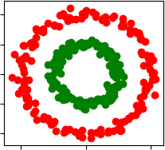
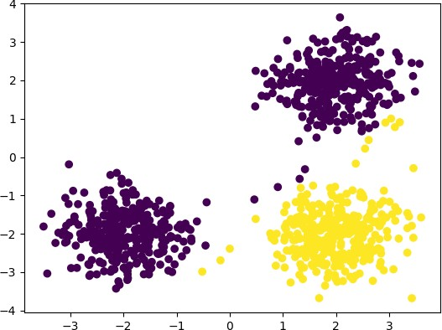
COT 4521: Introduction to Computational Geometry
Clustering Algorithms

Slide 2
Clustering Algorithms
A cluster is a collection of data objects
A clustering algorithm tries to put similar objects to one another within the same cluster and dissimilar objects in other clusters
Clustering is an unsupervised classification: The data is unlabeled
A clustering algorithm tries to understand what kind of structure in the data: what sub-population does the data have?

Slide 3
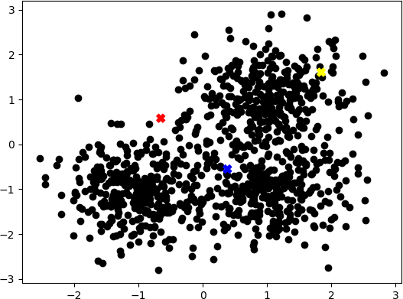
K-Means Algorithm: Example
Say that we have the following data points in the plan.

Slide 4
K-Means Algorithm: Example
K-means is a clustering algorithm that is best explained via an example

Slide 5
K-Means Algorithm: Example
Choose randomly 3 centroids : 𝑐1, 𝑐2, 𝑐3 (the points appear in blue, red and yellow)

Slide 6
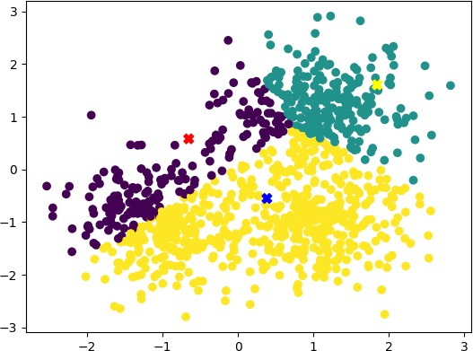
K-Means Algorithm: Example
assign each point x in the set to the closest centroid

Slide 7
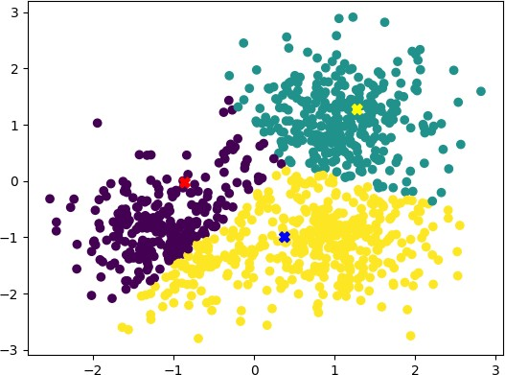
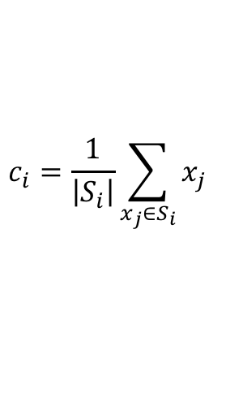
K-Means Algorithm: Example
Update the centroids 𝑐1, 𝑐2, 𝑐3 as follows :
$$c_{i}=\frac{1}{\left|S_{i}\right|}\sum_{x_{j}∈S_{i}}{x_{j}}$$

Slide 8
K-Means Algorithm: Example
Update the centroids 𝑐1, 𝑐2, 𝑐3 as follows :
$$c_{i}=\frac{1}{\left|S_{i}\right|}\sum_{x_{j}∈S_{i}}{x_{j}}$$
In other words, the new center is the average of the cluster members
assign each point x in the set to the closest centroid

Slide 9
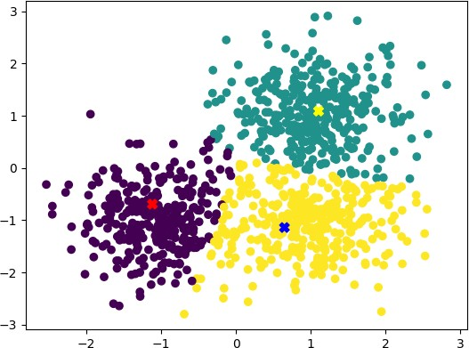
K-Means Algorithm: Example
Repeat until convergence

Slide 10
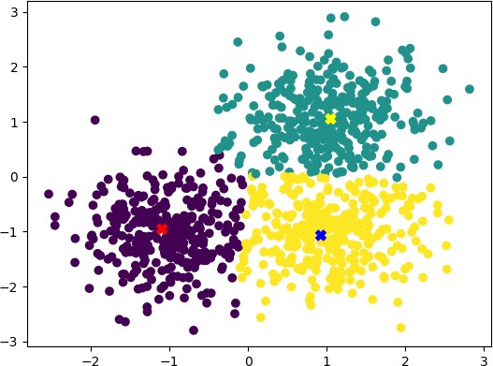
K-Means Algorithm: Example
Repeat until convergence

Slide 11
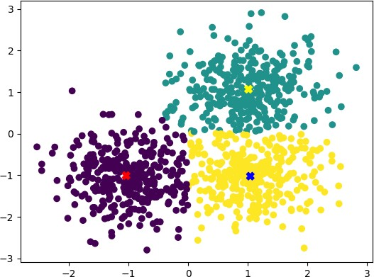
K-Means Algorithm: Example
Repeat until convergence

Slide 12
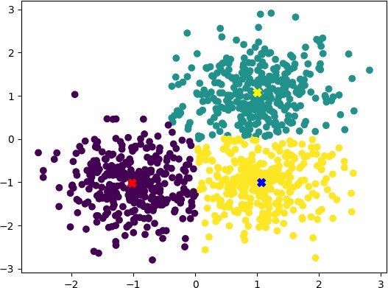
K-Means Algorithm: Example
Repeat until convergence

Slide 13
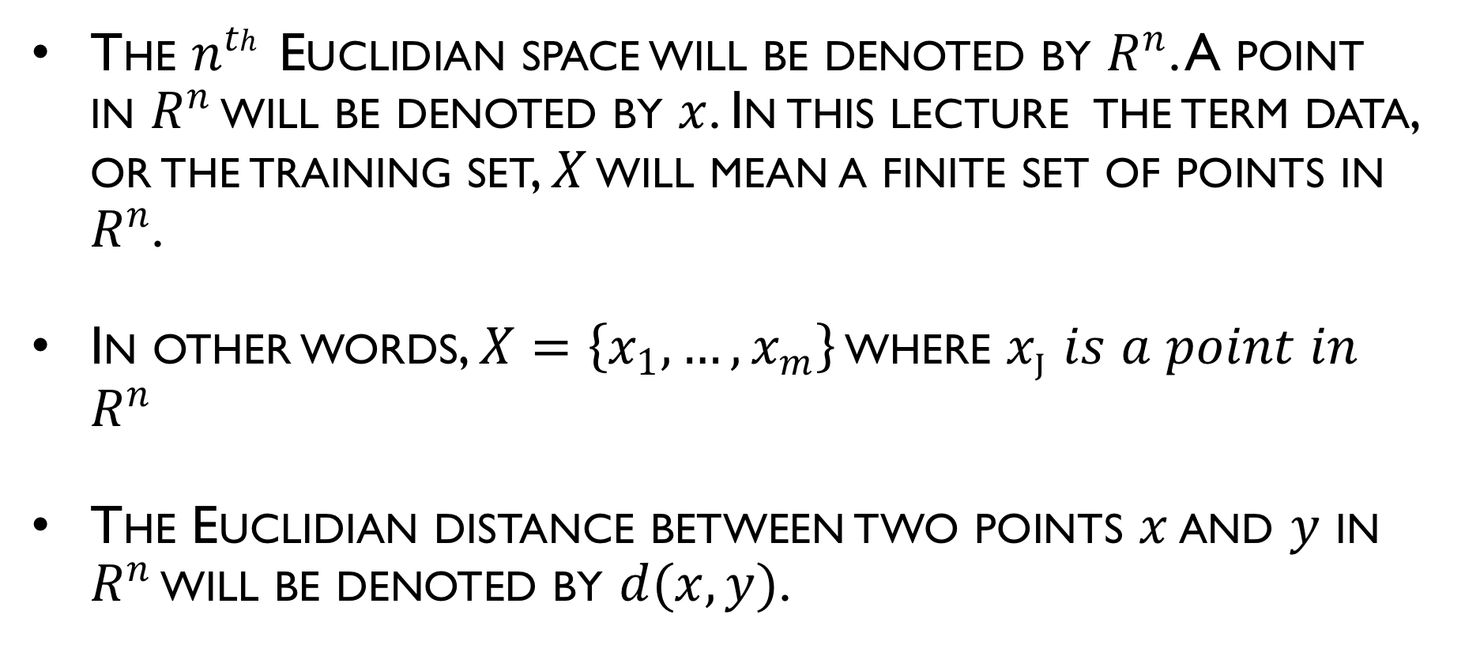
Notations
The $n^{th}$ Euclidian space will be denoted by $R^{n}$. A point in $R^{n}$ will be denoted by $x$. In this lecture the term data, or the training set, $X$ will mean a finite set of points in $R^{n}$.
In other words, $X=\left\{x_{1}, …, x_{m}\right\}$ where $x_{j}$ 𝑖𝑠 𝑎 𝑝𝑜𝑖𝑛𝑡 𝑖𝑛 $R^{n}$
The Euclidian distance between two points $x$ and $y$ in $R^{n}$ will be denoted by $d(x, y)$.

Slide 14
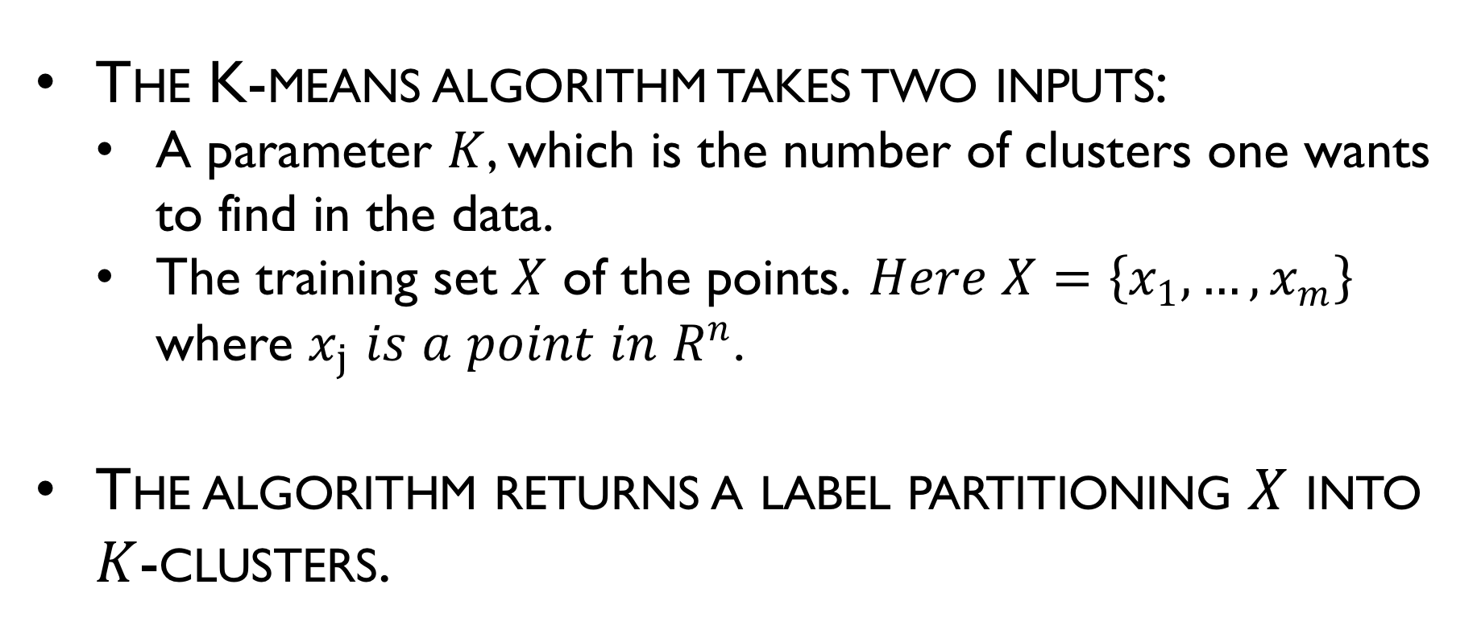
K-Means Algorithm
The K-means algorithm takes two inputs:
A parameter $K$, which is the number of clusters one wants to find in the data.
The training set $X$ of the points. 𝐻𝑒𝑟𝑒 $X=\left\{x_{1}, …, x_{m}\right\}$ where $x_{j}$ 𝑖𝑠 𝑎 𝑝𝑜𝑖𝑛𝑡 𝑖𝑛 $R^{n}$.
The algorithm returns a label partitioning $X$ into $K$-clusters.

Slide 15
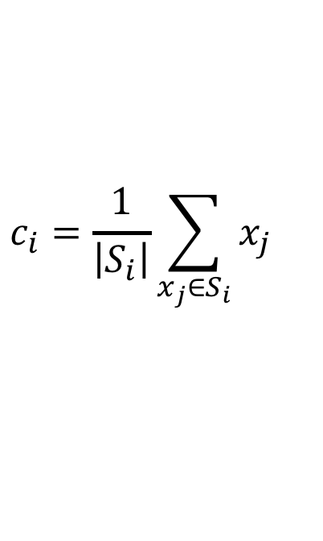
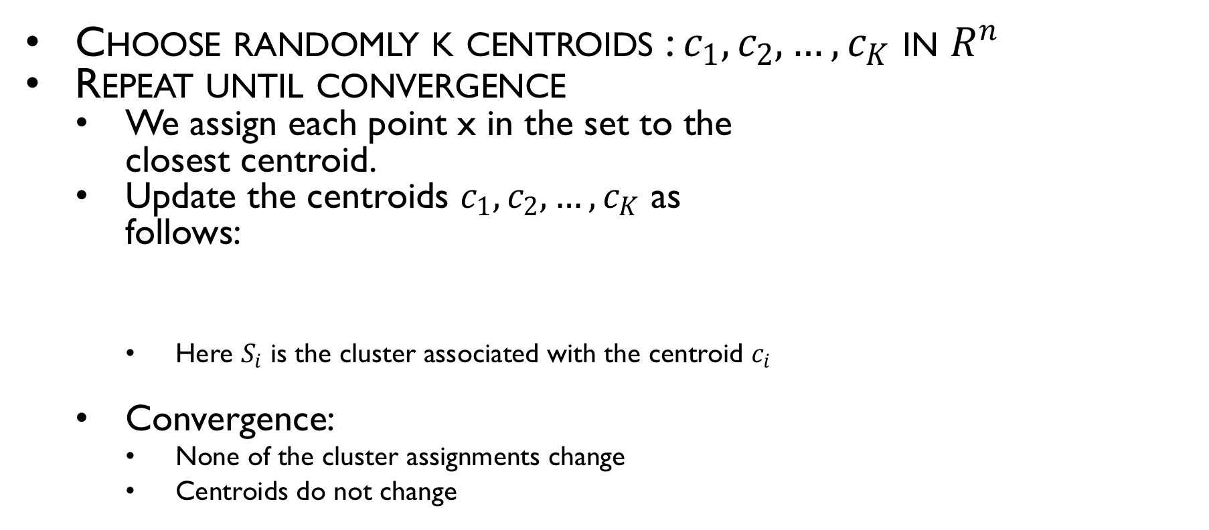
K-Means Algorithm
Choose randomly k centroids : $c_{1}, c_{2}, …, c_{K}$ in $R^{n}$
Repeat until convergence
We assign each point x in the set to the closest centroid.
Update the centroids $c_{1}, c_{2}, …, c_{K}$ as follows:
Here $S_{i}$ is the cluster associated with the centroid $c_{i}$
Convergence:
None of the cluster assignments change
Centroids do not change
Cluster assignment step
Centroid move step
$$c_{i}=\frac{1}{\left|S_{i}\right|}\sum_{x_{j}∈S_{i}}{x_{j}}$$

Slide 16
K-Means Algorithm
Choose randomly k centroids : $c_{1}, c_{2}, …, c_{K}$ in $R^{n}$
Repeat until convergence
We assign each point x in the set to the closest centroid.
Update the centroids $c_{1}, c_{2}, …, c_{K}$ as follows:
Here $S_{i}$ is the cluster associated with the centroid $c_{i}$
Convergence:
None of the cluster assignments change
Centroids do not change
Cluster assignment step
Centroid move step
$$c_{i}=\frac{1}{\left|S_{i}\right|}\sum_{x_{j}∈S_{i}}{x_{j}}$$
This is where mean
comes from

Slide 17
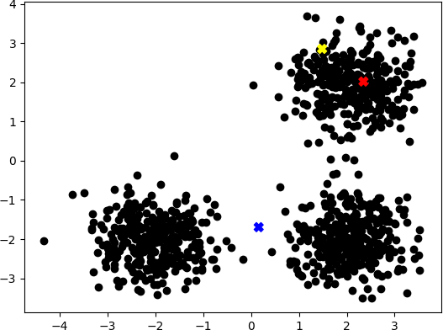
K-Means Algorithm: Example
Lets consider
another example

Slide 18
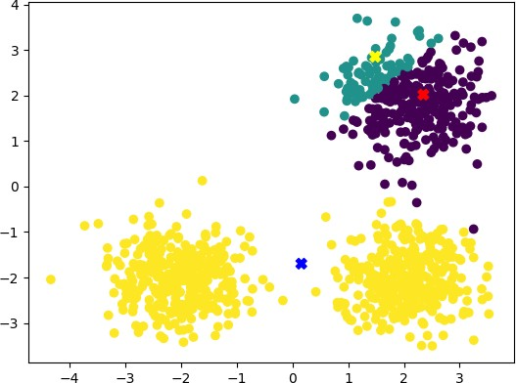
K-Means Algorithm: Example

Slide 19
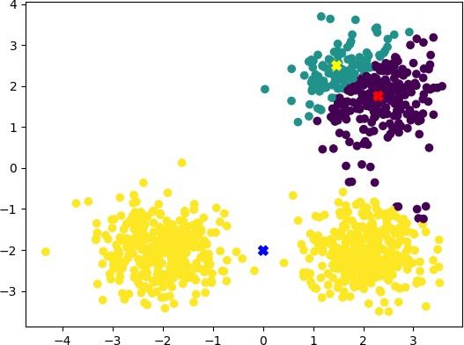
K-Means Algorithm: Example

Slide 20
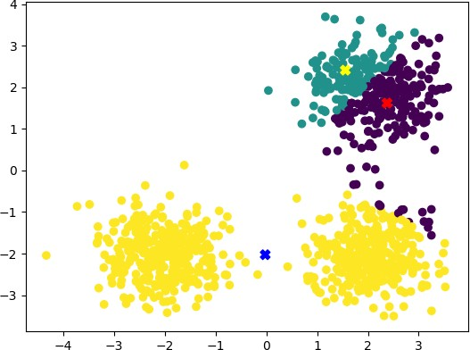
K-Means Algorithm: Example

Slide 21
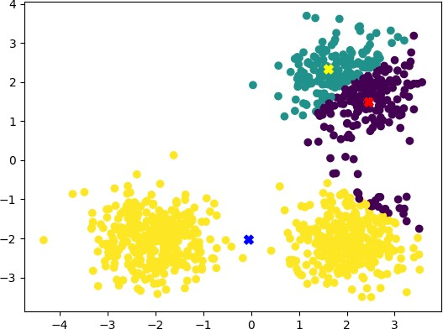
K-Means Algorithm: Example

Slide 22
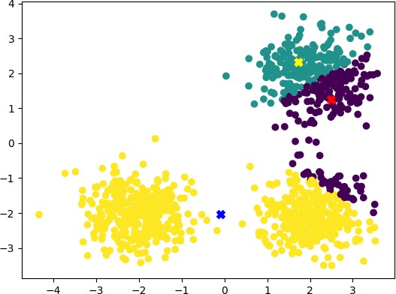
K-Means Algorithm: Example

Slide 23
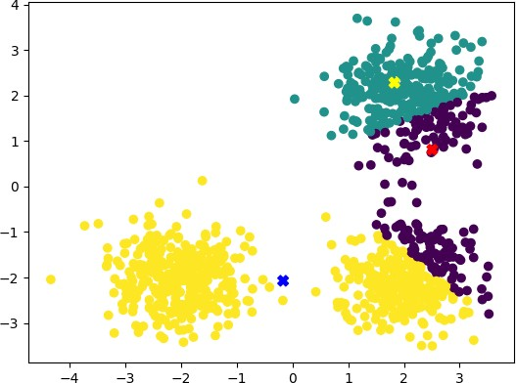
K-Means Algorithm: Example

Slide 24
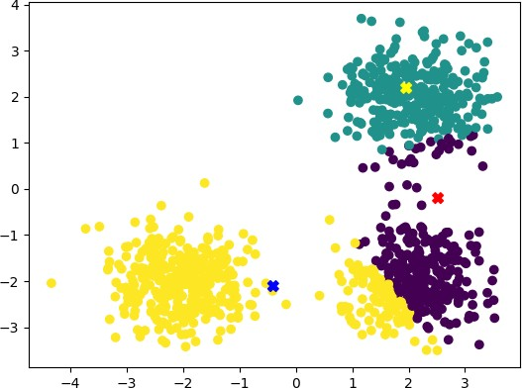
K-Means Algorithm: Example

Slide 25
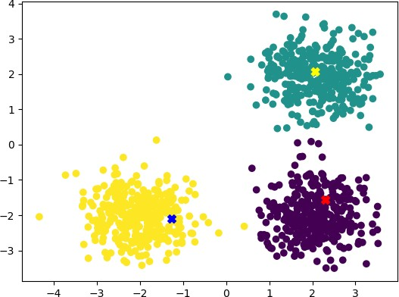
K-Means Algorithm: Example

Slide 26

K-Means Algorithm: Example

Slide 27
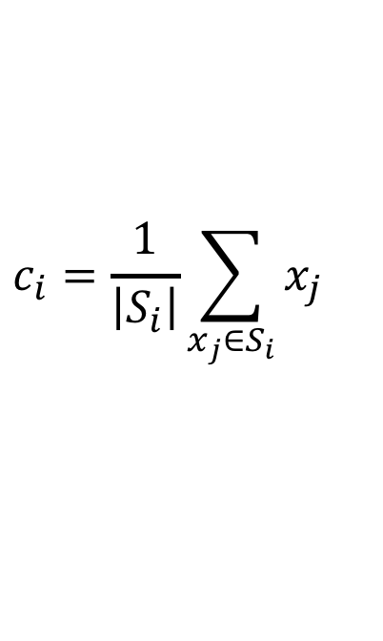
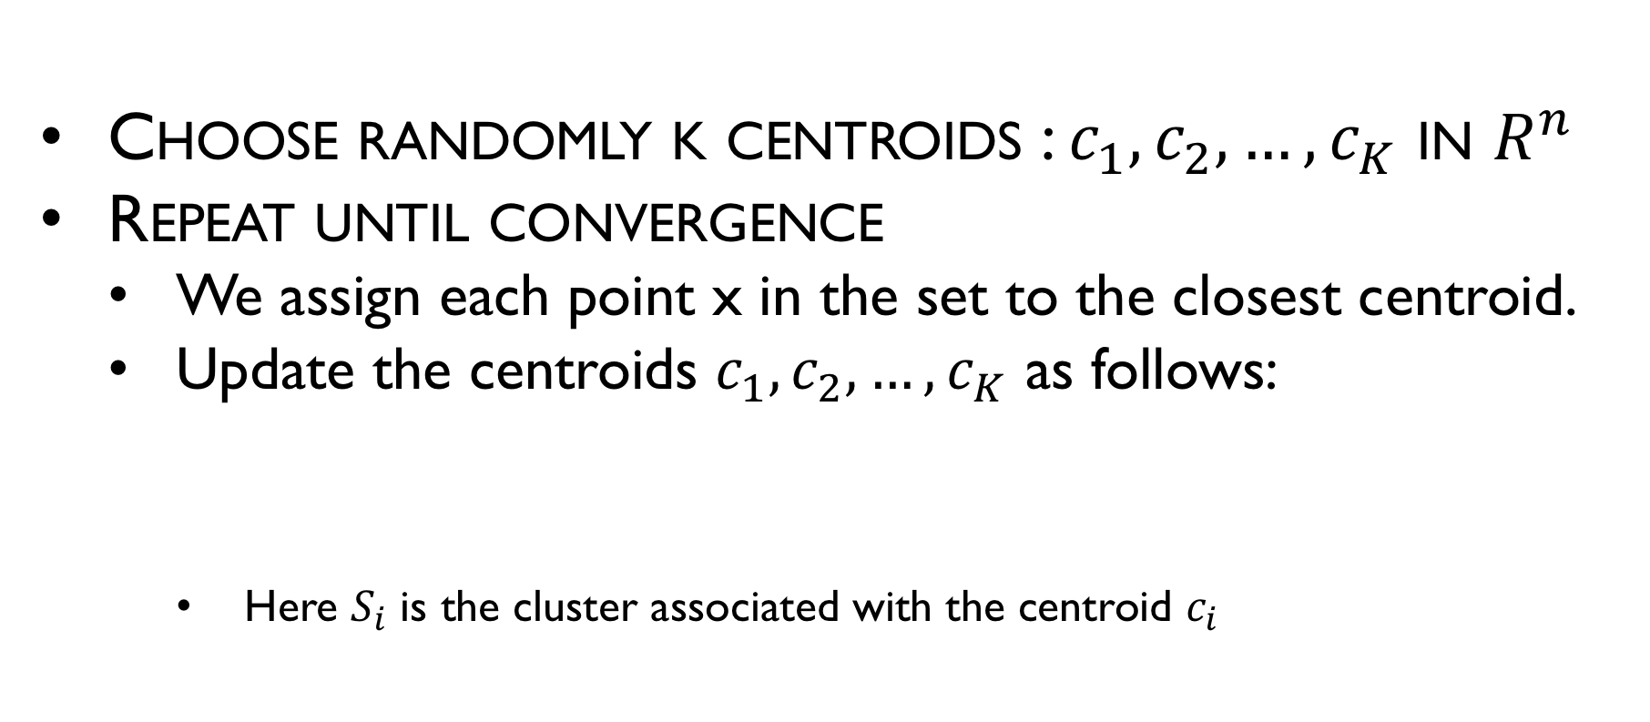
K-Means Algorithm: Complexity
Choose randomly k centroids : $c_{1}, c_{2}, …, c_{K}$ in $R^{n}$
Repeat until convergence
We assign each point x in the set to the closest centroid.
Update the centroids $c_{1}, c_{2}, …, c_{K}$ as follows:
Here $S_{i}$ is the cluster associated with the centroid $c_{i}$
$$c_{i}=\frac{1}{\left|S_{i}\right|}\sum_{x_{j}∈S_{i}}{x_{j}}$$

Slide 28
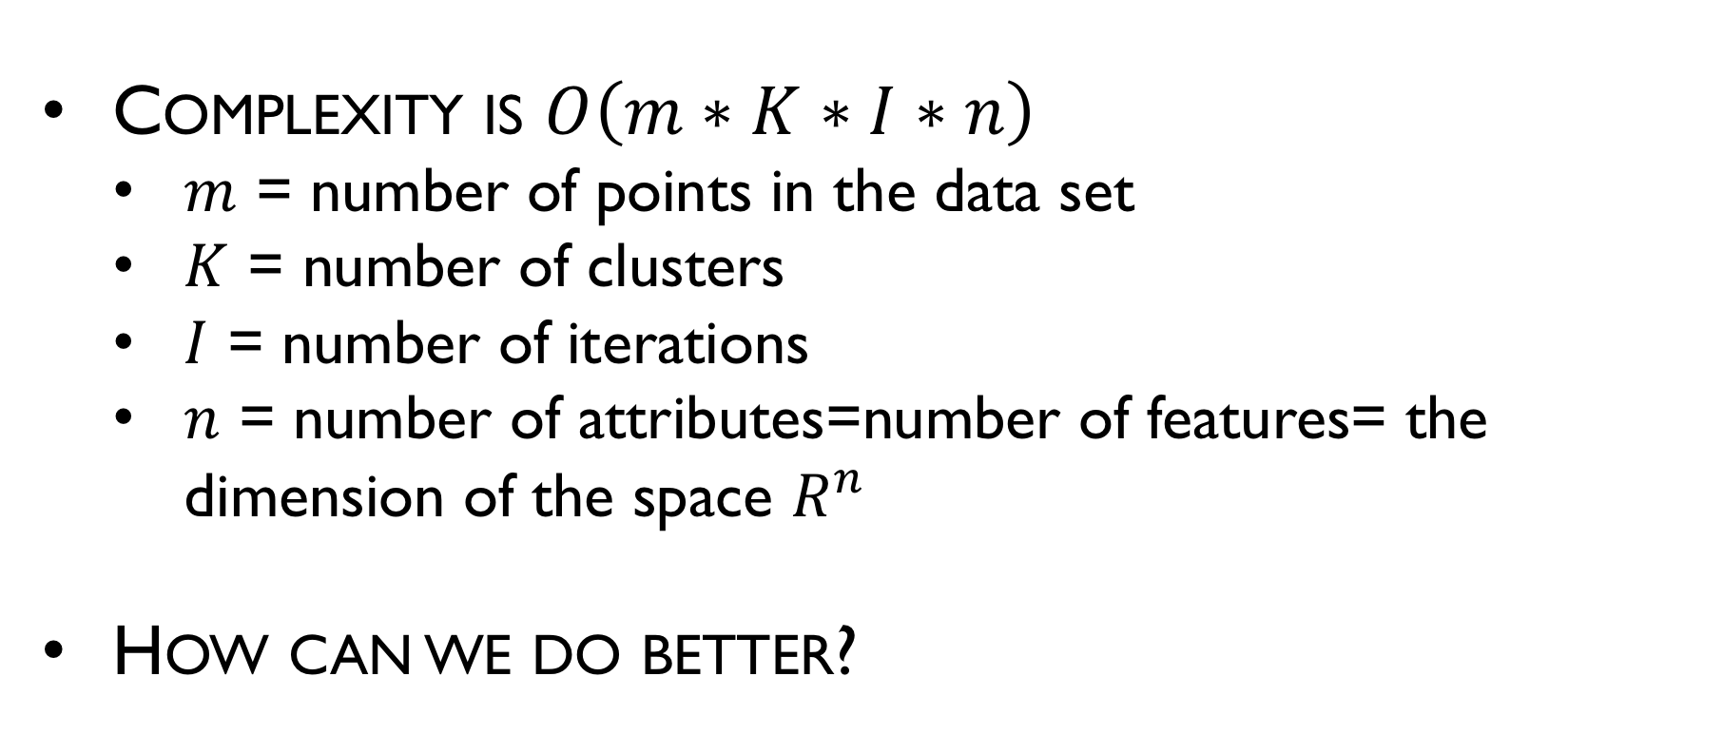
K-Means Algorithm: Complexity
Complexity is $O\left(m∗K∗I∗n\right)$
$m$ = number of points in the data set
$K$ = number of clusters
$I$ = number of iterations
$n$ = number of attributes=number of features= the dimension of the space $R^{n}$
How can we do better?

Slide 29
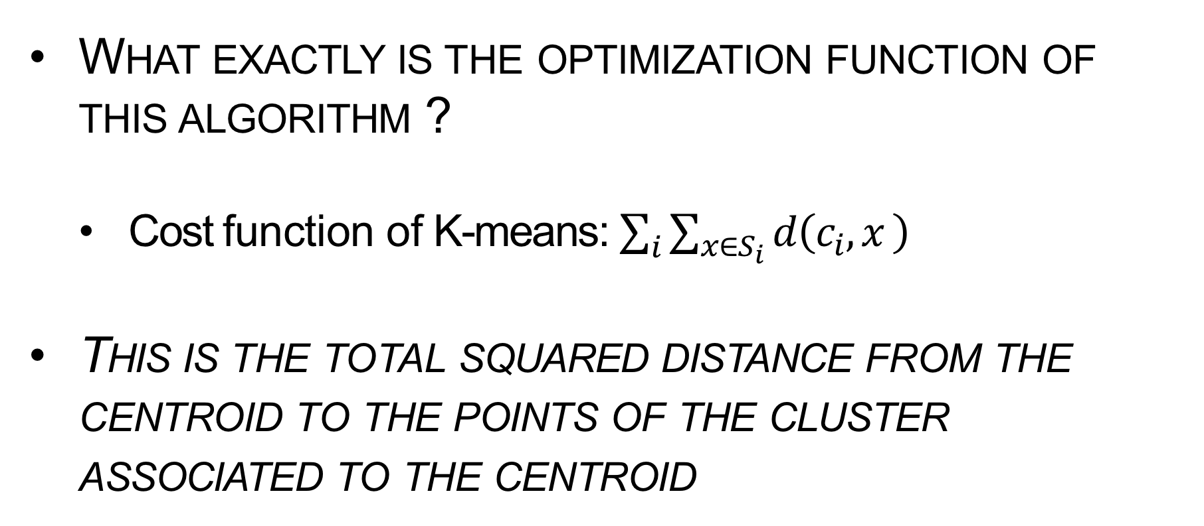
K-Means Algorithm: convergence
What exactly is the optimization function of this algorithm ?
Cost function of K-means: $\sum_{i}{\sum_{x∈S_{i}}{d\left(c_{i},x \right)}}$
This is the total squared distance from the centroid to the points of the cluster associated to the centroid

Slide 30
K-Means Algorithm: convergence
Since we start with random centers every time we run this algorithm:
Is it guaranteed to give the same clustering configuration?
Is the algorithm guaranteed to converge ?

Slide 31
K-Means Algorithm: convergence
The algorithm converges (in the sense that each iteration minimizes the cost function above) but it converges to a local min.
Which means that:
(1) the solution might not be the optimal solution and
(2) one might get different results for different initial starts.

Slide 32
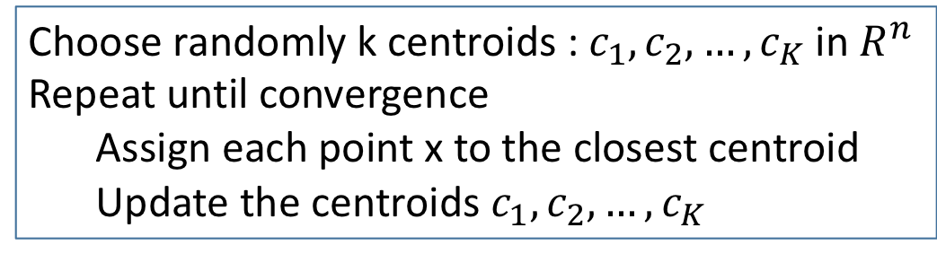
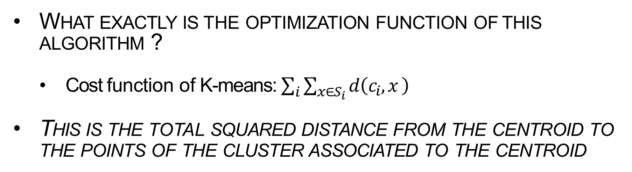
K-Means Algorithm: convergence
What exactly is the optimization function of this algorithm ?
Cost function of K-means: $\sum_{i}{\sum_{x∈S_{i}}{d\left(c_{i},x \right)}}$
This is the total squared distance from the centroid to the points of the cluster associated to the centroid
Choose randomly k centroids : $c_{1}, c_{2}, …, c_{K}$ in $R^{n}$
Repeat until convergence
Assign each point x to the closest centroid
Update the centroids $c_{1}, c_{2}, …, c_{K}$
Minimize the cost function with respect to the clusters
Minimize the cost function with respect to the centroids

Slide 33
K-Means Algorithm: problems
Outliers
Clusters with different densities
Non-convex shapes
Clusters with different sizes
May converge to local optimum
sklearn example here

Slide 34
K-Means Algorithm: remarks
K-means is clearly applicable to data sets where the clusters are very well-separated

Slide 35
K-Means Algorithm: remarks
K-means is clearly applicable to data sets where the clusters are very well-separated
K-Means is often applied to data that have no clear clustering structure

Slide 36
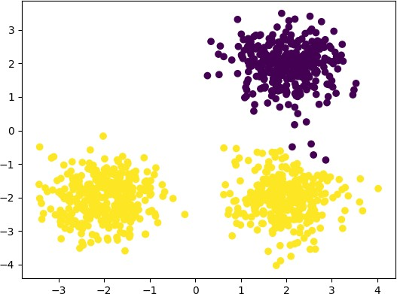
K-Means Algorithm: remarks
Selecting K is challenging
One solution for this is to run K-means several times and pick the attempt that minimizes the cost function

Slide 37

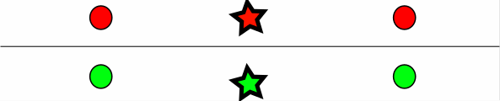
K-Means Algorithm: remarks
Nearby points may not end in the same cluster

Slide 38
K-Means Algorithm: remarks
Nearby points may not end in the same cluster
It is possible that K-means gets stuck in this local optimum.

Slide 39
K-Means Algorithm: remarks
Nearby points may not end in the same cluster
It is possible that K-means gets stuck in this local optimum.
How would you solve this problem ?

Slide 40
K-Means Algorithm: remarks
Nearby points may not end in the same cluster
It is possible that K-means gets stuck in this local optimum.
How would you solve this problem ?
Try different initialization and choose the one that produces the best result (wrt the cost function).

Slide 41
K-Means Algorithm: remarks
Using Euclidian Distance K-means will not give the natural clusters for this set.

Slide 42
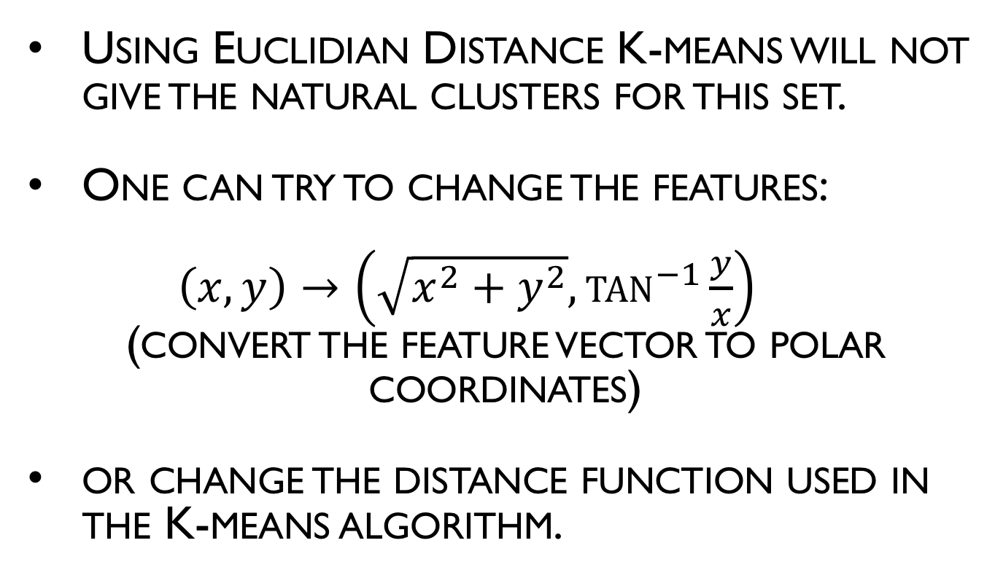
K-Means Algorithm: remarks
Using Euclidian Distance K-means will not give the natural clusters for this set.
One can try to change the features:
$\left(x,y\right)→\left(\sqrt{x^{2}+y^{2}},\tan^{−1}{\frac{y}{x}}\right)$
(convert the feature vector to polar coordinates)
or change the distance function used in the K-means algorithm.

Slide 43
K-means variations
Almost every aspect of K-means has been altered and changed to perform other clustering tasks.
Distance function: Any function that satisfy distance axioms can be used instead of the Euclidian distance.
Cost function
Initialization heuristics
Efficiency
Centroid definition: K-Medians, K-mediods
See Wikipedia page here

Slide 44
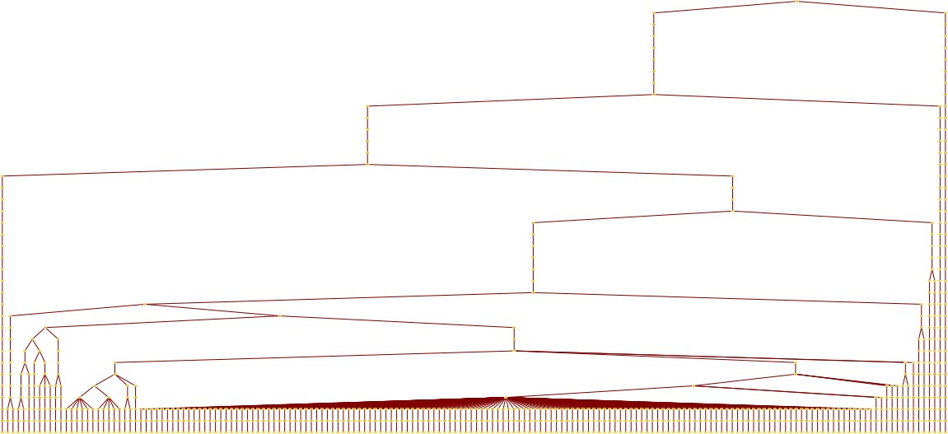
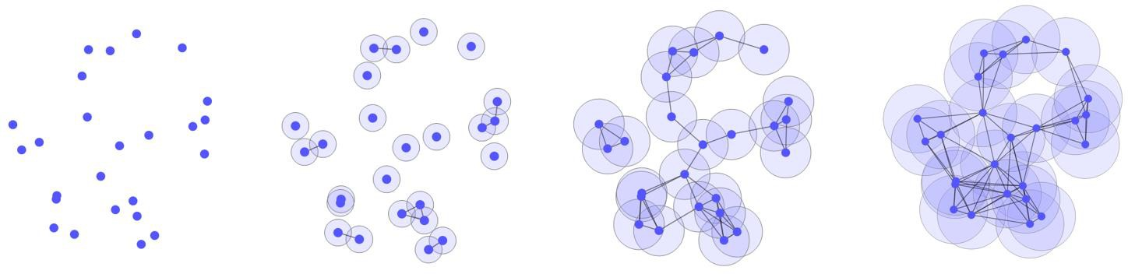
Hierarchical Clustering

Slide 45
Hierarchical Clustering
Hierarchical clustering is a family of clustering algorithms that build a tree clusters.
It is usually done by merging or splitting the clusters successively.
Agglomerative: bottom up (Merge)
Divisive: top down (Split)

Slide 46
Hierarchical Clustering
Hierarchical clustering is usually represented by a tree called the dendrogram that represents the clustering at all levels.
Each node in the tree represents a cluster
The root of the tree represents the cluster that contains all points
The leaves of the tree represents the clusters that contain the individual points
As we go from the leaves to the root, clusters start to merge according to some similarity criterion.
root
leaf

Slide 47

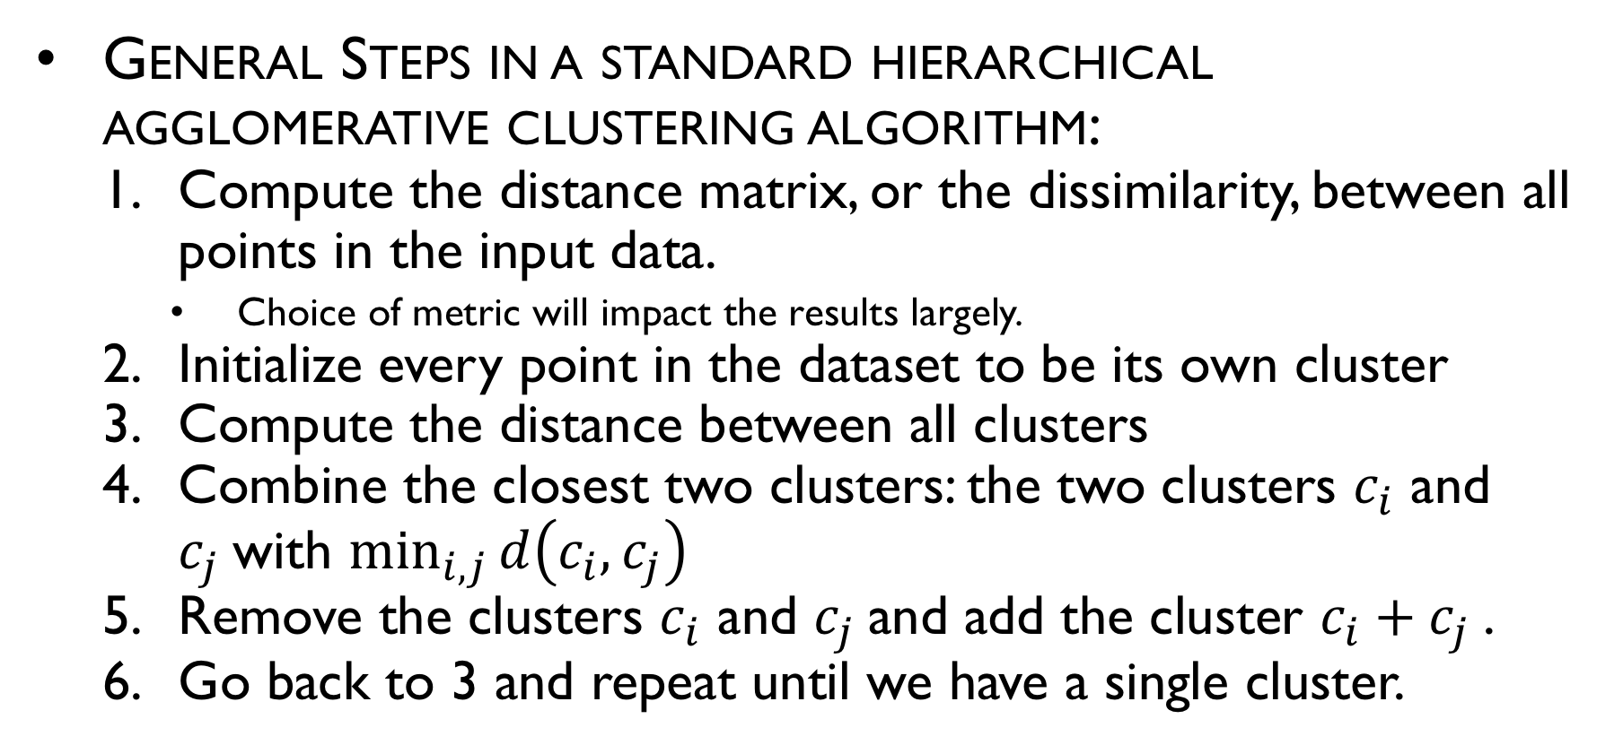
General Steps
General Steps in a standard hierarchical agglomerative clustering algorithm:
Compute the distance matrix, or the dissimilarity, between all points in the input data.
Choice of metric will impact the results largely.
Initialize every point in the dataset to be its own cluster
Compute the distance between all clusters
Combine the closest two clusters: the two clusters $c_{i}$ and $c_{j}$with $\min_{i,j}{d\left(c_{i},c_{j}\right)}$
Remove the clusters $c_{i}$ and $c_{j}$and add the cluster $c_{i}+c_{j}$.
Go back to 3 and repeat until we have a single cluster.

Slide 48
General Steps
Question : Given two clusters X and Y. How do we measure the distance between them?
This is important because step 3 we need to measure the distance between clusters rather than points.

Slide 49
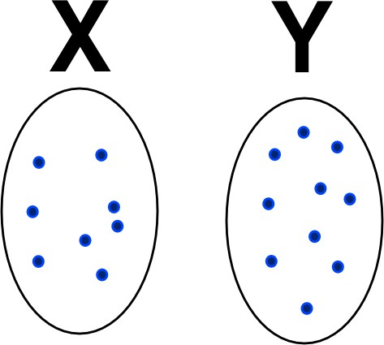
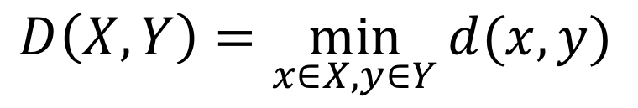
Distance between clusters
Given two clusters X and Y.
How do we measure the distance between them ?
One way is to measure the minimal distance between all points of X and Y.
This distance induce single linkage clustering.
$$D\left(X,Y\right)=\min_{x∈X,y∈Y}{d(x,y)}$$

Slide 50
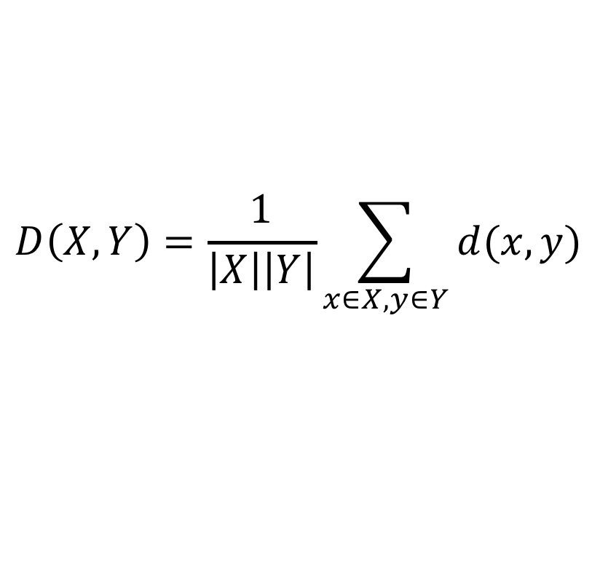
Distance between clusters
Given two clusters X and Y.
How do we measure the distance between them ?
We could also consider the mean distance between the points of the clusters
$$D\left(X,Y\right)=\frac{1}{\left|X\right|\left|Y\right|}\sum_{x∈X,y∈Y}{d(x,y)}$$

Slide 51
Distance between clusters
Given two clusters X and Y.
How do we measure the distance between them ?
There are other measures as well : The minimal energy criterion, the distance between the centroids of the clusters

Slide 52
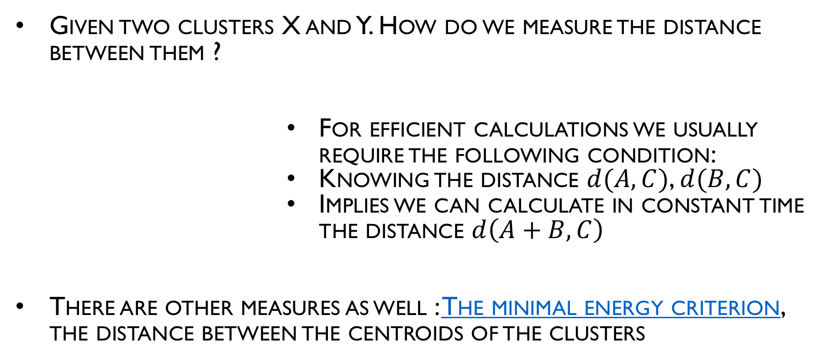
Distance between clusters
Given two clusters X and Y. How do we measure the distance between them ?
For efficient calculations we usually require the following condition:
Knowing the distance $d(A,C)$, $d(B,C)$
Implies we can calculate in constant time the distance $d\left(A+B,C\right)$
There are other measures as well : The minimal energy criterion, the distance between the centroids of the clusters

Slide 53
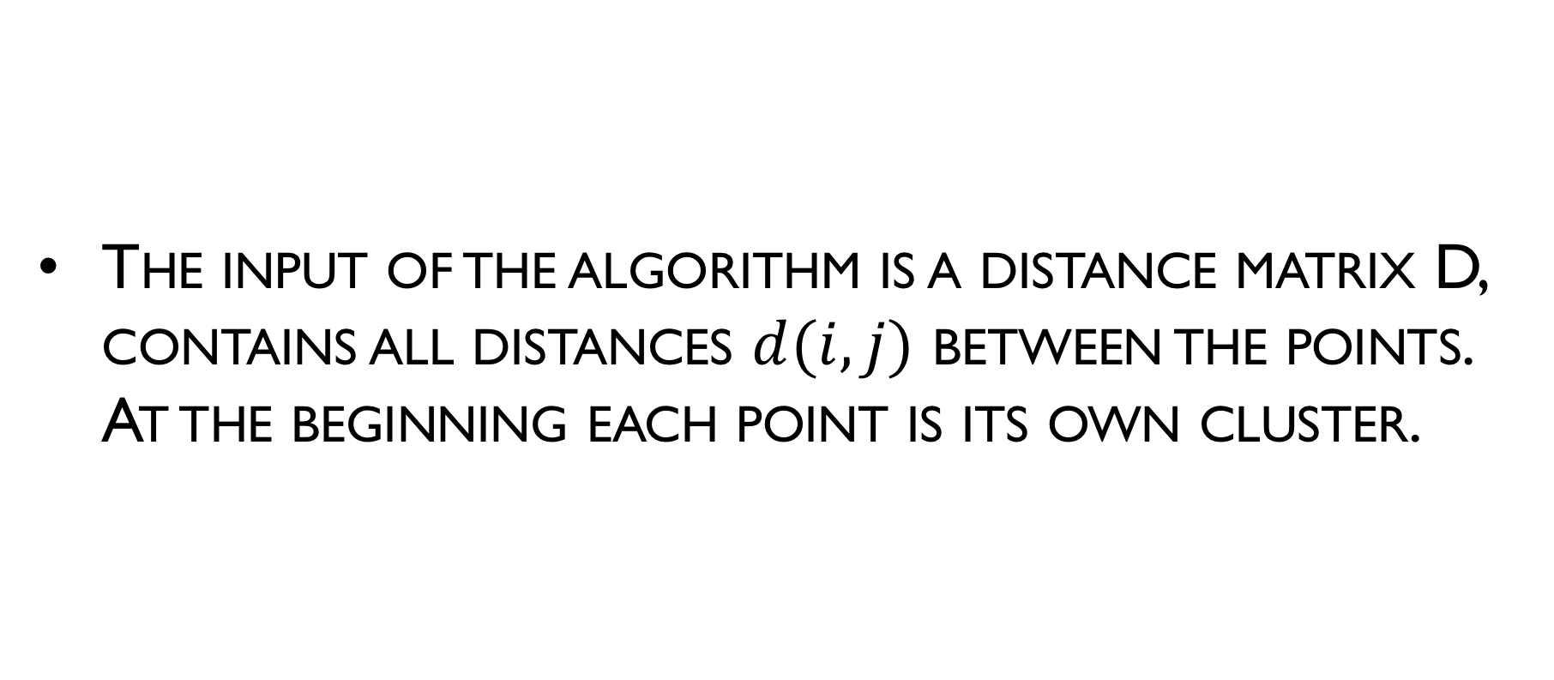
Single-linkage clustering algorithm
The input of the algorithm is a distance matrix D, contains all distances $d(i,j)$ between the points. At the beginning each point is its own cluster.

Slide 54
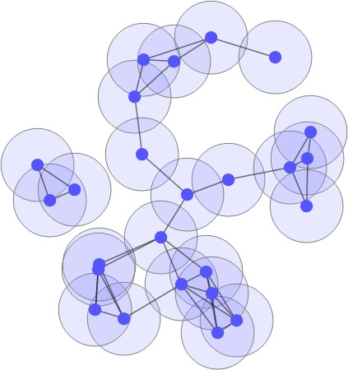
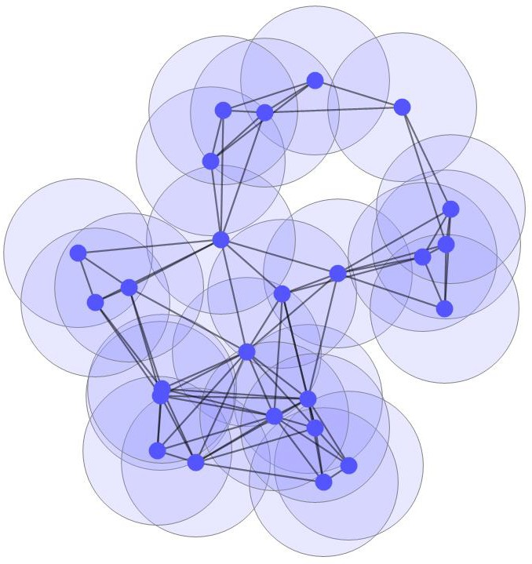
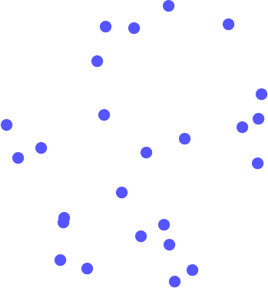
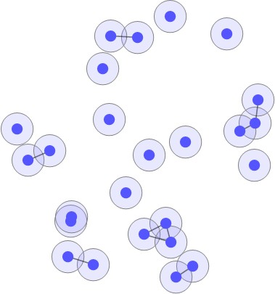
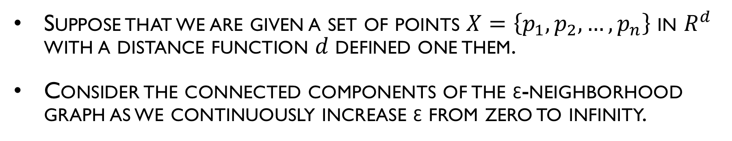
Single Linkage Hierarchical Clustering and the ɛ- Neighborhood Graph
Suppose that we are given a set of points $X=\left\{p_{1},p_{2},…,p_{n}\right\}$ in $R^{d}$ with a distance function 𝑑 defined one them.
Consider the connected components of the ɛ-neighborhood graph as we continuously increase ɛ from zero to infinity.
Every point is a connected component
When ɛ is a little larger we start some clusters starts to get form
When ɛ is even larger we have few clusters. As the clusters get larger and larger
At some point all points become a part to of a single cluster

Slide 55
Kruskal’s Algorithm
Let 𝐺 = (𝑉, 𝐸, 𝑤) be a connected weighted graph.
Informally, the algorithm can be given by the following steps:
Set 𝑉𝑇 𝑡𝑜 𝑏𝑒 𝑉, 𝑆𝑒𝑡 𝐸𝑇 = {}. Let 𝑆 = 𝐸
While 𝑆 is not empty and 𝑇 is not a spanning tree
Select an edge e from 𝑆 with the minimum weight and delete e from 𝑆.
If 𝑒 connects two separate trees of 𝑇 then add 𝑒 to 𝐸𝑇

Slide 56
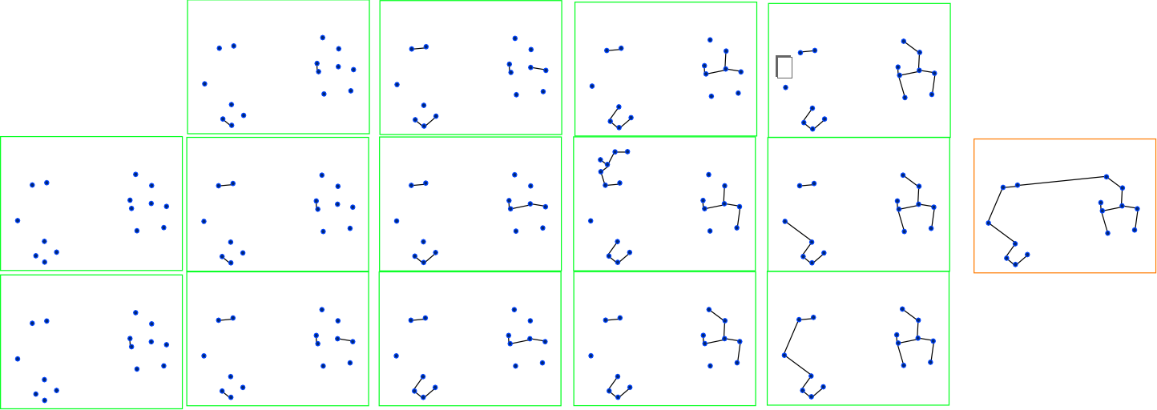
Single Linkage Hierarchical Clustering and the and Kruskal’s algorithm

Slide 57
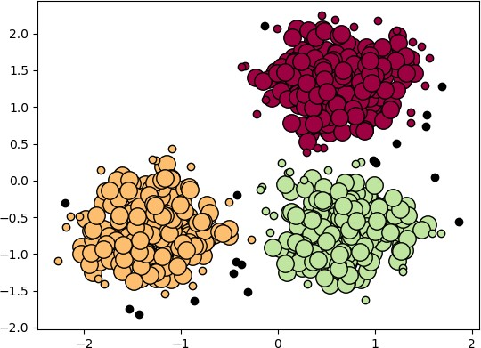
DBSCAN (Density-Based Spatial Clustering of Applications with Noise)

Slide 58
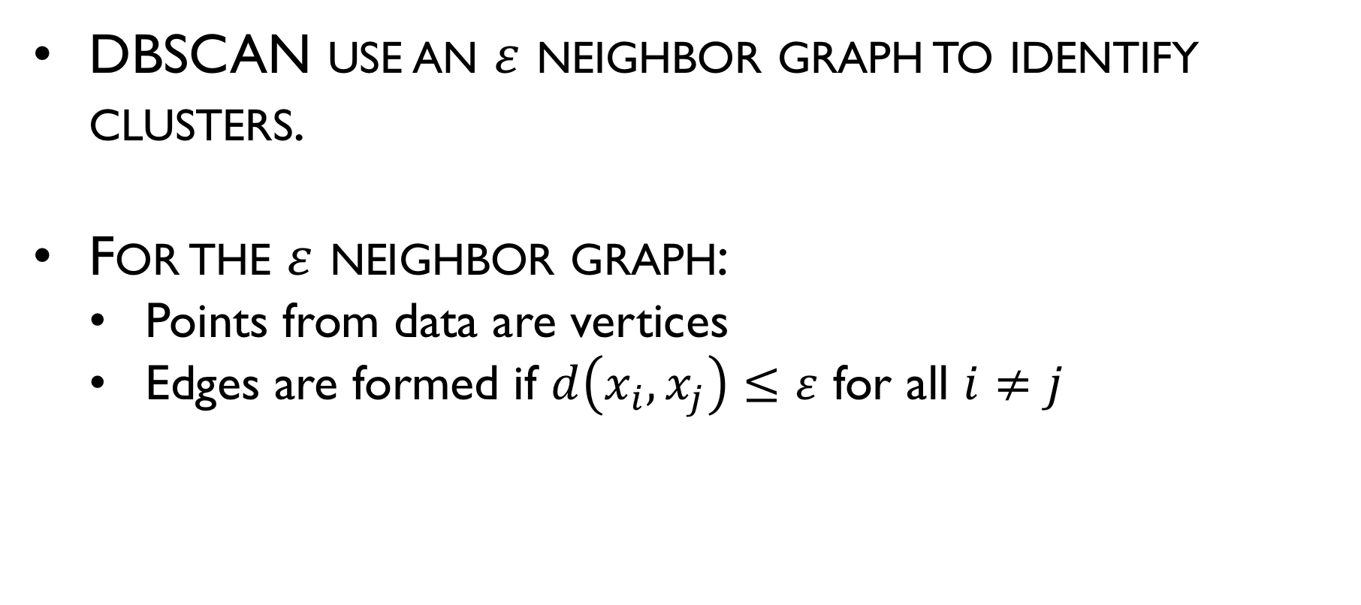
$ε$ neighbor graph
DBSCAN use an $ε$ neighbor graph to identify clusters.
For the $ε$ neighbor graph:
Points from data are vertices
Edges are formed if $d\left(x_{i},x_{j}\right)≤ε$ for all $i≠j$

Slide 59
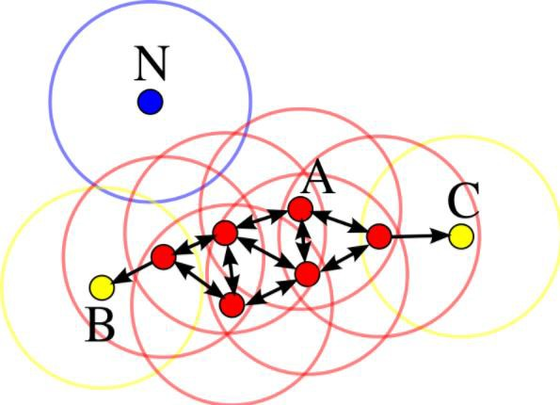
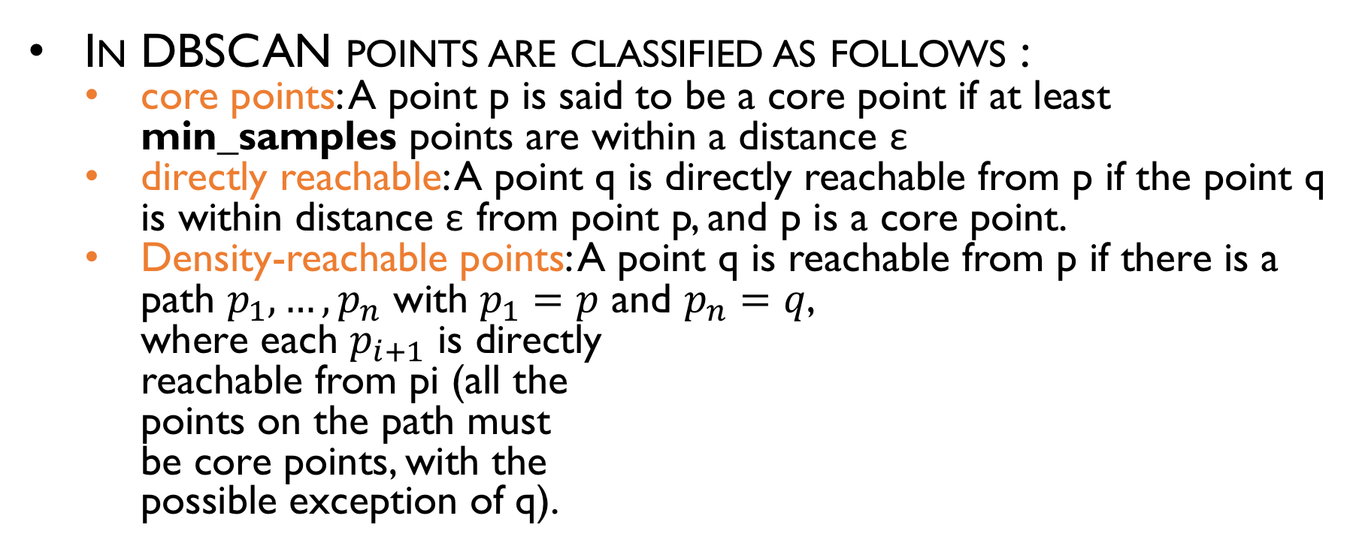
DBSCAN
In DBSCAN points are classified as follows :
core points: A point p is said to be a core point if at least min_samples points are within a distance ε
directly reachable: A point q is directly reachable from p if the point q is within distance ε from point p, and p is a core point.
Density-reachable points: A point q is reachable from p if there is a path $p_{1}, …, p_{n}$ with $p_{1}=p$ and $p_{n}=q$, where each $p_{i+1}$ is directly reachable from pi (all the points on the path must be core points, with the possible exception of q).
boundary points
outlier
Core points
min_samples=4

Slide 60
DBSCAN
In DBSCAN points are classified as follows :
Outliers: All points not reachable from any other point are called outliers.
Boundary points: Boundary points cannot reach other points but other points core points can reach them
boundary points
outlier
Core points
Image source
min_samples=4

Slide 61
DBSCAN-Reachability
If p is reachable from q. Does that mean q is reachable from p? Explain. Can you give an example from the points below?
boundary points
outlier
Core points
Image source
min_samples=4

Slide 62
DBSCAN-Density-connectedness
Two points p and q are density-connected if there is a point o such that both p and q are reachable from o.
A cluster then satisfies two properties:
All points within the cluster are mutually density-connected.
If a point is density-reachable from any point of the cluster, it is part of the cluster as well.
boundary points
outlier
Core points
Image source
min_samples=4

Slide 63
DBSCAN-Algorithm
Input a data X, a positive real number ε and a positive integer min_samples
Find the ε neighbor graph.
Identify the core points with more than MIN_SAMPLES neighbors.
Find the connected components of core points on the neighbor graph, ignoring all non-core points.
Assign each non-core point to a nearby cluster if the cluster is an ε neighbor, otherwise assign it to noise.

Slide 64
DBSCAN-sklearn
Sklearn DBSCAN / Sklearn example

Slide 65

Comparison between clustering algorithms
source

