Slide 1
COT 4521: Introduction to Computational Geometry
INTRODUCTION TO PROCESSING

Slide 2
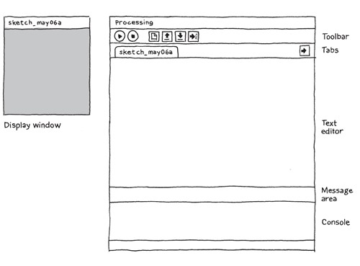
what is it?
Processing Development Environment (PDE)

Slide 3
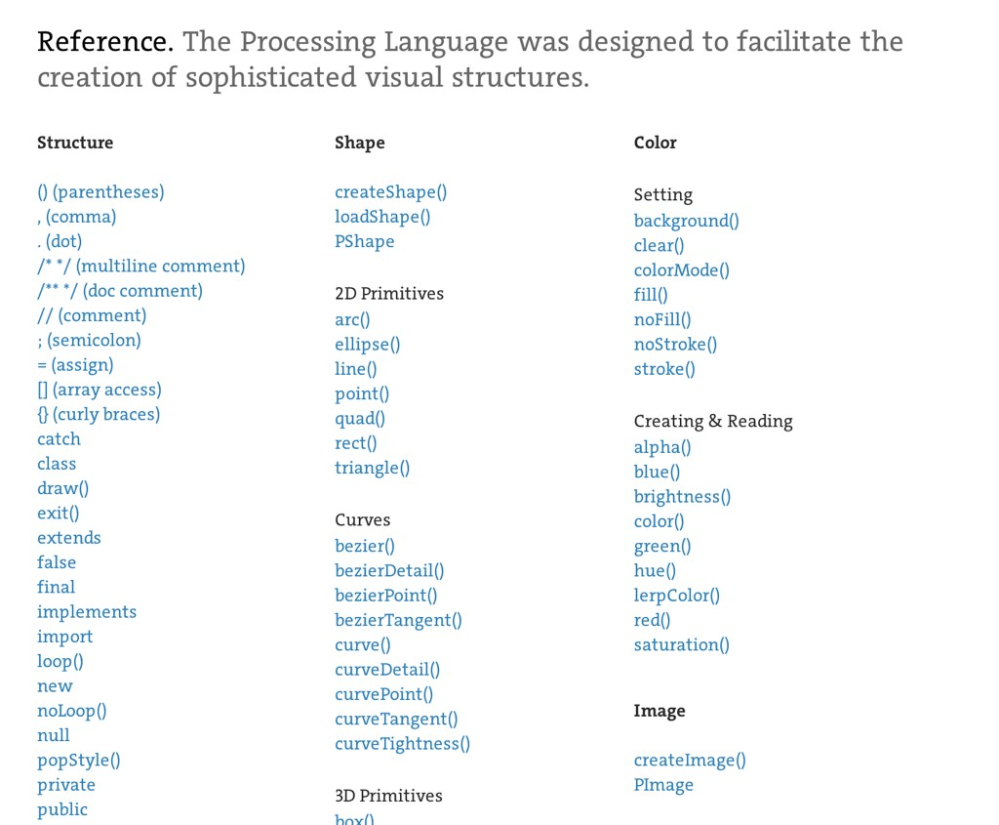
what is it?
Processing API

Slide 4
what is it?
open-source, online community
https://processing.org/
http://forum.processing.org/
https://github.com/processing

Slide 5
why not other languges?
difficulty to sketch with other languages
complicated setup
portability challenging
not easy to learn

Slide 6
why Processing?
+/- Java-based
- complexity
+ big standard library
+ similar syntax & portability
+ lots of user-contributed libraries
+ fast to startup

Slide 7

why Processing?
program = sketch

Slide 8
why Processing?
programming syntax
void setup() { size(480, 120);
}
void draw() {
if (mousePressed) {
fill(0);
} else { fill(255);
}
ellipse(mouseX, mouseY, 80, 80);
}

Slide 9

why Processing?
public class Hello
{
public static void main (String args[])
{
System.out.println("Hello, world!");
}
}
javac Hello.java
java Hello

Slide 10
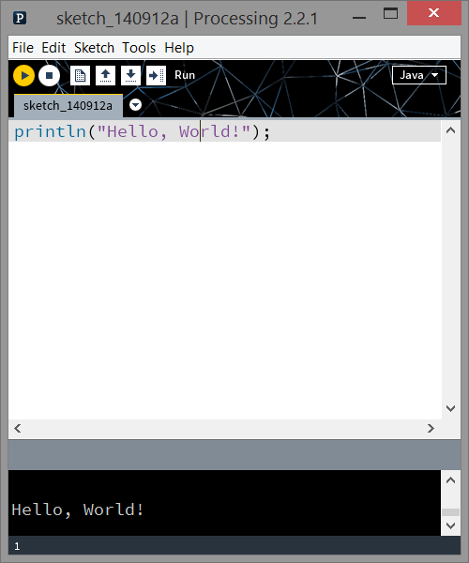
why Processing?
println(“Hello, World!”);

Slide 11
Graphics

Slide 12
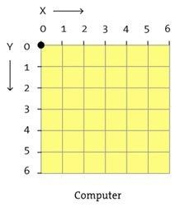
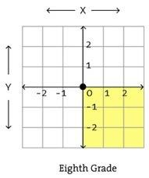
Monitors
grid of pixels
Right Hand Coordinate System
Monitor Coordinate System
(Left Hand Coordinate System)
Discuss in more detail

Slide 13
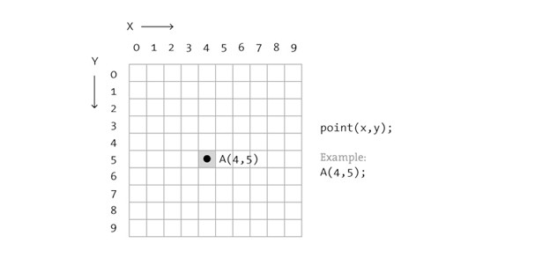
shape
point(x, y);

Slide 14
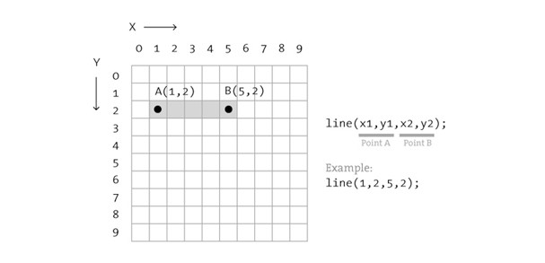
shape
line(x1, y1, x2, y2);

Slide 15
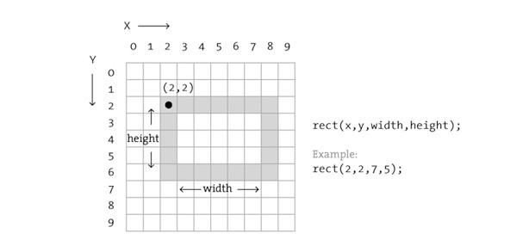
shape
rect(x, y, width, height);

Slide 16
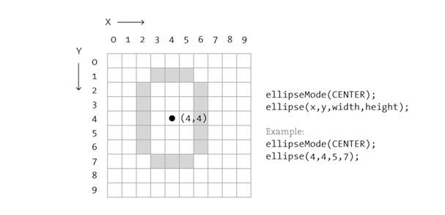
Shape
ellipseMode(CENTER);
ellipse(x, y, width, height);

Slide 17
Shape
triangle(x1, y1, x2, y2, x3, y3);
quad(x1, y1, x2, y2, x3, y3, x4, y4);
arc(x, y, width, height, start, stop);

Slide 18
Shape
More complex shapes available with:
beginShape() / vertex() / endShape()

Slide 19
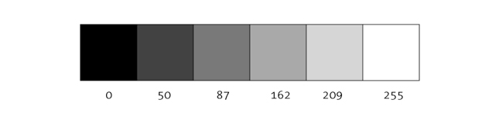
Color
luminance (black & white; grayscale)
background(255); // clear background

Slide 20
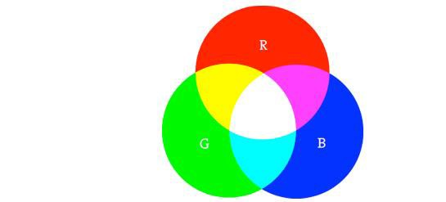
Color
RGB (default)
color c1 = color(r, g, b);
color c2 = #RRGGBB;

Slide 21
Color
RGBA
a = alpha / transparency / opacity
0 = transparent; 255 = opaque (solid)
color c1 = color(r, g, b, a);

Slide 22

properties
noStroke(); fill(c1); rect(...);
fill(c2); stroke(c3); ellipse(...);

Slide 23
properties
noFill();
noStroke(); ellipse(...);
rect(...);

Slide 24
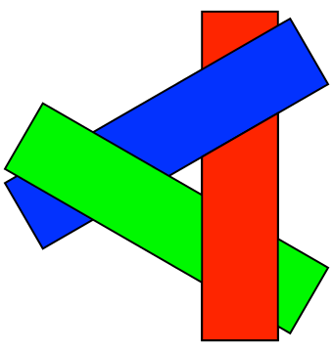
Order
shapes are painted one at a time
overlap can occur
some shapes are not supported

Slide 25
animation
runs once
void setup(){
...
}
void draw(){
...
}
cycles

Slide 26
text
// in setup()
PFont myFont;
myFont
= createFont("Georgia",
32);
// in draw() textFont(myFont); textAlign(CENTER,
CENTER);
text("Hello, World!",
width/2,
height/2);

Slide 27
programming

Slide 28
Structure
comments, variables, arrays, loops

Slide 29
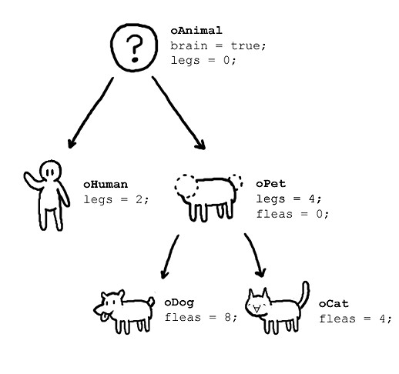

object-oriented
with classes
class oAnimal{ boolean brain; int legs;
oAnimal(){
brain = true;
legs = 0;
}
}

Slide 30
Built-in Trigonometry Functions
acos() / asin() / atan() / atan2()
degrees() / radians()
cos() / sin() / tan()

Slide 31
Built-in Calcuation Functions
Calculation
max() / min()
abs() / ceil() / constrain() / floor() / round()
lerp() / map() / norm()
dist() / mag()
exp() / log() / pow() / sq() / sqrt()

Slide 32
Pvector
Container for points and vectors
Variety of functionalities—vector arithmetic, dot/cross products, normalization, and interpolation
https://processing.org/reference/PVector.html
http://processing.github.io/processing-javadocs/core/processing/core/PVector.html

Slide 33
Object Storage
ArrayList (also FloatList, IntList, StringList)
HashMap (dict: also FloatDict, IntDict, StringDict)
Table, XML, JSON
(and anything else Java!)

Slide 34

Interaction: mouse
void
mousePressed()
void
mouseReleased()
void mouseClicked(){
if(mouseButton == LEFT)
fill(0);
else if(mouseButton == RIGHT) fill(255);
else
fill(126);
}
void
mouseClicked()
void
mouseDragged()
void
mouseMoved()
void
mouseWheel()
mouseX mouseY pmouseX pmouseY

Slide 35

Interaction: keyboard
void keyTyped(){
if(key == 'b')
fill(0);
else if(key == 'w') fill(255);
else
fill(126);
}
void
keyPressed()
void
keyReleased()
void
keyTyped()
keyPressed key keyCode

Slide 36

folder structure
folder [NAME] & [NAME].pde must match
optional data folder (for images, input)

Slide 37
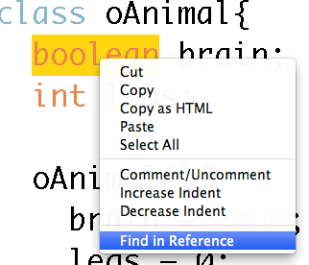
Documentation
available online
also in the PDE
http://processing.org/reference/

Slide 38
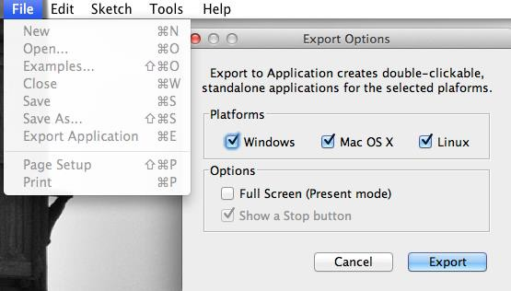
Exporting
creating applications is simple

Slide 39

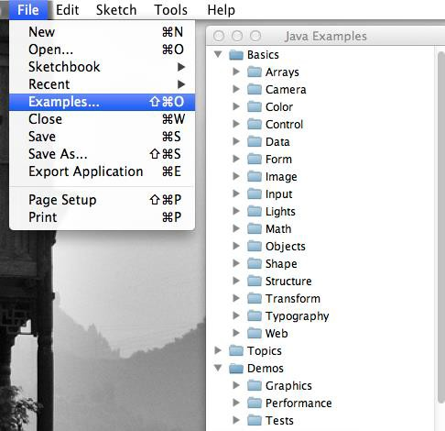
Examples
variety of samples

Slide 40
Demo

