Slide 1
COT 4521: Introduction to Computational Geometry
Segment Intersection

Slide 2
Problem Statement

Slide 3
Problem Statement

Slide 4
Representing Curves
Curves usually represented by a polynomial or polynomial spline
Bezier, NURBS, etc.
Tesselate Curve into many small line segments

Slide 5
Representing Curves
Curves usually represented by a polynomial or polynomial spline
Bezier, NURBS, etc.
Tesselate Curve into many small line segments

Slide 6
Representing Curves
Curves usually represented by a polynomial or polynomial spline
Bezier, NURBS, etc.
Tesselate Curve into many small line segments

Slide 7
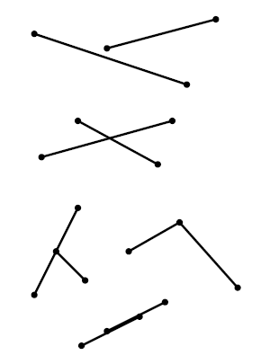
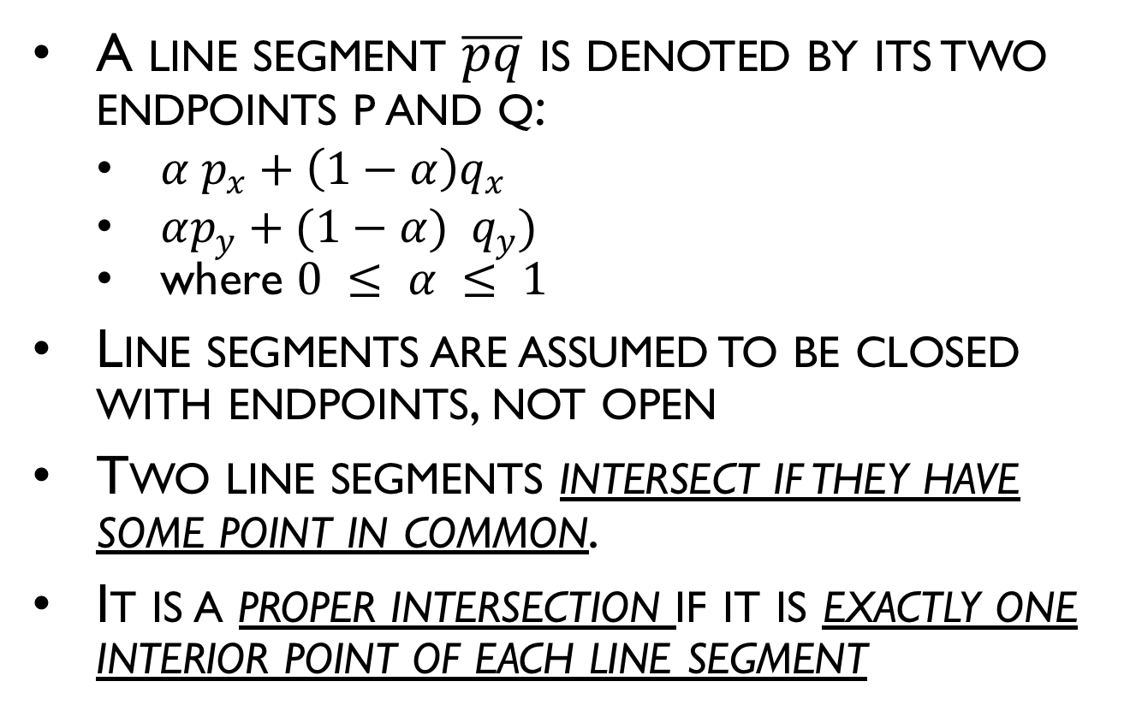
Segment-Segment Intersection
A line segment $\overline{pq}$ is denoted by its two endpoints p and q:
$α p_{x}+\left(1−α\right)q_{x}$
$αp_{y}+(1−α) q_{y})$
where $0 ≤ α ≤ 1$
Line segments are assumed to be closed with endpoints, not open
Two line segments intersect if they have some point in common.
It is a proper intersection if it is exactly one interior point of each line segment

Slide 8




Do they intersect?
Observation: If the two segments intersect, the two red points must lie on different sides of the black line (or lie exactly on it)
The same holds with black/red switched
$$P_{4}$$
$$P_{1}$$
$$P_{3}$$
$$P_{2}$$

Slide 9




Do they intersect?
What does “different sides” mean?
Use the cross product to determine sidedness
$$P_{4}$$
$$P_{1}$$
$$P_{3}$$
$$P_{2}$$

Slide 10
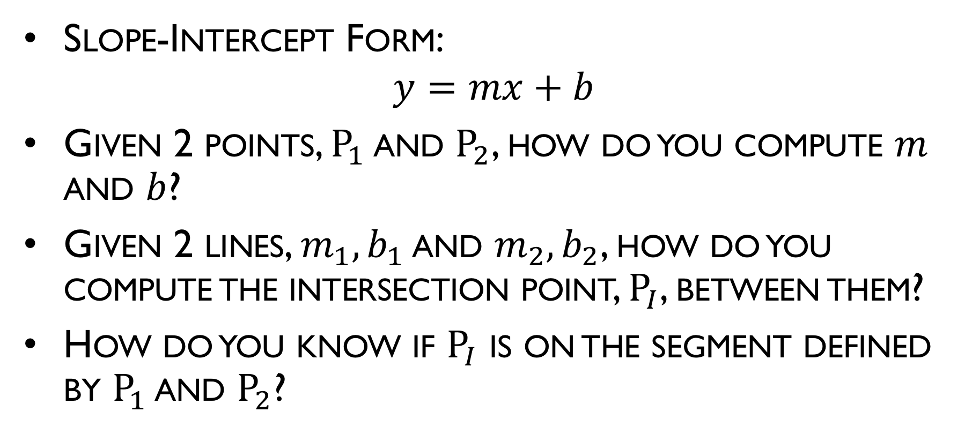
Representing a Line
Slope-Intercept Form:
$$y=mx+b$$
Given 2 points, $P_{1}$ and $P_{2}$, how do you compute $m$ and $b$?
Given 2 lines, $m_{1},b_{1}$ and $m_{2},b_{2}$, how do you compute the intersection point, $P_{I}$, between them?
How do you know if $P_{I}$ is on the segment defined by $P_{1}$ and $P_{2}$?
Notes:
M = (y2-y1)/(x2-x1)
Y1 = m*x1 + b -> b = y1 / (m*x1)
Y = m1 x + b1
Y = m2 x + b2
M1 x + b1 = m2 x + b2
(m1 – m2 ) x = (b2 – b1)
X = (b2 – b1) / (m1 – m2 )
Y = m1 x + b1
Min(X1,X2) <= XI <= max(x1,X2)
Min(Y1,y2) <= YI <= max(y1,Y2)

Slide 11
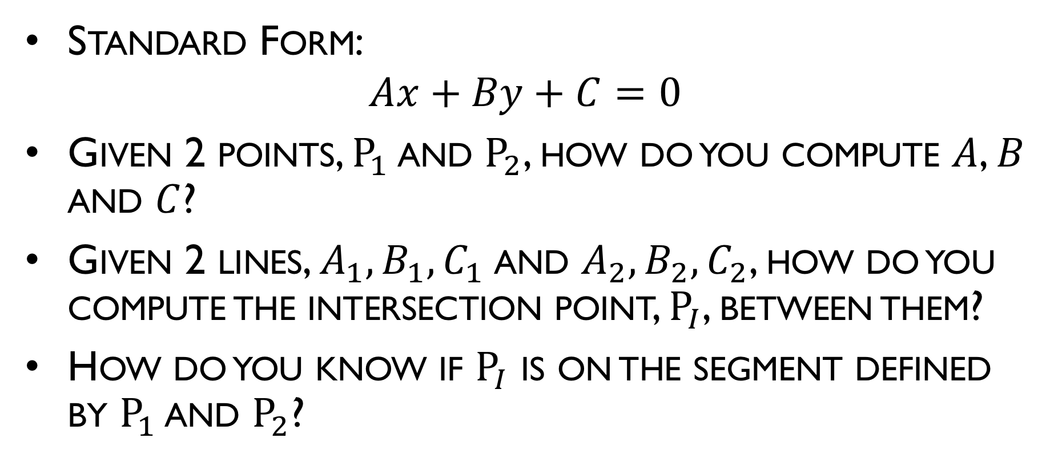
Representing a Line
Standard Form:
$$Ax+By+C=0$$
Given 2 points, $P_{1}$ and $P_{2}$, how do you compute $A$, $B$ and $C$?
Given 2 lines, $A_{1},B_{1},C_{1}$and $A_{2},B_{2},C_{2}$, how do you compute the intersection point, $P_{I}$, between them?
How do you know if $P_{I}$ is on the segment defined by $P_{1}$ and $P_{2}$?
Notes:
A = (y2-y1)
B = (x2-x1)
C = -( A x1 + B y1 )
A1 x + B1 y + C1 = 0
A2 x + B2 y + C2 = 0
Min(X1,X2) <= XI <= max(x1,X2)
Min(Y1,y2) <= YI <= max(y1,Y2)

Slide 12
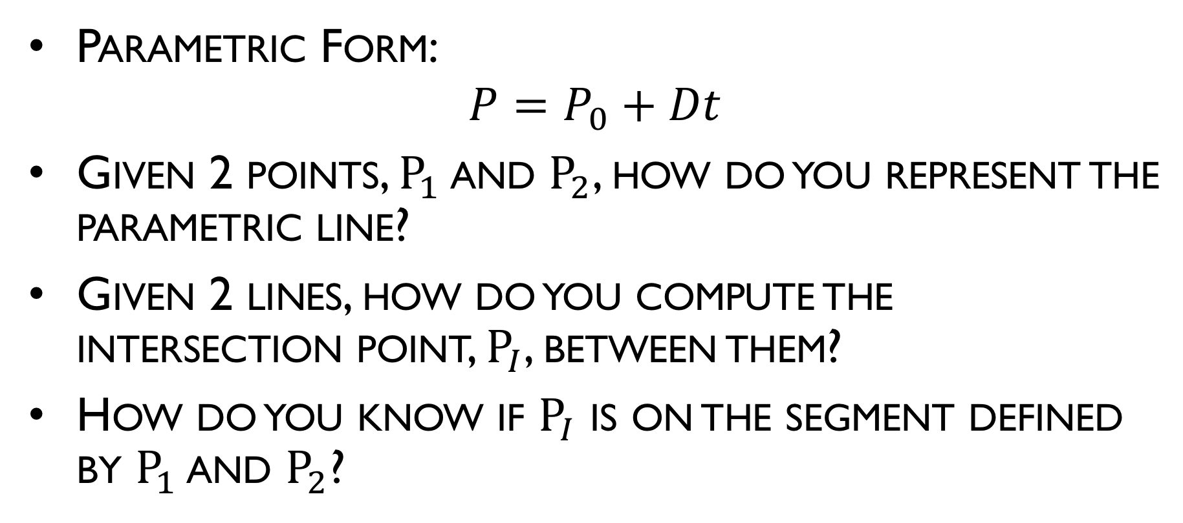
Representing a Line
Parametric Form:
$$P=P_{0}+Dt$$
Given 2 points, $P_{1}$ and $P_{2}$, how do you represent the parametric line?
Given 2 lines, how do you compute the intersection point, $P_{I}$, between them?
How do you know if $P_{I}$ is on the segment defined by $P_{1}$ and $P_{2}$?
Notes:
A = (y2-y1)
B = (x2-x1)
C = -( A x1 + B y1 )
A1 x + B1 y + C1 = 0
A2 x + B2 y + C2 = 0
Min(X1,X2) <= XI <= max(x1,X2)
Min(Y1,y2) <= YI <= max(y1,Y2)

Slide 13
Intersection of >2 Line Segments

Slide 14
Intersection of >2 Line Segments

Slide 15
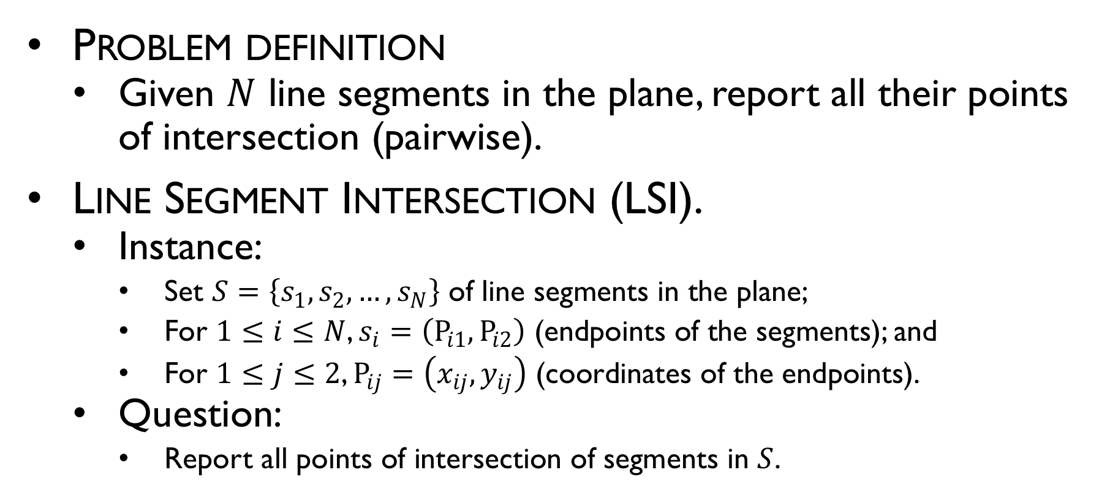
Intersection of line segments
Problem definition
Given $N$ line segments in the plane, report all their points of intersection (pairwise).
Line Segment Intersection (LSI).
Instance:
Set $S=\left\{s_{1},s_{2},…,s_{N}\right\}$ of line segments in the plane;
For $1≤i≤N$, $s_{i}=\left(P_{i1},P_{i2}\right)$ (endpoints of the segments); and
For $1≤j≤2$, $P_{ij}=\left(x_{ij},y_{ij}\right)$ (coordinates of the endpoints).
Question:
Report all points of intersection of segments in $S$.

Slide 16
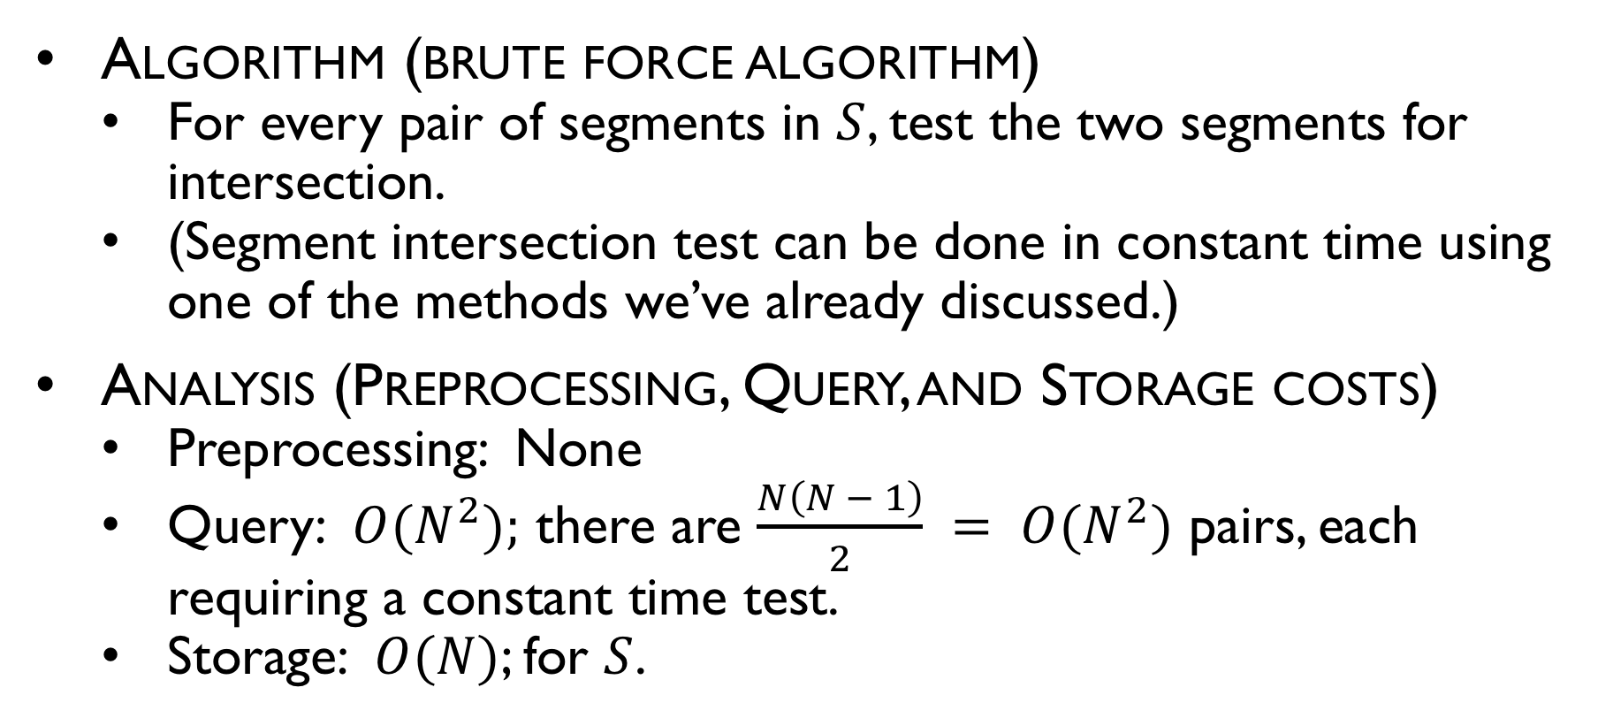
Intersection of line segments
Algorithm (brute force algorithm)
For every pair of segments in $S$, test the two segments for intersection.
(Segment intersection test can be done in constant time using one of the methods we’ve already discussed.)
Analysis (Preprocessing, Query, and Storage costs)
Preprocessing: None
Query: $O(N^{2});$ there are $\frac{N\left(N − 1\right)}{2} = O(N^{2})$ pairs, each requiring a constant time test.
Storage: $O(N)$; for $S$.

Slide 17
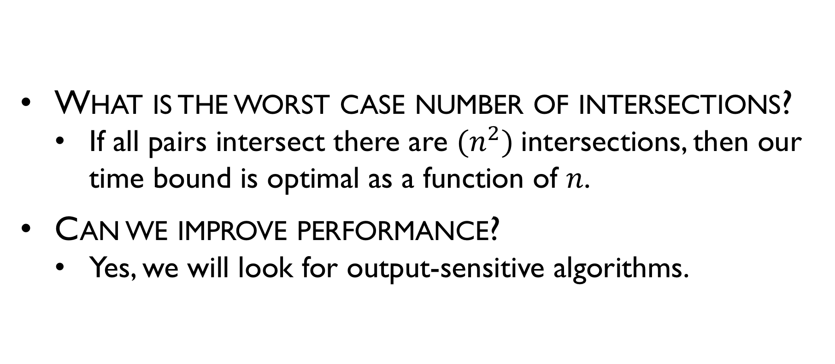
Naïve Intersection of >2 Line Segments
What is the worst case number of intersections?
If all pairs intersect there are $(n^{2})$intersections, then our time bound is optimal as a function of $n$.
Can we improve performance?
Yes, we will look for output-sensitive algorithms.

Slide 18
Observations?

Slide 19
Axis Aligned Bounding Boxes (AABB)

Slide 20

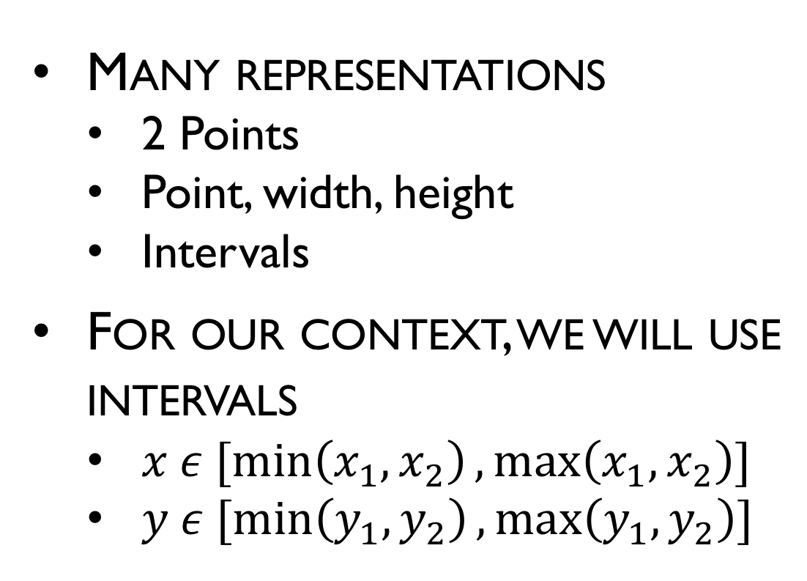

Axis Aligned Bounding Boxes (AABB)
Many representations
2 Points
Point, width, height
Intervals
For our context, we will use intervals
$x ε [\min\left(x_{1},x_{2}\right),\max\left(x_{1},x_{2}\right)]$
$y ε [\min\left(y_{1},y_{2}\right),\max\left(y_{1},y_{2}\right)]$
$$P_{2}(x_{2},y_{2})$$
$$P_{1}(x_{1},y_{1})$$

Slide 21
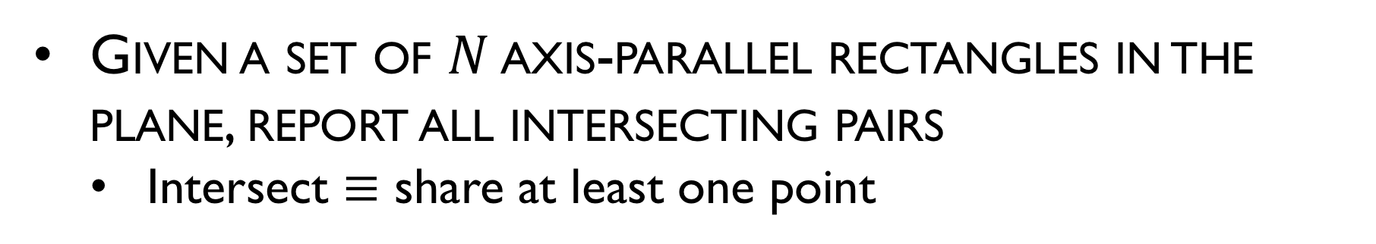
AABB Intersection
Given a set of $N$ axis-parallel rectangles in the plane, report all intersecting pairs
Intersect $≡$ share at least one point
r₆
r₇
r₅
r₄
r₈
r₃
r₁
r₂
Answer: (r₁, r₂) (r₁, r₃) (r₁, r₈) (r₃, r₄) (r₃, r₅) (r₄, r₅) (r₇, r₈)

Slide 22


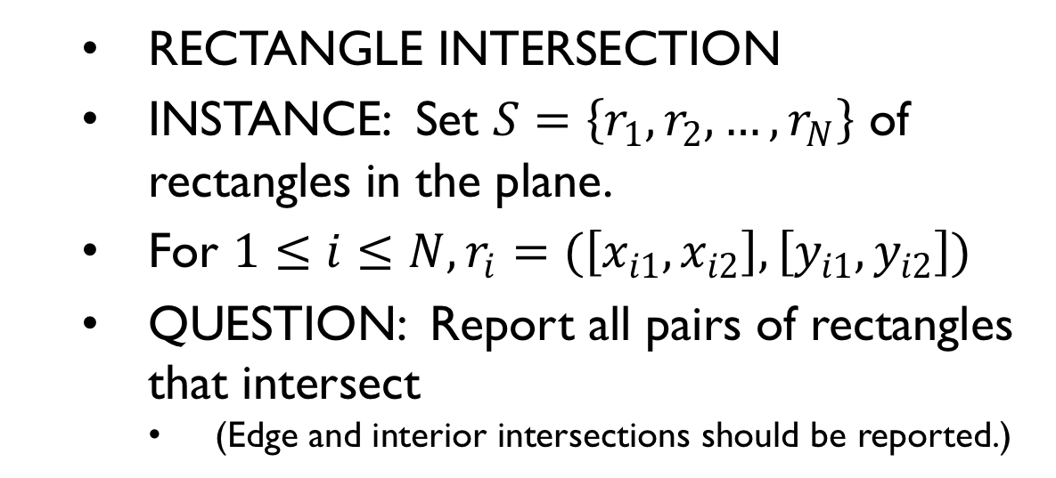



Intersection of rectangles Problem definition
RECTANGLE INTERSECTION
INSTANCE: Set $S=\left\{r_{1},r_{2},…,r_{N}\right\}$ of rectangles in the plane.
For $1≤i≤N, r_{i}=(\left[x_{i1},x_{i2}\right],\left[y_{i1},y_{i2}\right])$
QUESTION: Report all pairs of rectangles that intersect
(Edge and interior intersections should be reported.)
$$y_{i2}$$
$$r_{i}$$
$$y_{i1}$$
$$x_{i1}$$
$$x_{i2}$$
Considered to intersect.

Slide 23

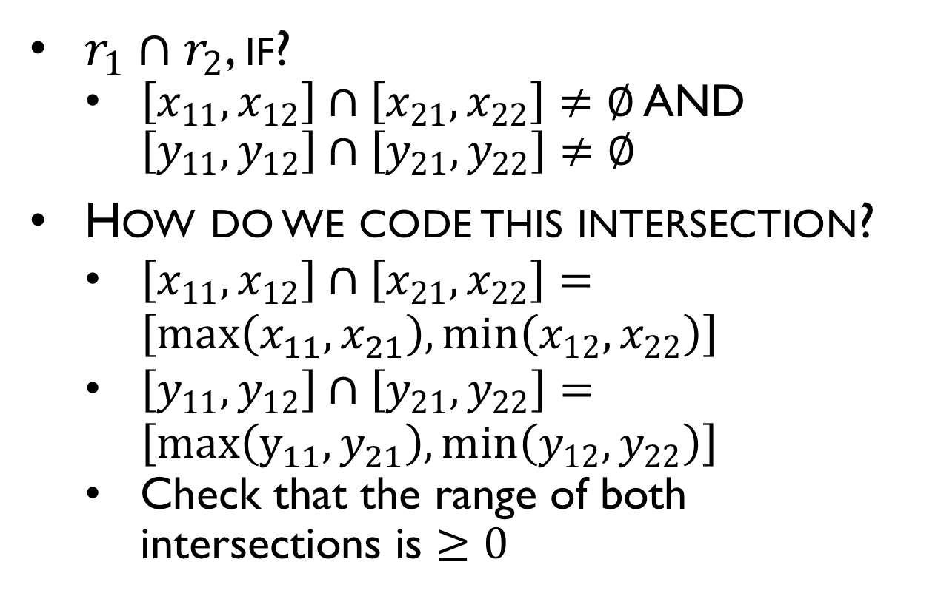

Checking if 2 Rectangles Intersect
$r_{1}∩r_{2}$, if?
$\left[x_{11},x_{12}\right]∩\left[x_{21},x_{22}\right]≠∅$ AND $\left[y_{11},y_{12}\right]∩\left[y_{21},y_{22}\right]≠∅$
How do we code this intersection?
$\left[x_{11},x_{12}\right]∩\left[x_{21},x_{22}\right]=\left[max\left(x_{11},x_{21}\right),min\left(x_{12},x_{22}\right)\right]$
$\left[y_{11},y_{12}\right]∩\left[y_{21},y_{22}\right]=\left[max\left(y_{11},y_{21}\right),min\left(y_{12},y_{22}\right)\right]$
Check that the range of both intersections is $≥0$
$$r_{2}$$
$$r_{1}$$

Slide 24
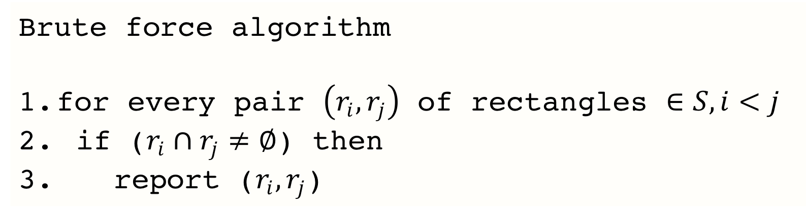
Intersection of a set of rectangles
Brute force algorithm
for every pair $\left(r_{i},r_{j}\right)$ of rectangles $∈S,i<j$
if ($r_{i}∩r_{j}≠∅$) then
report ($r_{i},r_{j}$)
r₆
r₇
r₅
r₄
r₈
r₃
r₁
r₂
Answer: (r1, r2) (r1, r3) (r1, r8) (r3, r4) (r3, r5) (r4, r5) (r7, r8)

Slide 25
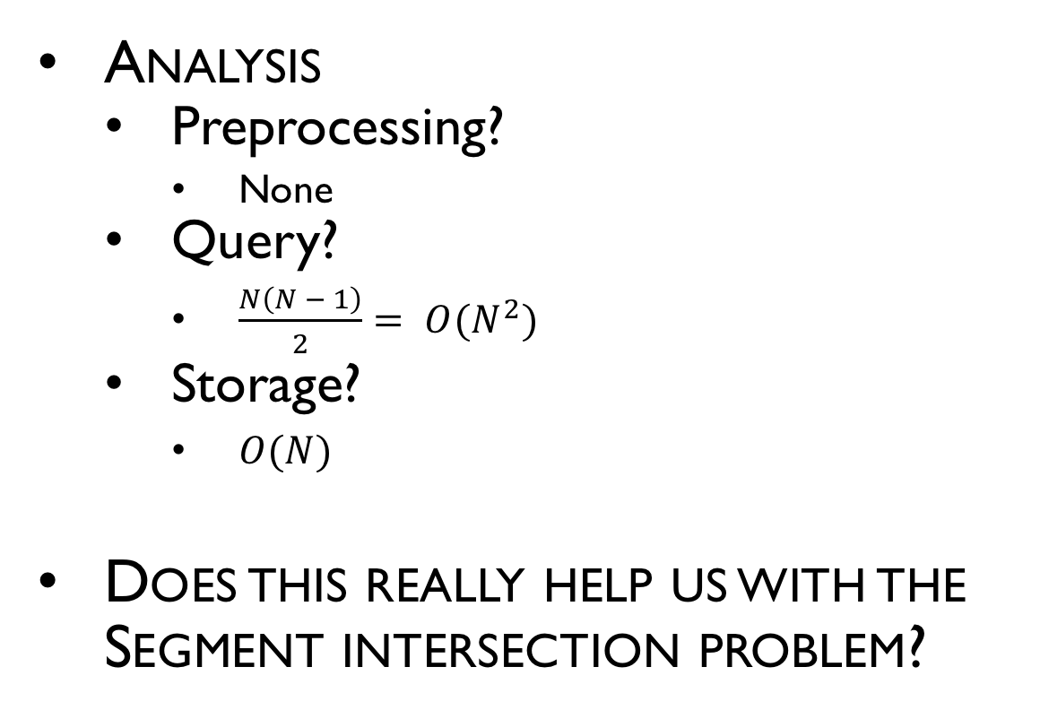
Intersection of rectangles
Analysis
Preprocessing?
None
Query?
$\frac{N\left(N − 1\right)}{2}= O(N^{2})$
Storage?
$O(N)$
Does this really help us with the Segment intersection problem?

Slide 26
1D Centered Interval Trees
Tree-based Data structure
Each node stores a center point
Intervals are placed into 3 group,
Left of center—placed in left subtree
Right of center—placed in right subtree
Covering center—placed in a specialized list*

Slide 27
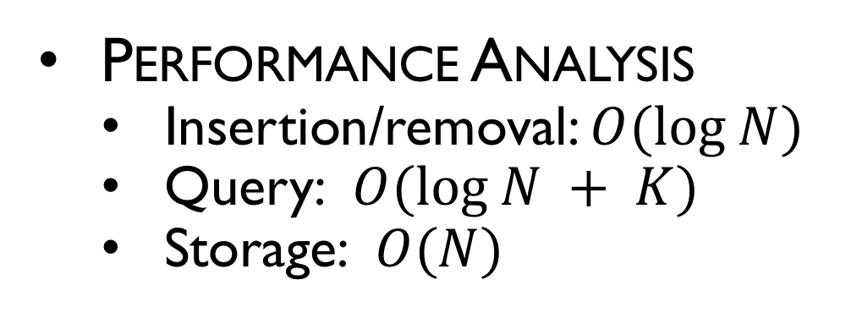
1D Centered Interval Trees
[0,4]
[6,11]
[14,22]
12
[13,16]
[19,24]
Performance Analysis
Insertion/removal: $O(log N)$
Query: $O(log N + K)$
Storage: $O(N)$
5.5
18.5
[14,22]
[0,4]
[6,11]
[13,16]
[19,24]

Slide 28
Intersection of rectangles
Algorithm using interval trees
Plane sweep algorithm, vertical (top-to-bottom) sweep Event points are Beginning and end of rectangle intervals
At the starting interval:
Compare rectangle x-interval to active set for overlap.
Add rectangle x-interval to active set.
At the ending interval:
Remove rectangle X-interval from active set.
Active set maintained in interval tree.

Slide 29
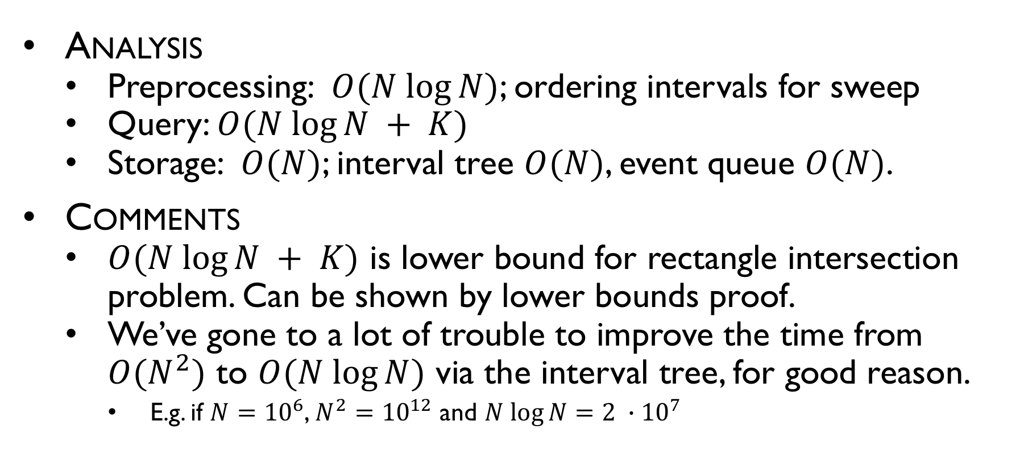
Intersection of rectangles
Analysis
Preprocessing: $O(N log⁡N)$; ordering intervals for sweep
Query: $O(N log⁡N + K)$
Storage: $O(N)$; interval tree $O(N)$, event queue $O(N)$.
Comments
$O(N log⁡N + K)$ is lower bound for rectangle intersection problem. Can be shown by lower bounds proof.
We’ve gone to a lot of trouble to improve the time from $O(N^{2})$ to $O(N log⁡N)$ via the interval tree, for good reason.
E.g. if $N={10}^{6}$, $N^{2}={10}^{12}$ and $N log⁡N=2 ∙{10}^{7}$

Slide 30
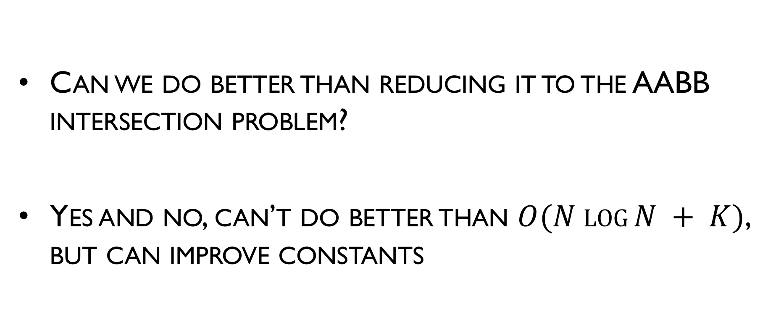
Back to the Segment Intersection Problem
Can we do better than reducing it to the AABB intersection problem?
Yes and no, can’t do better than $O(N log⁡N + K)$, but can improve constants

Slide 31
Sweep Algorithm

Slide 32
Sweep Algorithm

Slide 33
Sweep Algorithm – Where do Events Occur?

Slide 34
Events
When do the events happen?
When the sweep is:
At an upper endpoint of the line segment;
At a lower endpoint of the line segment; or
At an intersection point of line segments
At each type, the status changes

Slide 35
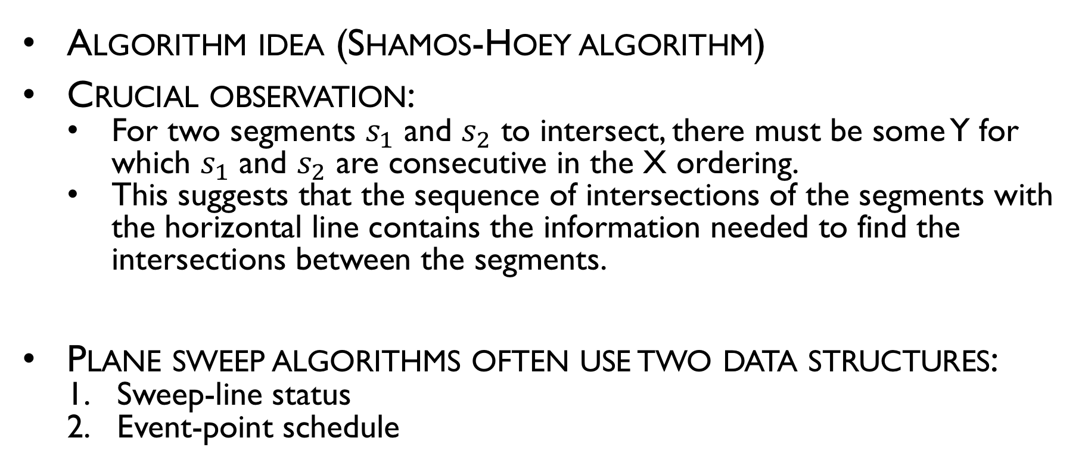
Intersection of line segments
Algorithm idea (Shamos-Hoey algorithm)
Crucial observation:
For two segments $s_{1}$ and $s_{2}$ to intersect, there must be some Y for which $s_{1}$ and $s_{2}$ are consecutive in the X ordering.
This suggests that the sequence of intersections of the segments with the horizontal line contains the information needed to find the intersections between the segments.
Plane sweep algorithms often use two data structures:
Sweep-line status
Event-point schedule

Slide 36
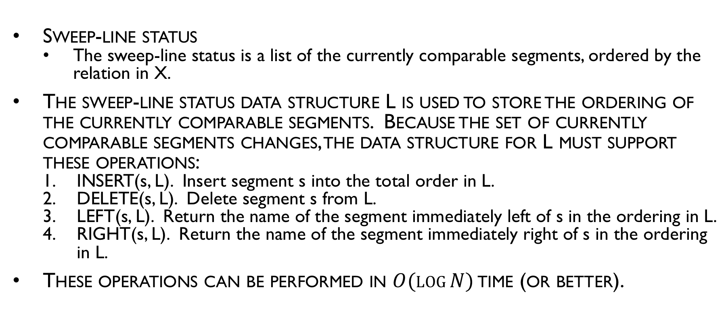
Intersection of line segments
Sweep-line status
The sweep-line status is a list of the currently comparable segments, ordered by the relation in X.
The sweep-line status data structure L is used to store the ordering of the currently comparable segments. Because the set of currently comparable segments changes, the data structure for L must support these operations:
INSERT(s, L). Insert segment s into the total order in L.
DELETE(s, L). Delete segment s from L.
LEFT(s, L). Return the name of the segment immediately left of s in the ordering in L.
RIGHT(s, L). Return the name of the segment immediately right of s in the ordering in L.
These operations can be performed in $O(log⁡N)$ time (or better).

Slide 37
Intersection of line segments
Event-point schedule
As the sweep-line is swept from top to bottom, the set of the currently comparable segments and/or their ordering by the relation of X changes at a finite set of y values; those are known as events.
The events for this problem are segment endpoints and segment intersections. The event-point schedule data structure E is used to store events prior to their processing. For E the following operations are needed:
MIN(E). Determine the smallest element in E (based on y), return it, and delete it.
INSERT(p, E). Insert abscissa p, representing an event, into E.
MEMBER(p, E). Determine if abscissa p is a member of E.
The priority queue data structure can perform all of these operations in O(log N) time.

Slide 38
Sweep Algorithm

Slide 39
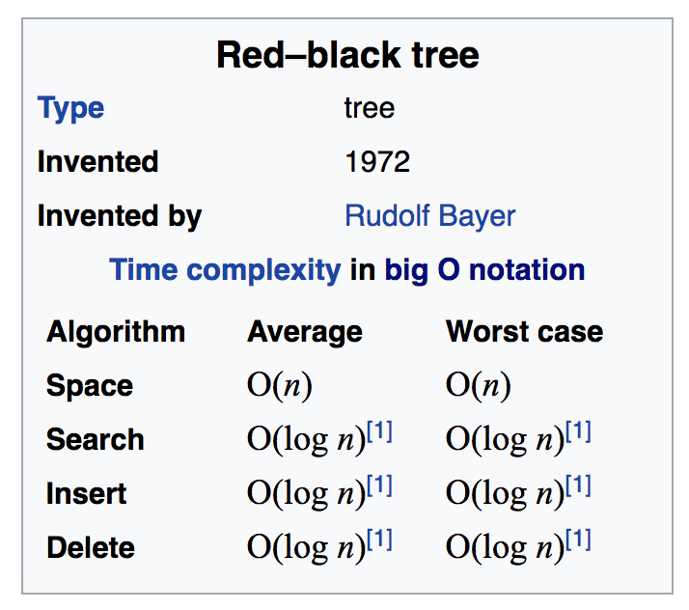
What Data Structures Should We Use?
Self-balancing trees (AVL, Red-black)

Slide 40
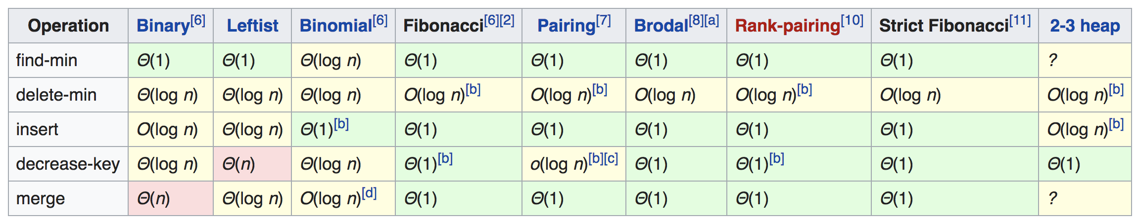
What Data Structures Should We Use?
Priority Queue

Slide 41
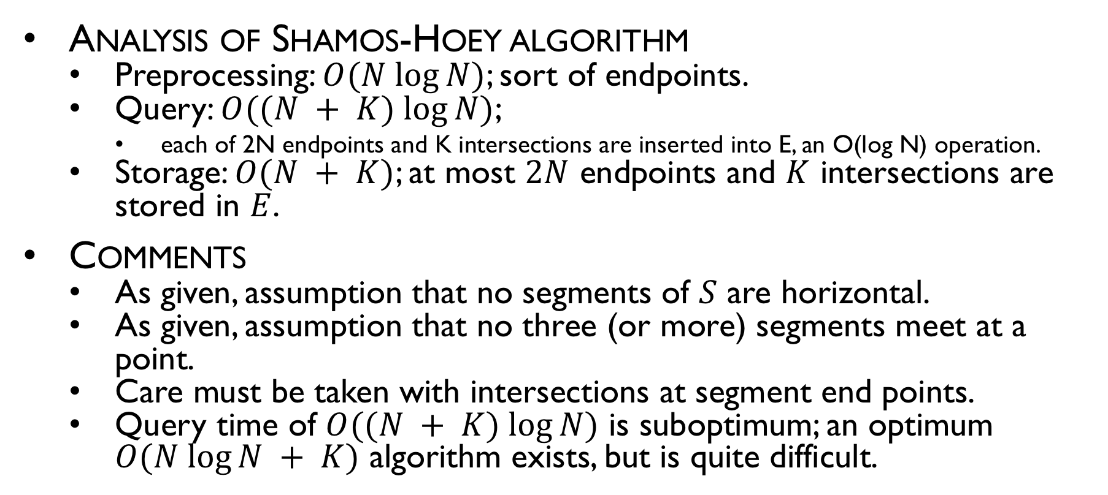
Intersection of line segment
Analysis of Shamos-Hoey algorithm
Preprocessing: $O(N log⁡N)$; sort of endpoints.
Query: $O((N + K) log⁡N)$;
each of 2N endpoints and K intersections are inserted into E, an O(log N) operation.
Storage: $O(N + K)$; at most $2N$ endpoints and $K$ intersections are stored in $E$.
Comments
As given, assumption that no segments of $S$ are horizontal.
As given, assumption that no three (or more) segments meet at a point.
Care must be taken with intersections at segment end points.
Query time of $O((N + K) log⁡N)$ is suboptimum; an optimum $O(N log⁡N + K)$ algorithm exists, but is quite difficult.

Slide 42
Can we use this algorithm to find the intersection of 2 regions?

Slide 43
Run Seeep Algorithm

Slide 44
Connectivity stored as doubly linked list

Slide 45
Walk the graph

Slide 46
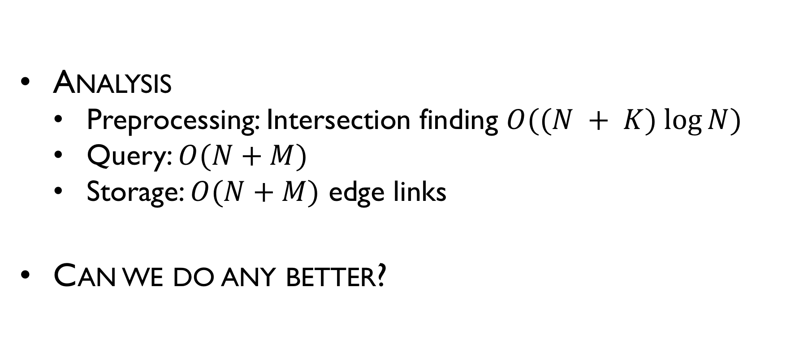
Intersection of line segment
Analysis
Preprocessing: Intersection finding $O((N + K) log⁡N)$
Query: $O(N+M)$
Storage: $O(N+M)$ edge links
Can we do any better?

