Slide 1
COT 4521: Introduction to Computational Geometry
Polygons

Slide 2
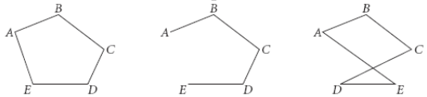
Polygon
Polygon is a region of a plane bounded by a finite collection of line segments forming a simple closed curve.
Boundary
Simple
Non-simple

Slide 3




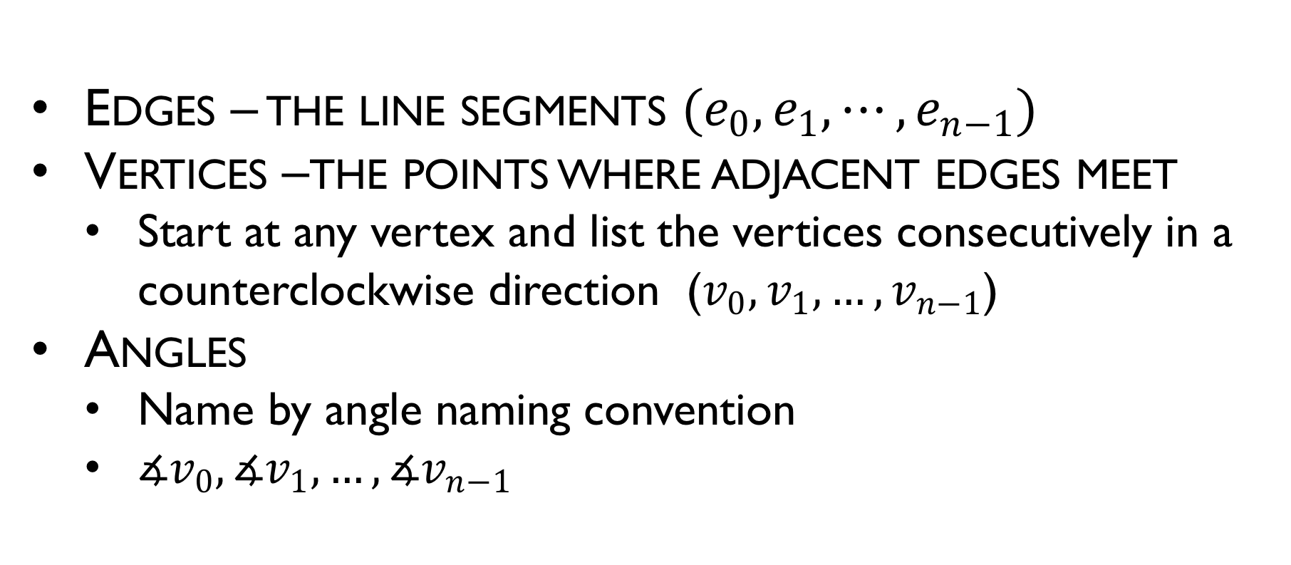






Polygon
Edges – the line segments $(e_{0}, e_{1},⋯,e_{n−1})$
Vertices –the points where adjacent edges meet
Start at any vertex and list the vertices consecutively in a counterclockwise direction ($v_{0},v_{1},…,v_{n−1}$)
Angles
Name by angle naming convention
$∡v_{0}, ∡v_{1},…, ∡v_{n−1}$
$$v_{2}$$
$$e_{1}$$
$$v_{1}$$
$$e_{2}$$
$$e_{0}$$
$$v_{3}$$
$$v_{0}$$
$$e_{3}$$
$$e_{4}$$
$$v_{4}$$

Slide 4
Properties of polygon
The line segments that make-up a polygon (called sides or edges) meet only at their endpoints, called vertices (singular: vertex) or less formally "corners"
Exactly two edges meet at every vertex
The number of edges always equals the number of vertices.
Two edges meeting at a corner are required to form an angle that is not straight (180°); otherwise, the line segments will be considered parts of a single edge

Slide 5
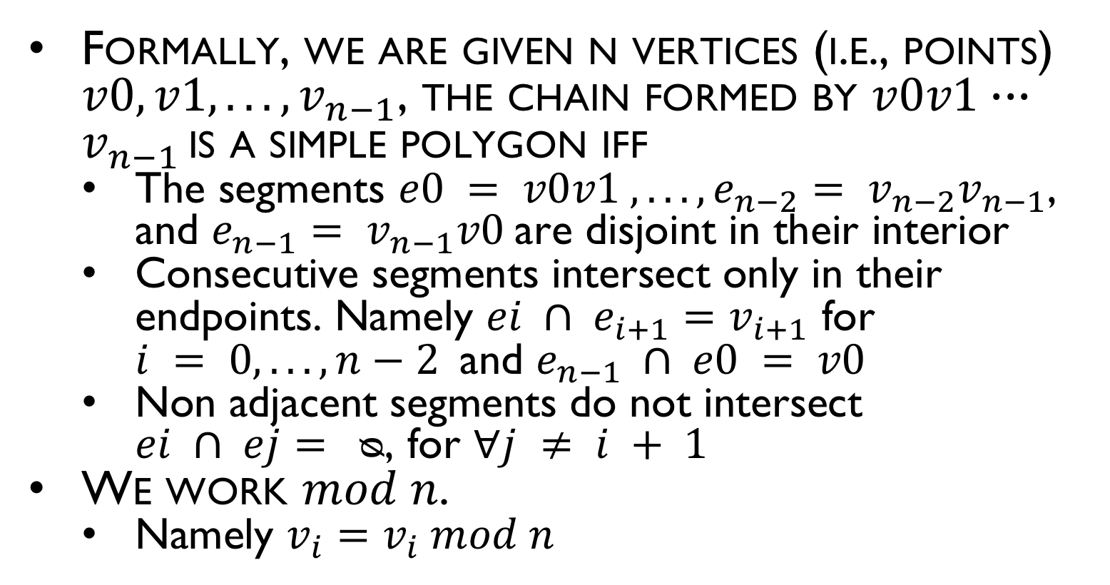
Formal Definition of a Simple Polygon
Formally, we are given n vertices (i.e., points) $v0, v1, . . . , v_{n−1}$, the chain formed by $v0v1∙∙∙v_{n−1 }$is a simple polygon iff
The segments $e0 = v0v1 , . . . , e_{n−2}= v_{n−2}v_{n−1}$, and $e_{n−1}= v_{n−1}v0$are disjoint in their interior
Consecutive segments intersect only in their endpoints. Namely $ei ∩ e_{i+1}=v_{i+1}$ for $i = 0, . . . , n−2$and $e_{n−1} ∩ e0 = v0$
Non adjacent segments do not intersect $ei ∩ ej= ᴓ$, for $∀j ≠ i + 1$
We work $mod n$.
Namely $v_{i}=v_{i} mod n$
$$v_{2}$$
$$e_{1}$$
$$v_{1}$$
$$e_{2}$$
$$e_{0}$$
$$v_{3}$$
$$v_{0}$$
$$e_{3}$$
$$e_{4}$$
$$v_{4}$$

Slide 6
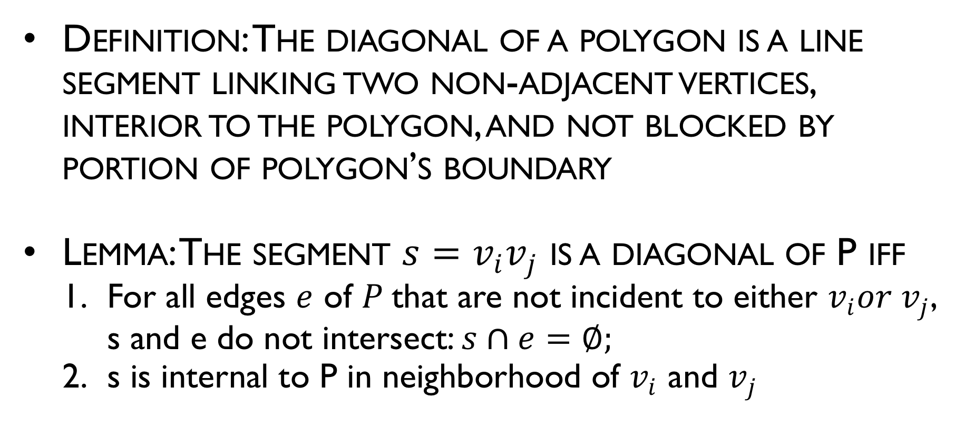
Diagonals
Definition: The diagonal of a polygon is a line segment linking two non-adjacent vertices, interior to the polygon, and not blocked by portion of polygon’s boundary
Lemma: The segment ${s=v}_{i}v_{j}$ is a diagonal of P iff
For all edges $e$ of $P$that are not incident to either $v_{i}{or v}_{j}$, s and e do not intersect: $s∩e=∅;$
s is internal to P in neighborhood of $v_{i}$ and $v_{j}$

Slide 7
Diagonals
Definition: The diagonal of a polygon is a line segment linking two non-adjacent vertices, interior to the polygon, and not blocked by portion of polygon’s boundary
Diagonal

Slide 8
Diagonals
Definition: The diagonal of a polygon is a line segment linking two non-adjacent vertices, interior to the polygon, and not blocked by portion of polygon’s boundary
which are legal diagonals?

Slide 9
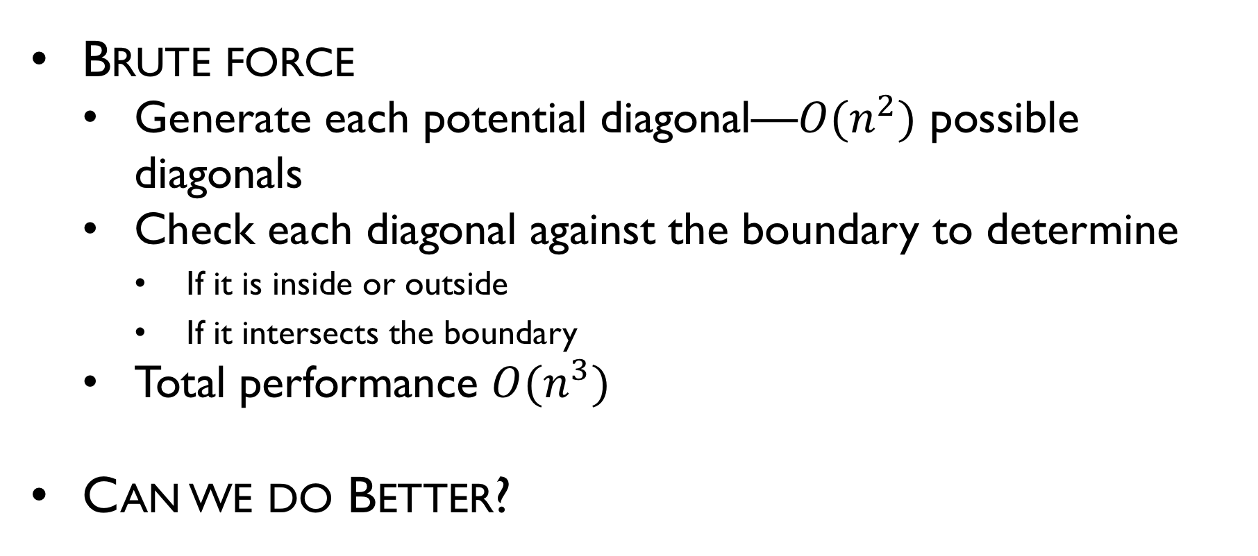
Efficient Diagonal Finding
Brute force
Generate each potential diagonal—$O(n^{2})$ possible diagonals
Check each diagonal against the boundary to determine
If it is inside or outside
If it intersects the boundary
Total performance $O(n^{3})$
Can we do Better?

Slide 10
Efficient Diagonal Finding
Variation on a sweep algorithm
From a given vertex, sweep both clockwise and counterclockwise, ordered by the distance of points
Retain a notion of “valid space” for diagonals

Slide 11
Efficient Diagonal Finding

Slide 12
Efficient Diagonal Finding

Slide 13
Efficient Diagonal Finding

Slide 14
Efficient Diagonal Finding

Slide 15
Efficient Diagonal Finding

Slide 16
Efficient Diagonal Finding

Slide 17
Efficient Diagonal Finding

Slide 18
Efficient Diagonal Finding

Slide 19
Efficient Diagonal Finding

Slide 20
Efficient Diagonal Finding

Slide 21
Efficient Diagonal Finding

Slide 22
Efficient Diagonal Finding

Slide 23
Efficient Diagonal Finding

Slide 24

Efficient Diagonal Finding
Analysis
Preprocessing: None
Query: Worst case $O(n^{2})$; $O(n)$ per vertex
Storage: $O(n)$

Slide 25
Triangulation Theory: Properties
Lemma: An internal diagonal exists between any two nonadjacent vertices of a polygon P if and only if P is convex polygon.
Proof: The proof consists of two parts, both established by contradiction.

Slide 26
Classification of Polygons by the Number of Edges
Most Common Polygons
Number of Sides | Name
3 | Triangle
4 | Quadrilateral
5 | Pentagon
6 | Hexagon
8 | Octagon
9 | Nonagon
10 | Decagon
12 | Dodecagon
n | n-gon

