Slide 1
COT 4521: Introduction to Computational Geometry
Polygons (part 2)

Slide 2



Point inside a polygon test
How can we tell if point $A$ is inside of polygon $P$?
$$P$$
$$A$$

Slide 3
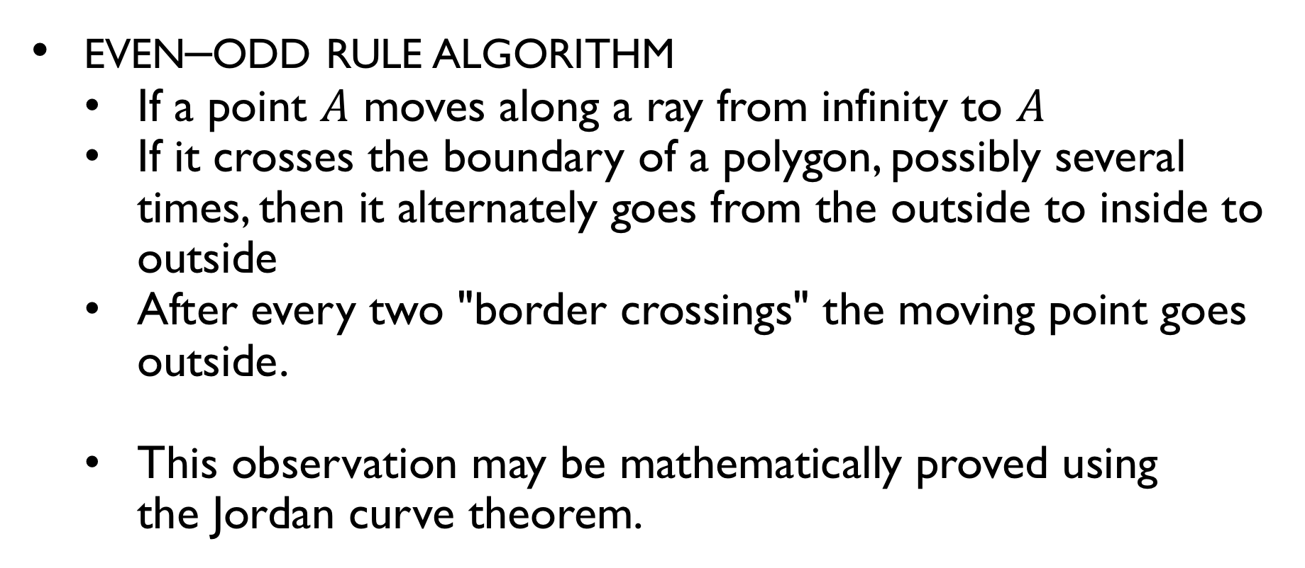
Point inside a polygon test
even–odd rule algorithm
If a point $A$ moves along a ray from infinity to $A$
If it crosses the boundary of a polygon, possibly several times, then it alternately goes from the outside to inside to outside
After every two "border crossings" the moving point goes outside.
This observation may be mathematically proved using the Jordan curve theorem.

Slide 4
Point inside a polygon test
How can we tell if point $A$ is inside of polygon $P$?
$$P$$
$$A$$

Slide 5
Sum of Angles
The sum of the internal angles of a polygon of n vertices is?
$$P$$

Slide 6
Sum of Angles
Use the Triangle Angle-Sum Theorem to find the sum of the measures of the angles of a polygon.
Triangle Angle-Sum Theorem
The sum of the measures of the angles of a triangle measure 180º

Slide 7
Sum of Angles
Theorem: The sum of the measures of the internal angles of an n-gon is (n - 2) *180.
Proof by induction

Slide 8
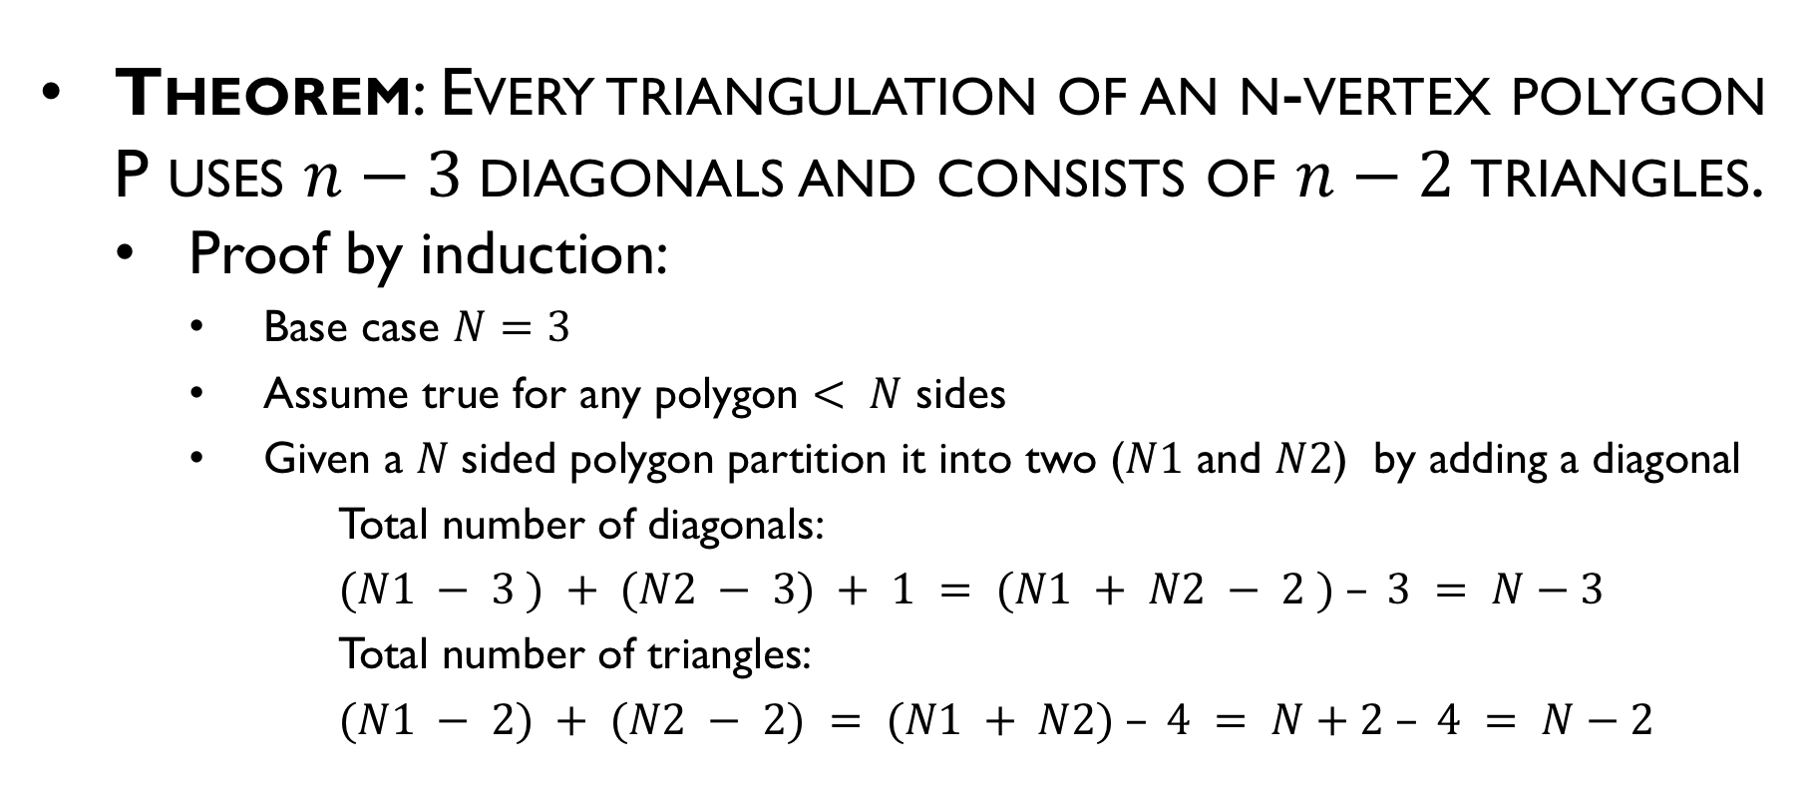
Triangulation Theory
Theorem: Every triangulation of an n-vertex polygon P uses $n−3$diagonals and consists of $n−2$triangles.
Proof by induction:
Base case $N=3$
Assume true for any polygon $< N$ sides
Given a $N$sided polygon partition it into two ($N1$ and $N2$) by adding a diagonal
Total number of diagonals:
$(N1 − 3 ) + (N2 − 3) + 1 = (N1 + N2 − 2 ) – 3 = N−3$
Total number of triangles:
$(N1 − 2) + (N2 − 2) = (N1 + N2) – 4 = N+2 – 4 = N−2$

Slide 9
Triangulation Example
9 vertices
7 triangles
6 diagonals

Slide 10
Area of a Polygon
What is the area of the polygon

Slide 11








Area of a triangle
$$c$$
$$area=0.5\left|a−b\right|\left|c−d\right|$$
$$a$$
$$b$$
$$d$$
$$Z$$
$$area\left(blue+green\right)=\left|\left(\vec{b−a}\right)×\left(\vec{c−a}\right)\right|$$
$$X$$
$$Y$$

Slide 12
Sum of Areas
Area of the polygon can be found by adding the areas of a triangulation

Slide 13

Another way of computing area
$$Area (T)=Area(p,b,c)+Area(p,c,a)+Area(p,a,b)$$
c
b
a
p

Slide 14
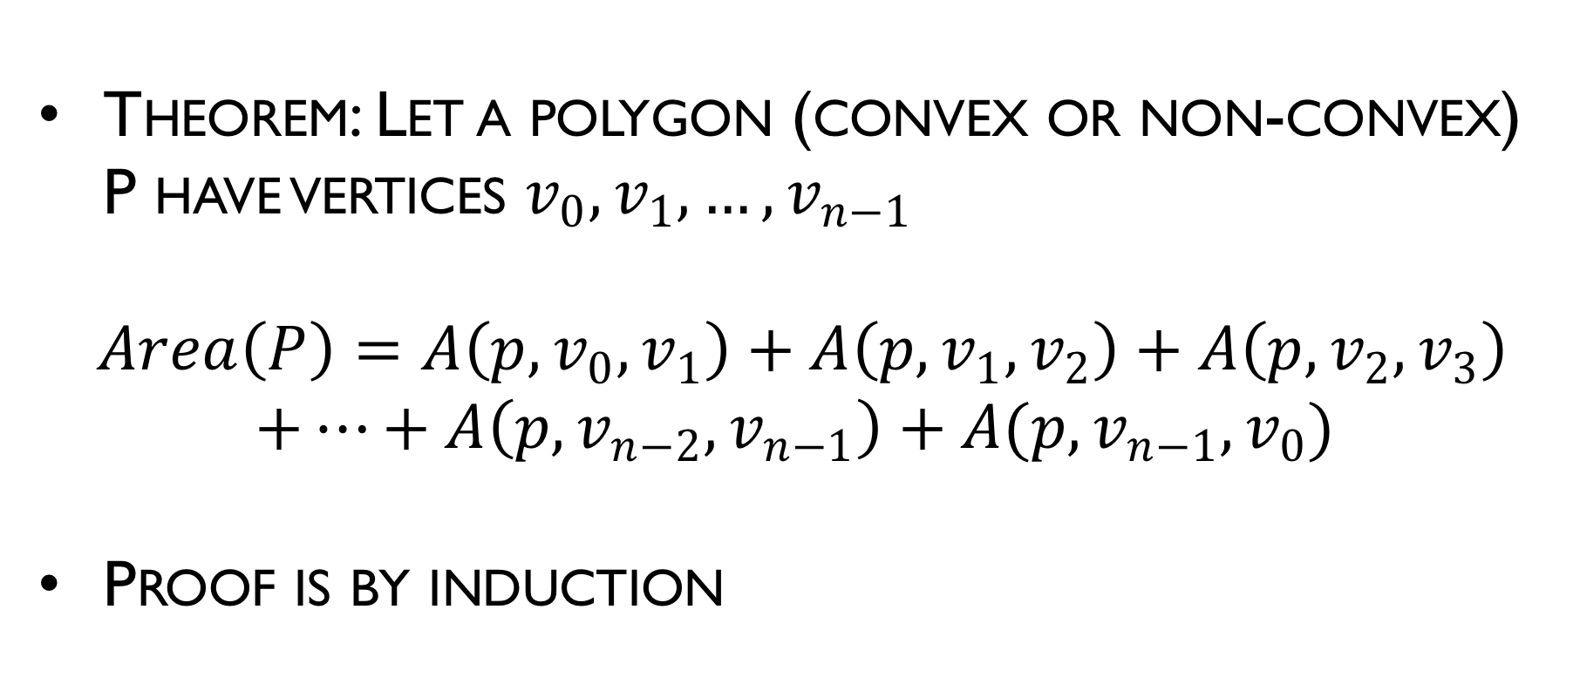
Area of Polygon
Theorem: Let a polygon (convex or non-convex) P have vertices $v_{0},v_{1},…,v_{n−1}$
$$Area\left(P\right)=A\left(p,v_{0},v_{1}\right)+A\left(p,v_{1},v_{2}\right)+A\left(p,v_{2},v_{3}\right)$$ $+…+A\left(p,v_{n−2},v_{n−1}\right)+A(p,v_{n−1},v_{0})$
Proof is by induction

Slide 15

Area of triangle
Heron’s formula:
$Area=sqrt\left(s\left(s−a\right)\left(s−b\right)\left(s−c\right)\right)$
where $s=\left(a+b+c\right)/2$ is the semiperimeter
A
b
c
C
a
B

Slide 16
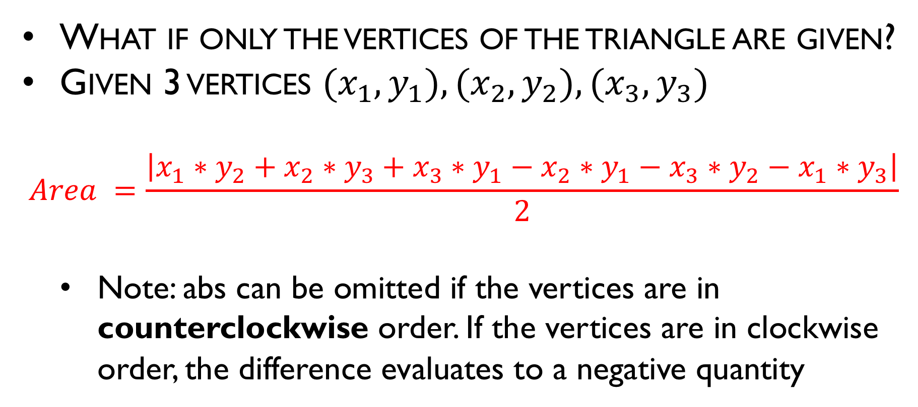
Area of triangle
What if only the vertices of the triangle are given?
Given 3 vertices $(x_{1}, y_{1}), (x_{2}, y_{2}), (x_{3}, y_{3})$
$$Area =\frac{\left|x_{1}∗y_{2}+x_{2}∗y_{3}+x_{3}∗y_{1}−x_{2}∗y_{1}−x_{3}∗y_{2}−x_{1}∗y_{3}\right|}{2}$$
Note: abs can be omitted if the vertices are in counterclockwise order. If the vertices are in clockwise order, the difference evaluates to a negative quantity

Slide 17
Area of triangle
That hard-to-memorize expression can be written this way:
Area = ½ *
-
x1 | y1
x2 | y2
x3 | y3
x1 | y1
+

Slide 18
Area of convex polygon
It turns out the previous formula still works!
Area = ½ *
x1 | y1
x2 | y2
x3 | y3
x4 | y4
x5 | y5
x1 | y1
-
(x3, y3)
(x4, y4)
+
(x2, y2)
(x5, y5)
(x1, y1)

Slide 19
Area of (non-convex) polygon
Miraculously, the same formula still holds for non-convex polygons!
Area = ½ * …

Slide 20
Point inside convex polygon?
Given a convex polygon and a point, is the point contained inside the polygon?
Assume the vertices are given in counterclockwise order for convenience
outside
inside
inside (definition may change)

Slide 21
Detour – Is polygon convex?
A quick question – how to tell if a polygon is convex?
Answer: It is convex if and only if every turn (at every vertex) is a left turn
Whether a “straight” turn is allowed depends on the problem definition
Our crossProd function is so useful

Slide 22
Point inside convex polygon?
Consider the turn p → p1 → p2
If p does lie inside the polygon, the turn must not be a right turn
Also holds for other edges (mind the directions)
p
p2
p1

Slide 23
Point inside convex polygon?
Conversely, if p was outside the polygon, there would be a right turn for some edge
p

Slide 24
Point inside convex polygon
Conclusion: p is inside the polygon if and only if it makes a non-left turn for every edge (in the counterclockwise direction)

Slide 25
Point inside (non-convex) polygon
Such a pain

Slide 26
Point inside polygon
Ray casting algorithm
Cast a ray from the point along some direction
Count the number of times it non-degenerately intersects the polygon boundary
Odd: inside; even: outside

Slide 27
Point inside polygon
Problematic cases: Degenerate intersections

Slide 28
Point inside polygon
Solution: Pick a random direction (i.e. random slope). If the ray hits a vertex of the polygon, pick a new direction. Repeat.

