Slide 1
COT 4521: Introduction to Computational Geometry
Delaunay Triangulation

Slide 2
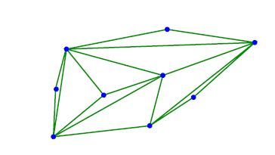
Triangulation of a point-set
Definition (Point-set triangulation)
Given a set S of n points in R², a triangulation of S is a planar graph with vertex set S, such that all the bounded faces are triangles, and these faces form a partition of the convex hull CH(S) of S.

Slide 3
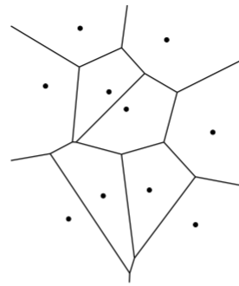
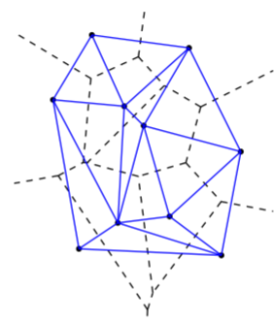
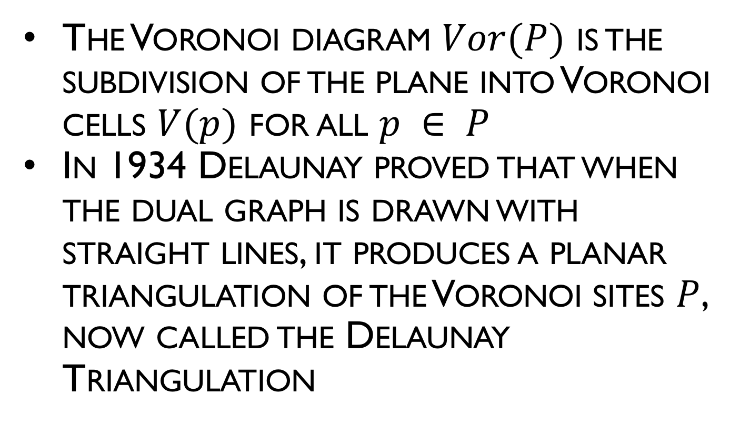
Delaunay Triangulations
The Voronoi diagram $Vor(P)$ is the subdivision of the plane into Voronoi cells $V(p)$ for all $p ∈ P$
In 1934 Delaunay proved that when the dual graph is drawn with straight lines, it produces a planar triangulation of the Voronoi sites $P$, now called the Delaunay Triangulation

Slide 4
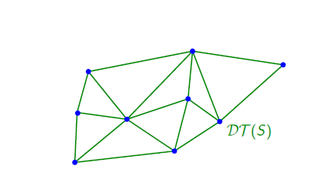
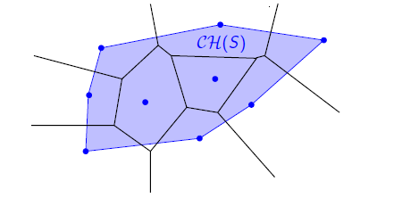
The Delaunay Triangulation
The Delaunay triangulation of the same set.
It has many interesting properties.

Slide 5
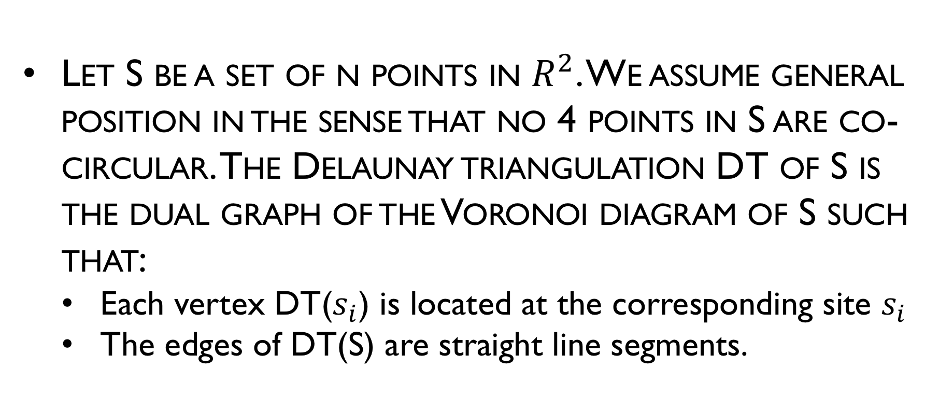
The Delaunay Triangulation
Let S be a set of n points in $R^{2}$. We assume general position in the sense that no 4 points in S are co-circular. The Delaunay triangulation DT of S is the dual graph of the Voronoi diagram of S such that:
Each vertex DT($s_{i}$) is located at the corresponding site $s_{i}$
The edges of DT(S) are straight line segments.

Slide 6
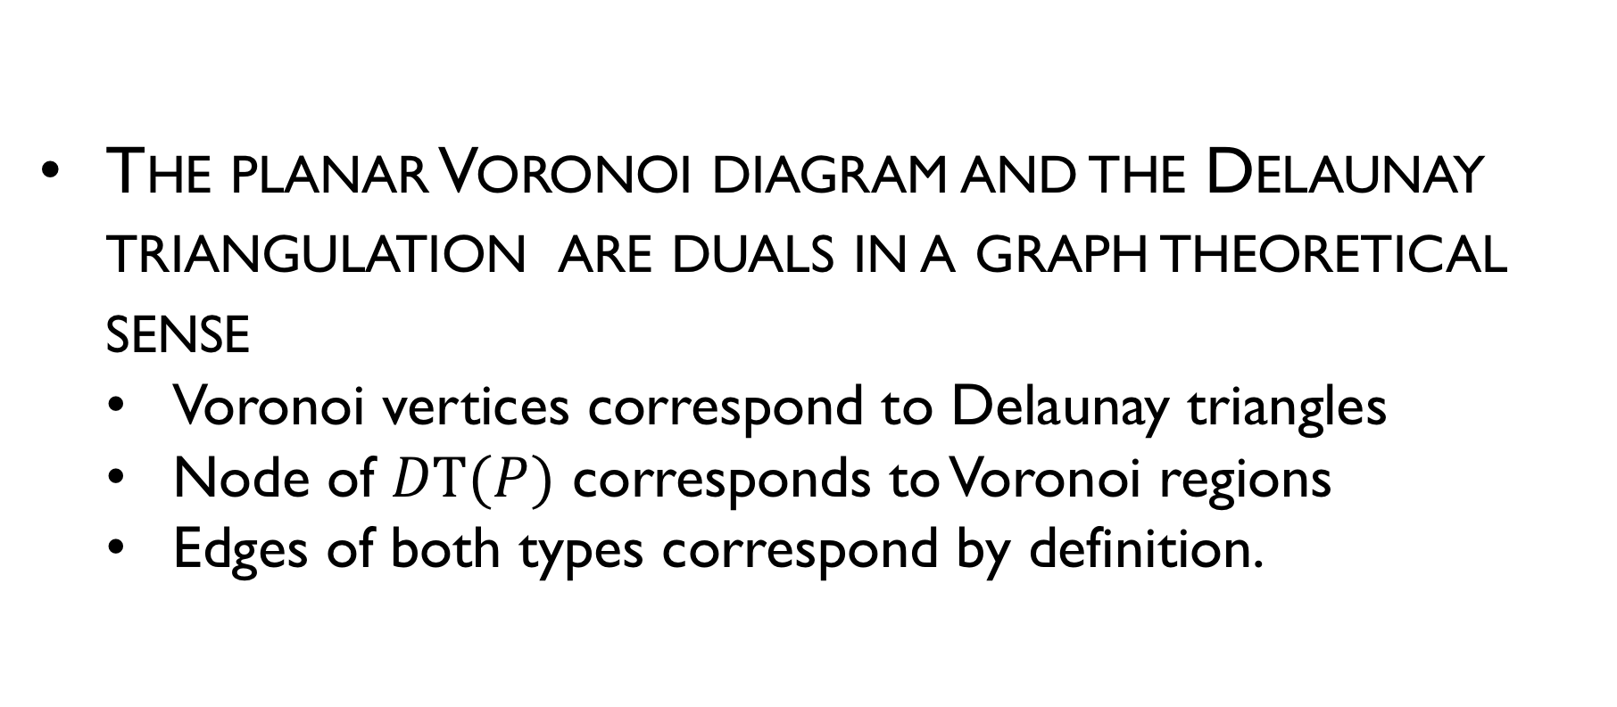
Properties of Delaunay Triangulations
The planar Voronoi diagram and the Delaunay triangulation are duals in a graph theoretical sense
Voronoi vertices correspond to Delaunay triangles
Node of $DT(P)$ corresponds to Voronoi regions
Edges of both types correspond by definition.

Slide 7
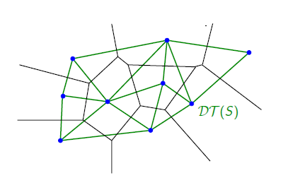
The Delaunay Triangulation
DT over VD
Face of DT(S) ⬄ vertex of VD(S)
Node of DT(S) ⬄ sites of VD(S)
Edges of DT(S) ⬄ edges of VD(S)
Boundary of DT(S): convex hull
Interior of each DT(S) face do not contain any cite

Slide 8
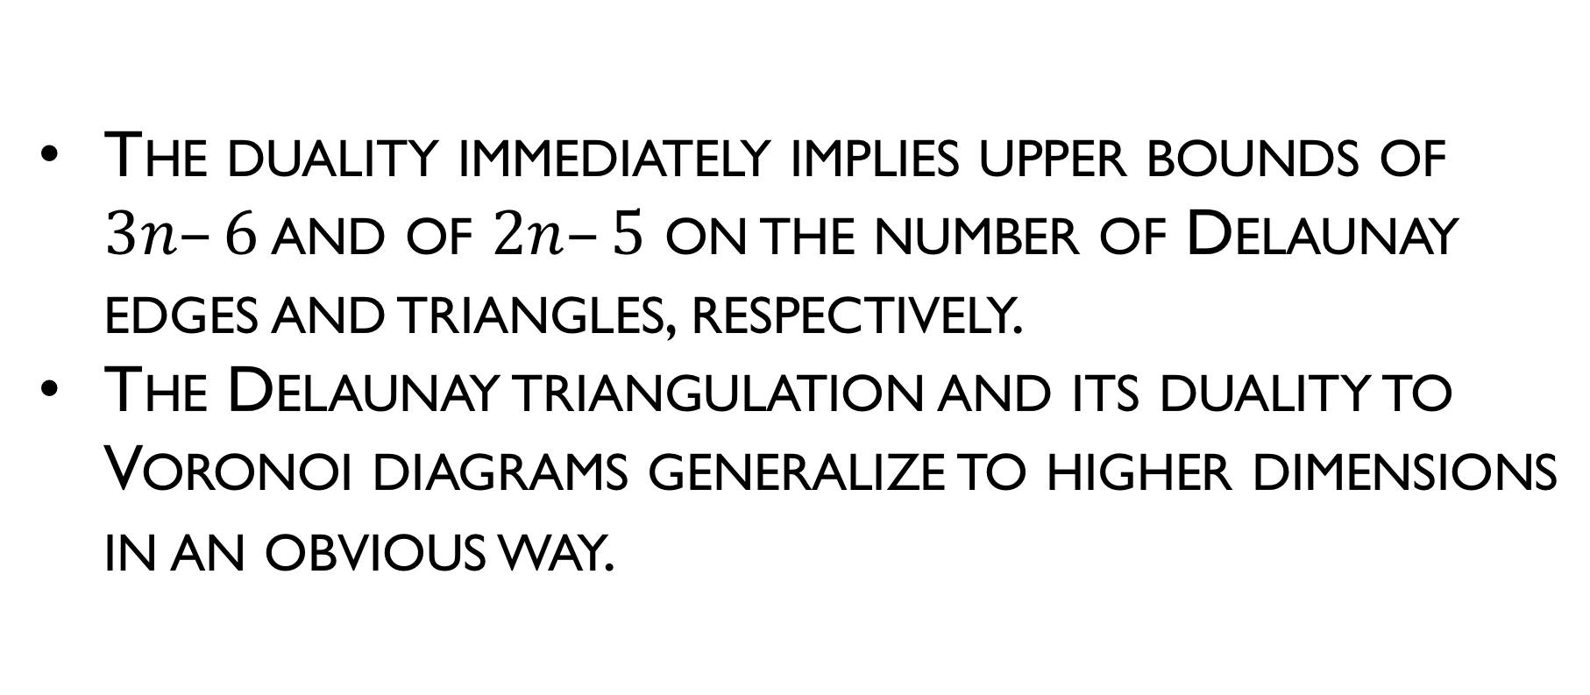
Properties of Delaunay Triangulations
The duality immediately implies upper bounds of $3n–6$ and of $2n–5$ on the number of Delaunay edges and triangles, respectively.
The Delaunay triangulation and its duality to Voronoi diagrams generalize to higher dimensions in an obvious way.

Slide 9
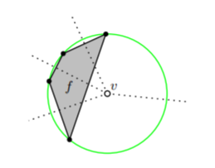
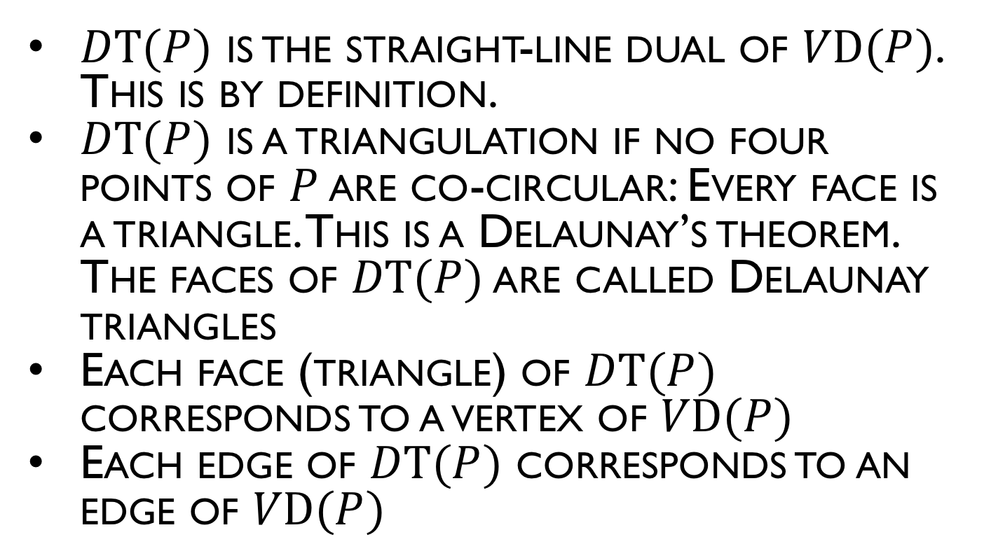
Properties of Delaunay Triangulations
$DT(P)$ is the straight-line dual of $VD(P)$. This is by definition.
$DT(P)$ is a triangulation if no four points of $P$ are co-circular: Every face is a triangle. This is a Delaunay’s theorem. The faces of $DT(P)$ are called Delaunay triangles
Each face (triangle) of $DT(P)$ corresponds to a vertex of $VD(P)$
Each edge of $DT(P)$ corresponds to an edge of $VD(P)$

Slide 10
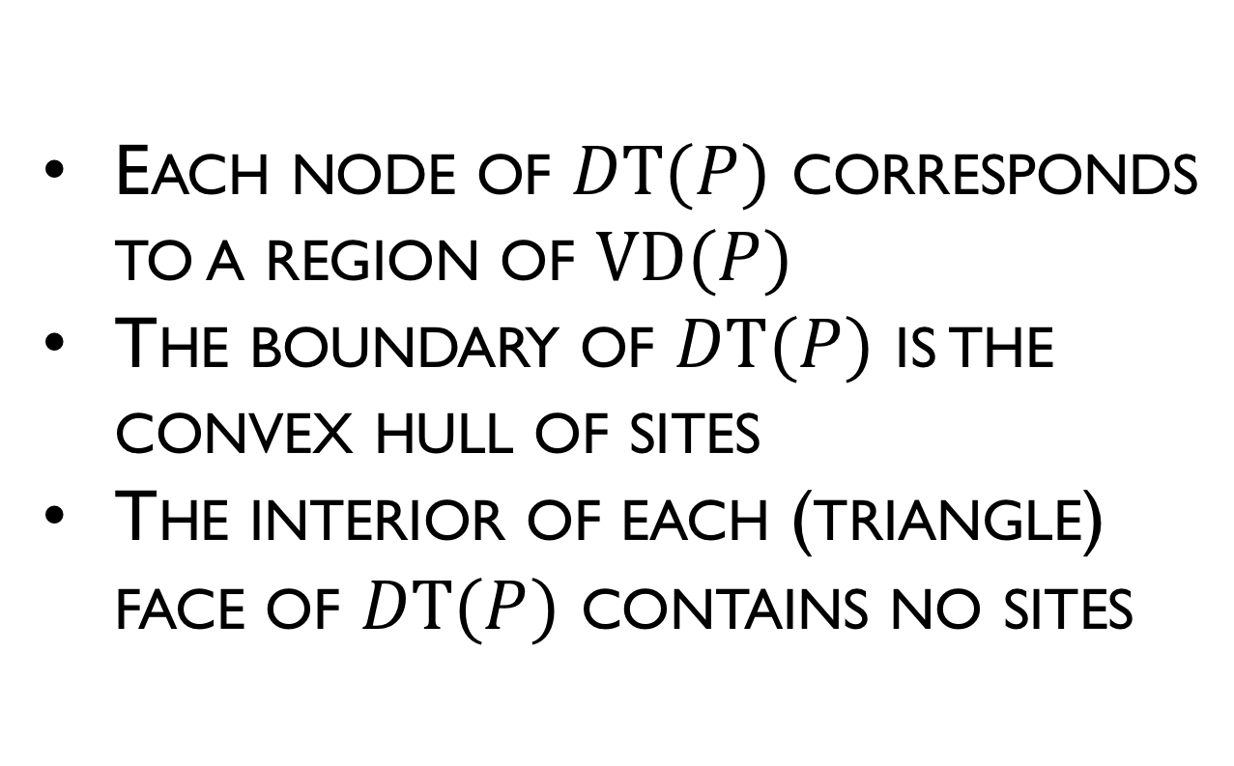
Properties of Delaunay Triangulations
Each node of $DT(P)$ corresponds to a region of $VD(P)$
The boundary of $DT(P)$ is the convex hull of sites
The interior of each (triangle) face of $DT(P)$ contains no sites

Slide 11
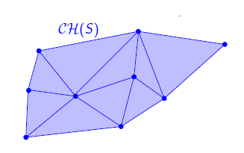

Convex Hull
The boundary of $DT(S)$ is convex hull of the sites.

Slide 12
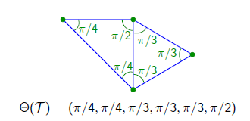
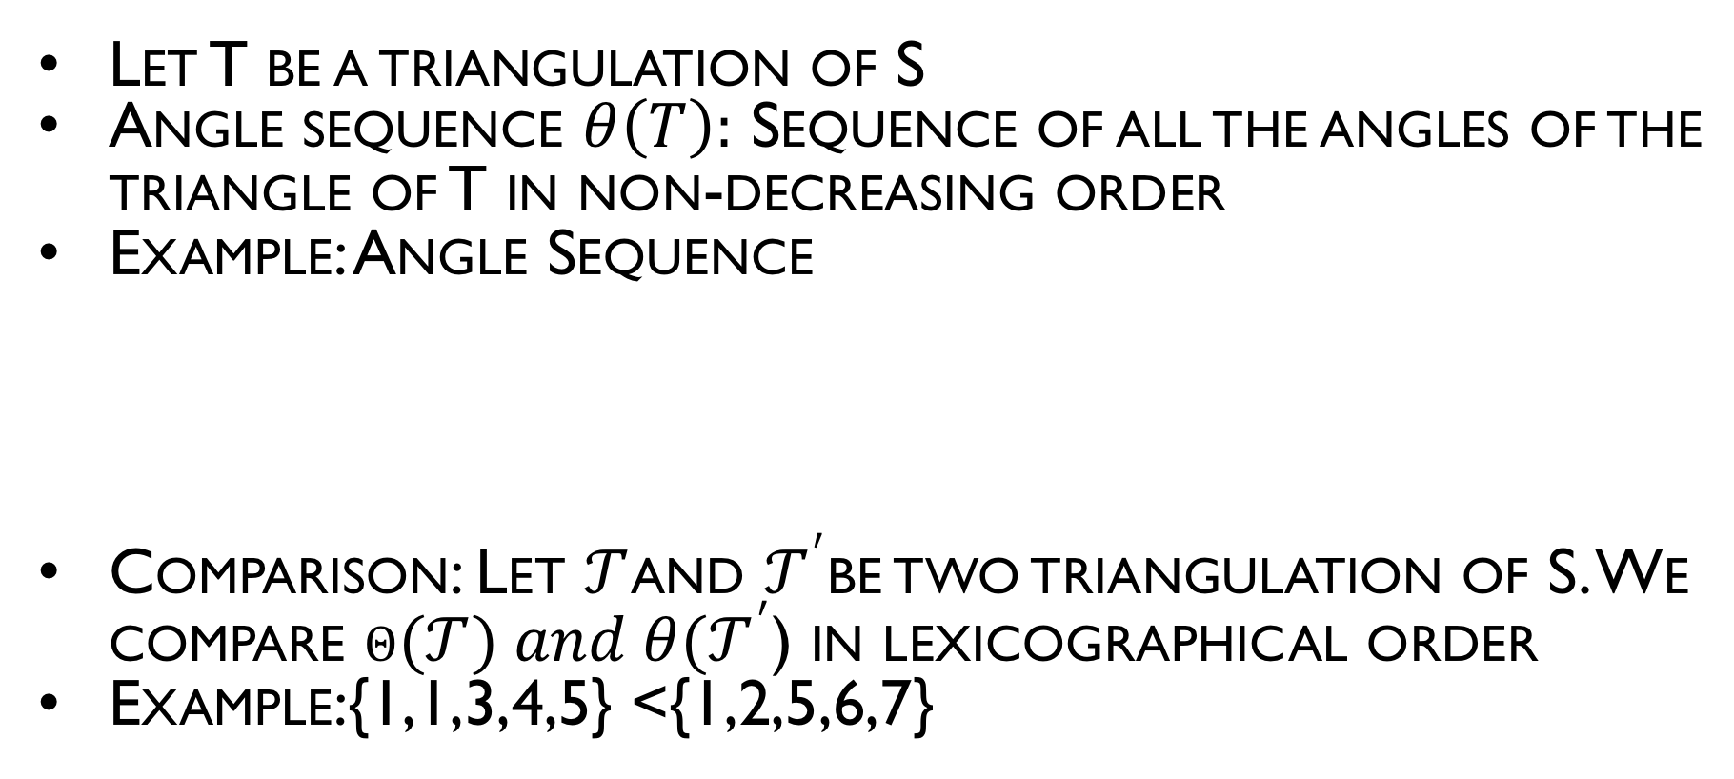
Triangulation Maximizing the Minimum Angle
Let T be a triangulation of S
Angle sequence $θ\left(T\right):$ Sequence of all the angles of the triangle of T in non-decreasing order
Example: Angle Sequence
Comparison: Let $𝒯$and $𝒯^{′}$be two triangulation of S. We compare $θ(𝒯) and {θ(𝒯}^{′}$) in lexicographical order
Example:{1,1,3,4,5} <{1,2,5,6,7}

Slide 13
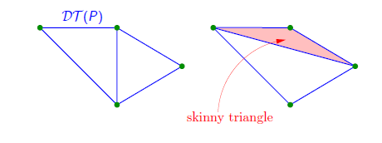
Optimality of the Delaunay Triangulation
Theorem: Let S be a set of points in general position. Then the angle sequence of DT (S) is maximal among all triangulations of S.
So the Delaunay triangulation maximizes the minimum angle.
Intuition: Avoids skinny triangles.

Slide 14
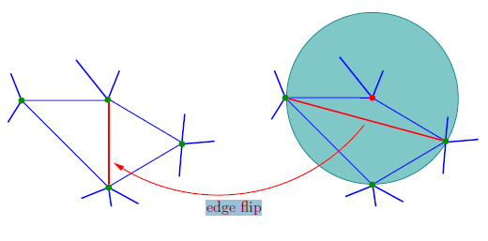
Optimality of the Delaunay Triangulation
Proof: Idea
Flip edges to ensure the circumcircle property.
It increases the angle sequence.

Slide 15
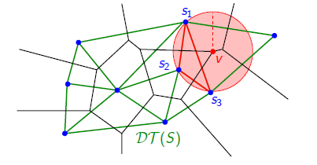
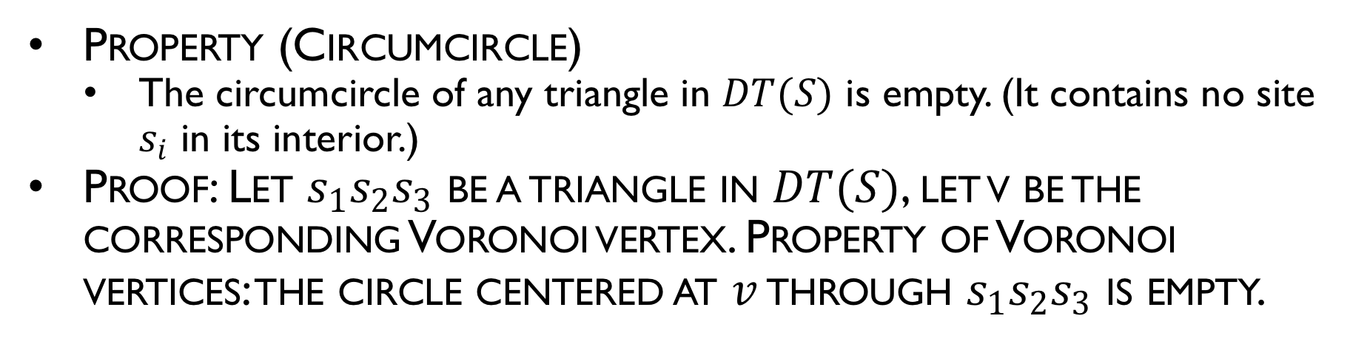
Circumcircle Property
Property (Circumcircle)
The circumcircle of any triangle in $DT(S)$ is empty. (It contains no site $s_{i}$ in its interior.)
Proof: Let $s_{1}s_{2}s_{3}$ be a triangle in $DT(S)$, let v be the corresponding Voronoi vertex. Property of Voronoi vertices: the circle centered at $v$ through $s_{1}s_{2}s_{3}$ is empty.

Slide 16
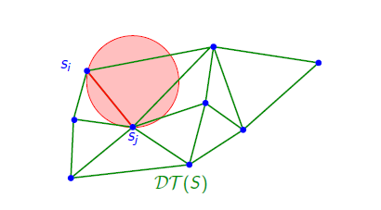
Empty Circle Property
Property (Empty circle)
(s_{i} s_{j} ) is an edge of DT (S) iff there is an empty circle through s_{i} and s_{j} .

Slide 17
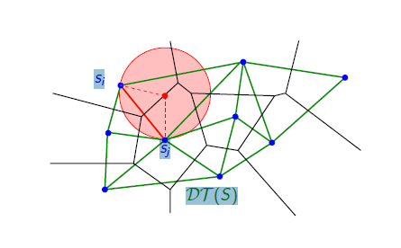
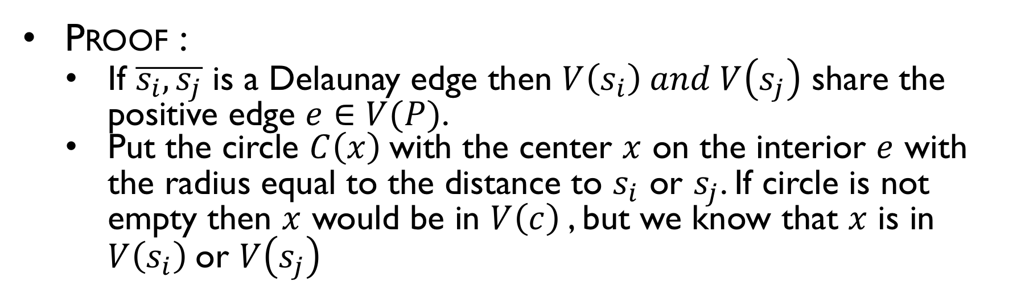
Empty Circle Property
Proof :
If $\overline{s_{i},s_{j}}$ is a Delaunay edge then $V\left(s_{i}\right) and V\left(s_{j}\right)$ share the positive edge $e∈V(P)$.
Put the circle $C\left(x\right)$with the center $x$ on the interior $e$ with the radius equal to the distance to $s_{i}$ or $s_{j}$. If circle is not empty then $x$ would be in $V\left(c\right)$, but we know that $x$ is in $V\left(s_{i}\right)$or $V\left(s_{j}\right)$

Slide 18
Delaunay-ization of a triangulation
Any triangulation of the convex hull can be converted into a Delaunay triangulation by repeatedly test the empty circle property.
If any edge “fails” the test, it is swapped with a new edge between the connecting triangles

