Slide 1
COT 4521: Introduction to Computational Geometry
Convex Polygon Intersection

Slide 2
Problem description
Here we consider a category of related intersection construction problems: Given two (or more) geometric objects, construct a new object which is their intersection.
The objects dealt with will be polygons, polyhedra, half-planes, half-spaces, and related types.
The objects will generally be specified by their vertices and orientations to identify the interior of the object. (The latter may be given by convention.)

Slide 3
Brief set theory Review
A
B

Slide 4
set theory—union: A ∪ B
A
B

Slide 5
set theory—intersection: A ∩ B
A
B

Slide 6
set theory—set difference: A \ B
A
B

Slide 7
set theory—symmetric difference: A ⊖ B
A
B

Slide 8
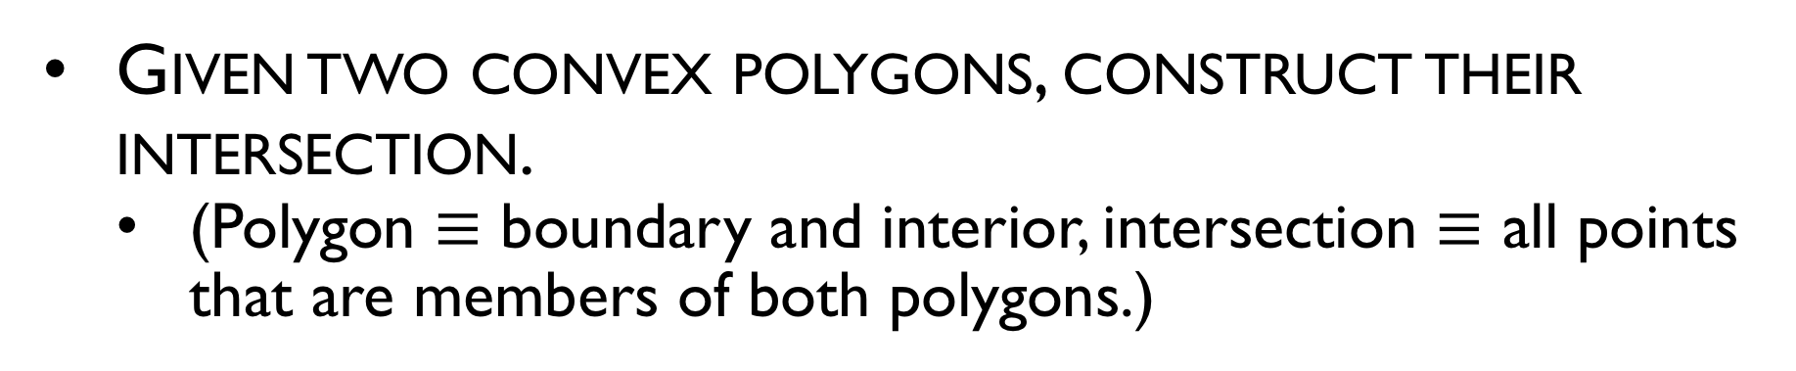
Intersection example
Given two convex polygons, construct their intersection.
(Polygon $≡$ boundary and interior, intersection $≡$ all points that are members of both polygons.)
A
A ∩ B
B

Slide 9
General intersection problems
Test or decision problem
Given two geometric objects, determine if they intersect.
Pairwise counting or reporting problem
Given a data set of N geometric objects, count or report their intersections.
Construction problem
Given a data set of N geometric objects, construct a new object which is their intersection.

Slide 10
Applications
Domain: Graphics
Problem: Hidden-line and hidden surface removal
Approach: Intersection of two polygons
Type: Construction
Domain: Pattern recognition
Problem: Finding a linear classifier between two sets of points
Approach: Intersection of convex hulls
Type: Test
Domain: VLSI design
Problem: Component overlap detection
Approach: Intersection of rectangles
Type: Pairwise

Slide 11
Can we use the line intersection algorithm to find the intersection of 2 regions?

Slide 12
Run Seeep Algorithm

Slide 13
Connectivity stored as doubly linked list

Slide 14
Walk the graph
But we can do better!

Slide 15
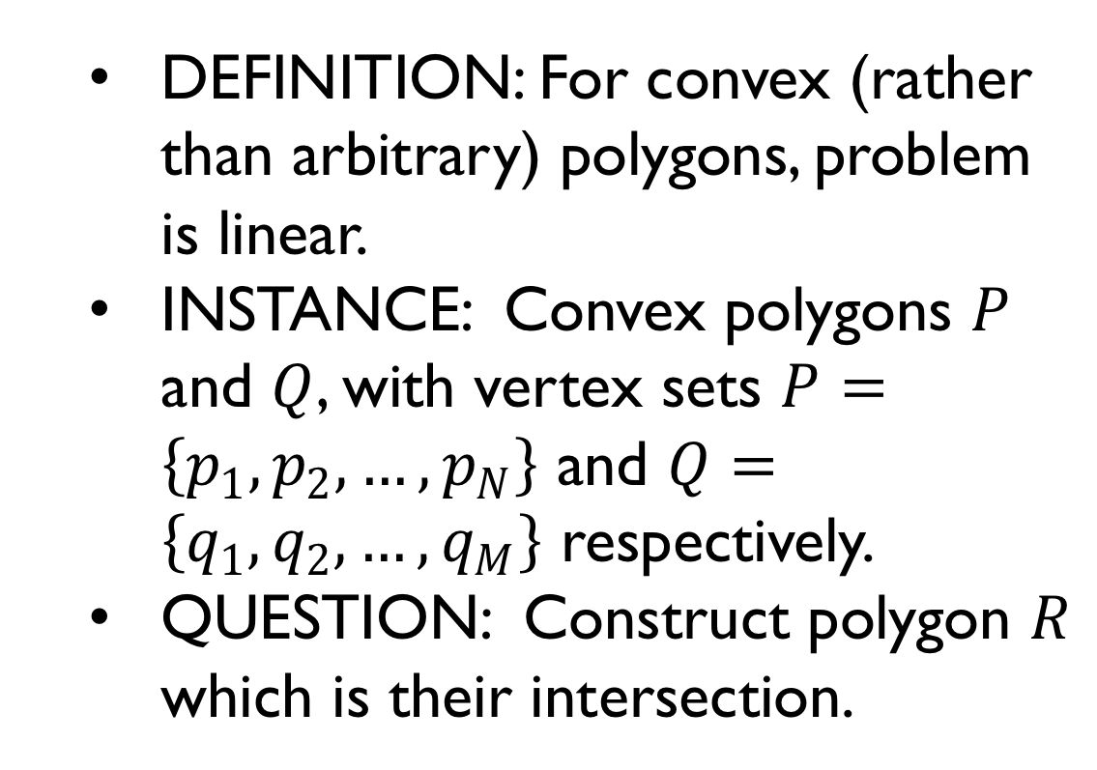
CONVEX POLYGON INTERSECTION
DEFINITION: For convex (rather than arbitrary) polygons, problem is linear.
INSTANCE: Convex polygons $P$ and $Q$, with vertex sets $P=\left\{p_{1},p_{2},…,p_{N}\right\}$ and $Q=\left\{q_{1},q_{2},…,q_{M}\right\}$ respectively.
QUESTION: Construct polygon $R$ which is their intersection.
p₁
q₁
p_{N}
p₂
q₂
q_{M}
p₃
q₃
p₈
P
R
Q
p₄
q₄
q₅
p₇
q₇
p₅
q₆
p₆

Slide 16
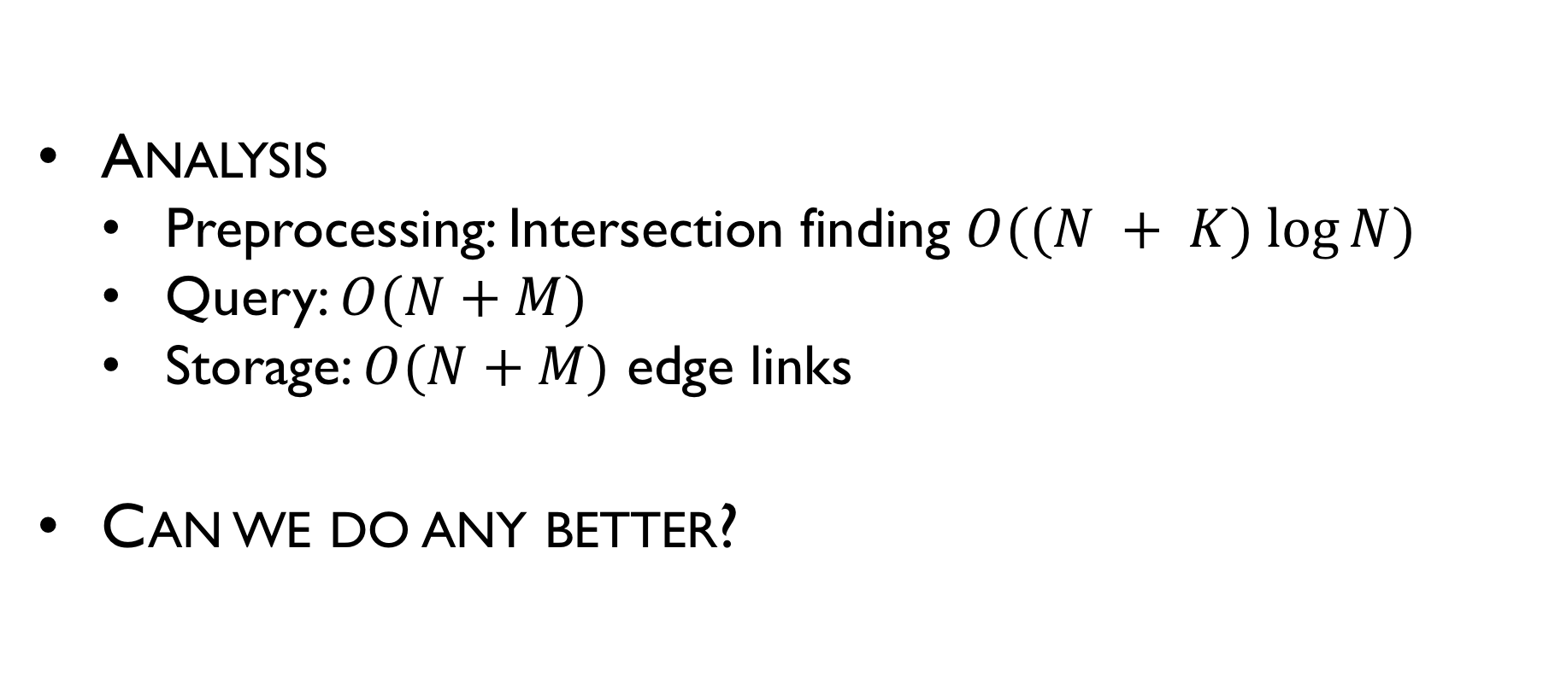
Intersection of line segment
Analysis
Preprocessing: Intersection finding $O((N + K) log⁡N)$
Query: $O(N+M)$
Storage: $O(N+M)$ edge links
Can we do any better?

Slide 17
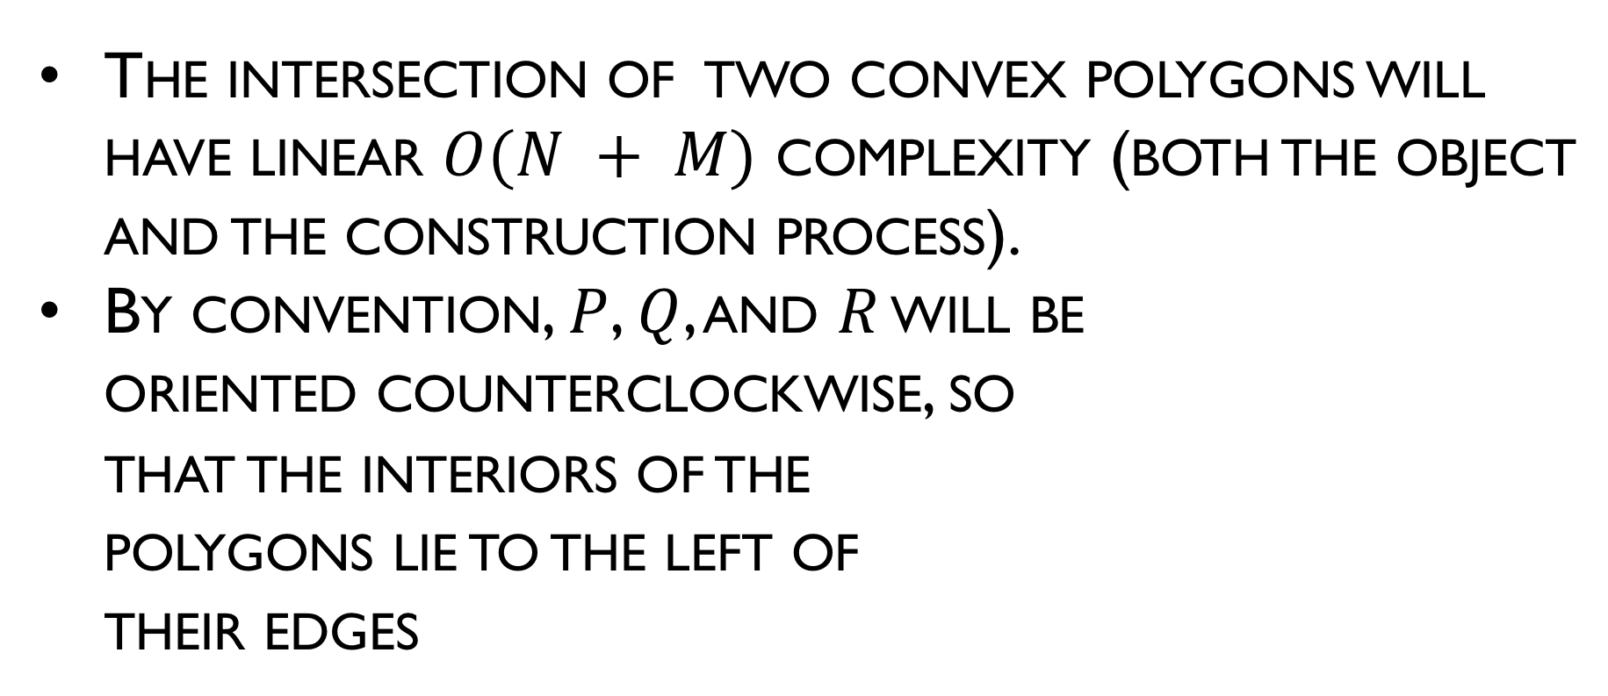
Intersection of convex polygons
The intersection of two convex polygons will have linear $O(N + M)$ complexity (both the object and the construction process).
By convention, $P$, $Q$, and $R$ will be oriented counterclockwise, so that the interiors of the polygons lie to the left of their edges
p₁
q₁
p_{N}
p₂
q₂
q_{M}
p₃
q₃
p₈
P
R
Q
p₄
q₄
q₅
p₇
q₇
p₅
q₆
p₆

Slide 18
O’Rourke-Chien-Olson-Naddor algorithm
This algorithm described in three sources:
O’Rourke with C code.
Preparata
Laszlo with C++ code.
Presentation is a synthesis of all three with focus on Laszlo.
The algorithm is based on three undergraduates’ homework assignment solutions in 1982.
Simpler than previously existing linear O(N + M) algorithm, e.g., Shamos’ 1978 algorithm.

Slide 19
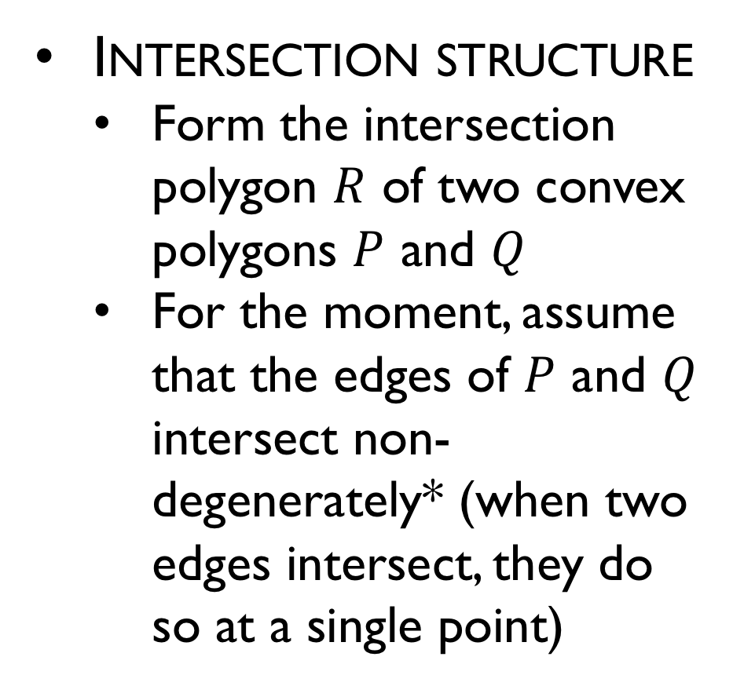
Intersection of convex polygons
Intersection structure
Form the intersection polygon $R$ of two convex polygons $P$ and $Q$
For the moment, assume that the edges of $P$ and $Q$ intersect non-degenerately* (when two edges intersect, they do so at a single point)
Intersection point
Q
P
Chain from P
Chain from Q
*In fact, the algorithm will handle degenerate intersections.

Slide 20
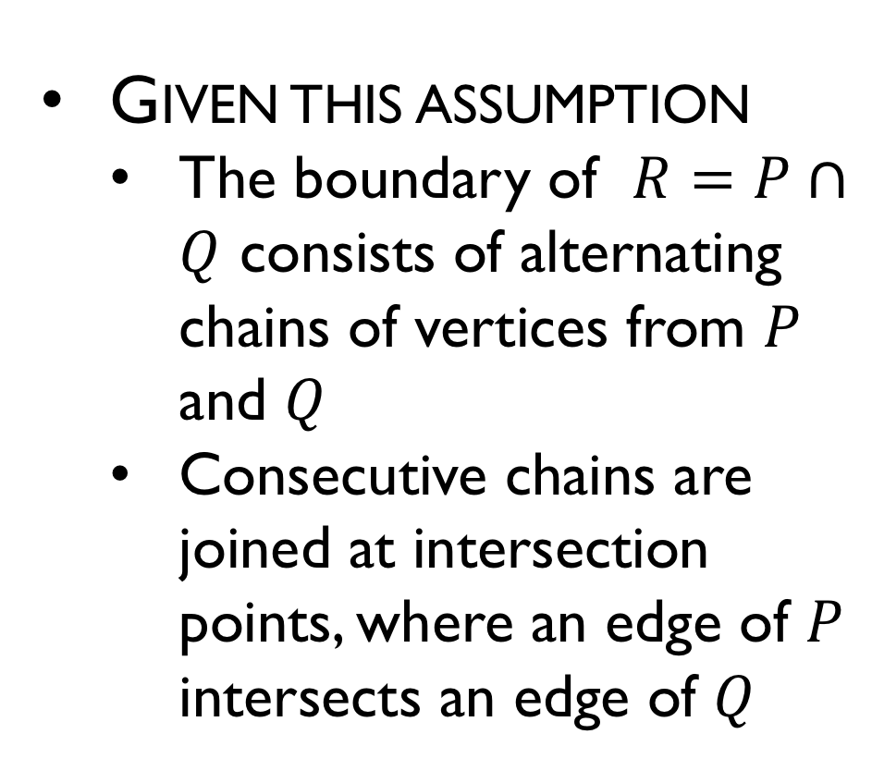
Intersection of convex polygons
Given this assumption
The boundary of $R=P∩Q$ consists of alternating chains of vertices from $P$ and $Q$
Consecutive chains are joined at intersection points, where an edge of $P$ intersects an edge of $Q$
Intersection point
Q
P
Chain from P
Chain from Q
*In fact, the algorithm will handle degenerate intersections.

Slide 21

Intersection of convex polygons
Regions that are within one polygon, but not both, are called sickles.
Sickles are bounded by two chains (inner and outer) of vertices, one from each polygon, and terminated by intersection points at either end
The boundary of $P∩Q$ is formed from the inner chains of the sickles
Outer chain
Initial intersection point
Inner chain
Terminal intersection point

Slide 22
Sickles
A vertex (of P or Q) belongs to a sickle either if:
It lies between the initial and terminal intersection points on either chain.
It is the destination of the edge of the internal chain containing the terminal intersection point of the sickle.
Note that some vertices may belong to > 1 sickles.
Terminal intersection point
Initial intersection point
Also belongs to next sickle

Slide 23
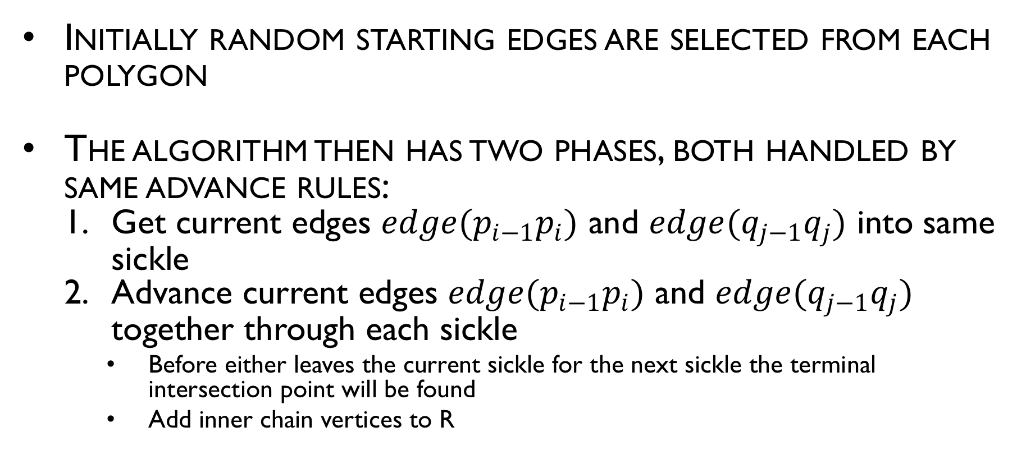
Algorithm overview
Initially random starting edges are selected from each polygon
The algorithm then has two phases, both handled by same advance rules:
Get current edges $edge(p_{i−1}p_{i})$ and $edge(q_{j−1}q_{j})$ into same sickle
Advance current edges $edge(p_{i−1}p_{i})$ and $edge(q_{j−1}q_{j})$ together through each sickle
Before either leaves the current sickle for the next sickle the terminal intersection point will be found
Add inner chain vertices to R

Slide 24
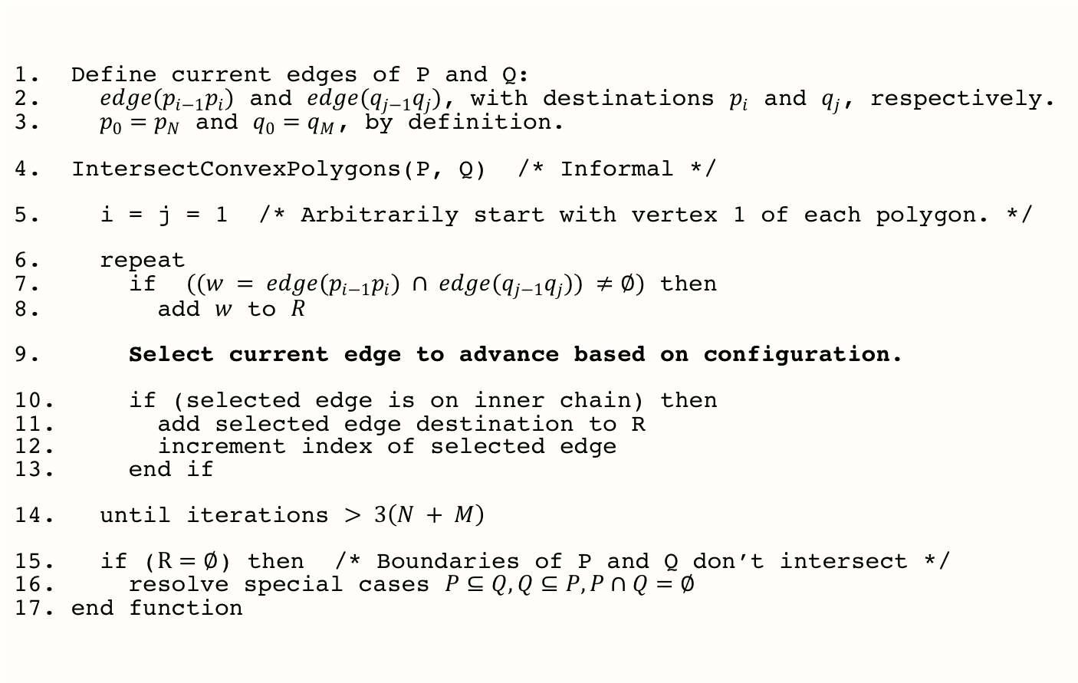
Pseudocode
Define current edges of P and Q:
$edge(p_{i−1}p_{i})$ and $edge(q_{j−1}q_{j})$, with destinations $p_{i}$ and $q_{j}$, respectively.
$p_{0}=p_{N}$ and $q_{0}=q_{M}$, by definition.
IntersectConvexPolygons(P, Q) /* Informal */
i = j = 1 /* Arbitrarily start with vertex 1 of each polygon. */
repeat
if $((w = edge(p_{i−1}p_{i}) ∩ edge(q_{j−1}q_{j})) ≠∅)$ then
add $w$ to $R$
Select current edge to advance based on configuration.
if (selected edge is on inner chain) then
add selected edge destination to R
increment index of selected edge
end if
until iterations $> 3\left(N + M\right)$
if ($R=∅$) then /* Boundaries of P and Q don’t intersect */
resolve special cases $P⊆Q, Q⊆P,P∩Q=∅$
end function

Slide 25
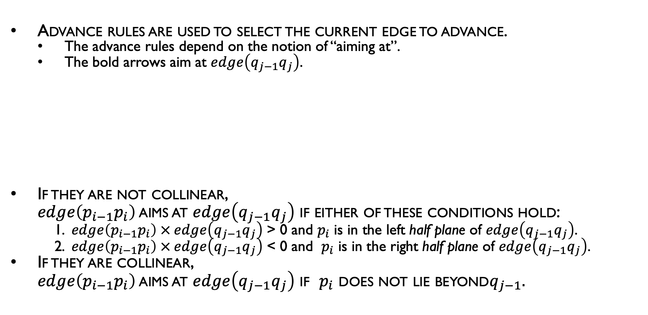
Aiming at
Advance rules are used to select the current edge to advance.
The advance rules depend on the notion of “aiming at”.
The bold arrows aim at $edge\left(q_{j−1}q_{j}\right)$.
If they are not collinear, $edge\left(p_{i−1}p_{i}\right)$ aims at $edge\left(q_{j−1}q_{j}\right)$ if either of these conditions hold:
1. $edge\left(p_{i−1}p_{i}\right) × edge\left(q_{j−1}q_{j}\right)$ > 0 and $p_{i}$ is in the left half plane of $edge\left(q_{j−1}q_{j}\right)$. 2. $edge\left(p_{i−1}p_{i}\right) × edge\left(q_{j−1}q_{j}\right)$ < 0 and $p_{i}$ is in the right half plane of $edge\left(q_{j−1}q_{j}\right)$.
If they are collinear, $edge\left(p_{i−1}p_{i}\right)$ aims at $edge\left(q_{j−1}q_{j}\right)$ if $p_{i}$ does not lie beyond$q_{j−1}.$
q_{i-1}
q_{i}

Slide 26
Half-plane
a half-space is either of the two parts into which a hyperplane divides an affine space
A half-space can be either open or closed
In 2D, a half-space is called a half-plane

Slide 27
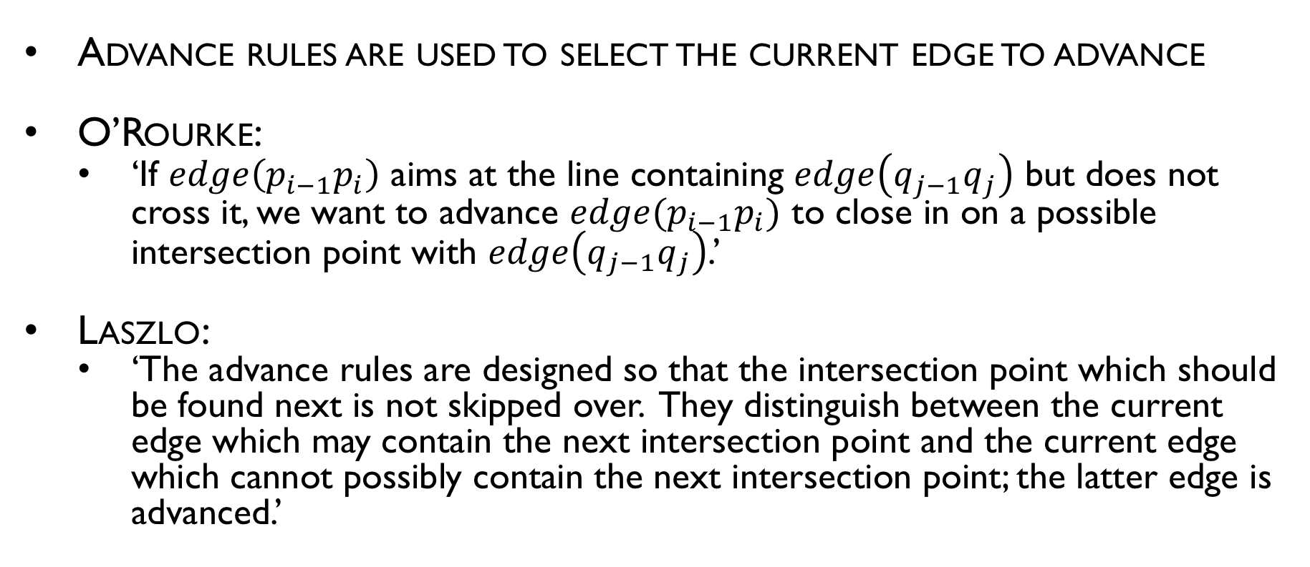
Advance rules, overall intent
Advance rules are used to select the current edge to advance
O’Rourke:
‘If $edge\left(p_{i−1}p_{i}\right)$ aims at the line containing $edge\left(q_{j−1}q_{j}\right)$ but does not cross it, we want to advance $edge(p_{i−1}p_{i})$ to close in on a possible intersection point with $edge\left(q_{j−1}q_{j}\right)$.’
Laszlo:
‘The advance rules are designed so that the intersection point which should be found next is not skipped over. They distinguish between the current edge which may contain the next intersection point and the current edge which cannot possibly contain the next intersection point; the latter edge is advanced.’

Slide 28

Advance rules (by Laszlo)
Case 1 –$edge(p_{i−1}p_{i})$ and $edge(q_{j−1}q_{j})$ aim at each other:
Advance whichever edge is to the right of the other
Assume $edge(q_{j−1}q_{j})$ is to the right; then the next intersection point cannot lie on $edge(q_{j−1}q_{j})$ because $q_{j}$ is outside the intersection polygon $R$.
q_{j}
p_{i}
Advance

Slide 29

Advance rules (by Laszlo)
Case 2 – $edge(p_{i−1}p_{i})$ aims at $edge(q_{j−1}q_{j})$ but not vice versa
Add $p_{i}$ to R if $p_{i}$ is left of $edge(q_{j−1}q_{j})$ , then advance $p_{i}$
$edge(p_{i−1}p_{i})$ cannot contain the next intersection point. In the figure, $p_{i}$ is not right of $edge(q_{j−1}q_{j})$, and is added to $R$
Advance
q_{j}
p_{i}

Slide 30

Advance rules (by Laszlo)
Case 3 – $edge(q_{j−1}q_{j})$ aims at $edge(p_{i−1}p_{i})$ but not vice versa:
Add $q_{j}$ to $R$ if $q_{j}$ is left of $edge(p_{i−1}p_{i})$, then advance $q_{j}$
$edge(q_{j−1}q_{j})$ cannot contain the next intersection point. In the figure, $q_{j}$ is right of $edge(p_{i−1}p_{i})$, and is not added to $R$.
Advance
q_{j}
p_{i}

Slide 31

Advance rules (by Laszlo)
Case 4 – $edge(p_{i−1}p_{i})$ and $edge(q_{j−1}q_{j})$ do not aim at each other:
Advance whichever edge ends to the right of the other.
Advance
q_{j}
p_{i}

Slide 32
Intersection Example

Slide 33
Intersection Example

Slide 34
Intersection Example

Slide 35
Intersection Example

Slide 36
Intersection Example

Slide 37
Intersection Example

Slide 38
Intersection Example

Slide 39
Intersection Example

Slide 40
Intersection Example

Slide 41
Intersection Example

Slide 42
Intersection Example

Slide 43
Intersection Example

Slide 44
Intersection Example

Slide 45
Intersection Example

Slide 46
Intersection Example

Slide 47
Intersection Example

Slide 48
Intersection Example

Slide 49
Intersection Example

Slide 50
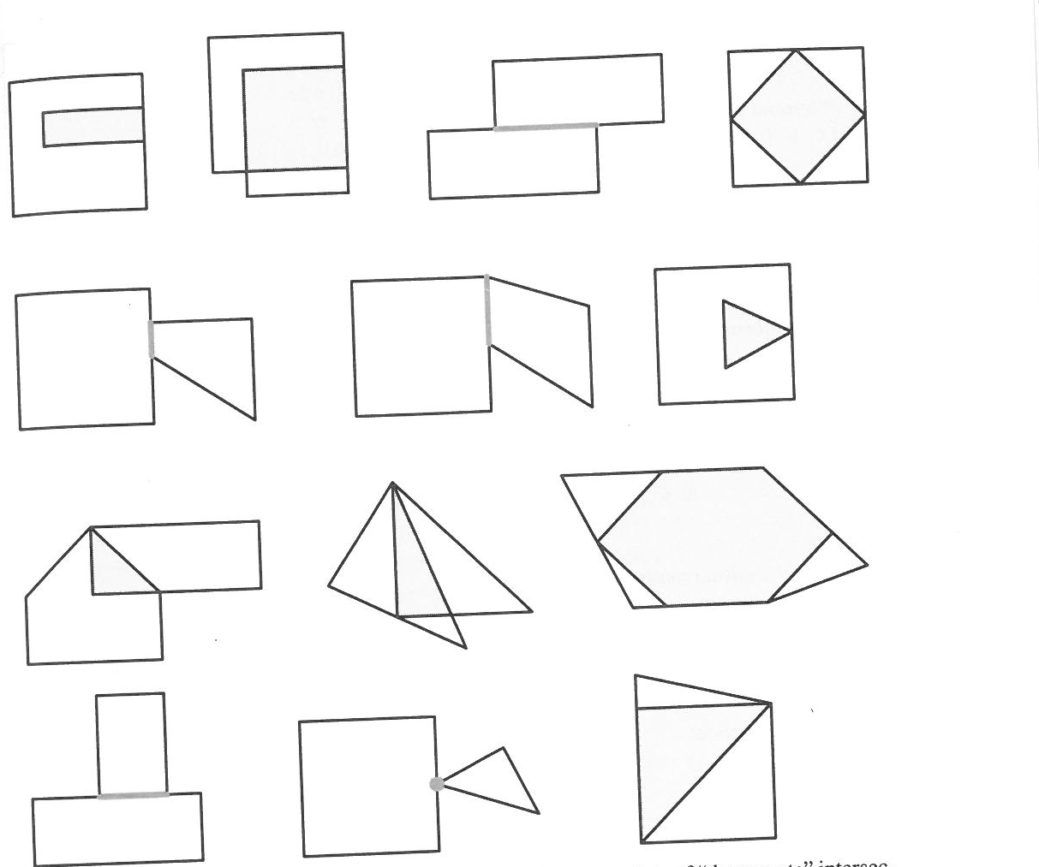
Example Degenerate intersections

Slide 51
Proof of correctness
Correctness follows from two assertions:
If current edges p and q belong to the same sickle, then the next intersection point, at which the sickle terminates, will be found next.
If the boundaries of P and Q intersect, current edges p and q will cross at some intersection point after no more than 2(N + M) iterations (advances).

Slide 52
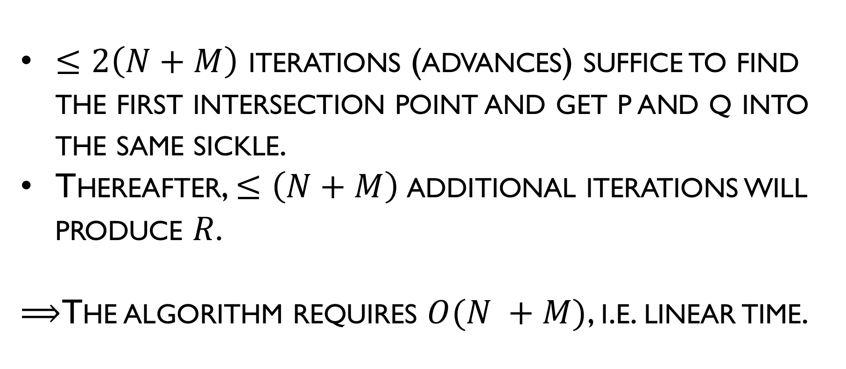
Analysis
$≤2\left(N+M\right)$ iterations (advances) suffice to find the first intersection point and get p and q into the same sickle.
Thereafter, $≤\left(N+M\right)$additional iterations will produce $R$.
$⟹$The algorithm requires $O(N +M)$, i.e. linear time.

