Slide 1
COT 4521: Introduction to Computational Geometry
The Art Gallery Problem

Slide 2
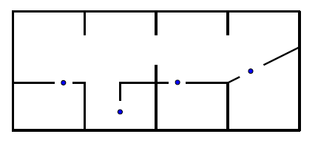
The Art Gallery Problem
The Art Gallery Problem: how many cameras we need to guard a given gallery so that every point is seen, and how we decide to place them?
In geometry terminology: How many points are needed in a simple polygon with n vertices so that every point in the polygon is seen?

Slide 3
The Art Gallery Problem
This problem was posed by Victor Klee in 1973
A guard of the gallery corresponds to a point on the polygonomial floor plan.
Guards can see in every direction, with a full range of visibility
The optimization problem is computationally difficult

Slide 4
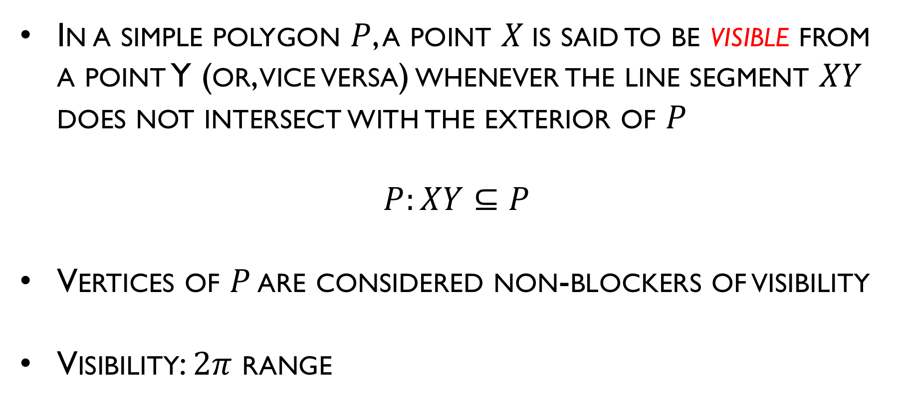
The Art Gallery Problems
In a simple polygon $P$, a point $X$is said to be visible from a point Y (or, vice versa) whenever the line segment $XY$ does not intersect with the exterior of $P$
$$P:XY⊆P$$
Vertices of $P$ are considered non-blockers of visibility
Visibility: $2π$ range

Slide 5
The Art Gallery Problems
Consider a room whose floor is polygon of N vertices, how many point lights (cameras) are needed to light the whole room?
A set of lights is said to cover a polygon if every point in the polygon is lighted.
Assume the lights themselves are not sources of shadows

Slide 6
Guarding a simple polygon
Given a simple polygon P with n vertices, find the minimum number of guards required for every point of P to be visible from some guard
Assume that every guard can view 360 degrees around it
How many lights we need to place to guard a simple polygon?
One guard is both necessary and sufficient for any convex polygon

Slide 7
Sufficient number of guards for any polygon of n vertices
How many guards are sufficient to cover any n-vertex simple polygon?
By placing a guard at every vertex, any n-vertex simple polygon can be trivially guarded with n guards — loose upper bound

Slide 8
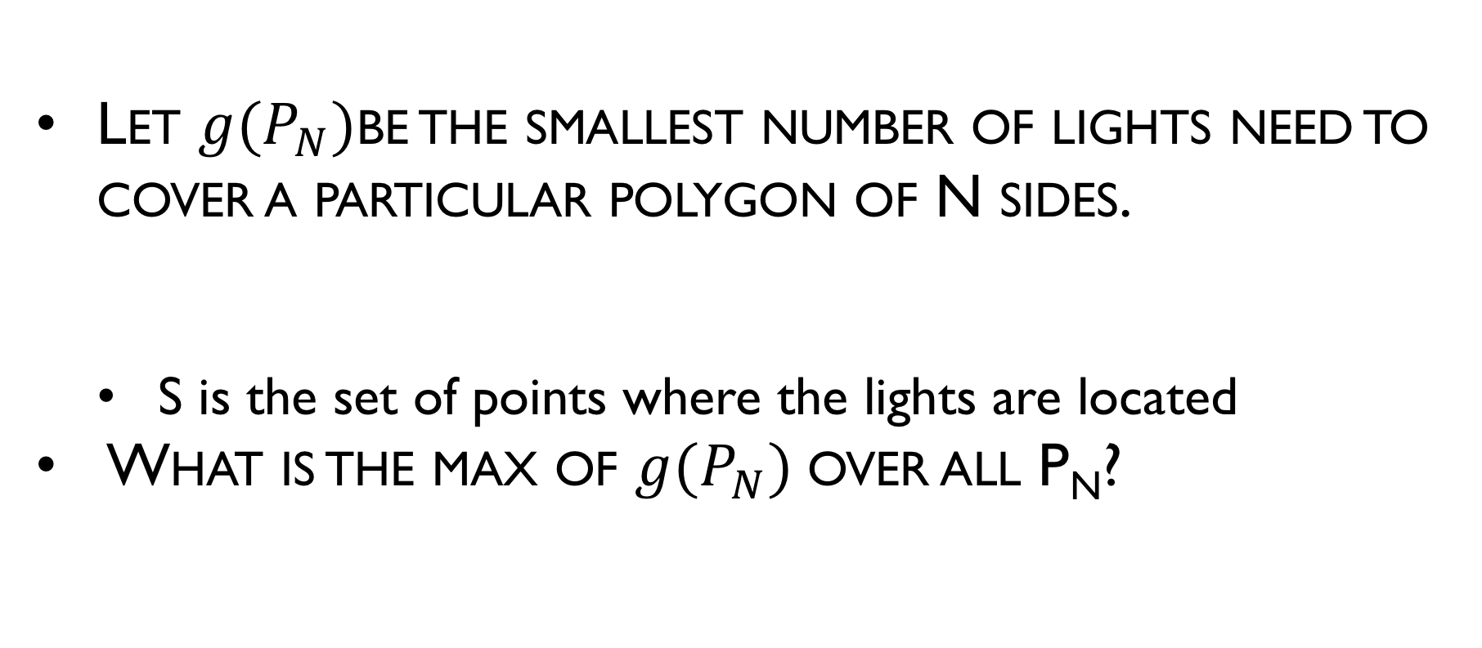
Maximum over minimum formulation Formal definition
Let $g(P_{N})$be the smallest number of lights need to cover a particular polygon of N sides.
S is the set of points where the lights are located
What is the max of $g(P_{N})$over all P_{N}?

Slide 9
How many lights are needed?
What is the maximum of
the minimum number of
lights needed to cover
a 12 sided polygon?

Slide 10
G(N) = ?

Slide 11
Maximum over minimum formulation
How many lights (cameras) needed (n=12)

Slide 12
Maximum over minimum formulation: Quiz
How many lights (cameras) needed (n=12)

Slide 13
Maximum over minimum formulation: Quiz
How many lights (cameras) needed (n=12)

Slide 14
Maximum over minimum formulation: Quiz
How many lights (cameras) needed (n=12)

Slide 15

G(N) = ….
Chvatal’s comb
G(12) = 4
Can it be that $G\left(N\right)=\left\lfloor \frac{N}{3}\right\rfloor$?

Slide 16
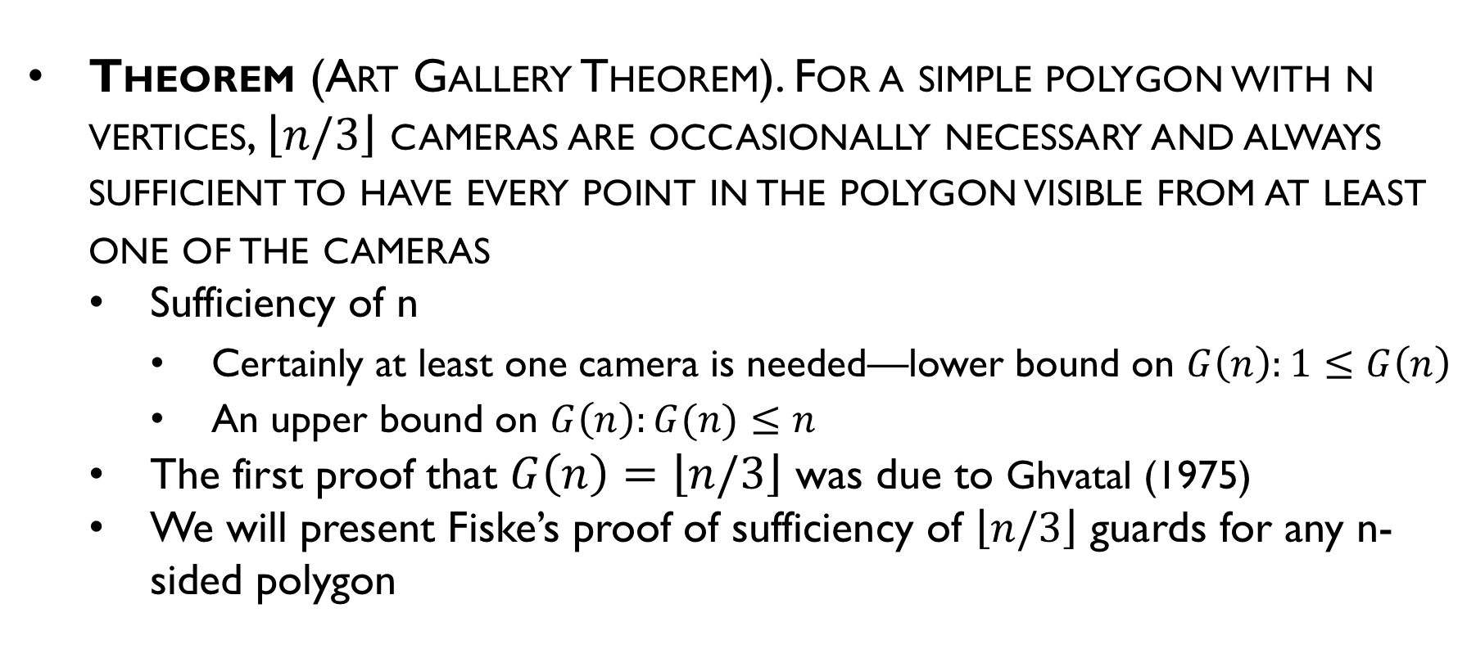
Maximum over minimum formulation
Theorem (Art Gallery Theorem). For a simple polygon with n vertices, $\left\lfloor n/3\right\rfloor$ cameras are occasionally necessary and always sufficient to have every point in the polygon visible from at least one of the cameras
Sufficiency of n
Certainly at least one camera is needed—lower bound on $G\left(n\right):1≤G\left(n\right)$
An upper bound on $G\left(n\right):G(n)≤n$
The first proof that $G\left(n\right)=\left\lfloor n/3\right\rfloor$ was due to Ghvatal (1975)
We will present Fiske’s proof of sufficiency of $\left\lfloor n/3\right\rfloor$ guards for any n-sided polygon

Slide 17
Fiske’ proof
Given arbitrary n-vertex P:
Triangulate P using diagonals
Color the vertices of triangulation graph G
G can be 3-colored (proof later)
Place lights at similarly colored nodes
Guaranteed to light the whole polygon P

Slide 18
Triangulation Theory
Existence of a Diagonal
Properties of Triangulations
Triangulation Dual
3-Coloring Proof

Slide 19
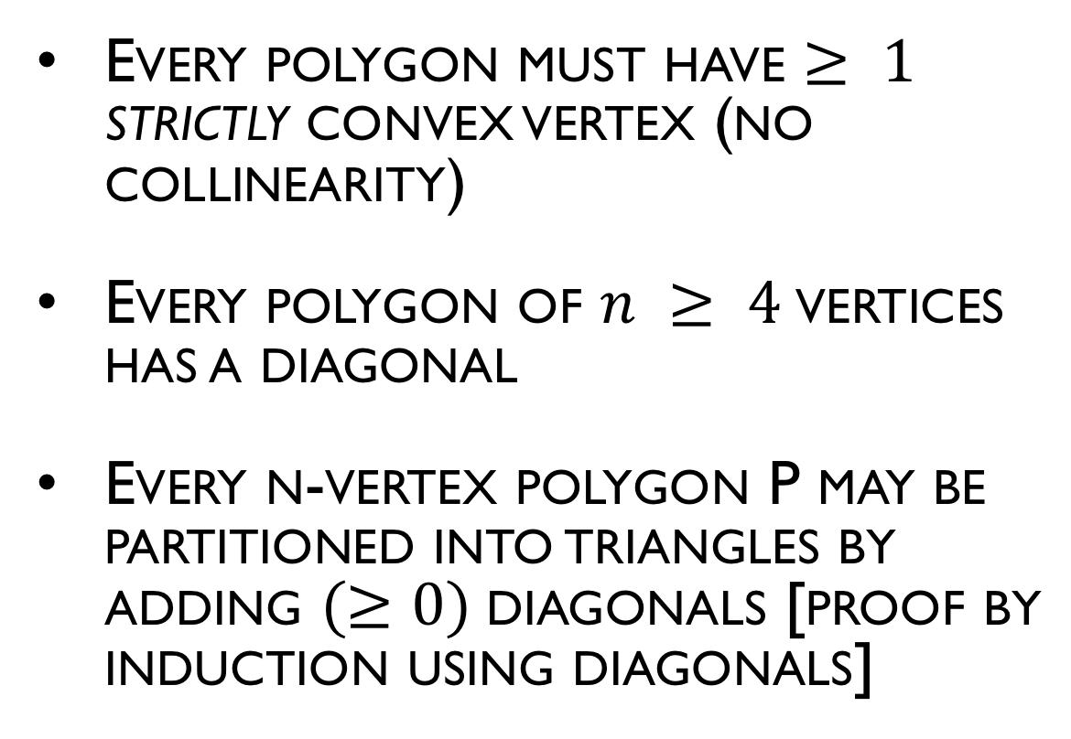
Triangulation Theory: Existence of a Diagonal
Every polygon must have $≥ 1$ strictly convex vertex (no collinearity)
Every polygon of $n ≥ 4$vertices has a diagonal
Every n-vertex polygon P may be partitioned into triangles by adding $(≥0)$diagonals [proof by induction using diagonals]

Slide 20
Triangulation Theory of Polygon
Lemma: Every polygon must have at least one strictly convex vertex.
Proof:
If the edges of polygon oriented in a counter-clockwise traversal, then a convex vertex is a left turn, and reflex vertex is right turn and interior of the polygon is always to the left
Let L is the line through the lowest vertex v (y-coordinate)
The interior of the polygon must be above
The edges following v must be above L
The walker make the left turn at v, thus v is convex
L
v

Slide 21
Triangulation Theory: Properties
Lemma: An internal diagonal exists between any two nonadjacent vertices of a polygon P if and only if P is convex polygon.
Proof: The proof consists of two parts, both established by contradiction.

Slide 22
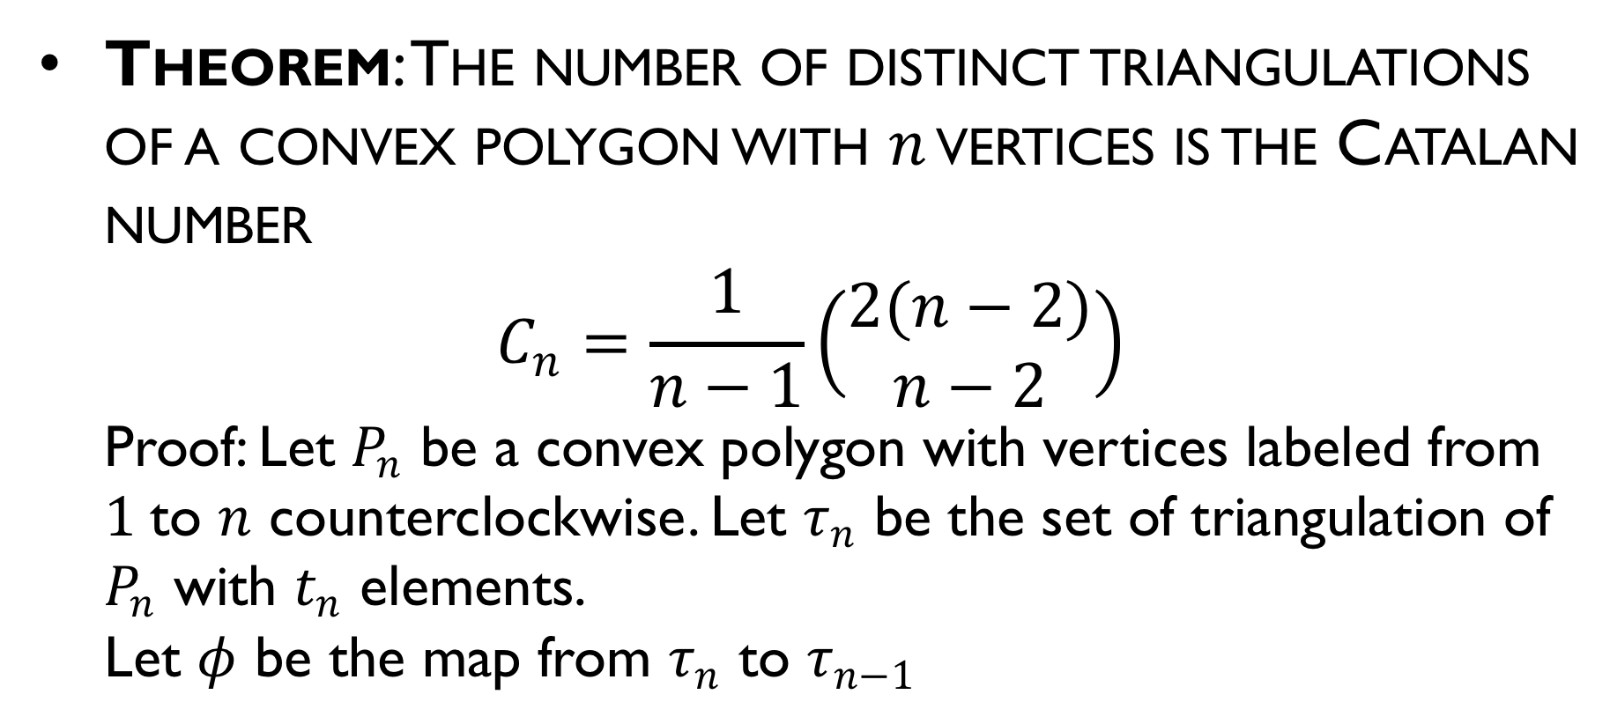
Triangulation Theory: Properties
Theorem: The number of distinct triangulations of a convex polygon with $n$ vertices is the Catalan number
$$C_{n}=\frac{1}{n−1}\left(\begin{matrix}2(n−2) \\ n−2\end{matrix}\right)$$
Proof: Let $P_{n}$ be a convex polygon with vertices labeled from $1$to $n$ counterclockwise. Let $τ_{n}$ be the set of triangulation of $P_{n}$ with $t_{n}$ elements.
Let $φ$ be the map from $τ_{n}$ to $τ_{n−1}$

Slide 23
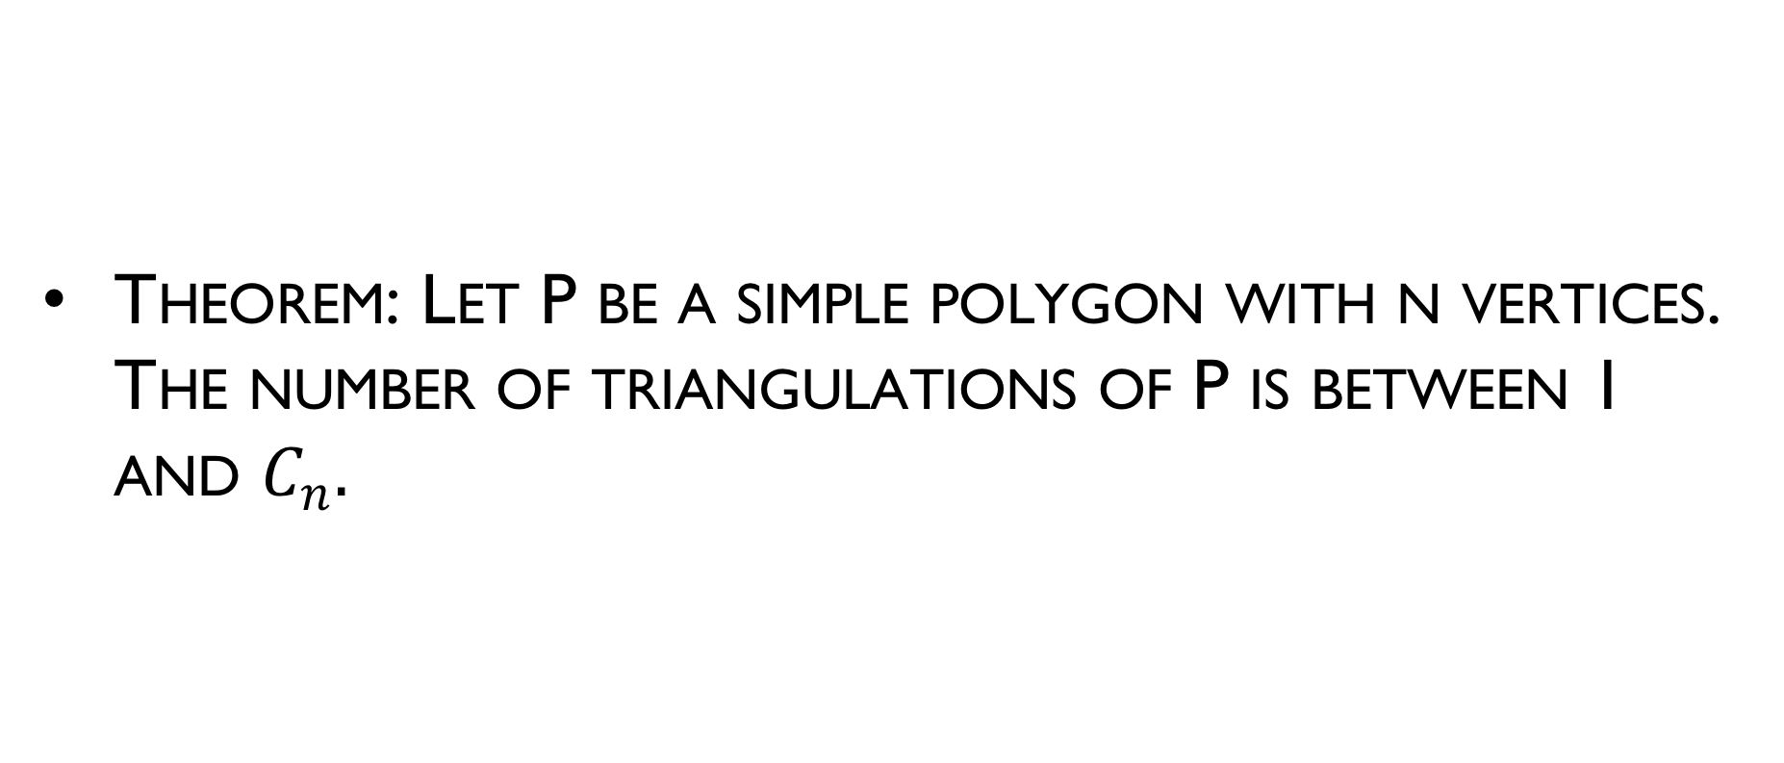
Triangulation Theory: Properties
Theorem: Let P be a simple polygon with n vertices. The number of triangulations of P is between 1 and $C_{n}.$

Slide 24
Brute Force Triangulation
Theorem: Every polygon P of n vertices can be partitioned into triangle by the addition of(zero or more) diagonals.
Complexity of diagonal-based algorithm:
O(n²) - # of diagonal candidates
O(n) testing each of neighborhoods
Repeating this O(n³) computation for each of the n-3 diagonals yields O(n⁴)

Slide 25
Triangulation Theory
Every polygon P of N vertices can be partitioned into triangles by the addition of zero or more diagonals. (Induction proof)
Base case: N = 3 (triangle)
Assumption: Let it be true for < N sided polygon
Any N sided polygon can be partitioned into two polygons of less then N sides each by adding a diagonal, each of which can be partitioned by using premise 2 above
Thus, it is true for all N.
Notes:
By induction, the two polygons can be triangulated using
m - 2 and n - m + 2 - 2 = n - m triangles. So the original
polygon is triangulated using m - 2 + n - m = n - 2
triangles

Slide 26
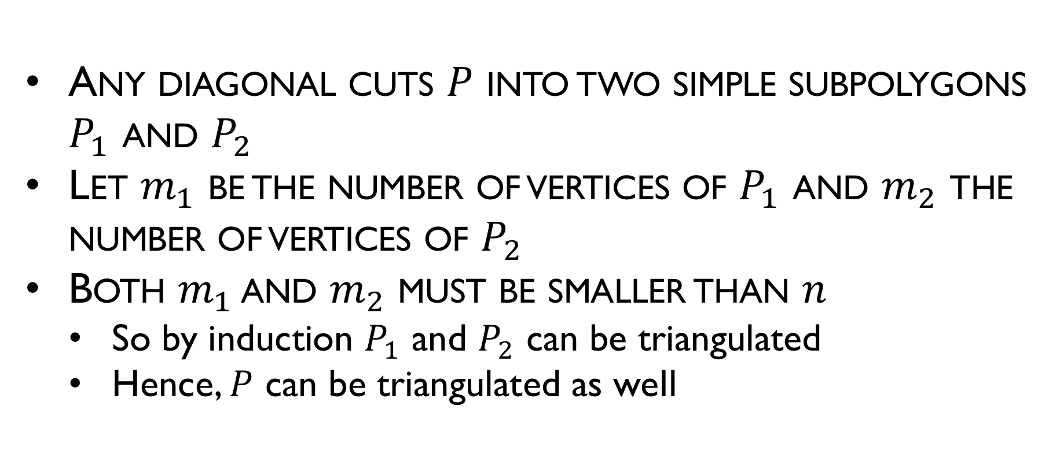
Triangulation Theory
Any diagonal cuts $P$ into two simple subpolygons $P_{1}$ and $P_{2}$
Let $m_{1}$ be the number of vertices of $P_{1}$ and $m_{2}$ the number of vertices of $P_{2}$
Both $m_{1}$ and $m_{2}$ must be smaller than $n$
So by induction $P_{1}$ and $P_{2}$ can be triangulated
Hence, $P$ can be triangulated as weIl

Slide 27
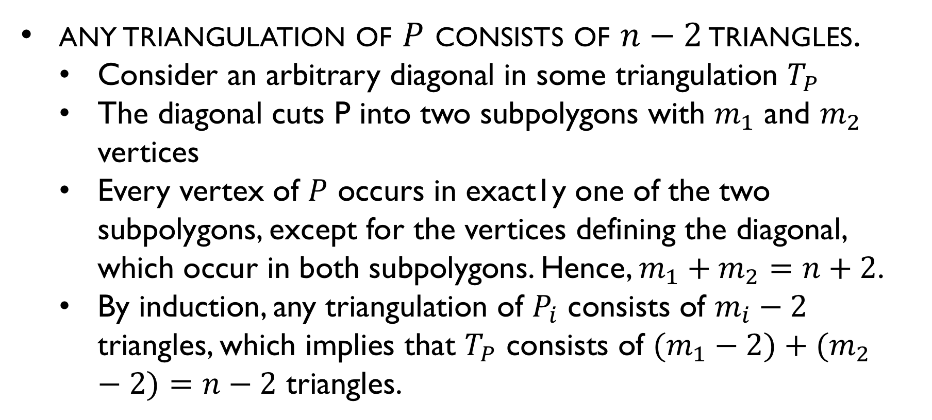
Triangulation Theory
any triangulation of $P$ consists of $n−2$ triangles.
Consider an arbitrary diagonal in some triangulation $T_{P}$
The diagonal cuts P into two subpolygons with $m_{1}$ and $m_{2}$ vertices
Every vertex of $P$ occurs in exact1y one of the two subpolygons, except for the vertices defining the diagonal, which occur in both subpolygons. Hence, $m_{1}+m_{2}=n+2$.
By induction, any triangulation of $P_{i}$ consists of $m_{i}−2$ triangles, which implies that $T_{P}$ consists of $(m_{1}−2)+(m_{2}−2)=n−2$ triangles.

Slide 28
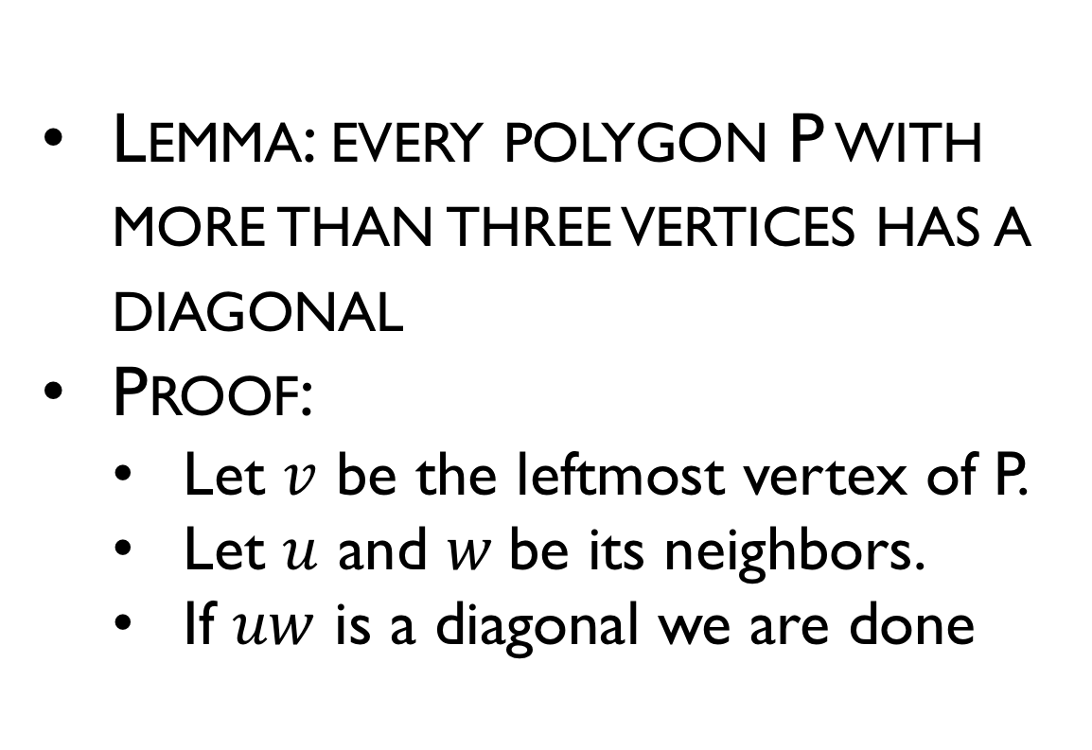
Existence of a Diagonal
Lemma: every polygon P with more than three vertices has a diagonal
Proof:
Let $v$ be the leftmost vertex of P.
Let $u$ and $w$be its neighbors.
If $uw$ is a diagonal we are done
w
v
u

Slide 29
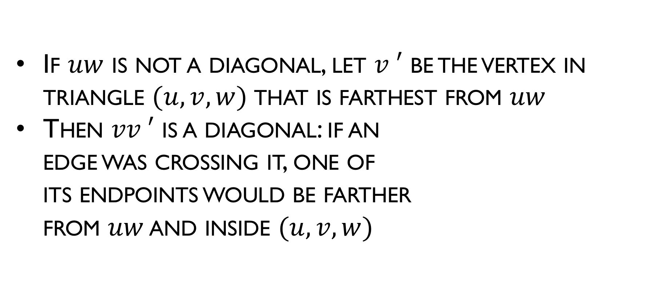
Existence of a Diagonal
If $uw$ is not a diagonal, let $v ′$ be the vertex in triangle $(u, v, w)$that is farthest from $uw$
Then $vv ′$ is a diagonal: if an edge was crossing it, one of its endpoints would be farther from $uw$ and inside $(u, v,w)$
w
v
v'
u

Slide 30
Triangulation Dual
The dual T of a triangulation is a tree, with each node of degree at most three.
Dual graph: each face gives a node; two nodes are connected if the faces are adjacent

Slide 31
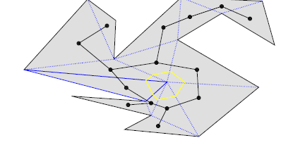
Properties of triangulations
Proof:
The degree three is immediate from the fact that every triangle have three sides.
If there is a cycle C in T it is easy to verify that...
There must be a vertex inside the polygon...

Slide 32
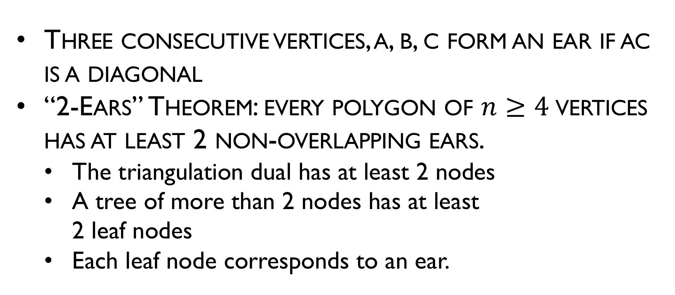
Meister’s Two Ears Theorem
Three consecutive vertices, a, b, c form an ear if ac is a diagonal
“2-Ears” Theorem: every polygon of $n≥4$vertices has at least 2 non-overlapping ears.
The triangulation dual has at least 2 nodes
A tree of more than 2 nodes has at least 2 leaf nodes
Each leaf node corresponds to an ear.
ear
ear

Slide 33
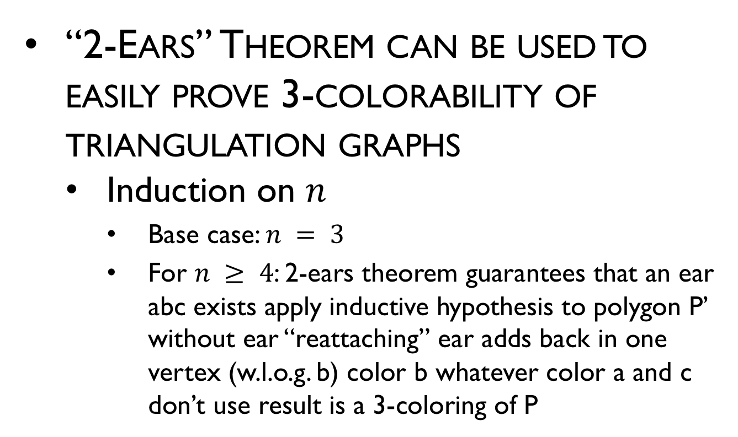
Triangulation Theory: 3-Coloring
“2-Ears” Theorem can be used to easily prove 3-colorability of triangulation graphs
Induction on $n$
Base case: $n = 3$
For $n ≥ 4$: 2-ears theorem guarantees that an ear abc exists apply inductive hypothesis to polygon P’ without ear “reattaching” ear adds back in one vertex (w.l.o.g. b) color b whatever color a and c don’t use result is a 3-coloring of P
a
b
c

Slide 34
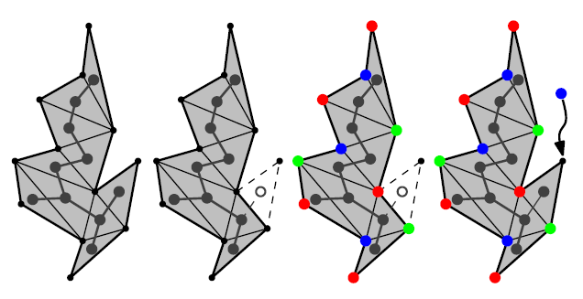
Fiske’ proof
3 colors

Slide 35
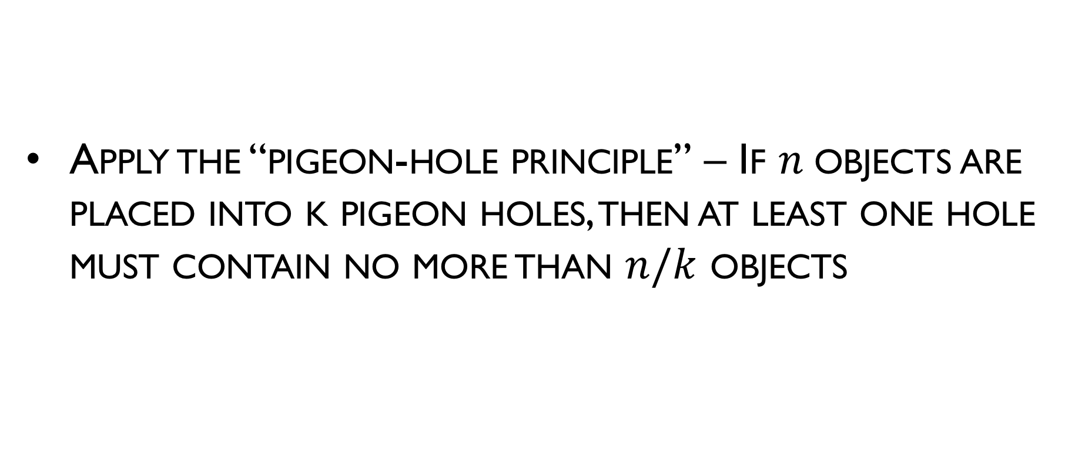
Fiske’ proof
Apply the “pigeon-hole principle” – If $n$objects are placed into k pigeon holes, then at least one hole must contain no more than $n/k$ objects

Slide 36
3 colors suffice…
5
4
5

Slide 37
3 colors suffice…
5
5
4

Slide 38
Pigeon Hole Principle
3 holes (colors) and 14 pigeons (vertices) to go into them.
There will always be one hole with less or equal to 14/3 pigeons
Generalizing: for 3 colors and N vertices there will be a color that is used at most N/3 times. Place the light at those colors.

Slide 39
Example

