Slide 1
COT 4521: Introduction to Computational Geometry
Polygon Partitioning

Slide 2
Objectives
Triangulation algorithms
Diagonal-based triangulation algorithm
Ear-based triangulation algorithm
Complexity of the algorithms
Definition of monotone polygon
Triangulation of a monotone polygon
Partitioning into monotone polygons
Triangulation of a polygon in n log n time

Slide 3
Triangulation of polygons
Decompose the polygon into shapes that are easier to handle: triangles
A triangulation of a polygon P is a decomposition of P into triangles whose vertices are vertices of P. In other words, a triangulation is a maximal set of non-crossing diagonals.
diagonal

Slide 4
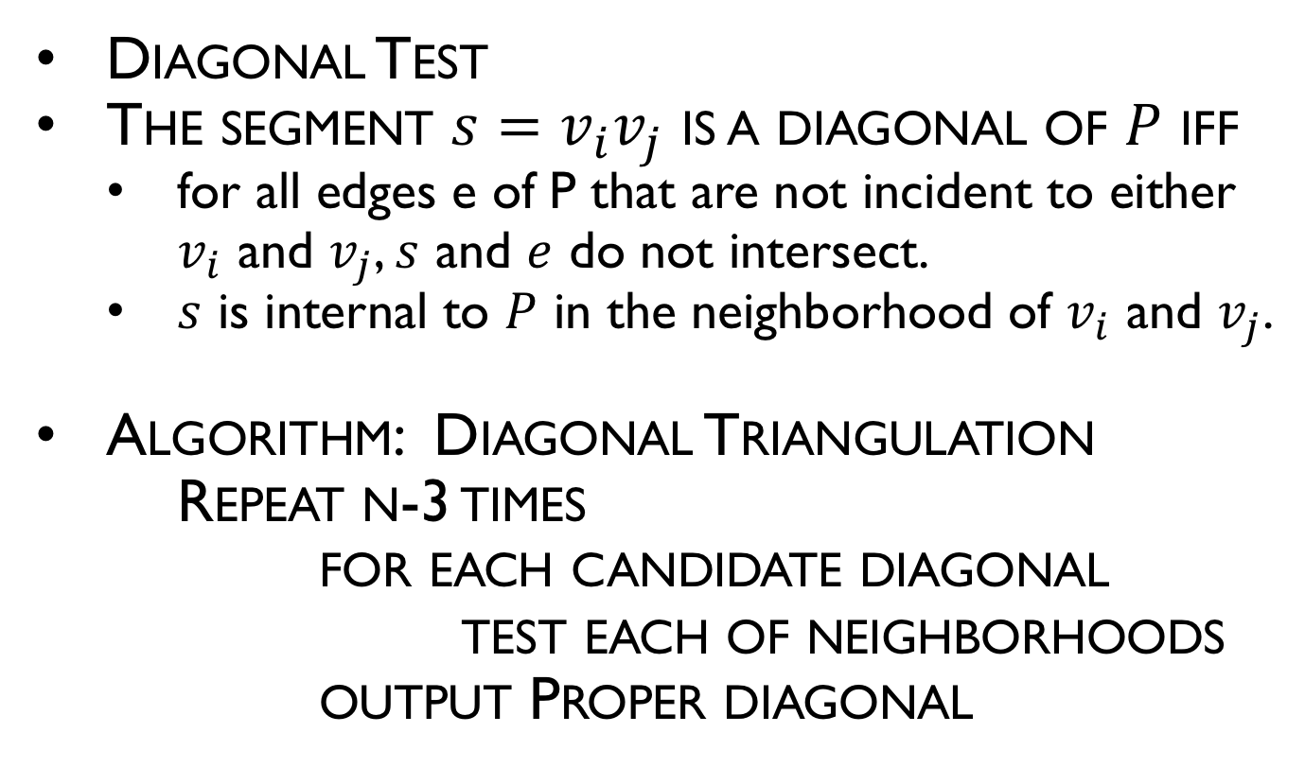
Diagonal-Based Triangulation
Diagonal Test
The segment $s=v_{i}v_{j}$ is a diagonal of $P$ iff
for all edges e of P that are not incident to either $v_{i}$ and $v_{j}$, $s$ and $e$ do not intersect.
$s$ is internal to $P$ in the neighborhood of $v_{i}$ and $v_{j}$.
Algorithm: Diagonal Triangulation
Repeat n-3 times
for each candidate diagonal
test each of neighborhoods
output Proper diagonal
5
4
1
3
2
0

Slide 5
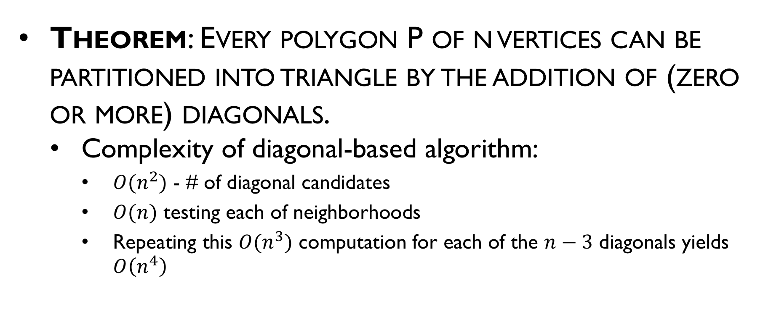
Brute Force Triangulation
Theorem: Every polygon P of n vertices can be partitioned into triangle by the addition of (zero or more) diagonals.
Complexity of diagonal-based algorithm:
$O(n^{2})$ - # of diagonal candidates
$O(n)$ testing each of neighborhoods
Repeating this $O(n^{3})$ computation for each of the $n−3$ diagonals yields $O\left(n^{4}\right)$

Slide 6
Ear Based Idea….
Locate an ear
Output diagonal
Clip the ear
Repeat until a triangle is left

Slide 7
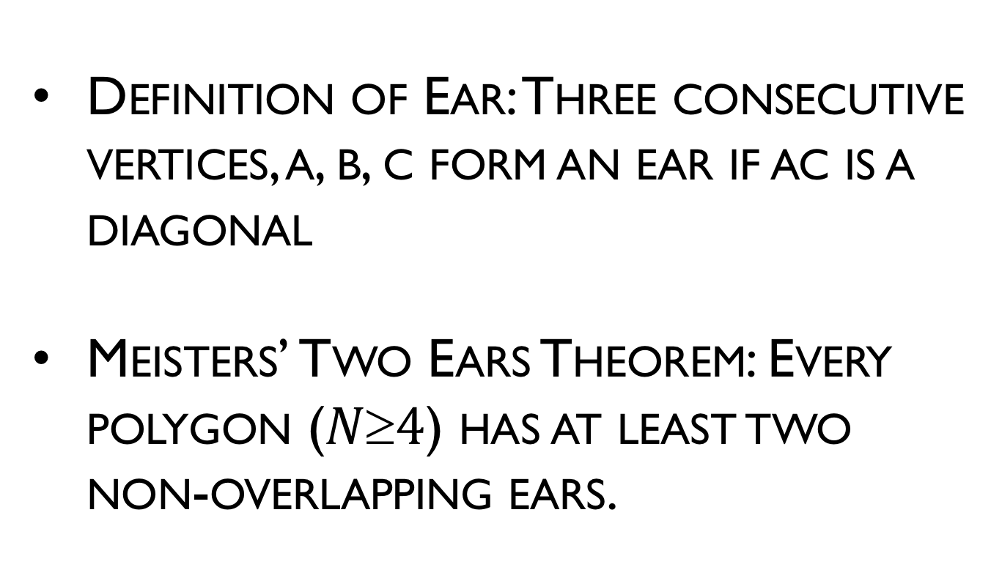
Ear Based Idea….
Definition of Ear: Three consecutive vertices, a, b, c form an ear if ac is a diagonal
Meisters’ Two Ears Theorem: Every polygon ($N4$) has at least two non-overlapping ears.

Slide 8
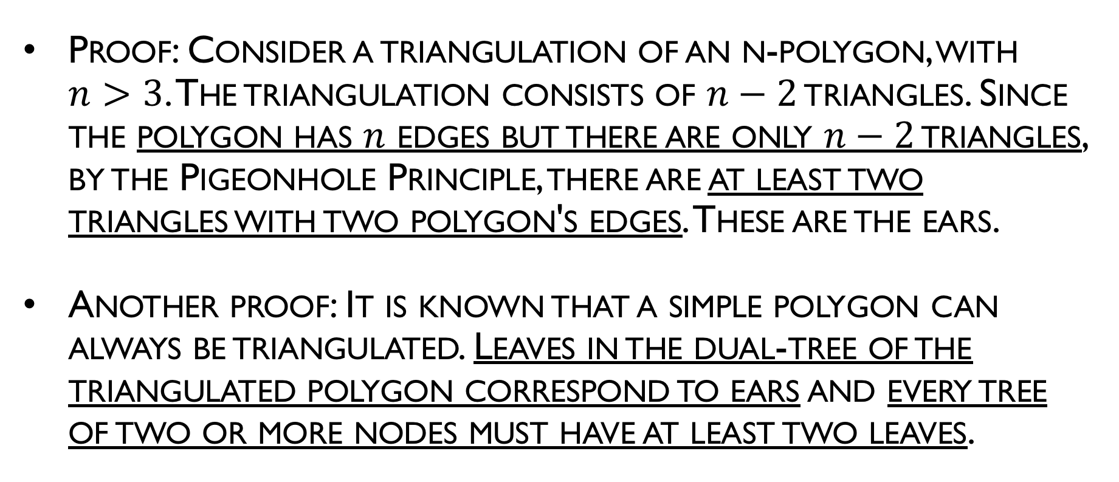
Ear Based Idea….
Proof: Consider a triangulation of an n-polygon, with $n>3$. The triangulation consists of $n−2$ triangles. Since the polygon has $n$ edges but there are only $n−2$ triangles, by the Pigeonhole Principle, there are at least two triangles with two polygon's edges. These are the ears.
Another proof: It is known that a simple polygon can always be triangulated. Leaves in the dual-tree of the triangulated polygon correspond to ears and every tree of two or more nodes must have at least two leaves.

Slide 9
Triangulation: Implementation
Algorithm: TRIANGULATION
Initialize the ear tip status of each vertex.
while n > 3 do
Locate an ear tip v₂.
Output diagonal v₁ v₃.
Delete v₂.
Update the ear tip status of v₁ and v₃.

Slide 10
Triangulation: Implementation
Algorithm: TRIANGULATION
Initialize the ear tip status of each vertex.
while n > 3 do
Locate an ear tip v₂.
Output diagonal v₁ v₃.
Delete v₂.
Update the ear tip status of v₁ and v₃.
O(n²)
+
O(n)
iterations
O(n)
iterations
O(n)
Total: O(n³)
Can be made: O(n²)

Slide 11
11
4
12
10
14
9
6
13
5
8
7
16
15
3
1
17
2
0

Slide 12
Monotone Partitioning
A chain is monotone with respect to a line L if every line orthogonal to L intersects the chain in at most 1 point
Polygon is monotone with respect to a line L if boundary of P can be split into 2 polygonal chains A and B such that each chain is monotone with respect to L
Monotonicity implies sorted order with respect to L
Monotone polygon can be (greedily) triangulated in O(n) time!

Slide 13
Monotone Polygon
l’
L
l’
l’
l’
Monotone w.r.t. line L
not monotone w.r.t. L
l’
l’
l’
l’

Slide 14
Monotone Polygon
l’
not monotone w.r.t. any line
l

Slide 15
Polygon triangulation
Algorithm: Polygon triangulation: monotone polygon with respect to y-line
Sort vertices by y coordinates
Partition into monotone polygons
Triangulate each monotone polygon

Slide 16
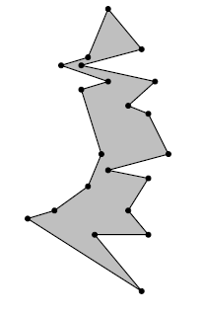
Monotone Polygon
A y-monotone polygon has a top vertex, a bottom vertex, and two y-monotone chains between top and bottom as its boundary

Slide 17
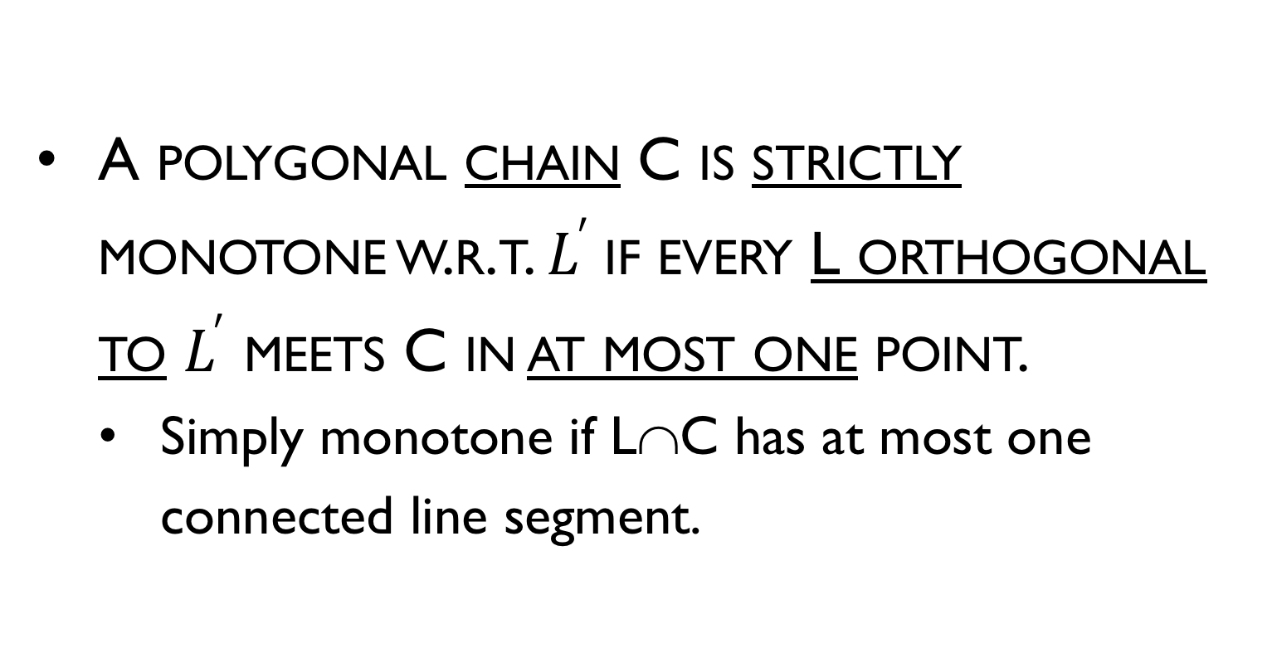
Monotone Polygon
A polygonal chain C is strictly monotone w.r.t. $L^{′}$if every L orthogonal to $L^{′}$ meets C in at most one point.
Simply monotone if L∩C has at most one connected line segment.

Slide 18
Monotone Polygon
A polygon P is said to be monotone w.r.t. a line L if ∂P can be split into two monotone chains w.r.t. L.

Slide 19
Monotone Polygon
The following property is characteristic for y-monotone polygons:
If we walk from a topmost to a bottommost vertex along the left (or the right) boundary chain, then we always move downwards or horizontally, never upwards.

Slide 20
Triangulation of Monotone Polygon
The algorithm to triangulate a monotone polygon depends on its monotonicity.
Developed in 1978 by Garey, Johnson, Preparata, and Tarjan
described in both
Preparata pp. 239-241 (1985)
Laszlo pp. 128-135 (1996)
The former uses y-monotone polygons, the latter uses x-monotone.

Slide 21
What kind of vertices does a Non-Y-Monotone Polygon have with respect to sweep of y?

Slide 22
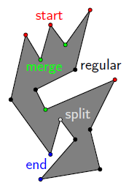
Properties of monotone polygon
If a polygon P has no interior cusps, then it is monotone
What types of vertices does a simple polygon have?
start
end
split
merge
regular

Slide 23
Properties of monotone polygon
Reflex vertex whose adjacent vertices are either both at or above v, or both at or below it.
If a polygon has no interior cusps then it is monotone with respect to the vertical line
Interior cusps
Upward
Cusp (merge)
v
v
Downward cusp (split)
v

Slide 24
Properties of monotone polygon
Lemma: A polygon is y-monotone if it has neither split vertices nor merge vertices
Proof: If P is not monotone, there must exist a line l intersecting P in more than a single segment. Let [p,q] be its leftmost sub segment.
Follow the boundary of P starting at q, where P is on the left. At some point r we must cross l.
If r ≠ p then the highest vertex must be a split one.
split vertex
P

Slide 25
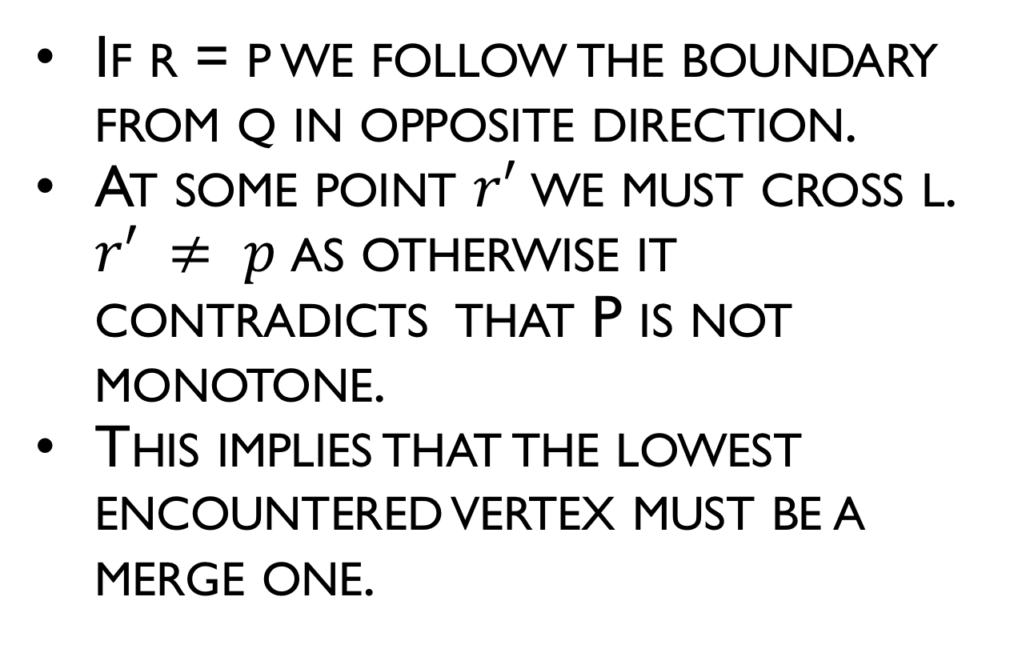
Properties of monotone polygon
If r = p we follow the boundary from q in opposite direction.
At some point $r′$we must cross l. $r′ ≠ p$as otherwise it contradicts that P is not monotone.
This implies that the lowest encountered vertex must be a merge one.
P
merge vertex

Slide 26
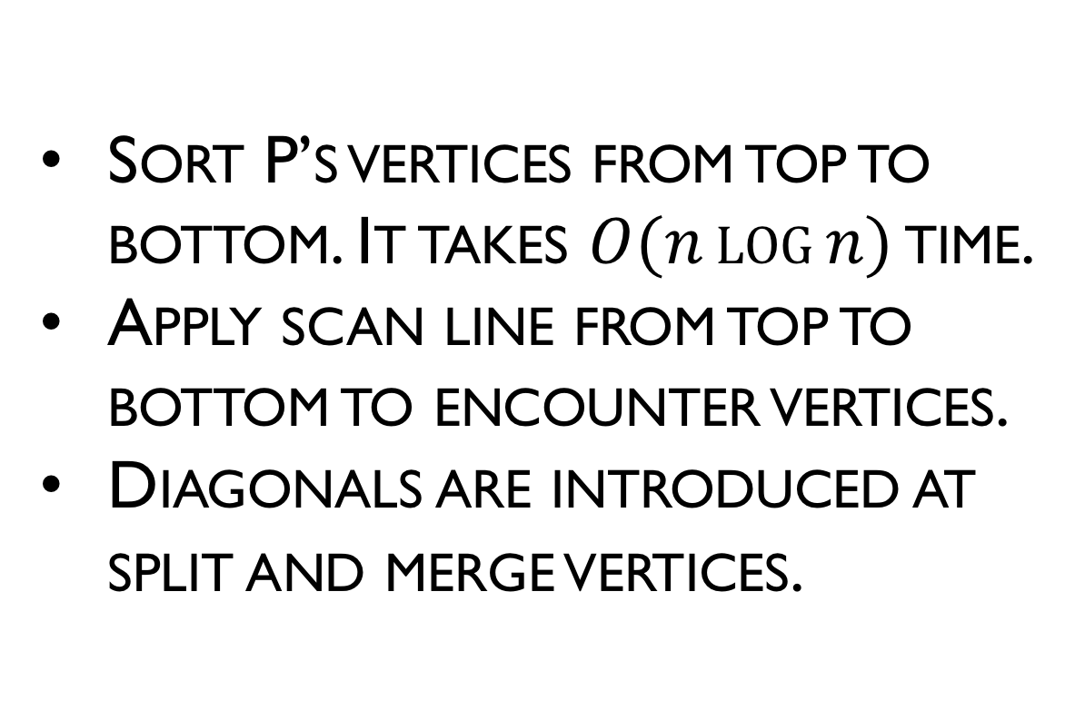
Getting Rid of Split and Merge Vertices
Sort P’s vertices from top to bottom. It takes $O(n\log{n})$ time.
Apply scan line from top to bottom to encounter vertices.
Diagonals are introduced at split and merge vertices.
P

Slide 27
Polygon Triangulation
Algorithm: POLYGON TRIANGULATION: MONOTONE PARTITION
Sort vertices by y coordinates
Perform plane sweep to construct trapezoids
Partition into monotone polygons
Triangulate each monotone polygon
P

Slide 28
Trapezoidalization
“Draw” horizontal line through each vertex
Consider only the connected segment inside the polygon containing the vertex
Two supporting vertices – top and bottom
If an “interior” supporting vertex is an interior cusp, break it
Connect downward for a upward cusp
Connect upward for an downward cusp
These connections partitions the polygon into monotone parts.

Slide 29
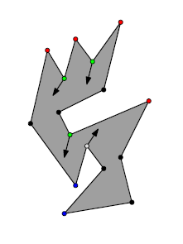
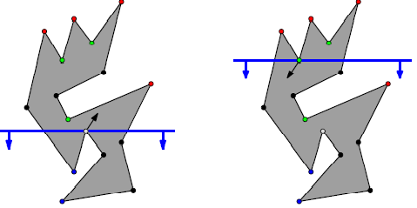
Sweep idea
Find diagonals from each merge vertex down, and from each split vertex up
A simple polygon with no split or merge vertices can have at most one start and one end vertex, so it is y-monotone

Slide 30
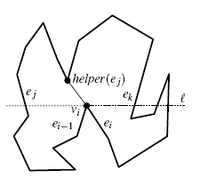
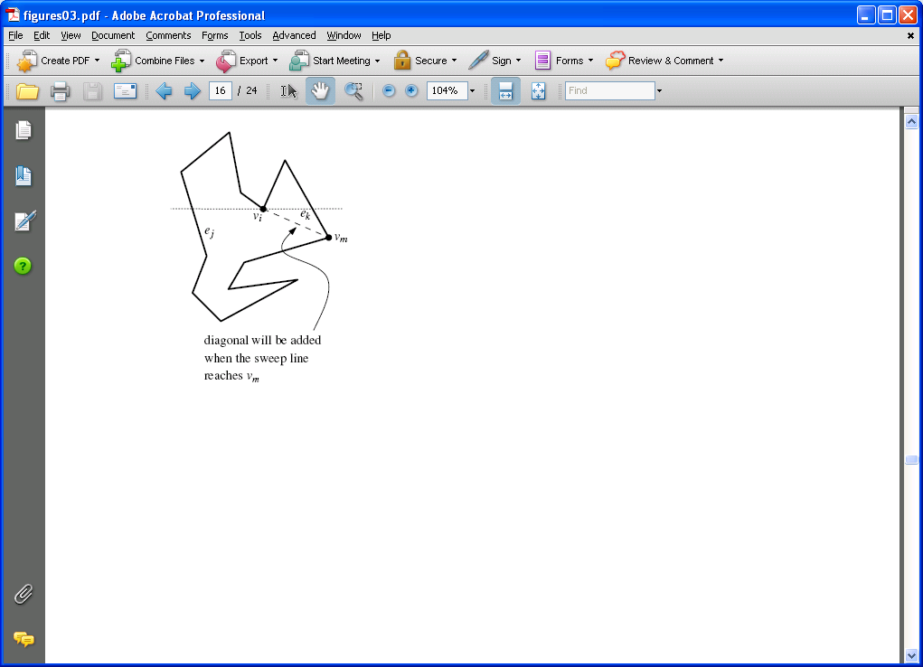
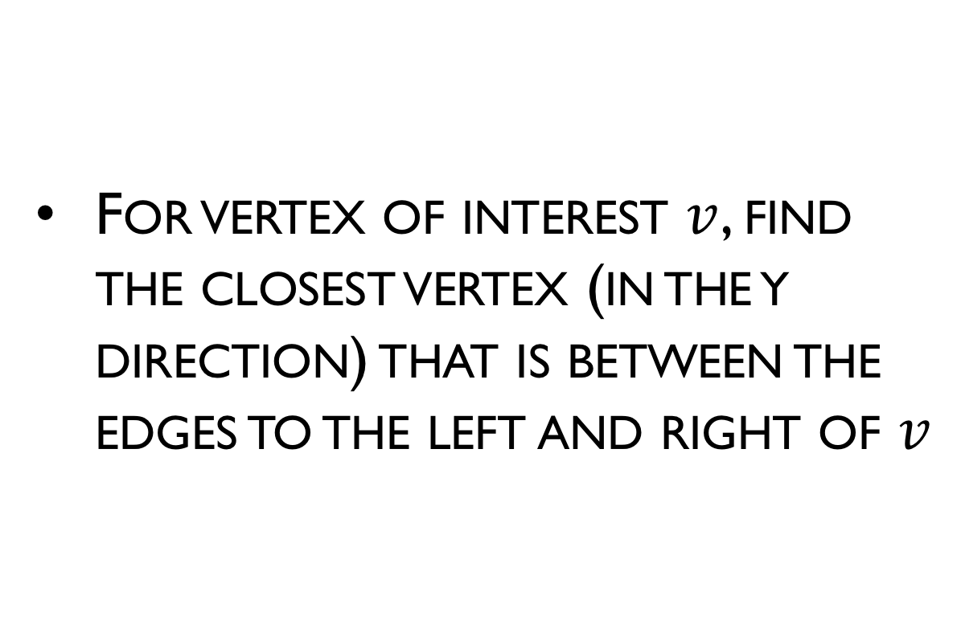
Sweep idea
For vertex of interest $v$, find the closest vertex (in the y direction) that is between the edges to the left and right of $v$

Slide 31
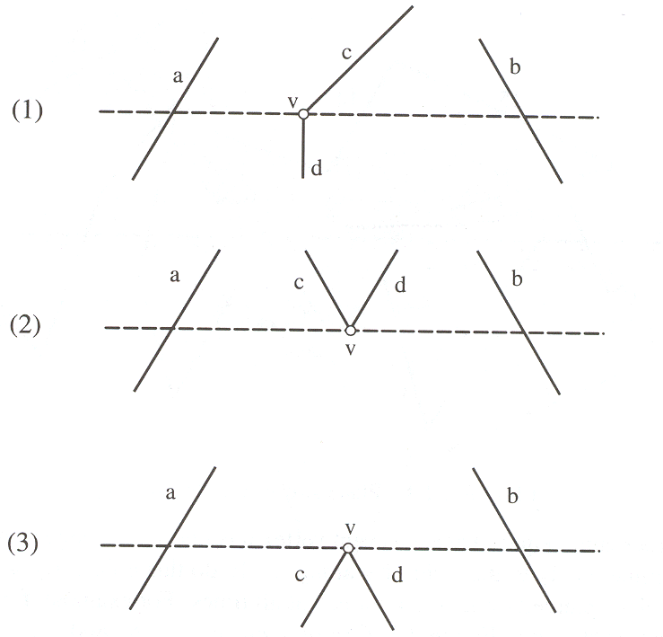
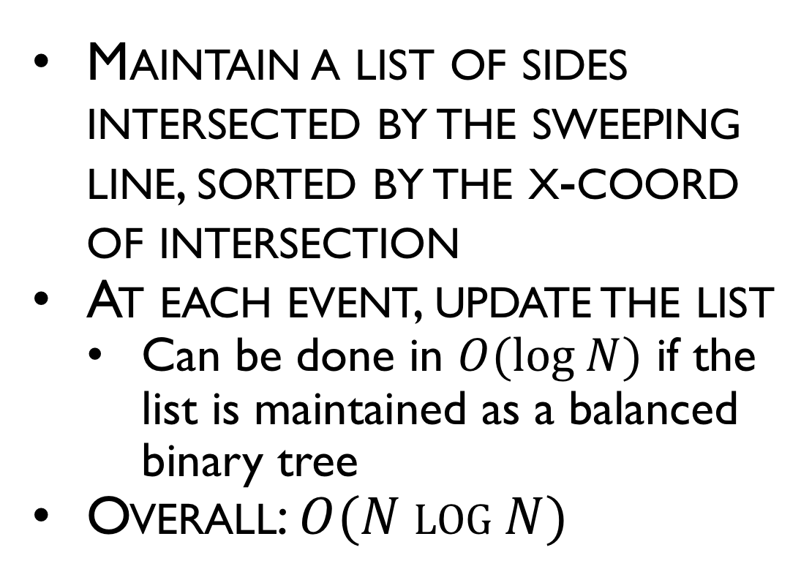
Forming trapezoids
Maintain a list of sides intersected by the sweeping line, sorted by the x-coord of intersection
At each event, update the list
Can be done in $O(log N)$ if the list is maintained as a balanced binary tree
Overall: $O(N log N)$

Slide 32
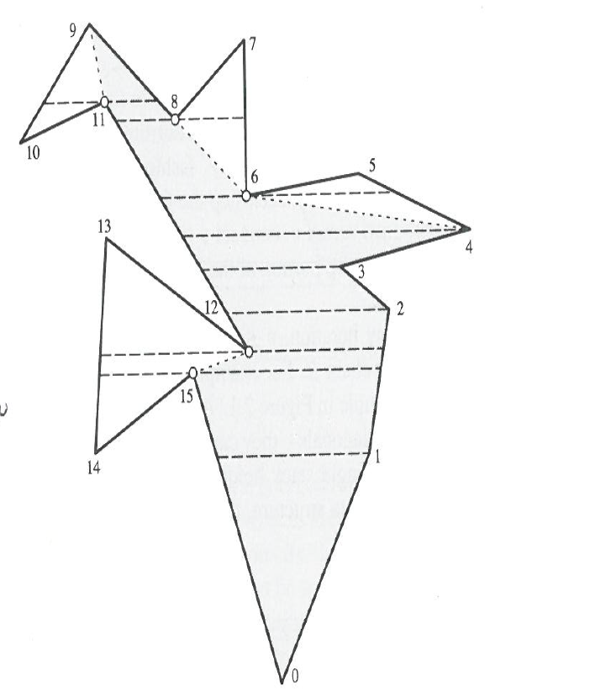
Forming trapezoids
Breaking into monotone parts
(full algorithm explained in book)

Slide 33
Line Sweep Example

Slide 34
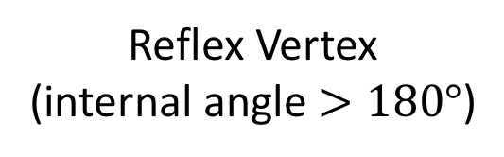
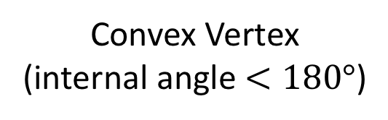
Reminder
Reflex Vertex (internal angle $>180°$)
Convex Vertex
(internal angle $<180°$)

Slide 35





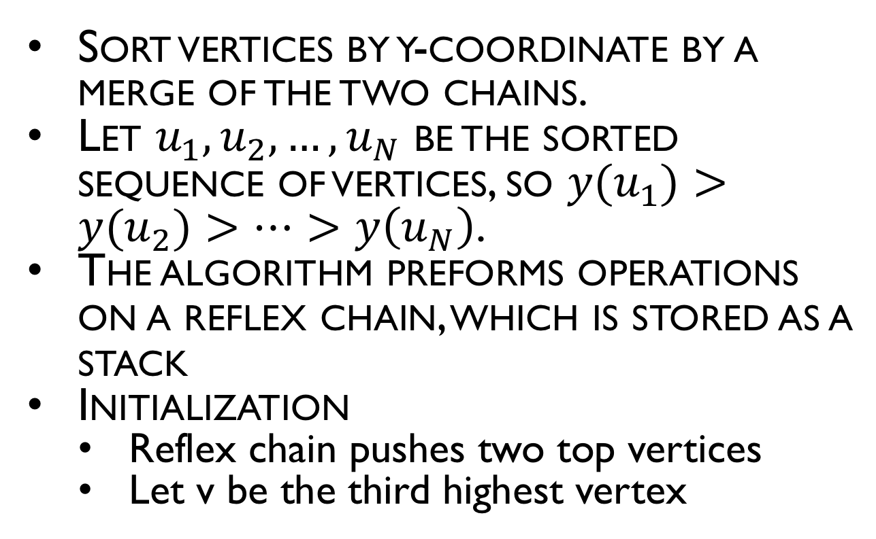









Triangulation of monotone polygon
Sort vertices by y-coordinate by a merge of the two chains.
Let $u_{1}, u_{2}, …, u_{N}$ be the sorted sequence of vertices, so $y(u_{1})>y(u_{2})>…>y\left(u_{N}\right)$.
The algorithm preforms operations on a reflex chain, which is stored as a stack
Initialization
Reflex chain pushes two top vertices
Let v be the third highest vertex
Reflex chain
$$u_{1}$$
$$v$$
$$u_{2}$$
$$u_{3}$$
$$u_{4}$$
$$u_{5}$$
$$u_{6}$$
$$u_{7}$$
$$u_{9}$$
$$u_{8}$$
$$u_{11}$$
$$u_{10}$$
$$u_{12}$$
$$u_{13}$$

Slide 36
Description of the processing triangulation
The algorithm processes one vertex at a time in order of decreasing y coordinate, creating diagonals of polygon P
At each step process 1 of 3 cases
Each diagonal bounds a triangle, and leaves a polygon with one less side still to be triangulated

Slide 37
Triangulation of monotone polygon
while v != lowest vertex do:
Case 1: v is on chain opposite reflex chain
Case 2: v is adjacent to bottom of reflex chain and v+ is strictly convex
Case 3: v is adjacent to bottom of reflex chain and v+ is reflex or flat

Slide 38





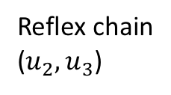

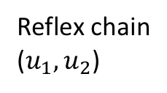
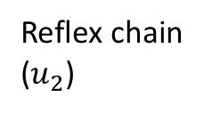





Triangulation of monotone polygon
Case 1: v is on chain opposite reflex chain
Draw diagonal from v to second vertex from top of chain
Remove top of chain
If chain has one element then add v, advance v
Reflex chain
($u_{1},u_{2}$)
$$u_{1}$$
$$v$$
$$u_{2}$$
$$u_{4}$$
$$u_{3}$$
$$u_{1}$$
$$v$$
Reflex chain
($u_{2}$)
$$u_{2}$$
$$u_{3}$$
$$u_{4}$$
$$u_{1}$$
$$v$$
Reflex chain
($u_{2},u_{3}$)
$$u_{2}$$
$$u_{3}$$
$$u_{4}$$

Slide 39


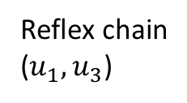

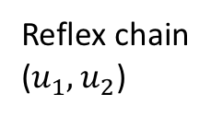




Triangulation of monotone polygon
Case 2: v is adjacent to bottom of reflex chain AND v+ is strictly convex
Draw diagonal from v to second vertex from bottom of chain
Remove bottom of chain
Add v to chain, advance v
Reflex chain
($u_{1},u_{2}$)
$$u_{1}$$
$$u_{2}$$
$$v$$
$$u_{3}$$
$$u_{4}$$
$$u_{1}$$
Reflex chain
($u_{1},u_{3}$)
$$u_{2}$$
$$u_{3}$$
$$u_{4}$$

Slide 40


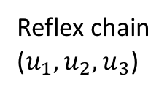
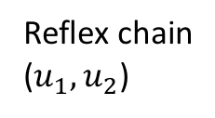



Triangulation of monotone polygon
Case 3: v is adjacent to bottom of reflex chain AND v+ is reflex or flat
Add v to bottom of reflex chain, advance v
Reflex chain
($u_{1},u_{2}$)
$$u_{1}$$
$$u_{2}$$
$$v$$
$$u_{3}$$
$$u_{4}$$
Reflex chain
($u_{1},u_{2},u_{3}$)
$$u_{1}$$
$$u_{2}$$
$$u_{3}$$
$$u_{4}$$

Slide 41









Triangulation of monotone polygon Example
$$u_{1}$$
$$u_{2}$$
$$u_{3}$$
$$u_{4}$$
$$u_{5}$$
$$u_{6}$$
$$u_{7}$$
$$u_{8}$$
$$u_{9}$$
$$u_{10}$$

Slide 42
Triangulation of monotone polygon Example
Case 1: v is on chain opposite reflex chain
Draw diagonal from v to second vertex from top of chain
Remove top of chain
If chain has one element then add v, advance v
$$u_{1}$$
Reflex chain
$$u_{2}$$
$$v$$
Case 2: v is adjacent to bottom of reflex chain AND v+ is strictly convex
Draw diagonal from v to second vertex from bottom of chain
Remove bottom of chain
Add v to chain, advance v
$$u_{3}$$
$$u_{4}$$
$$u_{5}$$
Case 3: v is adjacent to bottom of reflex chain AND v+ is reflex or flat
Add v to bottom of reflex chain, advance v
$$u_{6}$$
$$u_{7}$$
$$u_{8}$$
$$u_{9}$$
Case 3
$$u_{10}$$

Slide 43
Triangulation of monotone polygon Example
Case 1: v is on chain opposite reflex chain
Draw diagonal from v to second vertex from top of chain
Remove top of chain
If chain has one element then add v, advance v
$$u_{1}$$
$$u_{2}$$
Case 2: v is adjacent to bottom of reflex chain AND v+ is strictly convex
Draw diagonal from v to second vertex from bottom of chain
Remove bottom of chain
Add v to chain, advance v
$$u_{3}$$
$$u_{4}$$
$$u_{5}$$
Case 3: v is adjacent to bottom of reflex chain AND v+ is reflex or flat
Add v to bottom of reflex chain, advance v
$$u_{6}$$
$$u_{7}$$
$$u_{8}$$
$$u_{9}$$
$$u_{10}$$

Slide 44

Triangulation of monotone polygon Example
$$u_{1}$$
$$u_{2}$$
$$u_{3}$$
$$u_{4}$$
$$u_{5}$$
$$u_{6}$$
$$u_{7}$$
$$u_{8}$$
$$u_{9}$$
$$u_{10}$$

Slide 45
Analysis of triangulating a monotone polygon
The initial sort (merge) requires O(N) time.
Triangulation visits each of the N vertices and places on the stack exactly once, except when the while fails in case (ii).
This happens at most once per vertex, so that time can be charged to the current vertex.
⇒ The algorithm requires O(N) time to triangulate a monotone polygon, where N is the number of vertices of the polygon.

Slide 46
Putting it all together
Analysis of Triangulation of Simple Polygon
Sort vertices by y coordinates: O(N log N)
Perform plane sweep to construct trapezoids: O(N log N)
Partition into monotone polygons: O(N)
Triangulate each monotone polygon: O(N)
Overall: O(N log N)
N is the number of vertices of the polygon

Slide 47
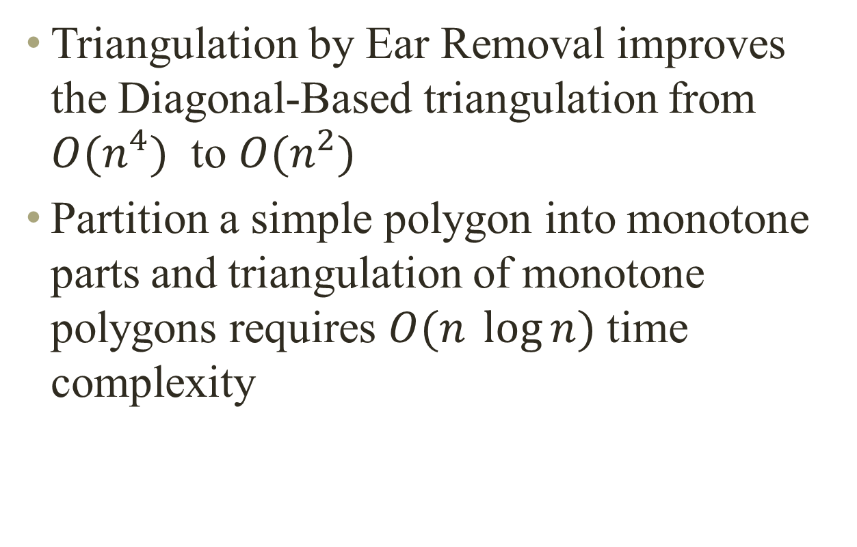
Summary
Triangulation by Ear Removal improves the Diagonal-Based triangulation from $O(n^{4})$ to $O(n^{2})$
Partition a simple polygon into monotone parts and triangulation of monotone polygons requires $O(n \log{n)}$ time complexity

Slide 48
Description of the processing triangulation of y-monotone polygons
The algorithm processes one vertex at a time in order of decreasing y coordinate, creating diagonals of polygon P.
The sweep line moves from top to down and stops at each vertex of polygon P
Each diagonal bounds a triangle, and leaves a polygon with one less side still to be triangulated

Slide 49
Description of the processing triangulation of y-monotone polygons
Sort the vertices top-to-down by a merge of the two chains
Initialize a stack. Push the first two vertices in the stack
Take the next vertex u, and triangulate as much as possible, top-down, while popping the stack
Push u onto the stack

Slide 50
Towards Linear-Time Triangulation
Year Complexity Authors

Slide 51
Linear-Time Triangulation
Chazelle’s Algorithm (High-Level Sketch)
Computes visibility map
Algorithm is like MergeSort (divide-and-conquer)
Partition polygon of n vertices into n/2 vertex chains
Merge visibility maps of subchains to get one for chain
Improve this by dividing process into 2 phases:
Coarse approximations of visibility maps for linear-time merge
Refine coarse map into detailed map in linear time

Slide 52
Convex Partitioning
Polygon partitioning is an important preprocessing step for many geometric algorithms
Partitioning a polygon means completely dividing the interior into nonoverlapping pieces.
Covering a polygon means that our decomposition is permitted to contain mutually overlapping pieces.
An issue associated with polygon decomposition is whether we are allowed to add Steiner vertices (either by splitting edges or adding interior points) or whether we are restricted to adding chords between two existing vertices.

Slide 53
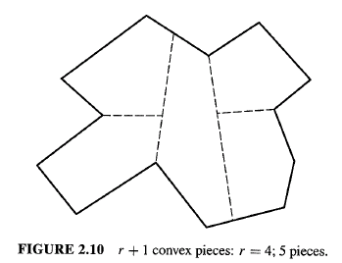
Convex Partitioning
Competing Goals:
minimize number of convex pieces
minimize partitioning time
Add (Steiner) points or just use diagonals and not add points?
Adding segments with Steiner points.
r = number of reflex vertices
Adding only diagonals.

Slide 54
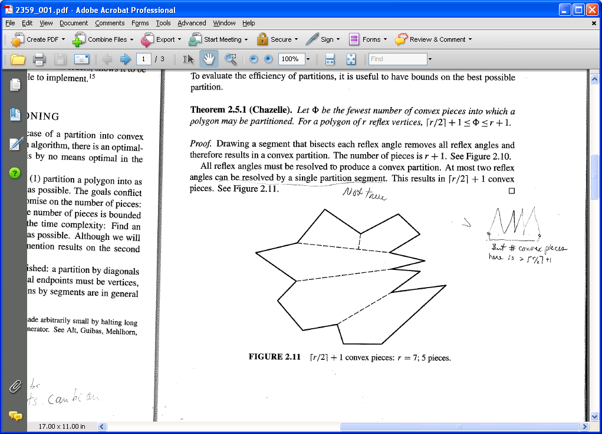
Convex Partitioning
Theorem (Chazelle): Let F be the fewest number of convex pieces into which a polygon may be partitioned. For a polygon of r reflex vertices:
Lower bound:
Must eliminate all reflex vertices. Single segment resolves at most 2 reflex angles.
Upper bound:
Bisect each reflex angle.

Slide 55
Convex Partitioning
Hertel-Mehlhorn’s Algorithm (1983):
Start with any triangulation.
Iteratively remove nonessential diagonals
Essential diagonal d are those that creates non-convex piece
Can be done in O(n) time with the use of appropriate data structures
The only issue is how far from the optimum might it be

Slide 56
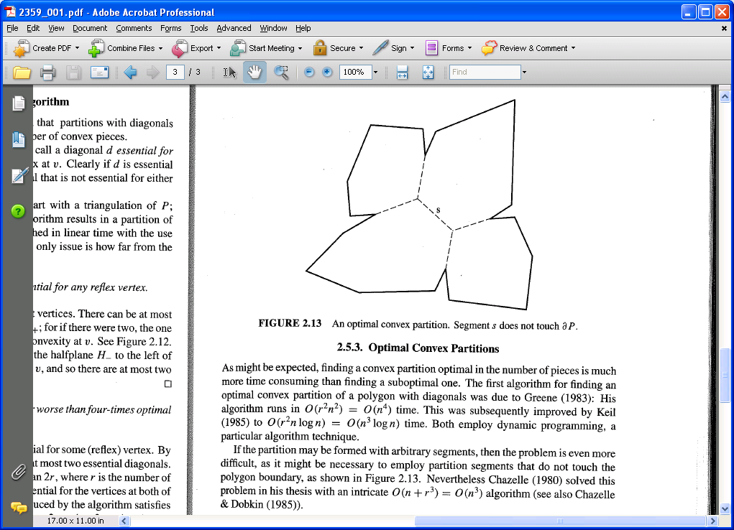
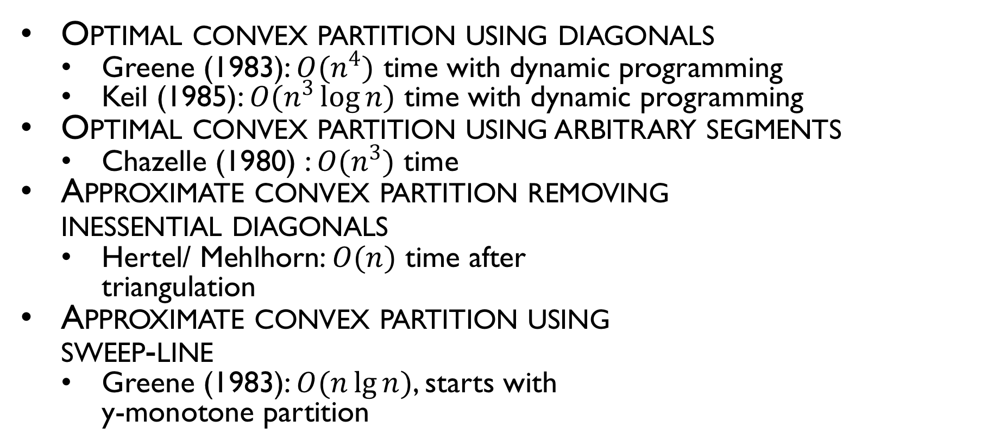
Algorithms for Optimal Convex Partitioning of a Polygon
Optimal convex partition using diagonals
Greene (1983): $O(n^{4})$ time with dynamic programming
Keil (1985): $O(n^{3}\log{n})$ time with dynamic programming
Optimal convex partition using arbitrary segments
Chazelle (1980) : $O(n^{3})$ time
Approximate convex partition removing inessential diagonals
Hertel/ Mehlhorn: $O(n)$ time after triangulation
Approximate convex partition using sweep-line
Greene (1983): $O(n\lg{n})$, starts with y-monotone partition

Slide 57
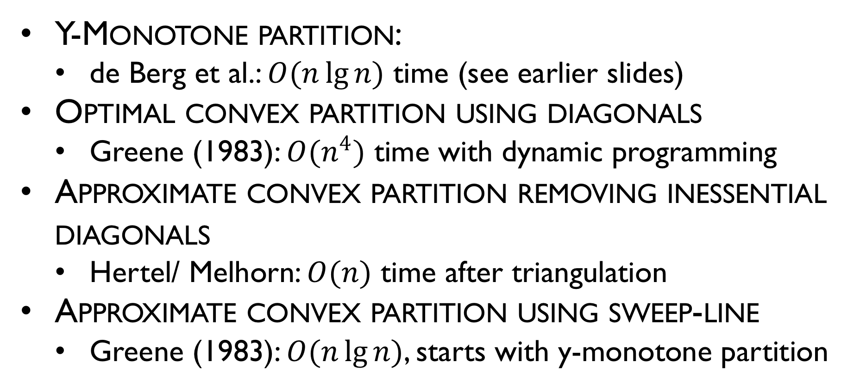
Convex Polygon Partitioning
Y-Monotone partition:
de Berg et al.: $O(n\lg{n})$ time (see earlier slides)
Optimal convex partition using diagonals
Greene (1983): $O(n^{4})$ time with dynamic programming
Approximate convex partition removing inessential diagonals
Hertel/ Melhorn: $O(n)$ time after triangulation
Approximate convex partition using sweep-line
Greene (1983): $O(n\lg{n})$, starts with y-monotone partition

