Slide 1
COT 4521: Introduction to Computational Geometry
Convex Hull

Slide 2
Convex Hull Algorithms
Definitions
Naïve Algorithms
QuickHull
Gift Wrapping
Graham Scan
Incremental
Divide-and-Conquer

Slide 3
Convex hulls
Given N distinct points on the plane, the convex hull of these points is the smallest convex polygon enclosing all of them

Slide 4
Applications of convex hull
Fitting ranges with a line
Sheep and goats problem—Can you draw a straight line fence that will separate the sheep from the goats?
Take the convex hull of each set, if they do not intersect then you can put in a fence. If they intersect, no. (useful in data mining)
Collision avoidance
Robotics problem - if the convex hulls don't run into each other than the robots won't either.
Smallest box
Finding the smallest area rectangle enclosing a polygon.
Shape analysis
Point shapes can be classified by the similarity of their convex shapes.

Slide 5
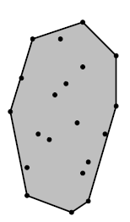
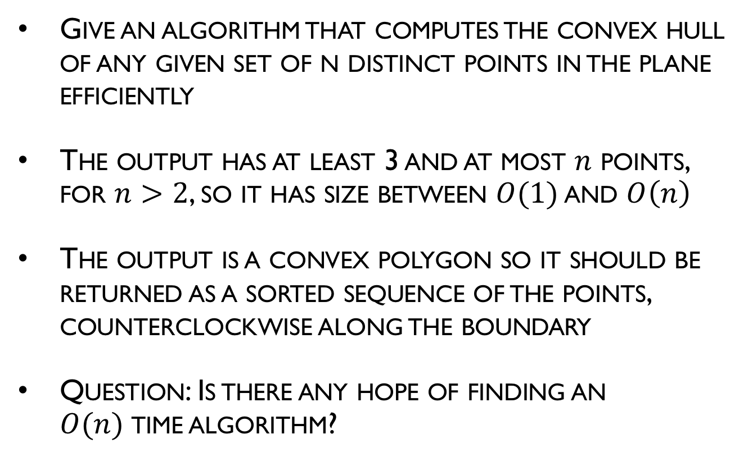
Convex hull problem
Give an algorithm that computes the convex hull of any given set of n distinct points in the plane efficiently
The output has at least 3 and at most $n$ points, for $n>2$, so it has size between $O(1)$ and $O\left(n\right)$
The output is a convex polygon so it should be returned as a sorted sequence of the points, counterclockwise along the boundary
Question: Is there any hope of finding an $O(n)$time algorithm?

Slide 6
Definitions of convexity and convex hull
The convex hull of a finite set of points S in the plane is the smallest convex polygon P that encloses S, smallest in the sense that there is no other polygon P’ such that P ⊇ P’ ⊇ S
Ideas?

Slide 7
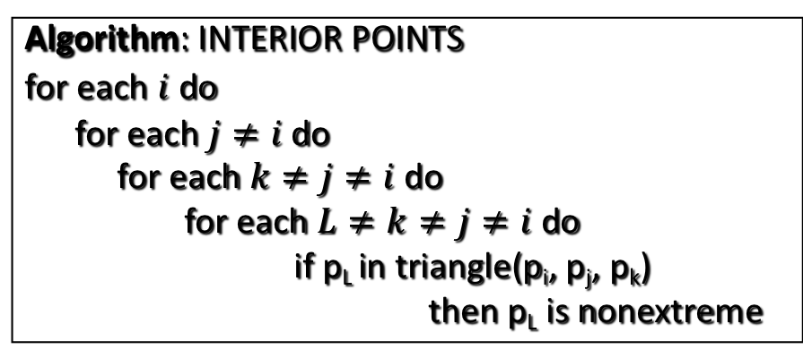
Naïve Algorithms for Extreme Points
Algorithm: INTERIOR POINTS
for each $i$ do
for each $j≠i$do
for each $k≠j≠i$ do
for each $L≠k≠j≠i$ do
if p_{L} in triangle(p_{i}, p_{j}, p_{k})
then p_{L} is nonextreme
Performance?
O(n⁴)

Slide 8
Definitions of convexity and convex hull
The convex hull of a set of points S is also intersection of all half spaces that contain S
Ideas?

Slide 9
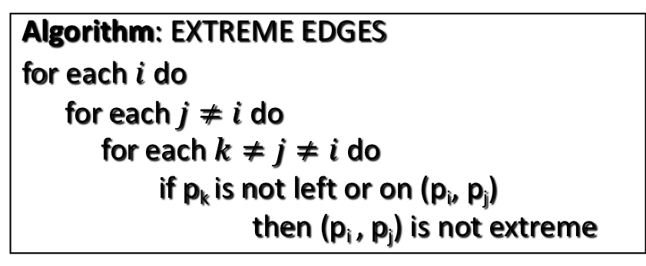
Naïve Algorithms for Extreme Points
Algorithm: EXTREME EDGES
for each $i$ do
for each $j≠i$ do
for each $k≠j≠i$ do
if p_{k} is not left or on (p_{i}, p_{j})
then (p_{i} , p_{j}) is not extreme
Performance?
O(n³)

Slide 10
QuickHull
Concentrate on points close to hull boundary
Named for similarity to Quicksort
The idea is:
Discard many points as definitely interior to the hull
Concentrate on those to the hull boundary

Slide 11
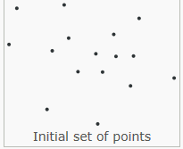
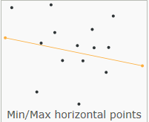
QuickHull Algorithm
Find two distinct extreme points
Use the rightmost lowest and leftmost highest points x and y, which are guaranteed extreme and distinct
The full hull is composed of an “upper hull” above a line and a “lower hull” below a line

Slide 12
QuickHull Algorithm
Divide
The line formed by these two points is used to divide the set into two different parts
Everything left from this line is considered one part, everything right of it is considered another one
Both of these parts are processed recursively
Find extreme points in an “upper hull” and in a “lower hull”

Slide 13
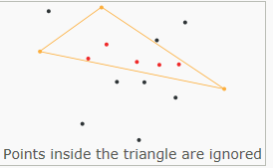
QuickHull Algorithm
Discard all points inside Δ
Operate recursively on the points outside segments AC and BC
C
A
B

Slide 14
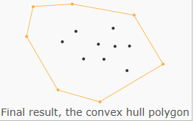
QuickHull Algorithm

Slide 15
QuickHull Example
Find two distinct extreme points
Divide
Find extreme points in upper and lower hull
Discard all points inside Δ
Recurse

Slide 16
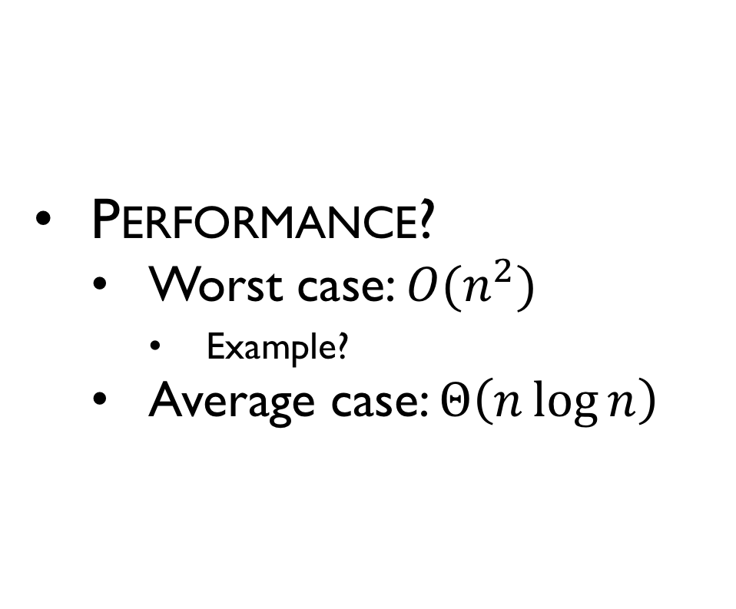
QuickHull Performance
Performance?
Worst case: $O(n^{2})$
Example?
Average case: $Θ\left(n\log{n}\right)$

Slide 17
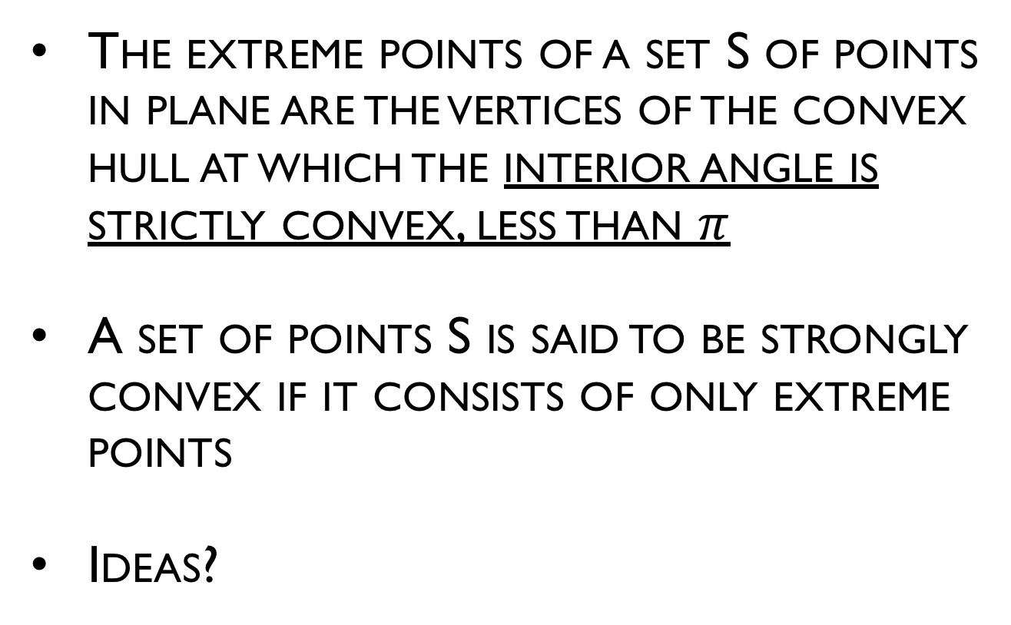
Extreme points
The extreme points of a set S of points in plane are the vertices of the convex hull at which the interior angle is strictly convex, less than $π$
A set of points S is said to be strongly convex if it consists of only extreme points
Ideas?

Slide 18
Jarvis's Algorithm (Gift-Wrapping)
The simplest algorithm for computing convex hulls simply simulates the process of wrapping a piece of string around the points
This algorithm is called Jarvis's march or gift-wrapping algorithm
Jarvis's march starts by computing the bottommost point, since we know this point must be a convex hull vertex

Slide 19
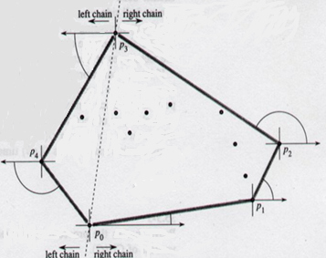
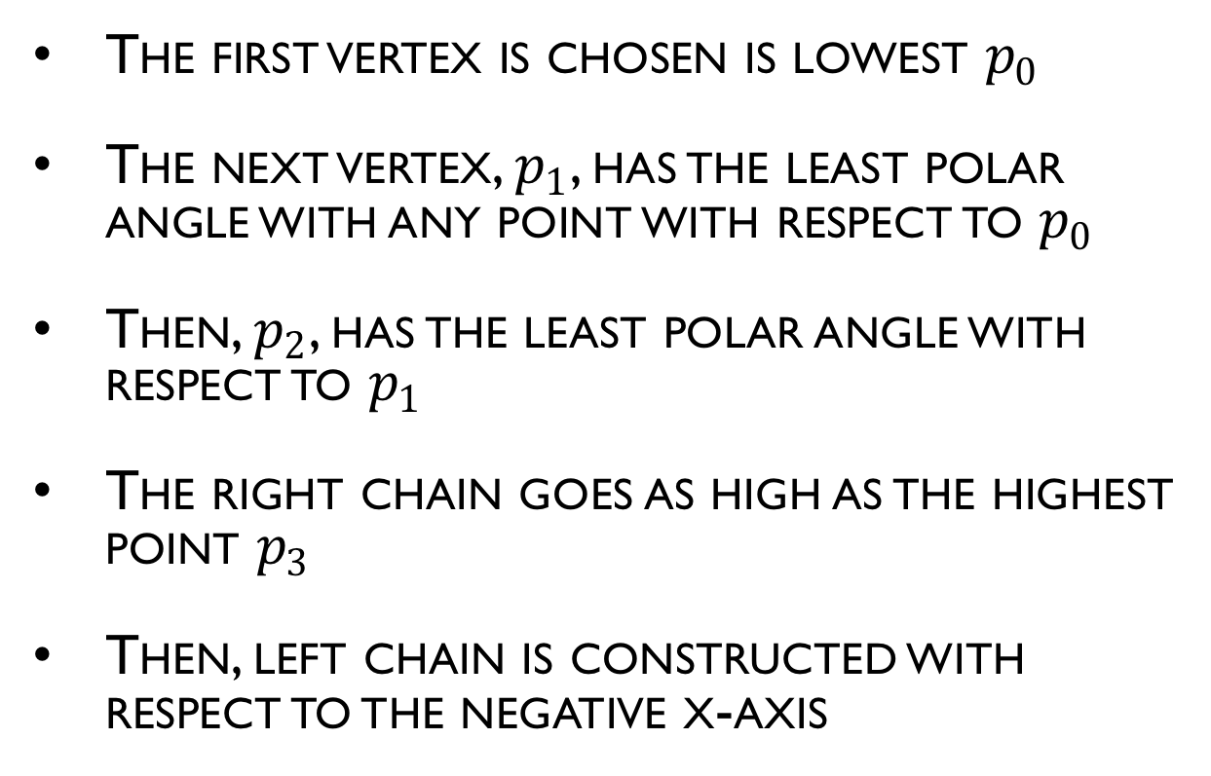
2D Gift Wrapping
The first vertex is chosen is lowest $p_{0}$
The next vertex, $p_{1}$, has the least polar angle with any point with respect to $p_{0}$
Then, $p_{2}$, has the least polar angle with respect to $p_{1}$
The right chain goes as high as the highest point $p_{3}$
Then, left chain is constructed with respect to the negative x-axis

Slide 20
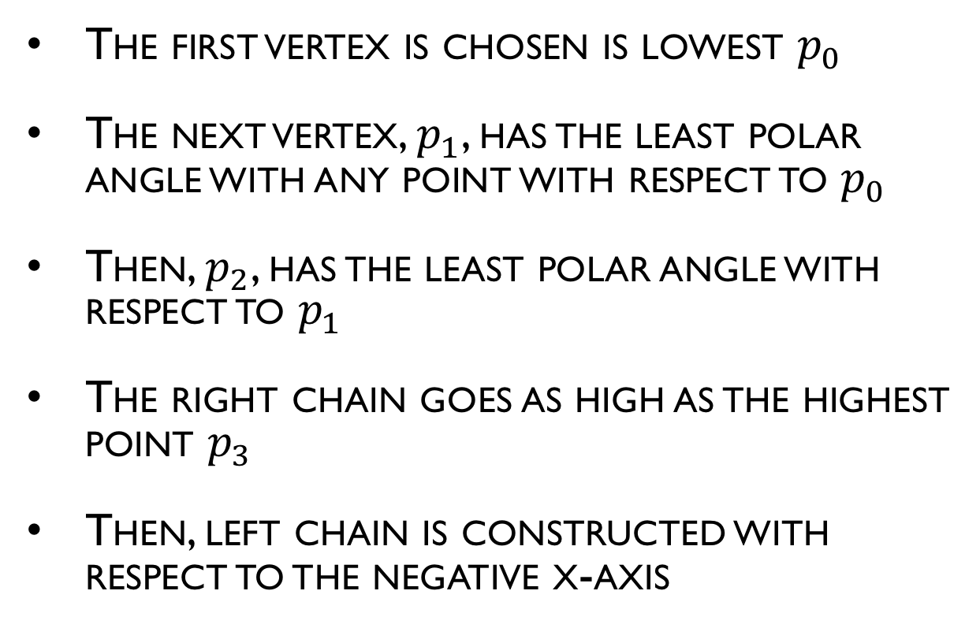
Example
The first vertex is chosen is lowest $p_{0}$
The next vertex, $p_{1}$, has the least polar angle with any point with respect to $p_{0}$
Then, $p_{2}$, has the least polar angle with respect to $p_{1}$
The right chain goes as high as the highest point $p_{3}$
Then, left chain is constructed with respect to the negative x-axis

Slide 21
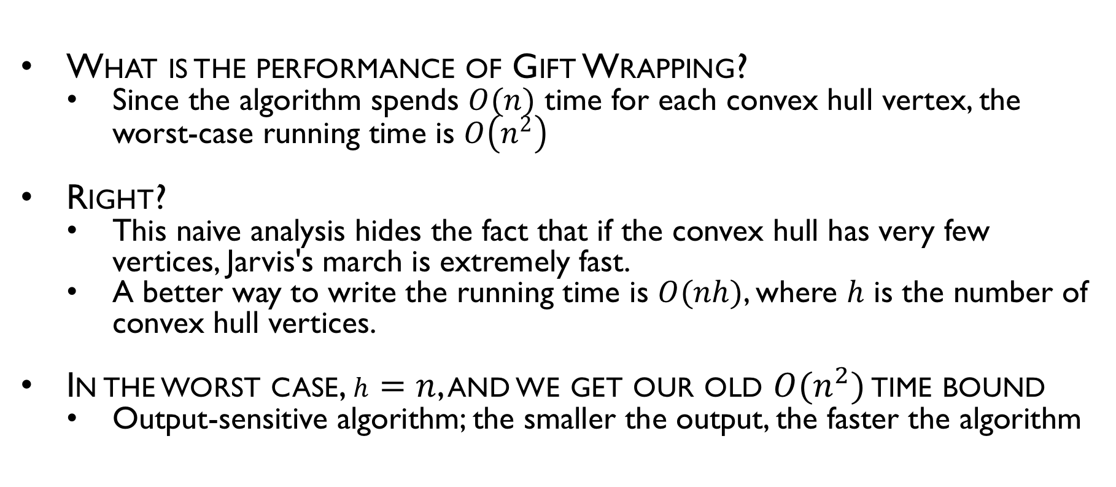
2D Gift Wrapping
What is the performance of Gift Wrapping?
Since the algorithm spends $O(n)$ time for each convex hull vertex, the worst-case running time is $O\left(n^{2}\right)$
Right?
This naive analysis hides the fact that if the convex hull has very few vertices, Jarvis's march is extremely fast.
A better way to write the running time is $O(nh)$, where $h$ is the number of convex hull vertices.
In the worst case, $h=n$, and we get our old $O(n^{2})$ time bound
Output-sensitive algorithm; the smaller the output, the faster the algorithm

Slide 22
Graham’s Algorithm
Given the left most point
Sort the points by angle, counterclockwise about that point
Process the points in their sorted order (use data structure – stack)

Slide 23
Graham’s Algorithm
Points sorted angularly provide “star-shaped” starting point
Prevent “dents” as you go via convexity testing

Slide 24
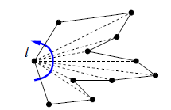
Graham’s Algorithm
Start Graham's scan by finding the leftmost point l
Then we sort the points in counterclockwise order around l.
We can do this in O(n log n) time with any comparison-based sorting algorithm (quicksort, merge sort, heap sort, etc.).
To compare two points p and q, we check whether the triple l; p; q is oriented clockwise or counterclockwise.
Once the points are sorted, we connected them in counterclockwise order, starting and ending at l.
The result is a simple polygon with n vertices.

Slide 25
Graham’s Algorithm
Using a stack data structure, place l and the 2 points after L onto the stack
Repeat until l
Place the the next element on the stack
Check for convexity

Slide 26
Graham’s Algorithm
Check for convexity
Pop the top 3 elements from the stack—p; q; r of the polygon (a initially, these are the 2 vertices after l)
We now apply the following two rules:
If p; q; r are in counterclockwise order—Push p; q; r back onto the stack
If p; q; r are in clockwise order—Remove q from the polygon by pushing p and q back onto the stack. Repeat convexity check.

Slide 27
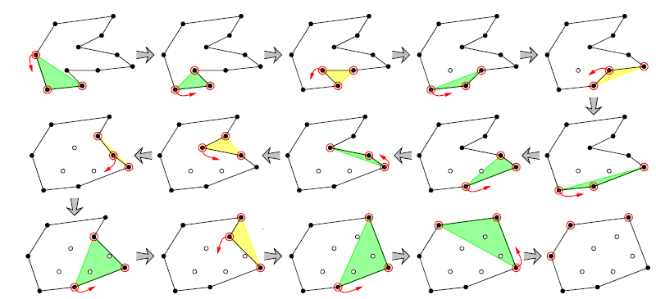
Graham’s Algorithm Example

Slide 28
Graham Scan Example
place l and the 2 points after L onto the stack
Repeat until l
Place the the next element on the stack
Check for convexity
Pop the top 3 elements from the stack—p; q; r of the polygon (a initially, these are the 2 vertices after l)
If p; q; r are in counterclockwise order—Push p; q; r back onto the stack
If p; q; r are in clockwise order—Remove q from the polygon by pushing p and q back onto the stack. Repeat convexity check.

Slide 29
Complexity of Graham’s Algorithm
Sorting phase: O(n log n)
Scanning phase
Whenever a point moves forward, it moves onto a vertex that hasn't seen a point before (except the last time)—So the first rule is applied n - 2 times.
Whenever a point moves backwards, a vertex is removed from the polygon—So the second rule is applied exactly n - h times, where h is as usual the number of convex hull vertices.
Since each counterclockwise test takes constant time, the scanning phase takes O(n) time altogether.
Overall: O(n log n)

Slide 30
2D Incremental
Add points, one at a time
update hull for each new point by finding tangent points
Key step becomes adding a single point to an existing hull.

Slide 31
How do we find tangets?
Naïvely?
Optimal?

Slide 32
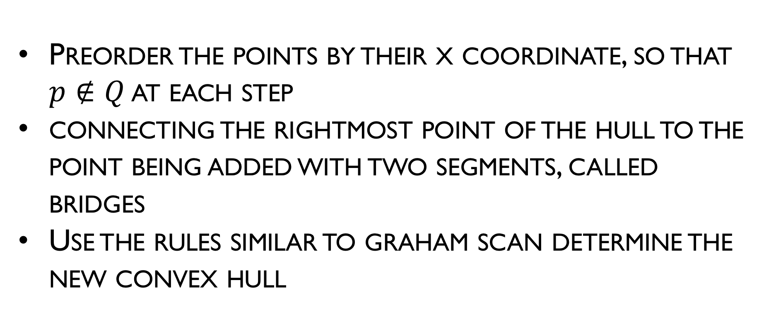
2D Incremental Optimal
Preorder the points by their x coordinate, so that $p∉Q$ at each step
connecting the rightmost point of the hull to the point being added with two segments, called bridges
Use the rules similar to graham scan determine the new convex hull

Slide 33
2D Incremental Optimal
Expand the bridges
As long as there is a clockwise turn at the endpoint of either bridge, remove that point from the circular sequence of vertices and connect its two neighbors.
As soon as the turns at both endpoints of both bridges are counter-clockwise, stop.
At that point, the bridges lie on the upper and lower common tangent lines of the two sub-hulls.

Slide 34
2D Incremental Optimal Example

Slide 35
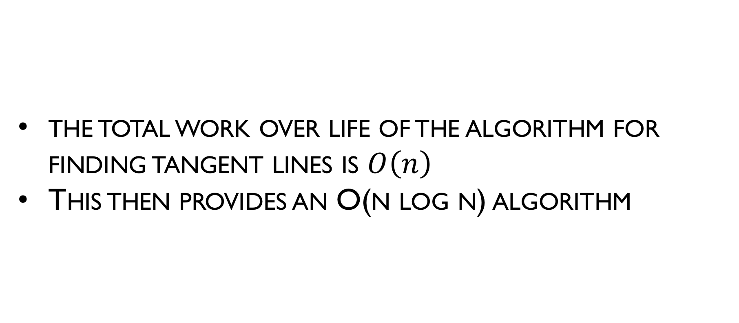
Optimal incremental algorithm
the total work over life of the algorithm for finding tangent lines is $O\left(n\right)$
This then provides an O(n log n) algorithm

Slide 36
The divide-and-conquer design paradigm
Divide the problem (instance) into subproblems, each of size n/b
Conquer the subproblems by solving them recursively.
Combine subproblem solutions.
Runtime is f(n)

Slide 37
Divide and Conquer
Idea of Divide and Conquer algorithm:
Start by choosing a pivot point p.
Partitions the input points into two sets L and R, containing the points to the left of p, including p itself, and the points to the right of p, by comparing x-coordinates.
Recursively compute the convex hulls of L and R. Finally, merge the two convex hulls into the final output.

Slide 38
Merging, thoughts?
B
A

Slide 39
Divide and Conquer (Merging)
Find the rightmost point of the hull of L with the leftmost point of the hull of R
Call these points p and q, respectively.
connecting pq with bridges
Use the rules of graham scan/Incremental to isolate the merged convex hull

Slide 40
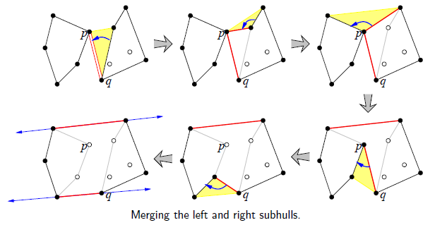
Divide and Conquer (Merge Example)

Slide 41
Divide and Conquer Example

Slide 42
Analysis of Divide and Conquer
Merging the two sub-hulls takes O(n) time.
The running time is given by the recurrence T(n) = O(n)+T(k)+T(n - k), just like quicksort, where k the number of points in R.

Slide 43
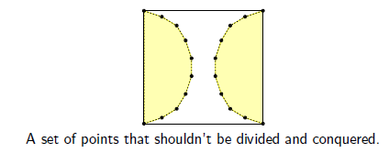
Analysis of Divide and Conquer
Just like quicksort, if we use a naive deterministic algorithm to choose the pivot point p, the worst-case running time of this algorithm is O(n²).
If we choose the pivot point randomly, the expected running time is O(n log n).
There are inputs where this algorithm is clearly wasteful (at least, clearly to us). If we're really unlucky, we'll spend a long time putting together the sub-hulls, only to throw almost every thing

Slide 44
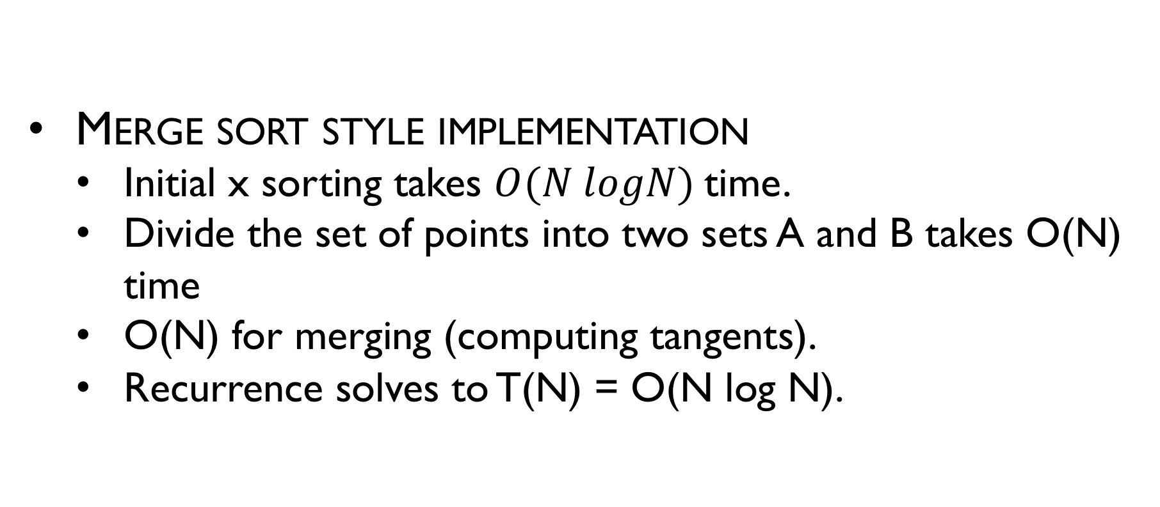
Analysis of Divide and Conquer
Merge sort style implementation
Initial x sorting takes $O(N logN)$time.
Divide the set of points into two sets A and B takes O(N) time
O(N) for merging (computing tangents).
Recurrence solves to T(N) = O(N log N).

Slide 45
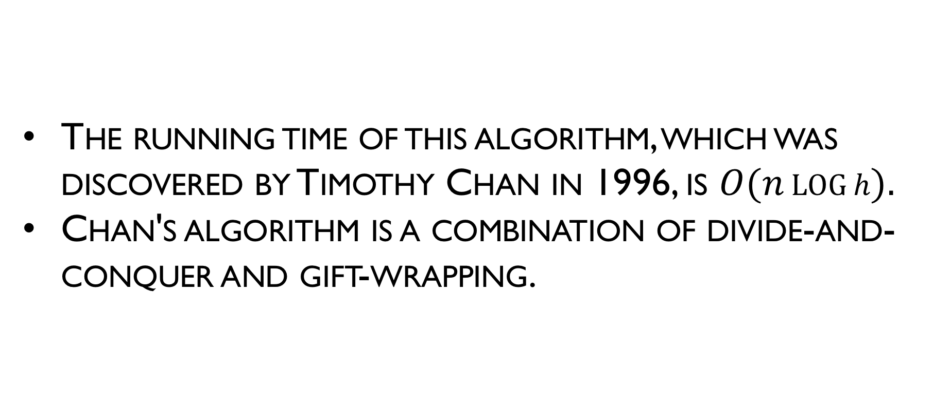
Chan’s algorithm (output-sensitive CH)
The running time of this algorithm, which was discovered by Timothy Chan in 1996, is $O(n\log{h}).$
Chan's algorithm is a combination of divide-and-conquer and gift-wrapping.

Slide 46
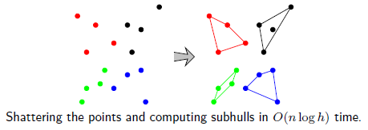
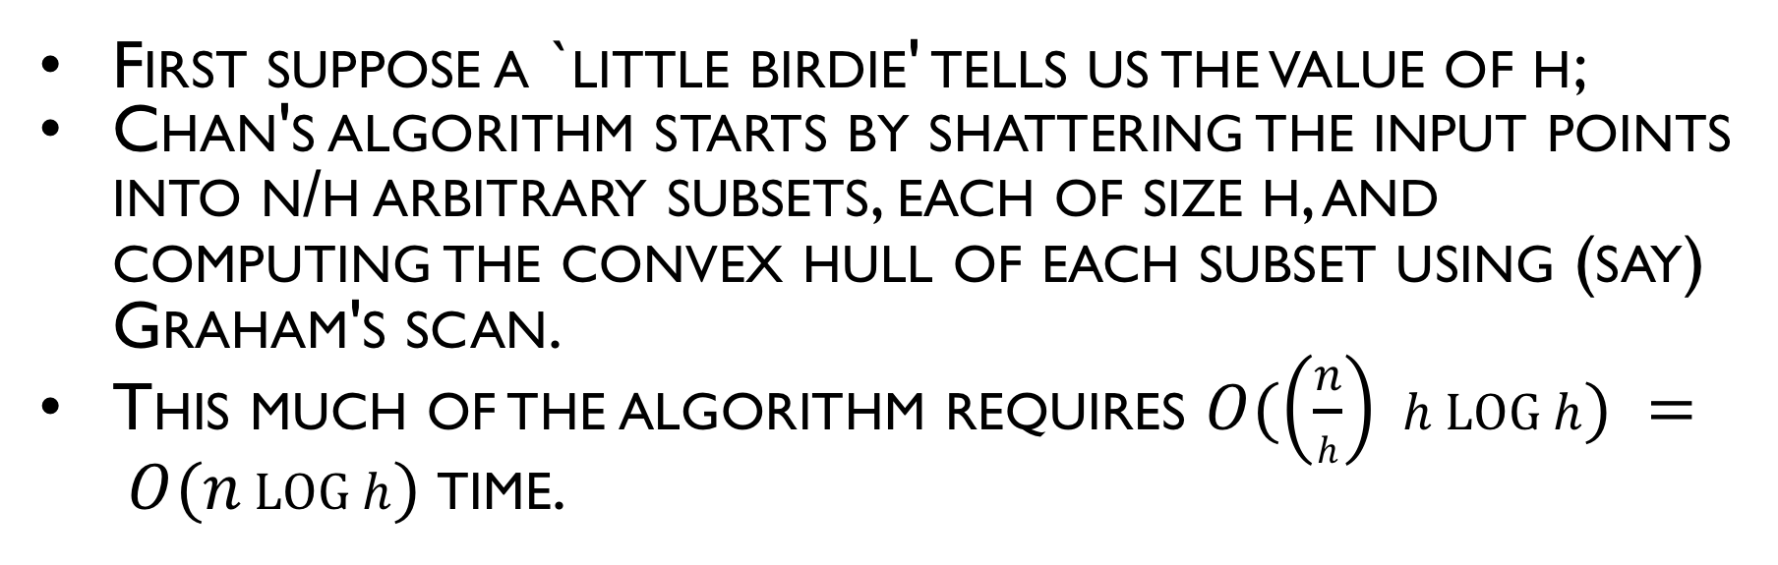
Chan’s algorithm (output-sensitive CH)
First suppose a `little birdie' tells us the value of h;
Chan's algorithm starts by shattering the input points into n/h arbitrary subsets, each of size h, and computing the convex hull of each subset using (say) Graham's scan.
This much of the algorithm requires $O(\left(\frac{n}{h}\right) h\log{h}) = O(n\log{h})$time.

