Slide 1
CIS 4930/6930-002 Data Visualization
PERCEPTION
Paul Rosen
Assistant Professor
University of South Florida
slides credits Chris Johnson (U of Utah), Hanspeter Pfister (Harvard), Bang Wong (Broad Institute), Miriah Meyer (U of Utah)

Slide 2
Topics
eye construction
perceptual vulnerabilities
popout
gestalt principles

Slide 3
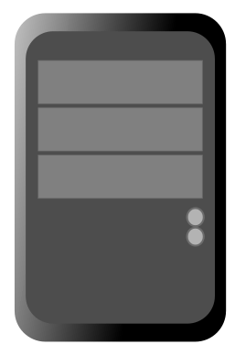
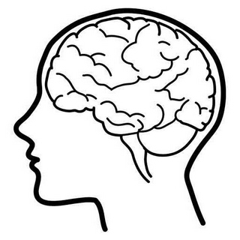
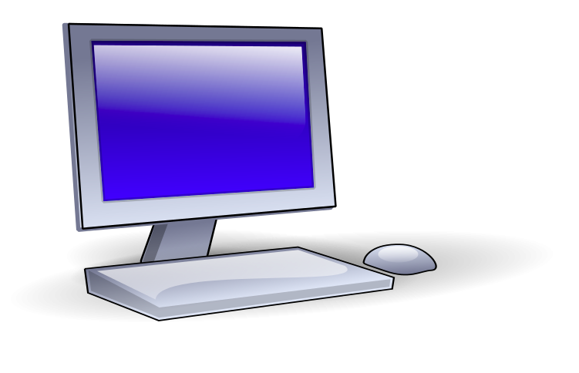

data
knowledge

Slide 4
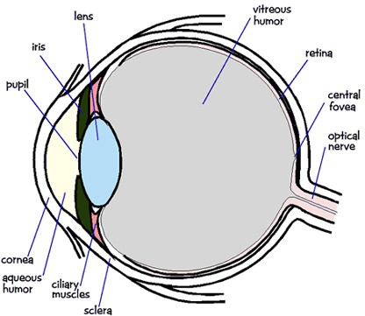

Slide 5
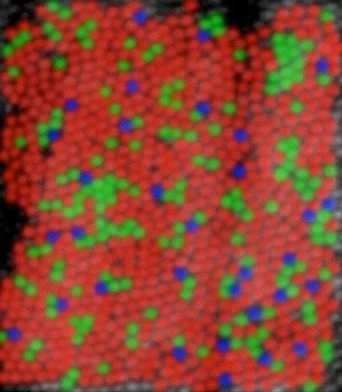
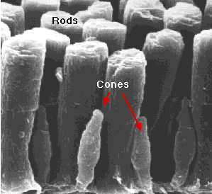
120 million rods
5-6 million cones
Wandell,“Foundations of Vision” (left) David R.Williams, Univ. of Rochester (right)

Slide 6
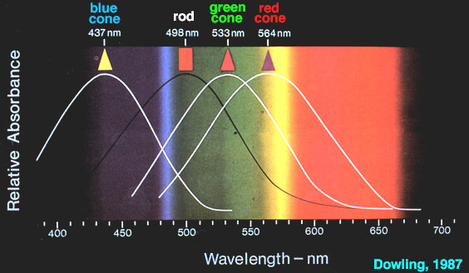
Cone Response

Slide 7
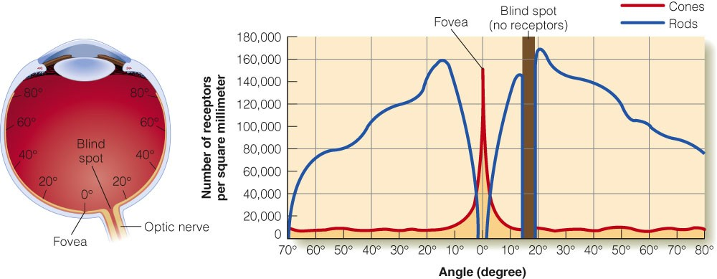
E. B. Goldstein “Sensation and Perception” (Adapted from Lindsay & Norman, 1977)

Slide 8
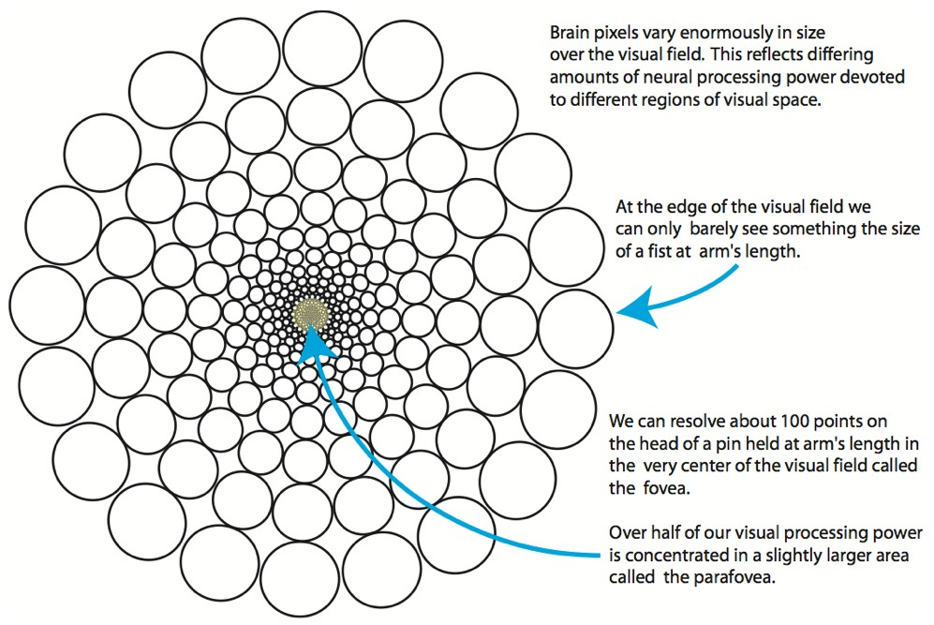
Ware 2010

Slide 9
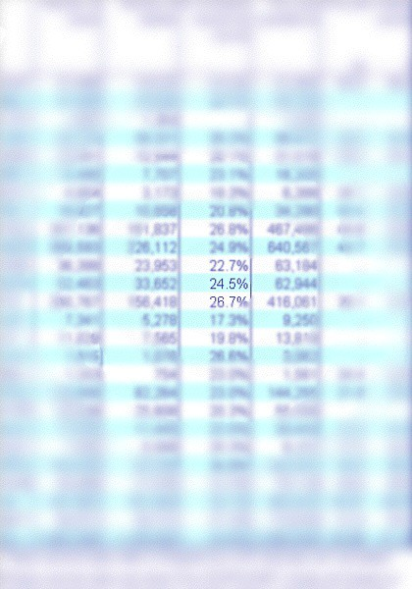
Foveation is relatively easy to see. The key to recognizing the phenomenon is to stair at a single word on the printed page. Then, without moving your gaze, note the blurriness of the surrounding text.
C.Ware,“Visual Thinking for Design”

Slide 10
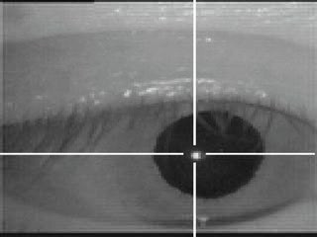
saccadic eye movements
rapid involuntary eye movements
moving: 20-100 ms
fixations: 200-600 ms
http://vision.arc.nasa.gov/personnel/jbm/home/projects/osa98/osa98.html

Slide 11
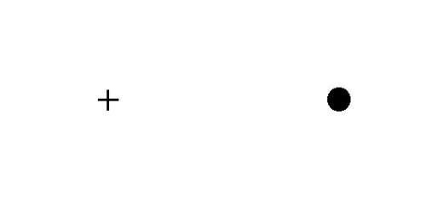
Blind Spot
Close left eye
Stair at +
Move forward and backward until disappears

Slide 12
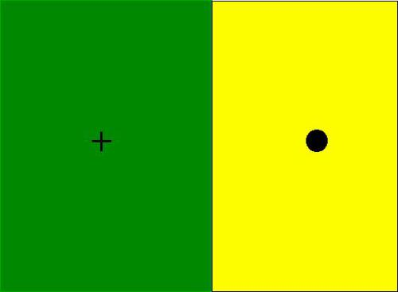
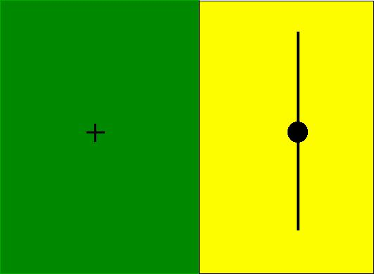
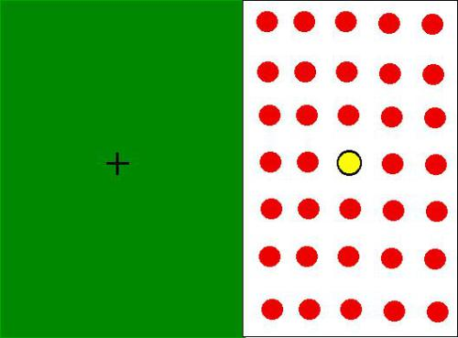
Blind Spot

Slide 13
Takeaway
Our vision at any given moment is relatively limited. Our brain “fills in the missing pieces” using a variety of evolved tools.
Be careful placing too much data on the screen. Crisp and clear will result in the best interpretation.

Slide 14
edge detection

Slide 15
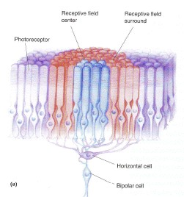
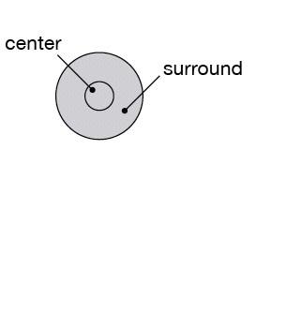

receptive field
light hits rods and cones
100M rods and cones
1M ganglion cells
single neuron fires
Bear, Connors, Paradiso,“Neuroscience”

Slide 16
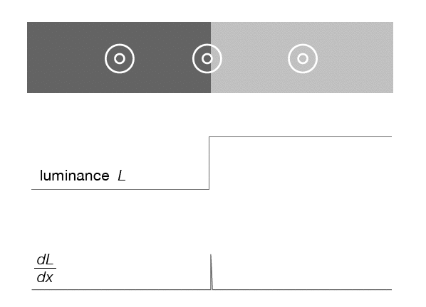
low activity
center and surrounds cancel
activity increased
or decreased at edges

Slide 17
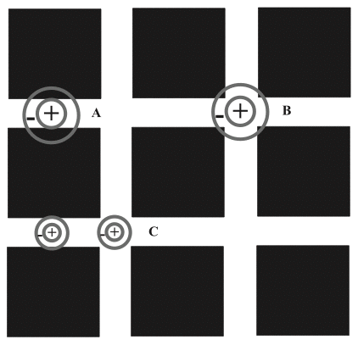
Hermann grid effect
Annie Prud’homme-Généreux

Slide 18
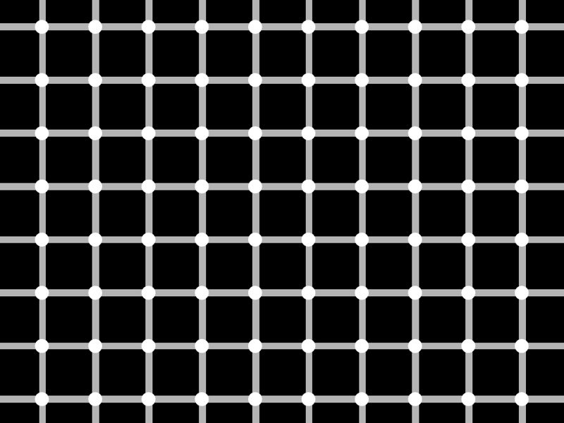

Slide 19
consequences of edge extraction

Slide 20
Cornsweet Illusion

Slide 21
Cornsweet Illusion

Slide 22
Cornsweet Illusion
Actual Luminance
Perceived Luminance

Slide 23
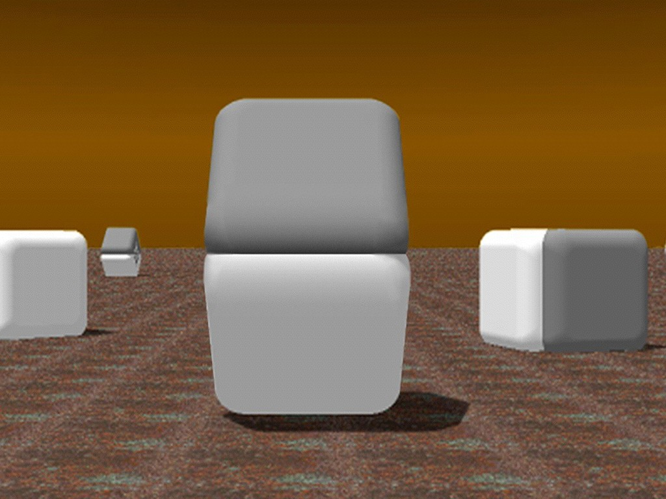
Cornsweet Illusion
D. Purves and R. B. Lotto

Slide 24

Mach Banding

Slide 25
simultaneous contrast

Slide 26
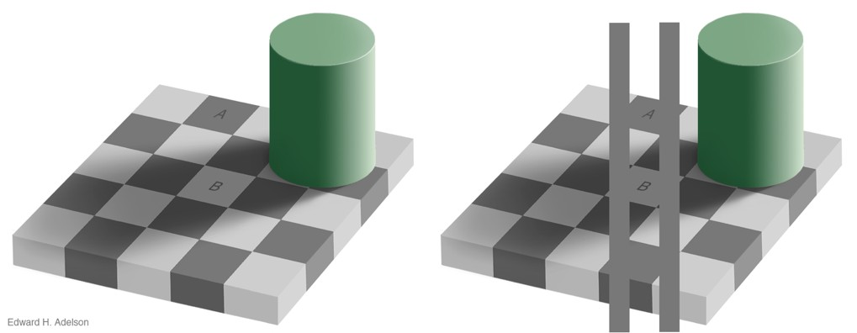
SIMULTANEOUS CONTRAST
http://persci.mit.edu/_media/gallery/checkershadow_double_full.jpg

Slide 27
SIMULTANEOUS CONTRAST

Slide 28
SIMULTANEOUS CONTRAST

Slide 29
SIMULTANEOUS CONTRAST

Slide 30
Takeaway
Our visual system is attracted to edges and is sensitive to differences, not absolute values.
Maximize the contrast with the background if the outlines of shapes are important.

Slide 31
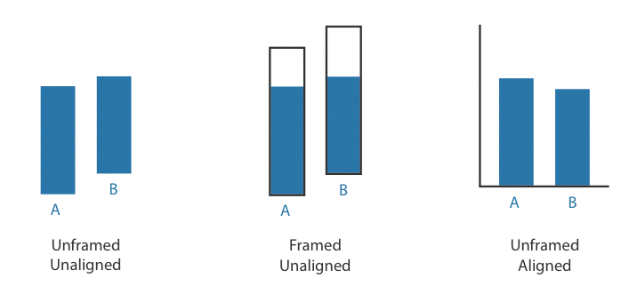
WEBER’S LAW
we judge based on relative, not absolute, differences

Slide 32
AXIS OF ALIGNMENT

Slide 33
AXIS OF ALIGNMENT

Slide 34
Takeaway
We have a strong propensity to assume our judgments are absolute, when in fact they are generally relative to the local context.
Do your best to not place data in difficult contexts. Choose position and orientation of objects carefully.

Slide 35
POPOUT

Slide 36
POPOUT

Slide 37
POPOUT

Slide 38
POPOUT

Slide 39
PRE-ATTENTIVE PROCESSING
requires attention, despite name
very fast: <200 ms
what matters most is contrast between features

Slide 40
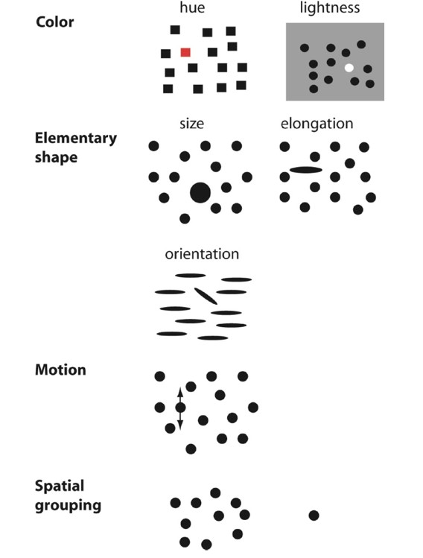
BASIC POPOUT CHANNELS
Ware 2008

Slide 41
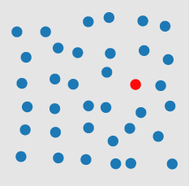
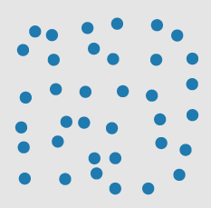
Pick the outlier
Healy 2007

Slide 42
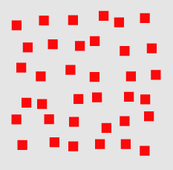
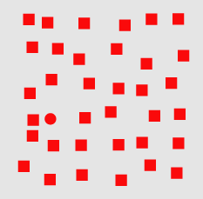
Pick the outlier
Healy 2007

Slide 43
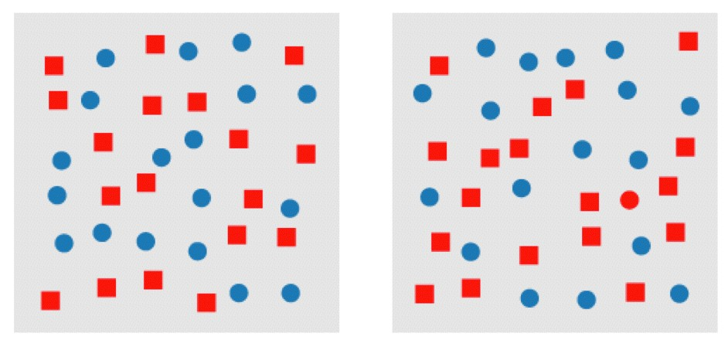
Pick the outlier
Healy 2007

Slide 44
CONJUNCTION
or, why to use a single channel at a time
Healey 2007

Slide 45
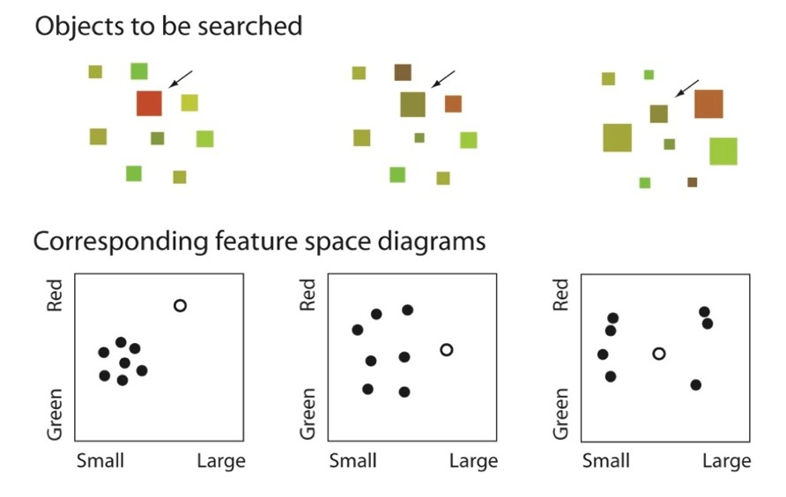
CONJUNCTION
or, why to use a single channel at a time

Slide 46
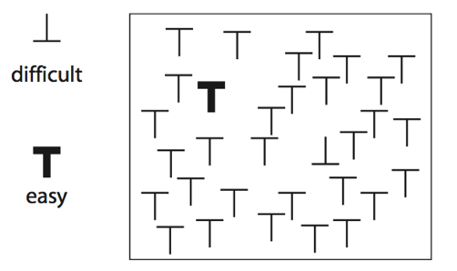
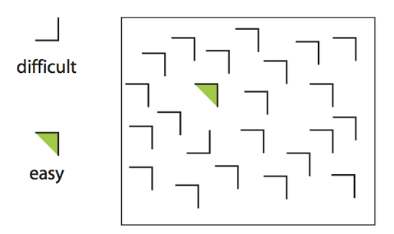
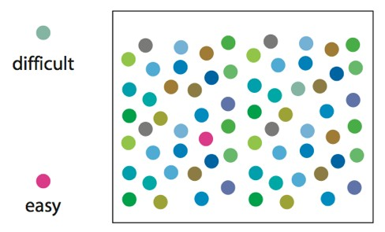
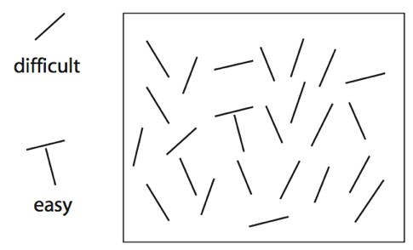

Slide 47
Takeaway
We can easily see objects that are different in color and shape, or that are in motion.
Use color and shape sparingly to make the important information pop out.

Slide 48
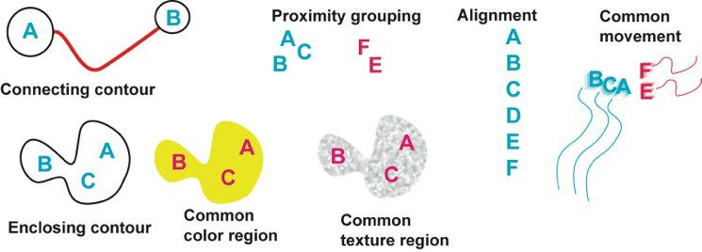
Gestalt principles
German: “Gestalt” = form
patterns transcend the visual stimuli that produced them

Slide 49
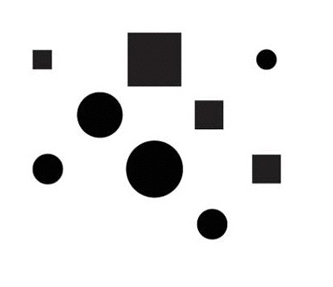
similarity
Bang Wong, “Gestalt Principles, 1”, Nature Methods

Slide 50
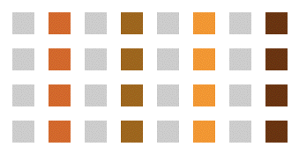
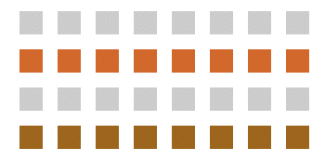
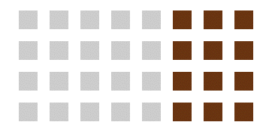
similarity
Andy Rutledge, “Gestalt Principles of Perception”

Slide 51
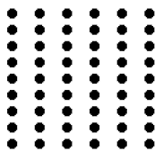
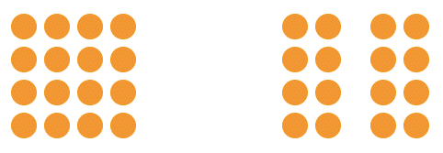
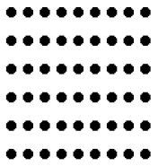
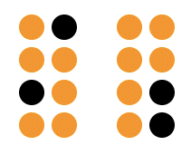
proximity
Andy Rutledge, “Gestalt Principles of Perception”

Slide 52
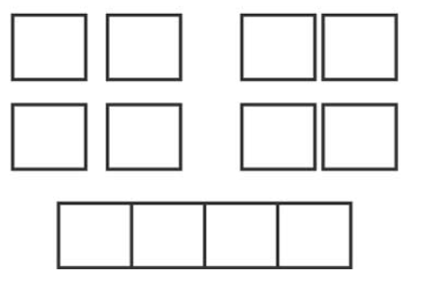
proximity
Bang Wong, “Gestalt Principles, 1”, Nature Methods

Slide 53
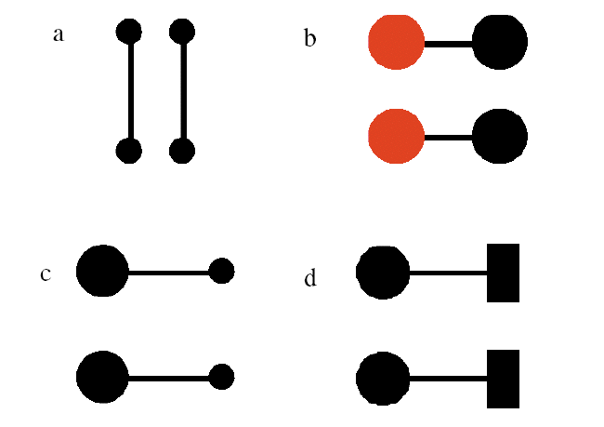
connectedness
Ware, “Information Visualization”

Slide 54
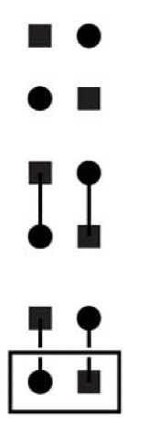
grouping
Similarity
Connection
Enclosure
Bang Wong, “Gestalt Principles, 1”, Nature Methods

Slide 55
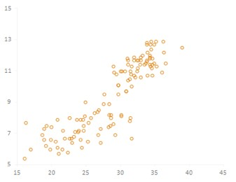
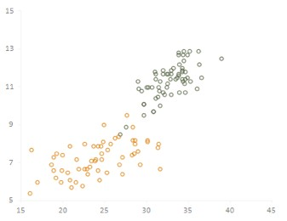
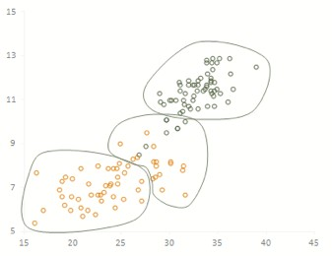
grouping
proximity
similarity
enclosure
Jorge Camoes

Slide 56
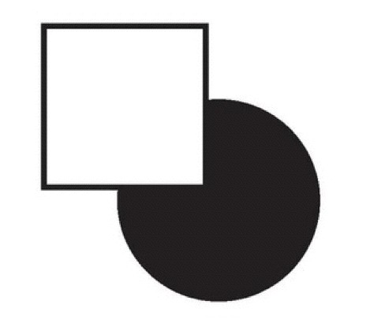
continuity
Bang Wong, “Gestalt Principles, II”, Nature Methods

Slide 57

continuity
Bang Wong, “Gestalt Principles, II”, Nature Methods

Slide 58


closure

Slide 59


figure / ground

Slide 60
common fate
A. Rutledge

Slide 61
Gestalt principles
similarity: things that look like each other (size, color, shape) are related
proximity: things that are visually close to each other are related
connection: things that are visually connected are related
continuity: we complete hidden objects into simple, familiar shapes
closure: we see incomplete shapes as complete
figure / ground: elements are perceived as either figures or background
common fate: elements with the same moving direction are perceived as a unit

Slide 62
Takeaways
Gestalt principles give us a conceptual understanding of the way our mind converts shapes into structured thought.
Using the Gestalt principles wisely will lead improve performance in interpretation of visualizations. Poor use may cause users to see things that aren’t there…

