Slide 1
CIS 4930/6930-002 Data Visualization
Model-View-Controller Design Pattern
Paul Rosen
Assistant Professor
University of South Florida
.

Slide 2
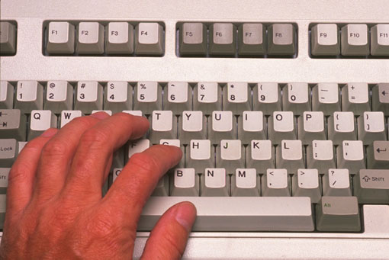
Model-View-Controller
Architecture for interactive apps
introduced by Smalltalk developers at XEROX PARC
Partitions application so that it is scalable and maintainable
View
Model
Controller

Slide 3
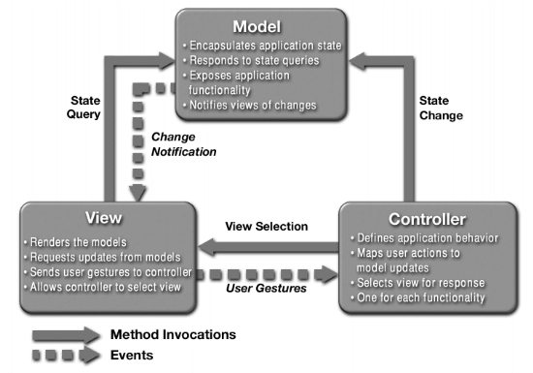
What is MVC?

Slide 4
View
The Model
The Model is the part that does the work--it models the actual problem being solved (i.e. it stores the data)
The Model should be independent of both the Controller and the View
But it provides services (methods) for them to use
Independence gives flexibility, robustness
Model
Controller

Slide 5
View
The View
The View shows what the Model is doing
The View is a passive observer; it should not affect the model
The Model should be independent of the View, but (but it can provide access methods)
The View should not display what the Controller thinks is happening
Model
Controller

Slide 6
View
The Controller
ften, the user is put in control by means of a GUI
in this case, the GUI and the Controller are often the same
The Controller and the Model can almost always be separated (what to do versus how to do it)
The design of the Controller depends on the Model
The Model should not depend on the Controller
Model
Controller

Slide 7
View
Controller Communication
Communicates with view
determines which objects are being manipulated (e.g., which object was selected with mouse click)
Calls model methods to make changes
model makes change and notifies views to update
Model
Controller

Slide 8
Advantages
Input processing is separated from output processing.
Controllers can be interchanged, allowing different user interaction modes.
Multiple views of the model can be supported easily.
View 1
View 3
Controller 1
Model
View 2
Controller 2

Slide 9
Why MVC?
Provides a logical structure for heavily interactive system
Adheres to good engineering design principles and practices
Information hiding, less coupling, simplicity, etc.
Delegated control style

Slide 10
Why MVC?
Combining MVC into one class or using global variables will not scale. Why?
model may have more than one view
each different & needing update on model changes
Separation eases maintenance. Why?
easy to add a new view later
may need new model info, but old views still work
can change a view later
e.g., draw shapes in 3-d
recall that the view handles selection

Slide 11
What’s the point?
It’s just plain easier
(even if it doesn’t look it)!
Studies show that most introductory CS college students tend to clump a UI program into one big monolithic main class
Unfamiliarity stems from student tendency to program according to styles presented in textbooks and not being introduced to design principles early

