Slide 1
CIS 4930/6930-002 Data Visualization
INTRODUCTION TO PROCESSING
Paul Rosen
Assistant Professor
University of South Florida
(slide acknowledgments: Hitesh Raju)

Slide 2
Announcements
Project #1 Due Next Class (1/14)
Project #2 posted

Slide 3
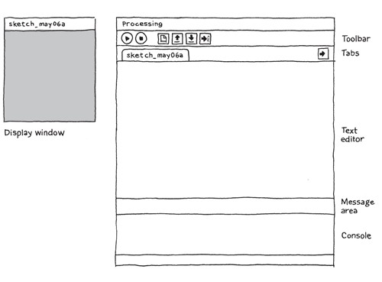
what is it?
Processing Development Environment (PDE)

Slide 4
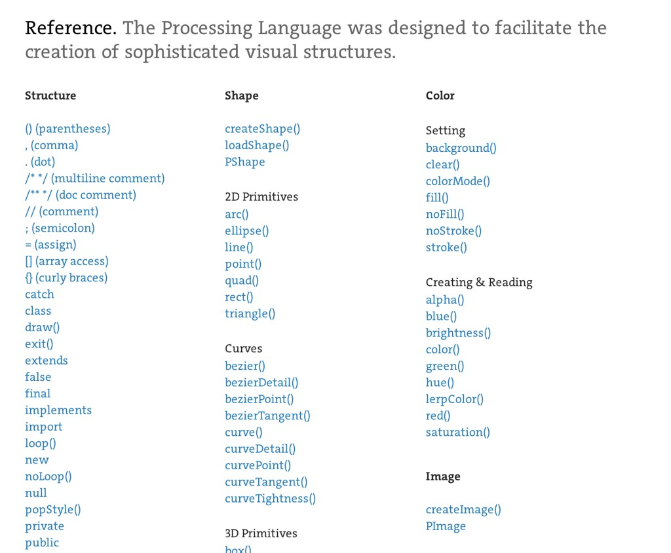
what is it?
Processing API

Slide 5
what is it?
open-source, online community
https://processing.org/
http://forum.processing.org/
https://github.com/processing

Slide 6
why not other languages?
difficulty to sketch with other languages
complicated setup
portability challenging
not easy to learn

Slide 7
why Processing?
+/- Java-based
- complexity
+ big standard library
+ similar syntax & portability
+ lots of user-contributed libraries
+ fast to startup

Slide 8

why Processing?
program = sketch

Slide 9
why Processing?
programming syntax
void setup() { size(480, 120);
}
void draw() {
if (mousePressed) {
fill(0);
} else { fill(255);
}
ellipse(mouseX, mouseY, 80, 80);
}

Slide 10

why Processing?
public class Hello
{
public static void main (String args[])
{
System.out.println("Hello, world!");
}
}
javac Hello.java
java Hello

Slide 11
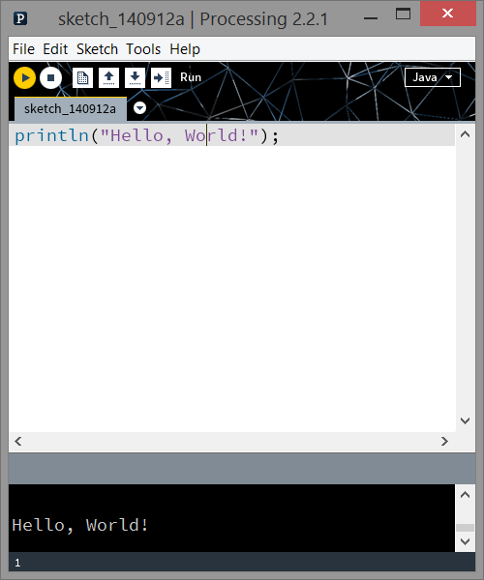
why Processing?
println(“Hello, World!”);

Slide 12
graphics

Slide 13
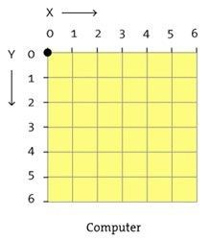
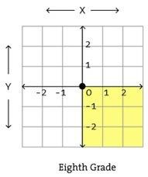
Monitors
grid of pixels

Slide 14
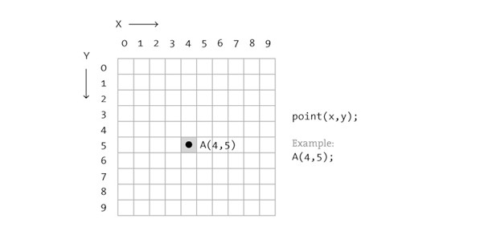
shape
point(x, y);

Slide 15
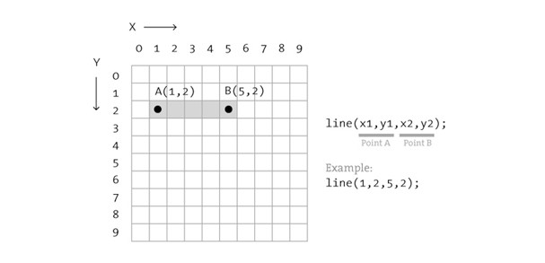
shape
line(x1, y1, x2, y2);

Slide 16
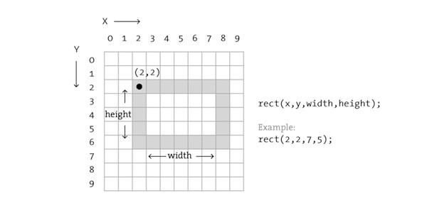
shape
rect(x, y, width, height);

Slide 17
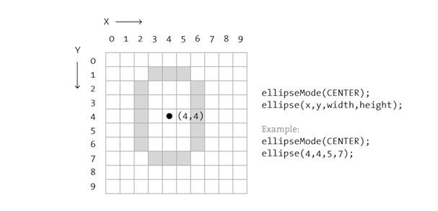
Shape
ellipseMode(CENTER);
ellipse(x, y, width, height);

Slide 18
Shape
triangle(x1, y1, x2, y2, x3, y3);
quad(x1, y1, x2, y2, x3, y3, x4, y4);
arc(x, y, width, height, start, stop);

Slide 19
Shape
More complex shapes available with:
beginShape() / vertex() / endShape()

Slide 20
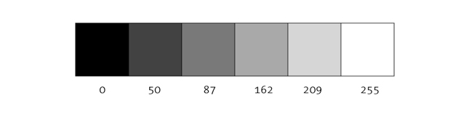
Color
luminance
background(255);

Slide 21
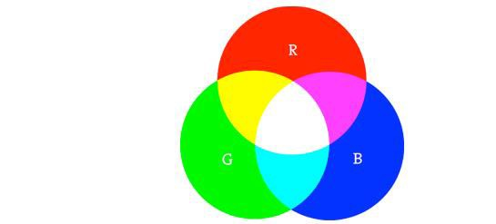
Color
RGB (default)
color c1 = color(r, g, b);
color c2 = #RRGGBB;

Slide 22
Color
RGBA
a = alpha / transparency / opacity
0 = transparent; 255 = opaque (solid)
color c1 = color(r, g, b, a);

Slide 23
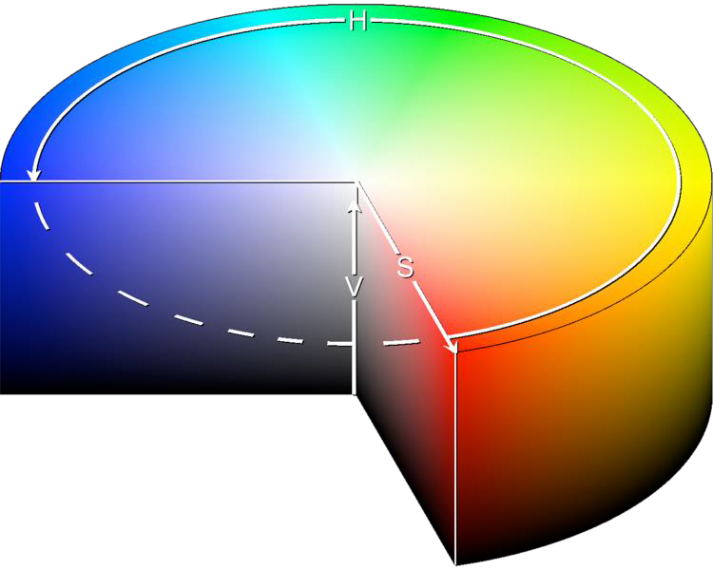
color modes
custom range: colorMode(RGB, 100);
HSB: colorMode(HSB);

Slide 24

Properties
noStroke();
fill(c1);
rect(...);
fill(c2);
stroke(c3);
ellipse(...);

Slide 25
Properties
noFill();
noStroke();
ellipse(...);
rect(...);

Slide 26
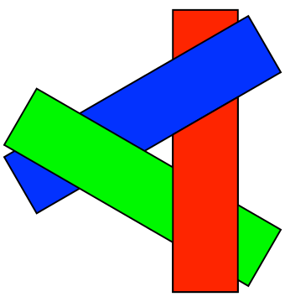
Order
shapes are painted one at a time
overlap can occur
some shapes are not supported

Slide 27
text
// in setup()
PFont myFont;
myFont
= createFont("Georgia",
32);
// in draw() textFont(myFont); textAlign(CENTER,
CENTER);
text("Hello, World!",
width/2,
height/2);

Slide 28
programming

Slide 29
Structure
comments, variables, arrays, loops

Slide 30
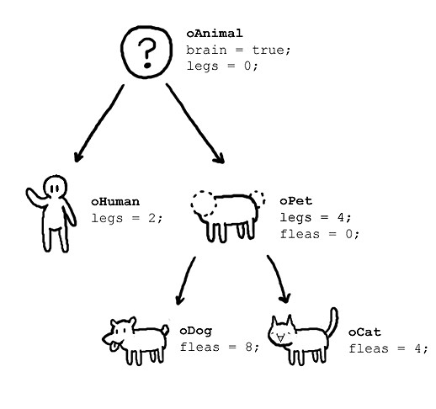

object-oriented
with classes
class oAnimal{ boolean brain; int legs;
oAnimal(){
brain = true;
legs = 0;
}
}

Slide 31
Built-in Trigonometry Functions
acos() / asin() / atan() / atan2()
degrees() / radians()
cos() / sin() / tan()

Slide 32
Built-in Calcuation Functions
Calculation
max() / min()
abs() / ceil() / constrain() / floor() / round()
lerp() / map() / norm()
dist() / mag()
exp() / log() / pow() / sq() / sqrt()

Slide 33
Map Function
map( 5, 2, 8, 0, 100 )
Constrain Function
constrain( 10, 2, 8 )
2
5
8
input value
input range
output range
0
50
100
input value
input range
2
8
10

Slide 34
Pvector
Container for points and vectors
Variety of functionalities—vector arithmetic, dot/cross products, normalization, and interpolation
https://processing.org/reference/PVector.html
http://processing.github.io/processing-javadocs/core/processing/core/PVector.html

Slide 35
Object Storage
ArrayList (also FloatList, IntList, StringList)
HashMap (dict: also FloatDict, IntDict, StringDict)
(and anything else Java!)

Slide 36
Data Loading
Built in parsers for:
csv, tsv – loadTable() / Table / TableRow
xml – loadXML() / XML
json – loadJSONObject() / loadJSONArray() / JSONObject / JSONArray

Slide 37

Interaction: mouse
void
mousePressed()
void
mouseReleased()
void mouseClicked(){
if(mouseButton == LEFT)
fill(0);
else if(mouseButton == RIGHT) fill(255);
else
fill(126);
}
void
mouseClicked()
void
mouseDragged()
void
mouseMoved()
void
mouseWheel()
mouseX mouseY pmouseX pmouseY

Slide 38

Interaction: keyboard
void keyTyped(){
if(key == 'b')
fill(0);
else if(key == 'w') fill(255);
else
fill(126);
}
void
keyPressed()
void
keyReleased()
void
keyTyped()
keyPressed key keyCode

Slide 39
animation
runs once
void setup(){
...
}
void draw(){
...
}
void mousePressed(){
...
}
cycles
when triggered
Calls with dotted lines are automatic

Slide 40

folder structure
folder [NAME] & [NAME].pde must match
optional data folder (for images, input)

Slide 41
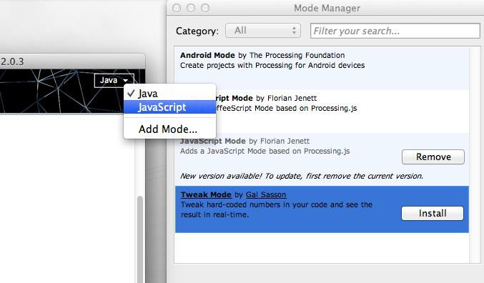
Modes
Java (default)
JavaScript
Android
etc.

Slide 42
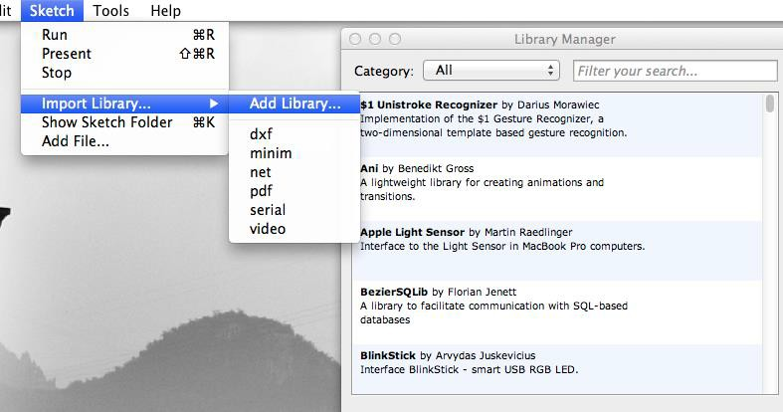
Libraries

Slide 43
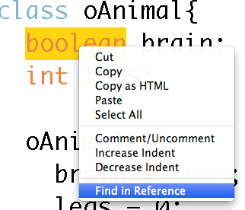
Documentation
available online
also in the PDE
http://processing.org/reference/

Slide 44
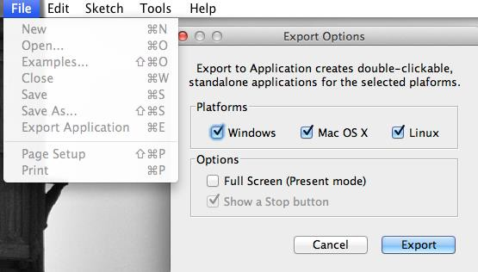
Exporting
creating applications is simple

Slide 45

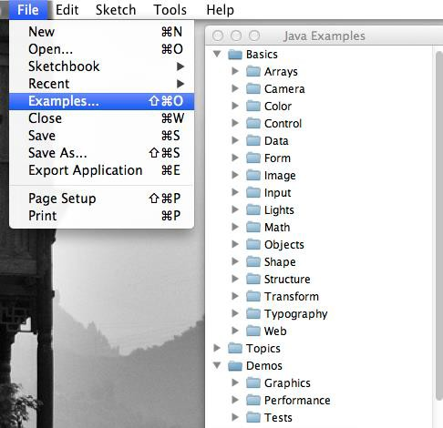
Examples
variety of samples

Slide 46
Demo

