Slide 1
CIS 4930/6930-002 Data Visualization
Activity: Analyzing the “Greatest Infographic Ever”
Paul Rosen
Assistant Professor
University of South Florida
.

Slide 2
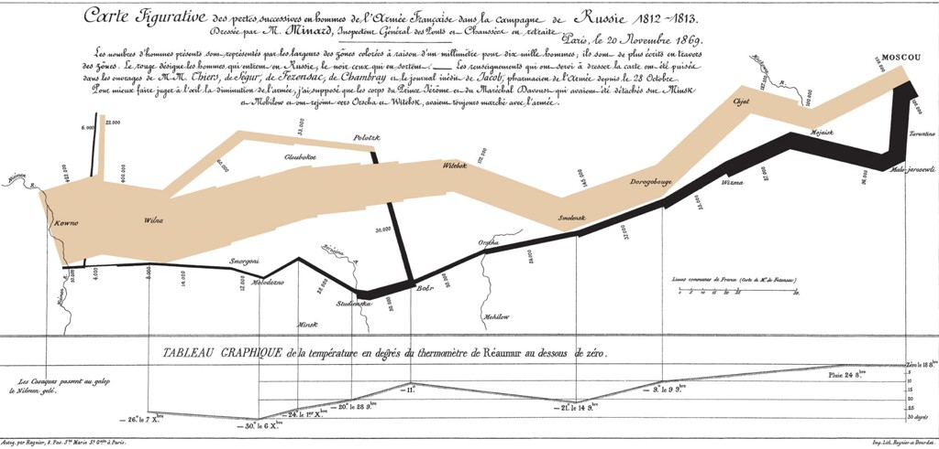
The “Greatest Infographic Ever”
Created by Charles Joseph Minard in 1861, the infographic depicts the losses suffered during Napoleon's Russian campaign of 1812.

Slide 3
Your task, with 1 or 2 partners
Identify all of the data encoded (temperature, date, position, etc.) in the image and by what means (color, position, shape, etc.)
Determine the type, location, timing, and cause for some of the key events of Napoleon’s march
Note, you may not be able to determine all type/location/timing/cause information for every event.

