Slide 1
CIS 4930/6930-002 Data Visualization
Introduction to Git
Paul Rosen
Assistant Professor
University of South Florida
(slide acknowledgments: http://excess.org/article/2008/07/ogre-git-tutorial/)

Slide 2
Git is a distributed version-control system
Terminology: In git-speak, a “version” is called a “commit.”
Git keeps track of the history of your commits, so you can go back and look at earlier versions, or just give up on the current version and go back some earlier version.
Can be used to implement a variety of software configuration management models and workflows

Slide 3
Git is a distributed version-control system
You keep your files in a repository on your local machine.
You synchronize your repository with a remote repository on a server (in our case, GitHub).
You protect your code from system crashes by synchronizing with the server.
If you move from one machine to another, you can pick up the changes by synchronizing with the server.
If you work on a team, other people’s uploads can be synchronized using the server.

Slide 4
GIT tools
A collection of many tools
Very flexible
You can do anything the model permits
Including shooting yourself in the foot
Need to understand the underlying model

Slide 5
Groups of Git commands
Setup and branch management
init, checkout, branch, clone
Modify
add, delete, rename, commit
Get information
status, diff, log
Create reference points
tag, branch
Synchronization with remote
push, pull, fetch, sync

Slide 6
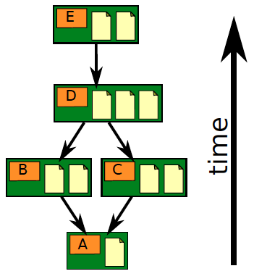
Repository Contains
files & directories
commits
ancestry relationships
http://edgyu.excess.org/git-tutorial/2008-07-09/intro-to-git.pdf

Slide 7
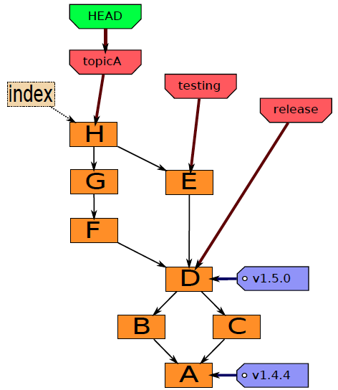
Ancestry graph features
form a directed acyclic graph (DAG)
Commits
Snapshots of file status
Tags
identify versions of interest
including “releases”
Branches
divergent path for source code modification
HEAD
is current checkout
usually points to a branch
Index
“staging area”
what is to be committed
http://edgyu.excess.org/git-tutorial/2008-07-09/intro-to-git.pdf

Slide 8
Local Operations
Working directory
Index (staging area)
Repository (.git directory)
Checkout the project (optional, most of the time)
add (stage) files
modify local files
commit

Slide 9
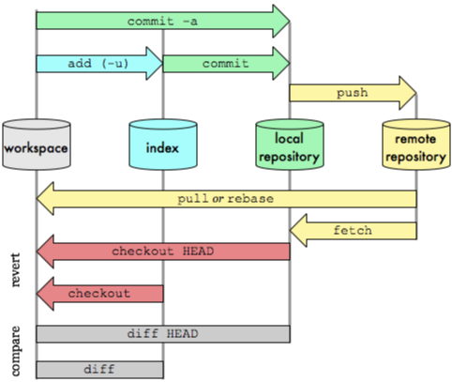
Git transport commands
sync
http://osteele.com/images/2008/git-transport.png

Slide 10
Git Software
Windows
Git command line tools – https://git-scm.com/download/win
Git GUI – https://tortoisegit.org/ (also requires download of command line tools)
MAC
Install xcode and the command-line tools
https://developer.apple.com/xcode/
http://railsapps.github.io/xcode-command-line-tools.html
Linux
git should already be installed. If not, use the appropriate package manager (e.g. apt or yum) to install it.

Slide 11
Getting Started
Create a github account, if you don’t already have one (https://github.com/)
GitHub Education account is optional (https://education.github.com/discount_requests/new)
Visit <https://classroom.github.com/a/0JcYQJsF> to setup your repository
Once the repository is created (this can take a few minutes) determine the remote path and pick a local directory for code.

Slide 12
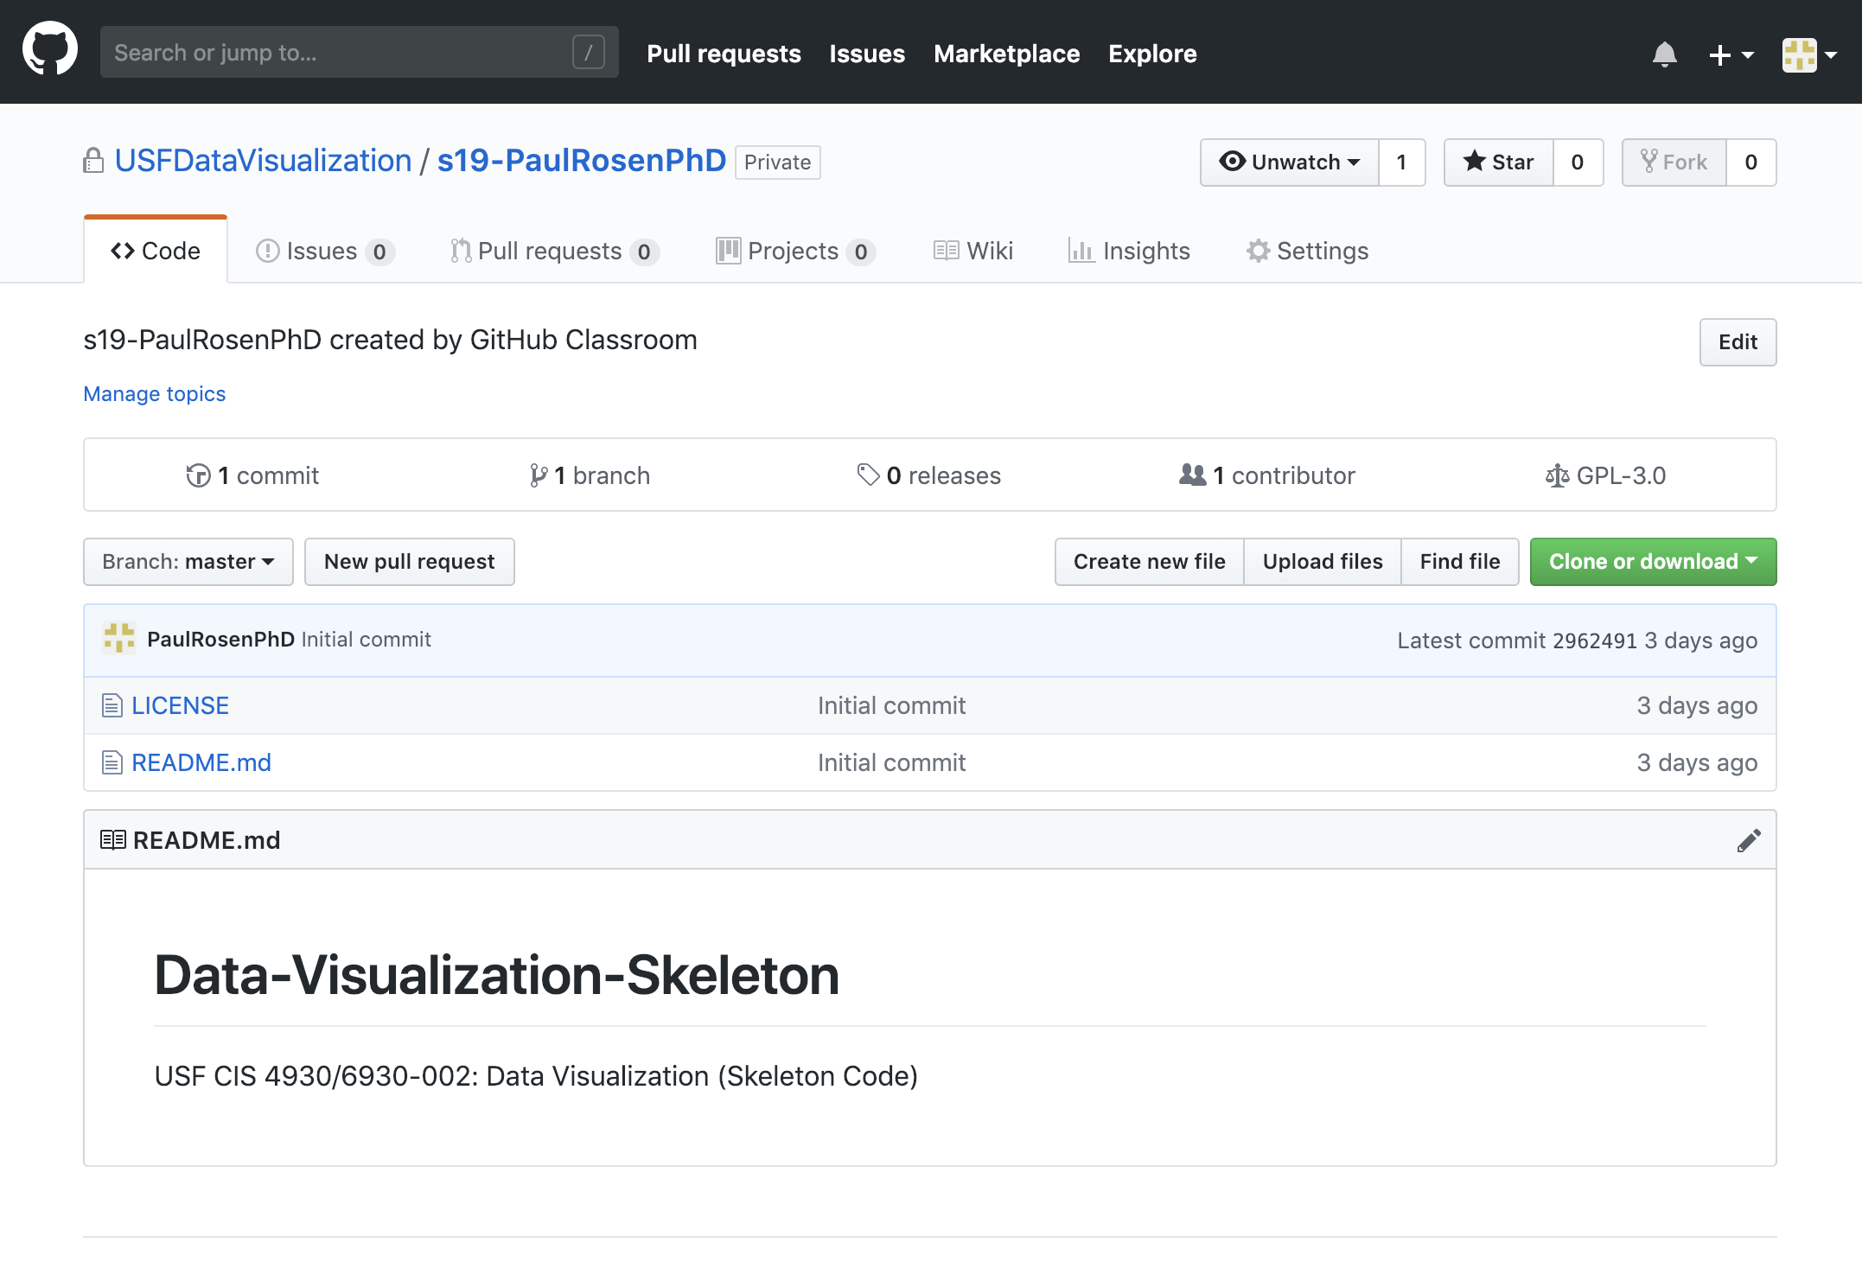
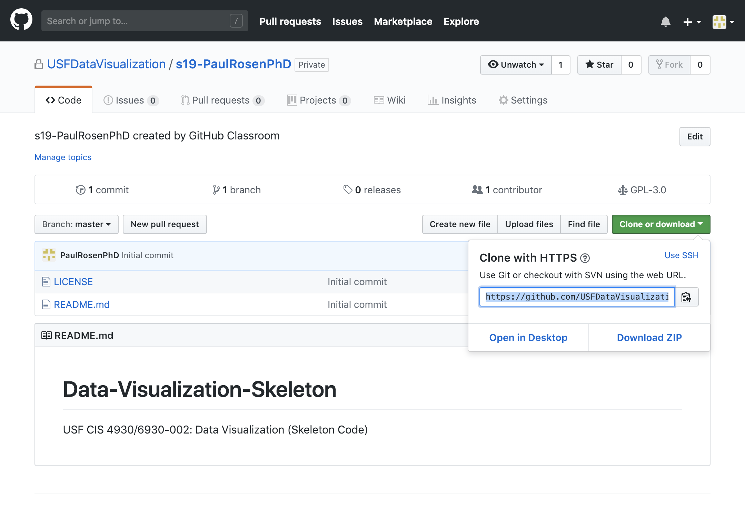
Finding Remote Path

Slide 13
Sample session commands
> git clone <remote_path> <local_directory>
> cd <local_directory>
> git pull
> touch newfile.txt
> git add newfile.txt
> git commit –m “added a new file”
> git push

Slide 14
Suggested workflow
sync (or pull)
sync (or pull)
sync (or pull)
edit
edit
edit
commit
commit
commit
edit
server
edit
server
edit
This is what we grade from!
commit
commit
commit
edit
edit
edit
commit
commit
commit
sync (or push)
sync (or push)
sync (or push)
stop working / start working
stop working/ change computers

Slide 15
References
http://book.git-scm.com/index.html
http://excess.org/article/2008/07/ogre-git-tutorial/
http://www-cs-students.stanford.edu/~blynn/gitmagic/
http://progit.org/book/
http://www.geekherocomic.com/2009/01/26/who-needs-git/
Many YouTube videos
ex. https://www.youtube.com/watch?v=HVsySz-h9r4

