Slide 1
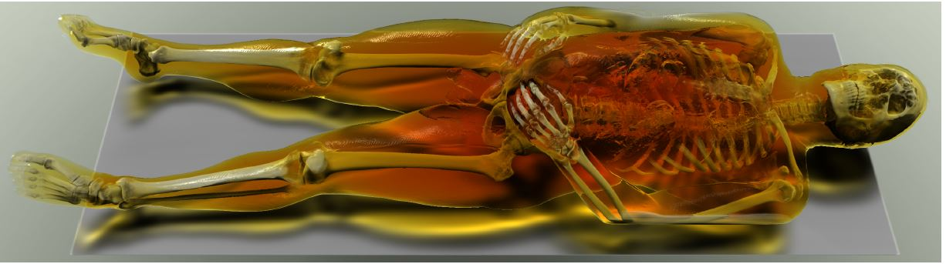
Interactive Dynamic Volume Illumination with Refraction and Caustics
By
Bhavana Doppalapudi
U 96038559

Slide 2
Existing methods:
Significant developments are made in developing high quality interactive methods for realistic volume illumination.
Problem……….??
Advanced illumination effects can provide important cues for visualization of complex spatial structures.
Problem………??

Slide 3
Physically accurate rendering of scaler fields is performed using offline methods such as volumetric photon mapping.
……..Interactions are important for volumetric data.
Should support
..interactions ..advanced refractive effects ..avoid precomputations ..dynamic manipulation

Slide 4
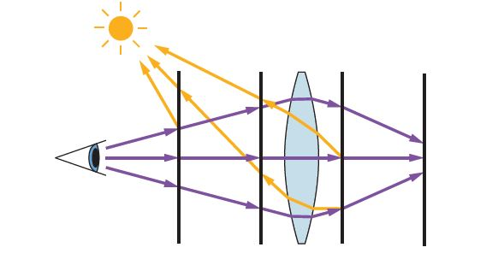
Proposed approach
An approach to interactive rendering of volumetric data with refractive scattering and caustics
Semi-Lagrangian scheme
Two pass approach
For visualization purposes it is advantageous to specify the relative position of light source with camera

Slide 5
Present approach
We back integrate light paths so as to avoid the problem of inefficient storing of illumination information if forward integration is performed.
LIGHT PROPAGATION: Light is passed in a plane by plane manner.
L_{i} = L_{i-1} I_{i}(1-α)m
LIGHT FILTERING: Application of elliptical convolutional kernel.

Slide 6
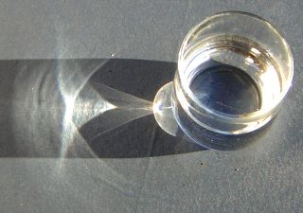
Present approach
CAUSTICS: Caused by concentrations and dispersal of light.
I_{i}=I_{i-1}S_{i-1}/S_{i}
In contrast to light, viewing rays are forward propagated.
Position, radiance, color and medium color stored in 2D buffer.

Slide 7
IMPLEMENTATION:
Algorithm
.. 6 buffers
.. Initialize
.. Light propagation
.. Viewing ray

Slide 8
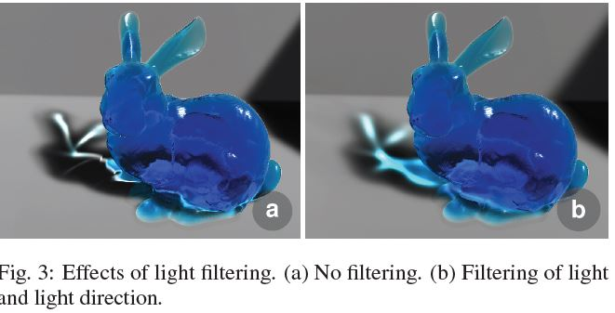
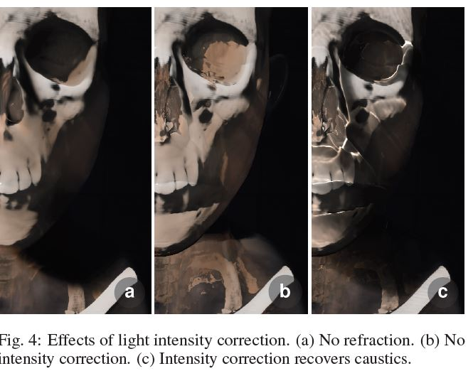
Results:

Slide 9
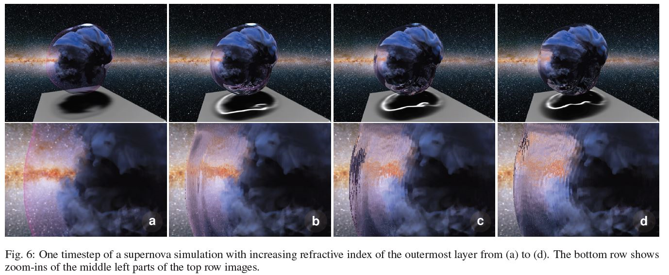
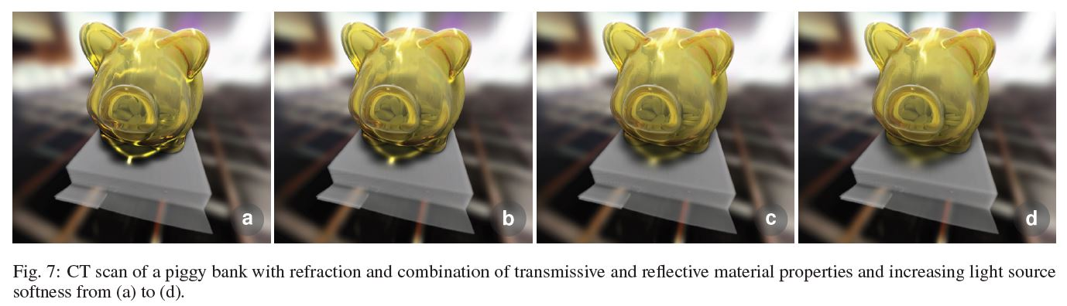

Slide 10
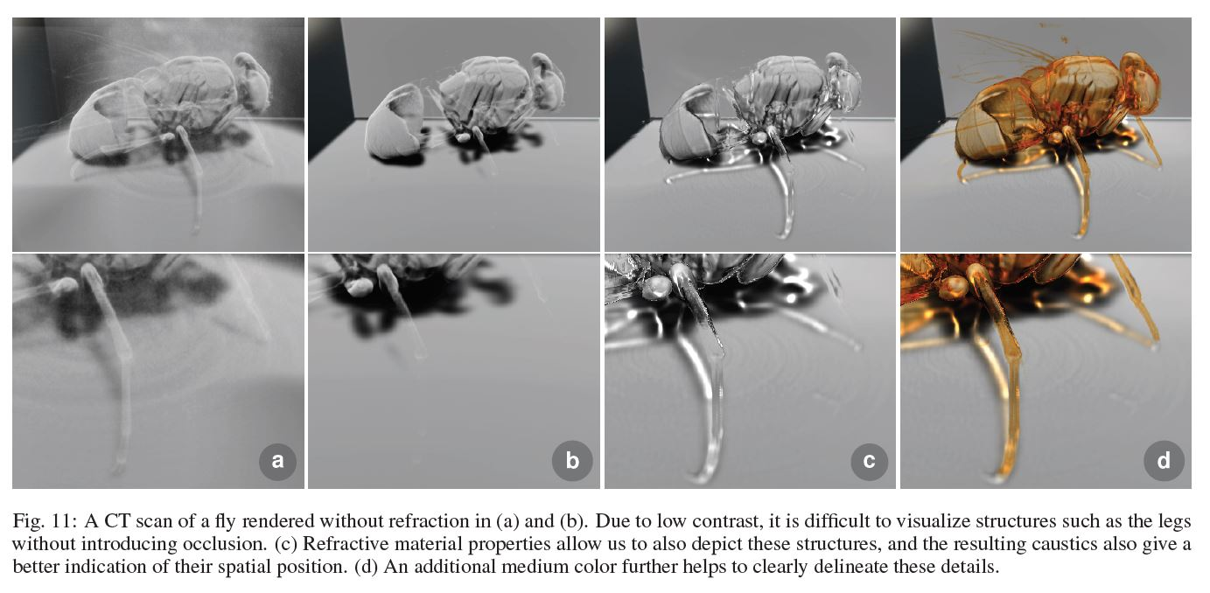

Slide 11
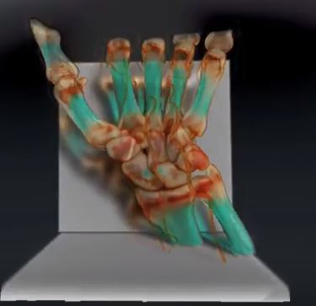
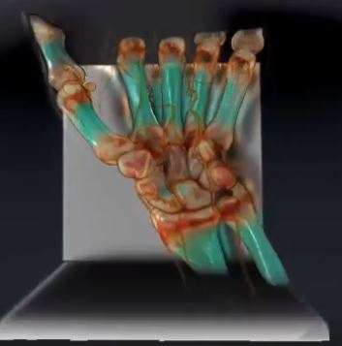
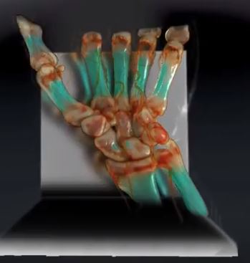
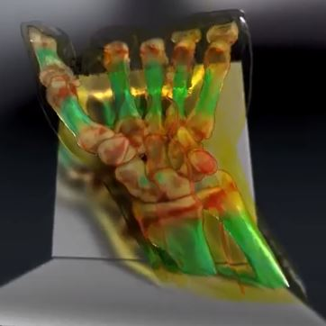

Slide 12


