Slide 1
Revisiting Stress Majorization as a Unified Framework for Interactive Constrained Graph Visualization
Paper by: Yunhai Wang et al.
Presentation by: Abdul Munim Zahid

Slide 2
Revisiting Stress Majorization as a Unified Framework for Interactive Constrained Graph Visualization
What does it mean?
Let’s break it down….

Slide 3
Revisiting Stress Majorization as a Unified Framework for Interactive Constrained Graph Visualization
Graph Visualization
Constrained Graph Visualization
Interactive Constrained Graph Visualization
Unified Framework for Interactive Constrained Graph Visualization
Stress Majorization as a Unified Framework for Interactive Constrained Graph Visualization
Revisiting Stress Majorization as a Unified Framework for Interactive Constrained Graph Visualization

Slide 4
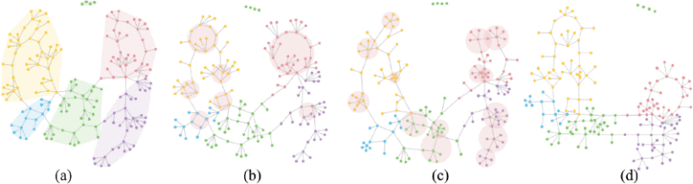
Constraints on a graph
Helps us meet various application specific layout requirements.
a) Cluster non-overlap (CN);
b) CN + circle constraint (CC);
c) CN + star constraint (SC);
d) CN + CC + SC + edge direction constraint.

Slide 5
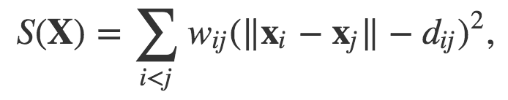
Stress Model
Attempts to minimize Euclidean distance and target distance, seeking minimal stress value
Popular method for automatically laying out nodes and edges of a graph to create a planar visualization
Maintains structure
Aims to minimize the sum of squared distance differences between pairs of nodes

Slide 6
Limitations of Stress Model
Can not generate a user-desired layout for an effective visualization
Does not allow application-specific layout requirements
non-overlapping of nodes
directed edges between nodes etc
Not aesthetically pleasing

Slide 7
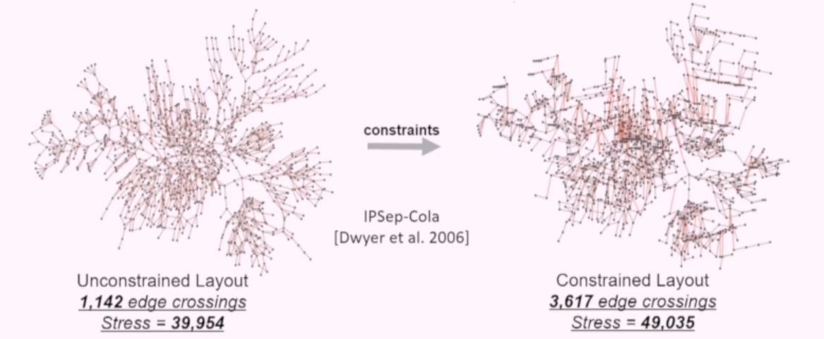
Problems to solve
Hard to interact with and explore the graph
Not aesthetic
Hard constraints increases stress values and edge crossings in a graph decreasing the readability of the graph

Slide 8
Proposal
Reformulate stress model to create a Vectorized Stress Majorization (VSM)
Introduce “edge vector” in stress model where edge vector is the distance & angle between two nodes
Convert the stress model from a scalar system to a vector system
Current Stress Model:
Uses scalar distance between nodes
Proposed Model:
Uses vector of distance+angle between nodes

Slide 9

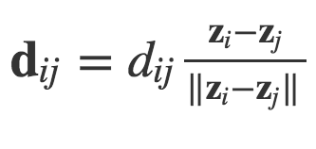
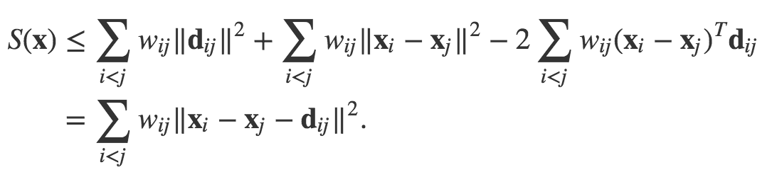
Approach
Expanding current stress model
Adding the edge vector ->
We get

Slide 10
Features of the new framework
Direct Constraints
Edge Length Constraint
Edge Direction Constraint
Temporal Coherence Constraint
Metric-Based Constraints
Non-Overlap Constraint
Minimizing Edge Crossings
Shape-Based Constraints
Circle Constraint
Star Constraint
Symmetry Constraint

Slide 11
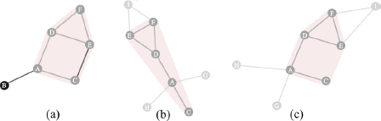
Features of the new framework
Temporal Coherence Constraint
Current Methods
Our Approach

Slide 12
[RECALL] Constraints on a graph
Helps us meet various application specific layout requirements.
a) Cluster non-overlap (CN);
b) CN + circle constraint (CC);
c) CN + star constraint (SC);
d) CN + CC + SC + edge direction constraint.

Slide 13
Results
Compared VSM with two previous models
IPSep-Cola model
SV model
Compared based on
Direct constraints
Metrics and Shape based constraints
Performance

Slide 14
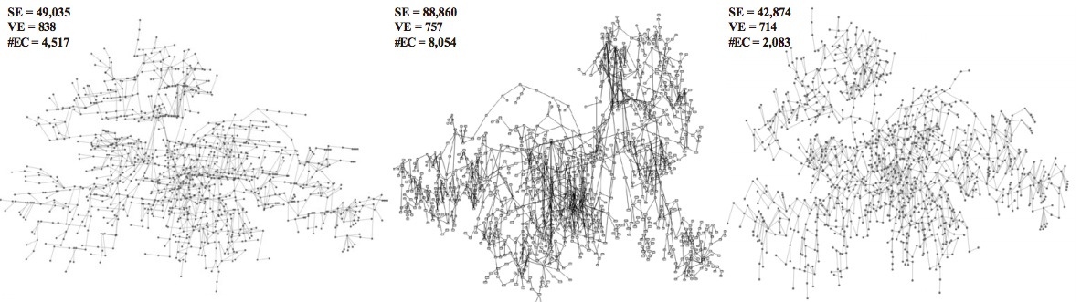
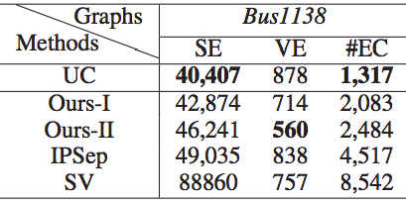
Comparison of Direct Constraints
Left -> IPSep Center-> SV Right -> Ours-11
UC = Unconstrained
SE = Stress Error
VE = Vertical Error
#EC = Number of Edge Crossings

Slide 15
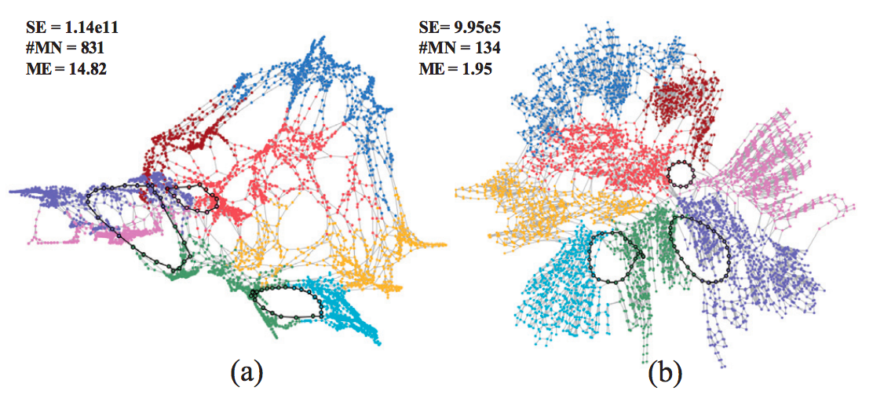
Comparison of Metric and Shape based Constraints
cluster non-overlap and circle constraints generated by SV
VSM method with vi j set to 3.5
#MN = Number of misplaced nodes
ME = Shape Mismatching error
SE = Stress Error

Slide 16
Conclusions
Vectorized Stress Majorization (VSM) model handles more constraints than other models
VSM is more user friendly and takes into account user’s constraints
VSM outperforms other models
VSM is a unified framework

