Slide 1
Glyph Visualization: A Fail-Safe Design Scheme Based on Quasi-Hamming Distances
Philip A. Legg, Eamonn Maguire, and Simon Walton and Min Chen
Presented by: Zhiqiang Wu

Slide 2
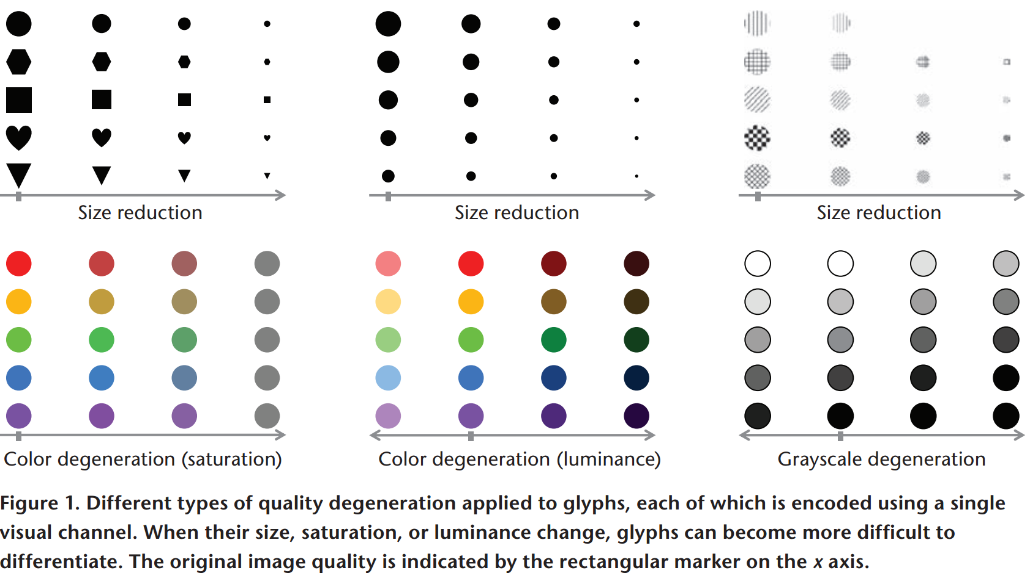

Slide 3
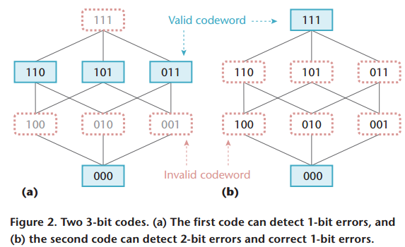
Hamming Distance
Definition
In the context of binary encoding, Hamming distance is a measure of the number of bit positions in which two code words differ
Principles
A code of d + 1 minimal Hamming distance can be used to detect d bits of errors during transmission
A code of 2d + 1 minimal Hamming distance can be used to correct d bits of errors during transmission

Slide 4
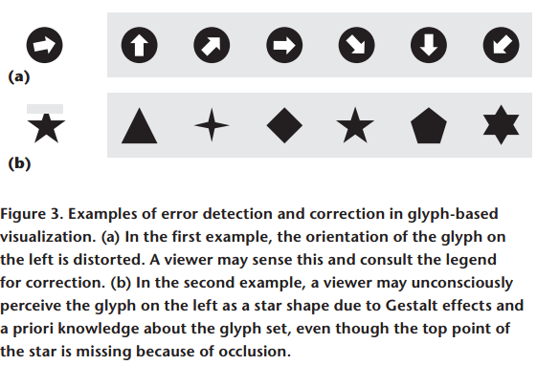
Quasi-Hamming distance (QHD)
Definition
QHD can be considered a kind of measurement of “perceptual distance” between two glyphs

Slide 5
Measuring QHD
Establish a measurement unit
Find the just-noticeable difference (JND) of the visual channel and each JND equals 1 bit
Proposed five methods to measure the distance between two glyphs
Estimation by expert designers
Crush tests
Task-based evaluation
User-centric estimation
Computer-based similarity measures
Uniformly sample the visual channel’s space, while ensuring every pair of samples differ by at least the JND of this channel
Organize those samples into a network

Slide 6
Measuring QHD
Two proof-of-concept experiments based on user-centric estimation and computer-based similarity measures
User centric estimation
20 participants to rate how well they could differentiate 104 pairs of glyphs, on an integer scale between 0 and 10.
Divide 104 stimuli pairs into three main groups: 8 reference pairs, 48 primitive pairs, and 48 application-specific pairs
Computer-based metric
A metric is developed based on weighted invariant image moments

Slide 7
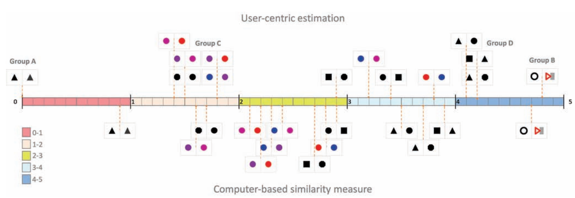
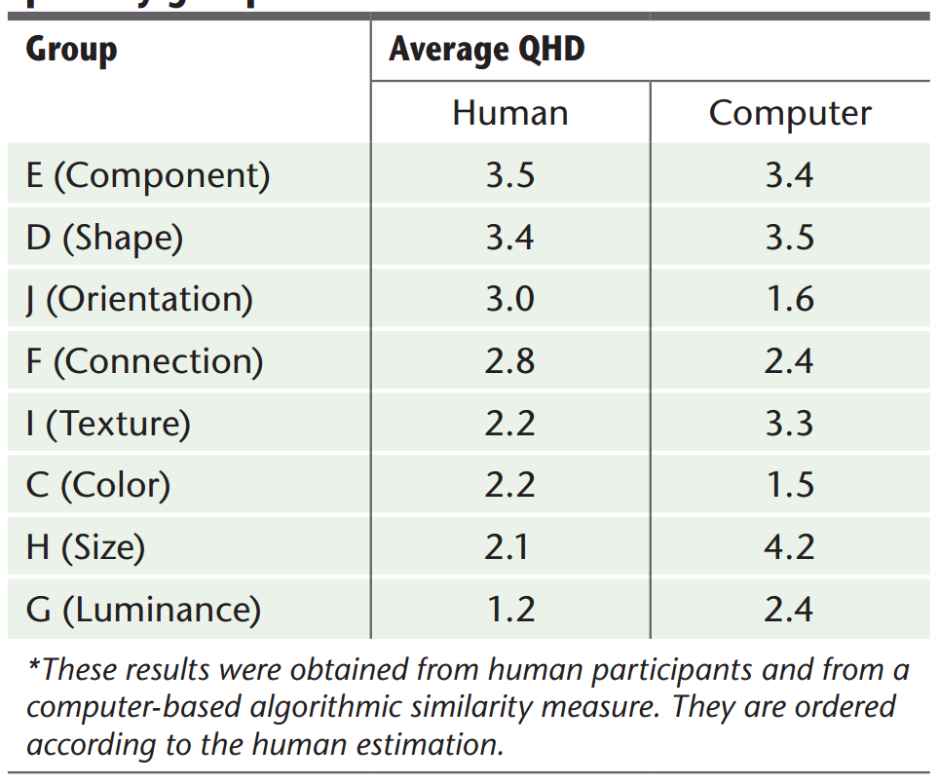
Measuring QHD

Slide 8
Case Study—Visualizing File-System Events
Designing File-System Event Glyphs
Initial design
Expert Evaluation, Crush Test, Human-Centric Estimation, and Computer-Based Similarity Measures are used to test and improve the Glyphs
Evaluating Event Glyphs
Results from human-Centric Estimation, and Computer-Based Similarity Measures are used to compare with the results from 104 stimuli pairs
Application for visualizing Dropbox activity log

Slide 9
Thank You!
Q & A

