Slide 1
Data Visualization Saliency Model: A Tool for Evaluating Abstract Data Visualizations Laura E. Matzen, Michael J. Haass, Kristin M. Divis, Zhiyuan Wang, and Andrew T. Wilson
Presented by:- Ruby Shrestha

Slide 2
Outline
Introduction to saliency models
explore why existing saliency models underperform for abstract data visualizations
identify features of visualizations that are incompatible with the existing saliency models.
outline the features of the Data Visualization Saliency (DVS) model that addresses these features and incorporates top-down attention
compare performance of DVS to a set of existing saliency models.
discuss how the DVS model could be used as an evaluation tool
limitations and future work

Slide 3
Saliency models
Saliency models assess the visual features of an image to predict which areas of that image will draw a viewer’s attention.
The models take an input image and generate a saliency map that predicts which regions of the image will be most likely to draw a human viewer’s attention
The existing saliency models’ predictions of where viewers will look are based only on the physical properties of the visual stimulus
They are models of what is known as bottom-up visual attention.

Slide 4
Saliency models : continued
Bottom-up visual processing
drawn to regions of a stimulus that are distinct from things around them in terms of their basic visual features (color, shape, contrast etc)
Top-down visual processing
is allocated voluntarily based on the viewer’s task and prior knowledge
Regions with high bottom-up saliency may or may not be relevant to the viewer’s task and goals

Slide 5
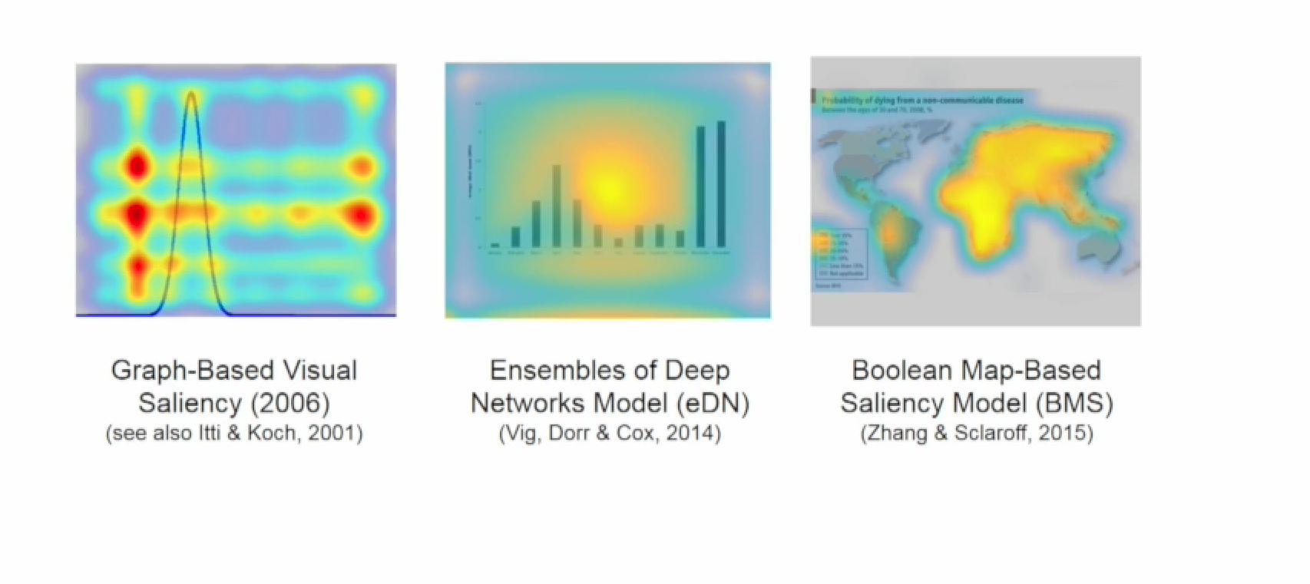
While these models can accurately predict where viewers will look in a natural scene, they typically do not perform well for abstract data visualizations.

Slide 6
Why existing models fail for visualization?
Spatial Scales
The features in visualization are very small compared to the size of the object
Resizing and smoothing the image may cause the loss of the features
Central bias is used in some of the models, all the data in visualization is not directed to the center

Slide 7
Why existing models fail for visualization?
2) Color
Most of the models work in RGB color space which does not correspond well to human perception

Slide 8
Why existing models fail for visualization?
3) Text
In prior work, it was found that people viewing data visualizations devote a disproportionate amount of attention to regions containing text.
It was also found that in general, literate people’s attention is automatically drawn to text
While text draws attention and needs many many fixations, it is not included as a feature in most saliency models.

Slide 9
THE DATA VISUALIZATION SALIENCY MODEL (DVS Model)
two primary components are a modified version of the Itti model and a text recognizer
combines the outputs of the modified Itti model and a text map to produce saliency maps that are specialized for data visualizations.
Itti model used as a starting point as it performed best on abstract visualization compare to other models
Color map changed from RGB to CIE LAB

Slide 10
DVS continued
Text Saliency Map
Maximally Stable Extremal Regions (MSER) as candidate text regions were extracted
Various text-diagnostic features were applied to filter out the non-text candidates.
To exclude MSER regions that are not text, detected MSER regions went through a filtering process based on simple properties of these regions, such as aspect ratio , Euler number , and solidity .

Slide 11
Comparision of DVS to other models
Stimuli used (4 sets 108 images)
35 data visualizations from MASSVIS set
Line drawings from MIT Saliency Benchmark
Have spatial property of natural scenes but have fine details
Fractals from MIT Saliency benchmark
Have vivid colors, abstract shapes and patterns
27 new data visualizations
3 of each 9 common vis types
Eye tracking data collected from 30 people
Each image presented for 5 seconds

Slide 12
Metrics of comparision
MIT Saliency Benchmark project uses 8 metrics to assess the performance of saliency models by comparing them to human fixations
3 location based metrics
4 distribution based metrics
1 value based metric
These metrics are standard to compare the saliency models to the human fixation data

Slide 13
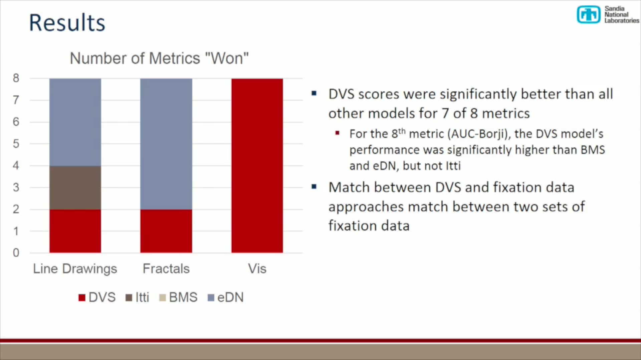
Comparision of DVS to other models
For line drawing and factals, eDN model wins most of the metrics
DVS performs significantly better than other models for vis

Slide 14
Limitations
DVS model currently applies only to static images. It can be applied to still images representing different phases of an interactive process, but it cannot capture the interactive component itself.
does not change the spatial scales used by the Itti model. It resizes and smooths images, resulting in the loss of fine-grained details that are often very important in data visualizations.
The DVS model incorporates one aspect of top-down attention by incorporating attention to text.

Slide 15
Future work
In future work, motion detection algorithms could be incorporated into the model, enabling it to predict which parts of a dynamic scene will draw the viewer’s attention most strongly
In future work, we plan to address these issues by allowing larger input images (limiting the need for resizing) and exploring the effects of changing the scales at which multiresolution differences are calculated.
The combination of the modified Itti maps, text saliency maps, and Gestalt-based maps could further improve the model’s performance

Slide 16
THANK YOU !!!

