Slide 1

ACTIVIS: Visual Exploration of Industry-Scale Deep Neural Network Models
Authors:
Minsuk Kahng, Pierre Y. Andrews, Aditya Kalro, and Duen Horng (Polo) Chau
Presented by:
SHIVA ALLANI
#0580-9575

Slide 2
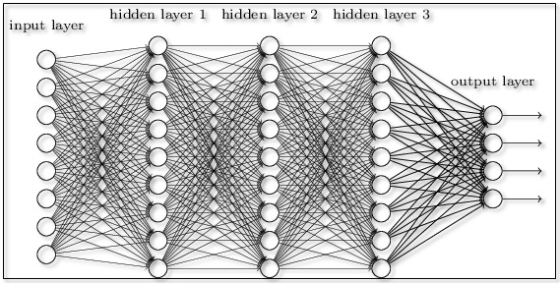
What is Deep Neural Network Model ?

Slide 3
Problems in interpreting the DNN
Most machine learning models capture nonlinear hidden data structures of data using a huge number of parameters.
Large scale data sets.
Data consists of different types like text , images and numerical data.
Complexity of machine learning algorithms.
So it is a high priority that there is need for visualizing tool that is flexible and generalizable.

Slide 4
Motivation behind developing the tool
To help engineers, including non-experts of machine learning , to more easily reuse algorithms in different products and manage experiments with ease, Facebook built a unified machine learning platform called FBLearner flow.
Users can train a model by picking a relevant workflow from a collection of existing workflows and specifying several input parameters for the selected workflow.
Once the training process is done , the interface provides a high level information to aid result analysis. To help the user interpret the results there is need for effective visualizing tool.

Slide 5
ACTIVIS What it does ?
ActiVis supports both interpretation strategies for visualization and comparison of multiple instances and subsets
unifies instance- and subset-level inspections.
tightly integrates overview of complex models and localized inspection .
scales to a variety of industry-scale datasets and models.
visualizes how neurons are activated by user-specified instances or instance subsets

Slide 6
Example: Convolutional Neural Network
consider our user who is training a word-level convolutional neural network (CNN) model to classify question sentences into one of six categories (e.g., whether a question asks about numeric values, as in “what is the diameter of a golf ball?”).
DESC
NUM
LOC
ABBR
ENTY
HUM

Slide 7
Example.

Slide 8
Sorting neurons by their average activation values for the LOC(location)

Slide 9
Hovering over an instance subset.

Slide 10
Compare and visualize multiple layers

Slide 11
RESULT:

Slide 12
FUTURE WORK
Automatic discovery of interesting subsets.
Supporting input- dependent models.

Slide 13
THANK
YOU

