Slide 1

Conceptual and Methodological Issues in Evaluating Multidimensional Visualizations for Decision Support
Authors: Evanthia Dimara, Anastasia Bezerianos, and Pierre Dragicevic
Presented by: Maha Alharbi

Slide 2
Problem
No previous work has evaluated a tool for decision-making task
Limited use of decision making task
Lack of appropriate baselines of comparison

Slide 3
Why?
Hard to identify the right metrices
Lack of methodological guidance
Lack of definitions for decision tasks

Slide 4
Solution in 5 steps

Slide 5
Step1: defining the task

Slide 6
Multi-attribute choice task
Multi-attribute choice task: is a task that consists of finding the best alternative among a fixed set of alternatives, where alternatives are defined across several attributes (e.g., camera).

Slide 7
Multi-attribute choice task
Alternatives:
Known in advanced
Defined across set of attributes
Multidimensional visualizations tool.
attributes
 | price | resolution | ………..
Camera 1
Camera 2
Camera 3
……..
……..
alternatives

Slide 8
Step2: finding sensible visualization baselines

Slide 9
Visualization techniques:

Slide 10
Step3: technique design

Slide 11
Design Principles
Keep visualizations comparable:
Consistent visual design (space, color)
Consistent interaction design
Same amount of information

Slide 12
Experiment
Goal: evaluating multidimensional visualizations for decision making
Method: compare (PC, SM, and TV) on:
Basic data exploration (analytic tasks)
Decision making (multi-attribute tasks)

Slide 13
Step4: basic data exploration

Slide 14
Analytic Session
Value retrieval
Range
correlation

Slide 15
Step5: decision making

Slide 16

Decision Making Session
Task: Choose a holiday package

Slide 17
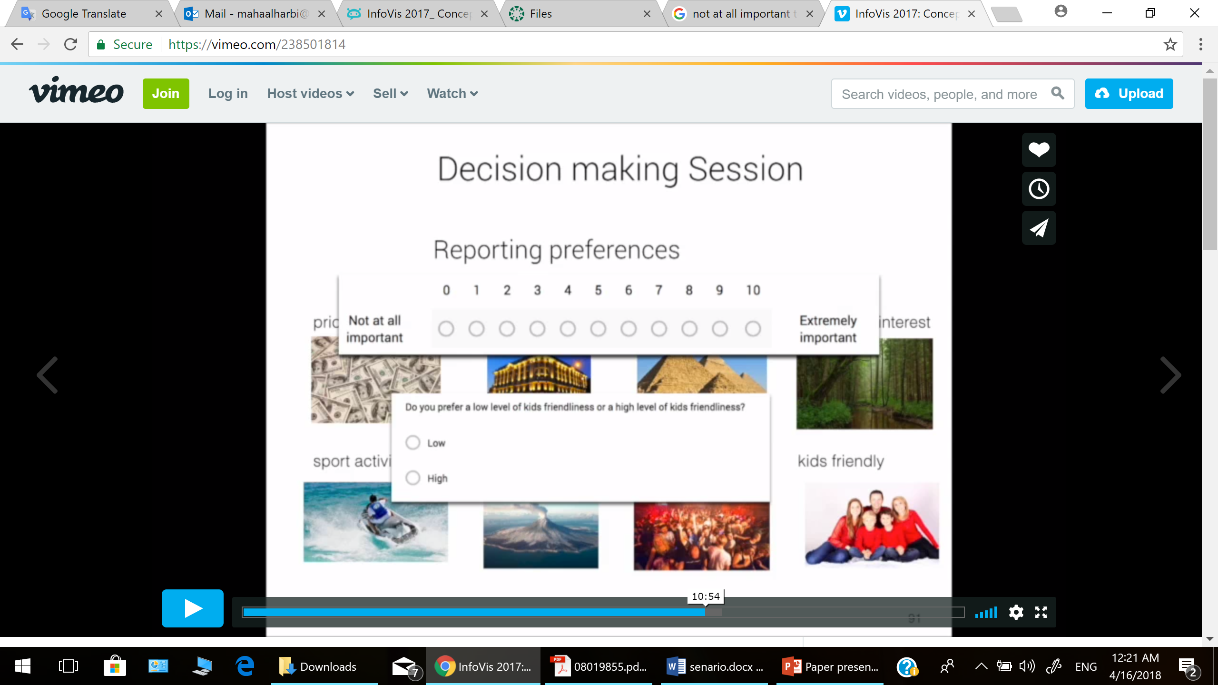


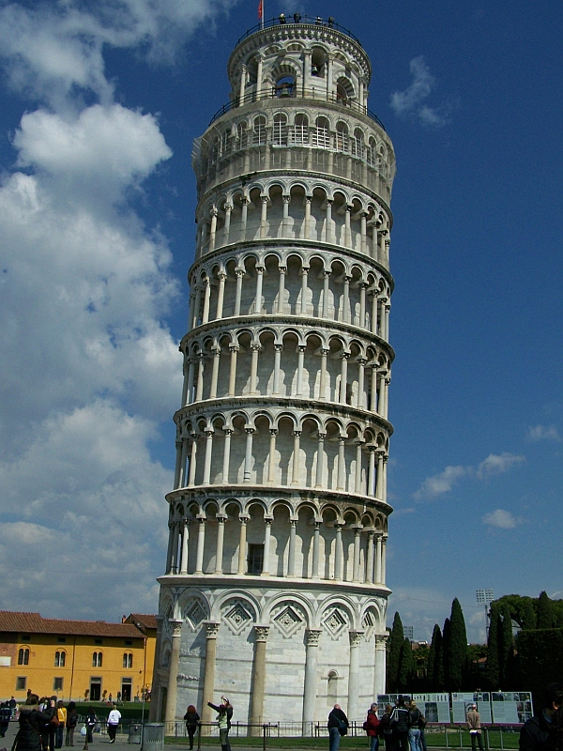





Decision Making Session
Holiday package attributes:
Price | Hotel quality | Archeological interest | Landscape interest
Sport activity level | Security level | Nightlife interest | Kids friendly
Do you prefer a low level of kids friendliness or a high level of kids friendliness?
Low
High

Slide 18

Decision Making Session
Confidence
Satisfaction
Easiness
attachment
Confidence
Satisfaction
Easiness
attachment
Confidence
Satisfaction
Easiness
attachment

Slide 19

Decision accuracy metric:
Accuracy for decision tasks → desirability score
accuracy = max ($d_{pre} −d_{post}$)
pre
post

Slide 20
Results
Mean accuracy
Accuracy:
95-100 success rate
Not accurate
Accurate

Slide 21
Results
Time:

Slide 22
Thank you!

