Slide 1
GLOBE BROWSING: Contextual SPATIO-TEMPORAL PLANETARY SURFACE VISUALIZATION Authors: Karl Bladin, Emil Axelsson, Erik Broberg, Carter Emmart, Patric Ljung, Alexander Bock, and Anders Ynnerman, Venkata Sireesha dadi
Basically, work is done on modifying and uniting multiple data processing to investigate geospatial surface data of various celestial bodies.
The results are:
Addresses high-resolution map data on the surface of Mars.
Describing concurrent weather conditions on Earth that require temporal datasets
Gaining more knowledge and information about Pluto from the New Horizons spacecraft which acquired images during a single flyby.

Slide 2

introduction
In 1962,after the invention of telescope, the hunt for more knowledge made a leap forward when National Aeronautics and Space Administration’s (NASA’s) Mariner 2 flew by Venus and Viking program, launched in the year 1975, which gathered important information about Mars, its surface from the two orbiting satellites.
Resulting, detailed statistics about surface data of all celestial bodies.

Slide 3
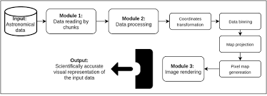
INTRODUCTION
The technical challenges involved are from size, complexity, numerical precision and accuracy, need for curvature corrections, and incompleteness and variety of sources.
Figure depicts an overview of this processing pipeline. The four underpinning principles are:
Complete evidence on visualization should be done and that data should be rooted.
Data from multiple probes should be amalgamated for knowledge representation.
Decision should be taken on request for areas of interest.
Data should be selected, updated and easily accessible.

Slide 4

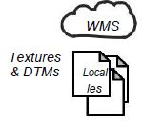
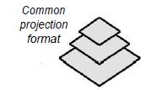


INTRODUCTION
Processing
Rendering
Acquisition
Asynchronous loading
Real-time protection
Illustration of processing pipeline

Slide 5
RELATED WORK
Application is on applied science and methods over four major topics, namely science communication, large-scale astronomical visualization, geographical information systems (GIS), and level-of-detail (LOD) rendering methods for terrains.
Science communication :Visual communication, use of animations and interactive techniques through computer graphics are at the core of interfacing detections and contextualizing information.
Astronomical visualization :One of the challenges is dealing with locating and map reading over far distances.
Fu and Hanson introduced a Z-buffer remapping so that objects can be visible to a wide range of distances instead of using a fixed point depth buffer.
“Eyes of solar system” by NASA
Another package is WWT(World Wide Telescope) which combines various data sources into a dataset.

Slide 6
RELATED WORK
Geographic information systems: GIS reckons completely on transformation and visualize geospatial data. For example, texture and height maps, digital elevation models (DEMs) or digital terrain models (DTMs).
Level-of-detail globe rendering: LOD and multiresolution, out-of-core rendering methods are crucial when visualizing and navigating across large datasets. Examples of earlier LOD techniques for globe rendering include the real-time optimally adapting meshes (ROAM).

Slide 7
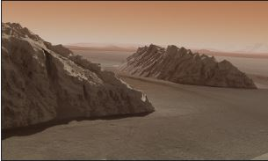
DATA SCENARIOS AND ACQUISITION
MARS
The large scale imaging campaign of Mars is carried out by the Mars Reconnaissance Orbiter (MRO), furnished with an array of cameras, spectrometers, and radar used to image the surface at different resolutions.
Mars global digital image mosaic (MDIM) is used which is global image dataset with a resolution of up to 240 meters/pixel.
The Context Camera (CTX) on the MRO gives gray-scale images of the planetary surface with about 6 meters/pixel resolution used for providing contextual information for the other instruments observing the Martian surface.
High resolution terrain and texture on Mars

Slide 8
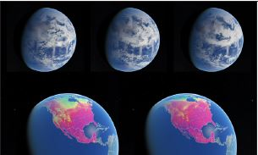
earth
Earth’s thick atmosphere inhibits the addition of surface features. Design constraint for interplanetary spacecraft is available using band-width through the Deep Space Network (DSN)
Geostationary GOES-16 is used which encapsulates an image of the entire western hemisphere every 15 minutes at 10, 000 pixels.
The datasets are available through a public interface provided by the NASA Global Imagery Browse Services (GIBS) that provides a unified interface to make NASA and National Oceanic and Atmospheric Administration (NOAA)
Time varying datasets on earth

Slide 9
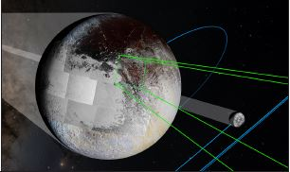
Pluto
Best images of Pluto were came to know from Hubble ,New horizons spacecraft in July 2015 when it was flying past it.
The Ralph instrument’s data source is a Multispectral Visible Imaging Camera (MVIC) which enables the recovery of spectral information and thus provides color information for the LORRI (Long range reconnaissance imager) images.
The Radio Science Experiment (REX) has the capacity to detect radio emissions directly from Pluto’s surface, thus measure its surface temperature or Earth-based radio signals that pass through Pluto’s atmosphere.
Between January and July, the resolution increased to 1km/pixel
Image acquisition on Pluto

Slide 10

DATA ACCESS AND PREPARATION
The most common pattern for global image sources is a web-based LOD service called the Web Map Service (WMS). The online datasets in the system can be checked Geospatial Data Abstraction Library (GDAL) which provides access to a variety of WMS dialects through a single interface.
The HiRISE patches from NASA are referenced in meters by our equirectangular latitude-longitude rendering pipeline. Virtual datasets are defined using XML specifications where properties such as data type, geographic extent, scale factors, offsets, and multiple raster bands can be specified for multipurpose.
Use of the NASA Ames Stereo Pipeline (ASP) stereogrammetry software for content creation becomes a precious tool in our pipeline for building DTMs from stereo pairs.

Slide 11
Real time Image projection and Rendering system
The tools used enable the user to reconstruct the location, orientation of the space craft. To map this kind of image to equirectangular format, position and navigation are combined to give an image projection.
This is available through NASA’s Planetary data system.
Data obtained is in chunks that represent a property. In rendering system, they are evaluated and split to child nodes or merged to form bigger chunks.
It is important when we process multiple layers of data.

Slide 12
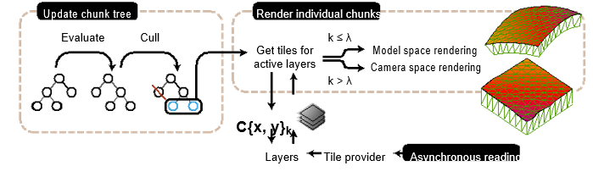
Chunk processing
Chunk nodes are organized in a quad-tree and defined as C{x, y}_{k} for a geographic coordinate index (x, y) and detail level k.
Our error metric is calculated quickly using the logarithm of the inverse distance from its closest point to the camera position.

Slide 13
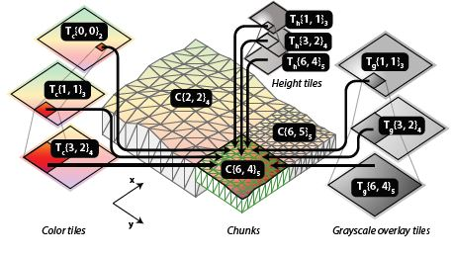
Tile management
A layer is corresponded to tile provider so that the user will use the tile index, representing the corresponding chunk to render.
The tile provider uses an in-memory least recently used (LRU) cache so that it can return a cached tile upon request. It is shared by tile providers of the same layer group and keeps record of the total amount of tile data cached in system memory. When the cache is full, the one which is least used is set to reused again to create a new tile.

Slide 14
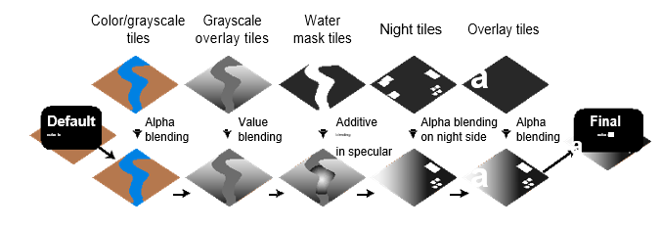
Layer blending
Gray-scale affects only the value component of the base color in HSV space. Water masks are used to change the reflection in the surface shading. Night tiles are useful for Earth where cities illuminate the side that is not facing the Sun.
A time stamp is used to instantiate a tile provider for any given time step. This template can be a file path or a GDAL WMS configuration that contains a time stamp key along with metadata defining time format, start time, end time, and temporal resolution.
Layer group blending is performed to blend different layer groups by sampling and configuration of each active layer group to get the final color. Layers can be manually ordered and combined using per layer settings such as transparency or blend mode.

Slide 15
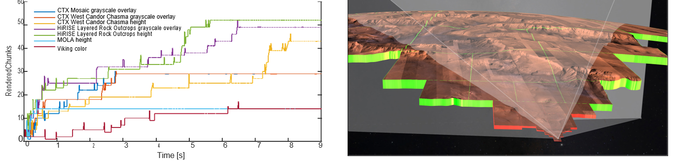
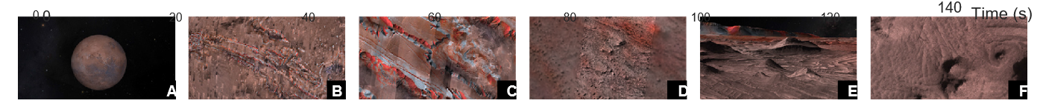
Results :Globe browsing on mars
When new layers are activated, the frame time increases due to the need of shader recompilation. By descending to the surface, more of the chunk tree is traversed.
At point E, the camera is rotated and thus reduces the chunk tree when the data is available in areas previously invisible to the camera.
This scenario combines data sources stored on local WMS servers (CTX Mosaic and MOLA) and local patches stored on a spinning hard disk (HiRISE). There is no difference between the loading times of the two.

Slide 16
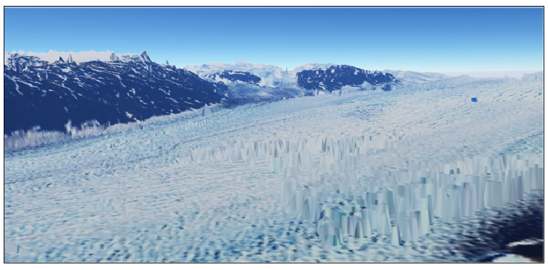
Temporal datasets on earth
On April 22nd 2017 at the Hayden Planetarium, consisting of multiple global datasets that show, parameters like precipitation, temperature, and the aerosol content of the atmosphere.
We are able to record number of parameters which includes surface reflectance, cloud pressure, acids and oxides, temperatures, snow and ice coverage, soil and vegetation indices, chlorophyll levels and such others using scientific equipment.

Slide 17
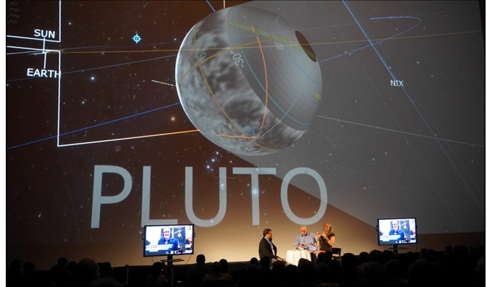
Visualizing acquisition on pluto
NASA’s New Horizons mission flew by the Pluto system on July 14th, 2015 and took measurements with its appropriate instruments. The main are the LORRI and Ralph instruments, that gives images of Pluto and its moons’ surfaces.
This mission visualization was presented to about 2,500 people during a public, global event with 13 different locations. A video stream of the event was made available. This was also later provided as a video-on-demand, called “Breakfast at Pluto”.
Space missions, such as New Horizons or Cassini, are very expensive and venturing tasks carried out in the public interest.

Slide 18
THANKYOU

