Slide 1
Taking Word Clouds Apart: An Empirical Investigation of the Design Space for Keyword Summaries
Authors : Cristian Felix, Steven Franconeri, Member, IEEE, and Enrico Bertini, Member, IEEE
Akhilesh Gundaboina(U25998227)
DEPARTMENT OF COMPUTER SCIENCE
Data Visualization Paper Presentation.

Slide 2
Problem Statement
Researchers have, in the past, studied some aspects of effectiveness with word clouds, however, the existing literature is somewhat scattered and do not seem to address the problem in a sufficiently systematic and holistic manner.
The paper presents a set of four user studies aimed at exploring the visual design space of what we call keyword summaries aimed at helping people derive an intuition of what information a given document collection (or part of it) may contain.
For instance, in summarizing reviews of restaurants that receive negative (1 star) reviews, one can identify trends and major issues that consumers mention in their reviews.

Slide 3
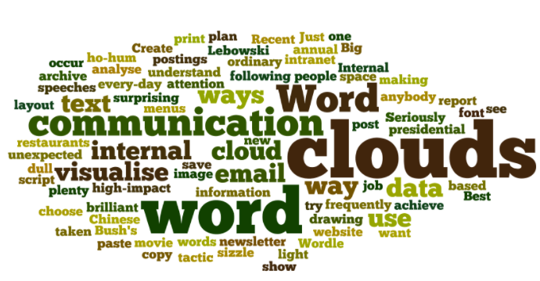
Problem Statement
Word Cloud: Collections of words organized in space-optimized compact layouts in which font size encodes the frequency (or other relevance) value.
Several shortcomings:
1) the lack of natural reading order in how words are laid out
2) the use of font size to communicate quantitative information, which is believed to be sub-optimal compared to other visual channels.
3) the variation in word size due to word length rather than value.
keyword Summaries: lists of words with associated quantitative values used to help people derive an intuition of what information a given document collection (or part of it) may contain.

Slide 4
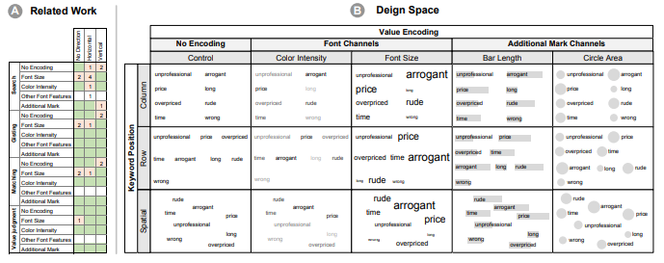

Slide 5
Solution
The systematic approach derives from two factors.
Define a design space based on spatial layout and value encoding, two key visual parameters linked to performance, and include all meaningful combinations in the study.
Study these combinations across a set of representative tasks aimed at spanning a wide spectrum of task granularity: low-level tasks, to address low-level perceptual issues, and high-level tasks, to deal with tasks in which cognition plays a more prominent role.

Slide 6
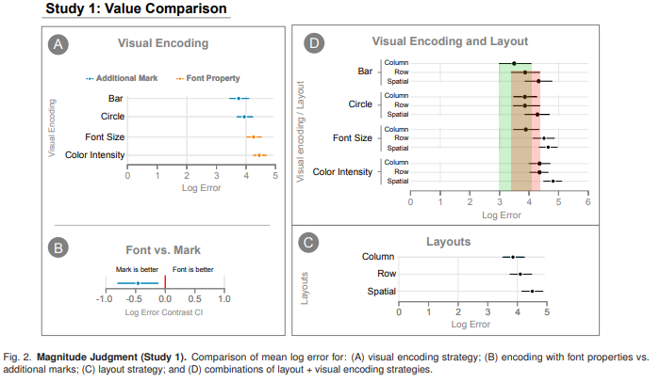
This first study focuses on understanding how accurate are people in decoding quantitative values from the keyword summary.
The first study used a mixed 3×4 design, with the 3 layouts (row, column, spatial) assigned between subjects and the 4 visual encodings (font size, color intensity, bar length and circle area) assigned within subjects.
(A) shows the effect of visual encoding. Bar and circle marks perform better than font size and color intensity.
(B)A clear view of the difference between using font properties and additional mark is shown
(C) Performance
(D) The interaction between marks and alignment is made clear
Solution

Slide 7
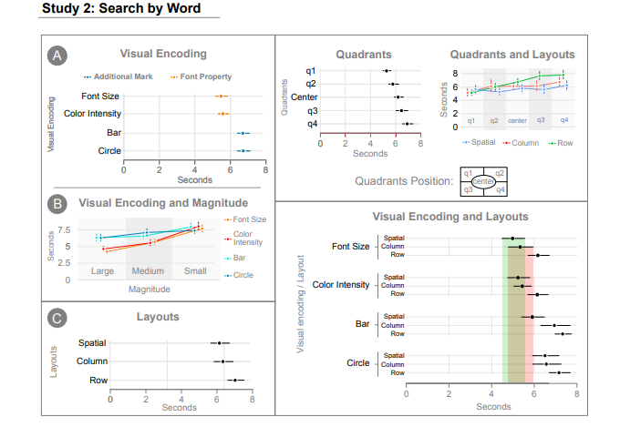
Solution
focus on how different encodings and layouts affect the time it takes to find a keyword in a summary.
For this task, however, two additional parameters :target quadrant and target magnitude, which respectively represent in which quadrant the target word is and which magnitude the target word is associated to.
(A)shows the main effect of visual encoding.
(B)Shows the effect of target magnitude parameter in relation to the encoding parameter.
(C)The spatial and column layouts have very similar performance and seem to have a some what better performance than the row layout.

Slide 8
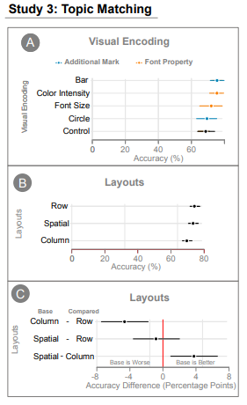
Solution
Shows ability of viewers to identify topics the keyword summaries describe.
(A) shows the mean accuracy for each visual encoding. Bar and color intensity show slightly better performance
(B)and(C)show the accuracy results by layout. Here as well the results do not show any particularly strong trend. The lack of strong difference between conditions seems to indicate that as task increases in complexity, the difference between the conditions becomes smaller or disappears.

Slide 9
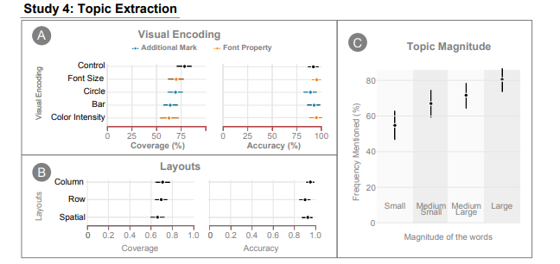
Solution
This study shows how different design solutions affect the performance of a topic discovery task.
(A)shows accuracy and coverage results for the 5 possible visual encoding strategies.
(B)when comparing layouts ,all intervals over lap considerably and the point estimates are all close one to another.
(C)The topics encoded with larger magnitudes are identified more often than topics with smaller magnitude words.

Slide 10
Results
To summarize, the specific use one wants to make of a keyword summary will be the key to opt for solution to be used.
If the goal is to get a general sense of the main concepts contained in the summary, disregarding frequency or relevance, simple lists seem to be a powerful solution.
As soon as marks or fonts encode frequency values, the reading order of the observer can be influenced and thus generate potentially harmful biases.
If searching for specific words is an important task, adding marks rather than using font encoding seems to be detrimental to the search.
If extracting frequency or relevance values associated to the words is important, then using additional marks such as bars (using length/position) or circles (using area) seems to be a good choice, as well as using a column or row layout.
If a compromise between search and value encoding is needed then the column layout with bars seems to be a good solution.

Slide 11
Results
The results of the studies showed us a strong dependency on the tasks users are performing.
The results, as well as, guidelines details on how to design effective keyword summaries based in the discoveries.
This approach is novel and will be a significant contribution to both theory and practice.

Slide 12


