Slide 1
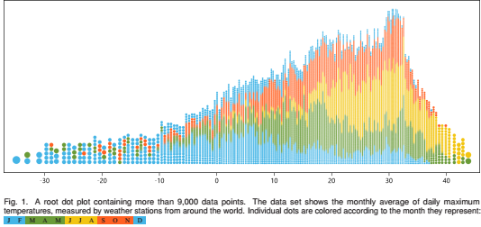
Non linear Dot plots
Nils Rodrigues and Daniel Weiskopf, Member, IEEE Computer Society

Slide 2
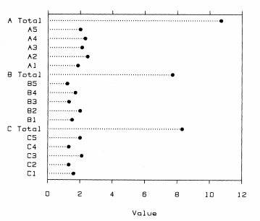
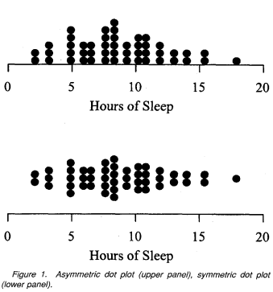
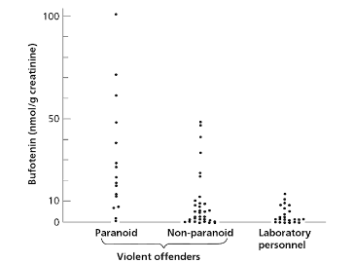
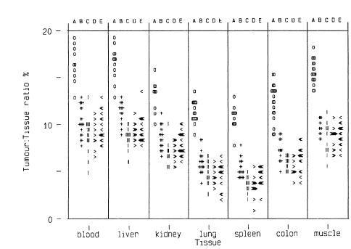
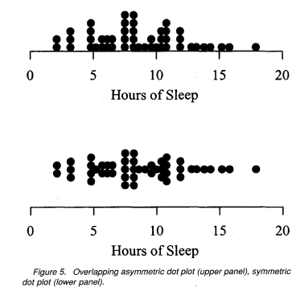
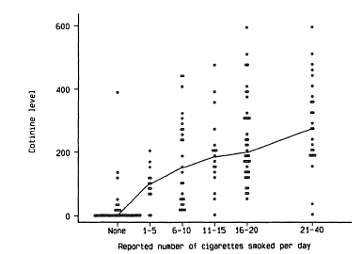
Dot plots : designed and used for displaying data values directly
1.Graphical Perception and Graphical Methods for Analyzing Scientific Data William S. Cleveland and Robert McGill Science, New Series, Vol. 229, No. 4716 (Aug. 30, 1985), pp. 828-833
2. P. Armitage, G. Berry, and J. N. S. Matthews. Statistical Methods in Medical Research. John Wiley & Sons, 2008.
3. L. Wilkinson. Dot plots. The American Statistician, 53(3):276–281, 1999

Slide 3
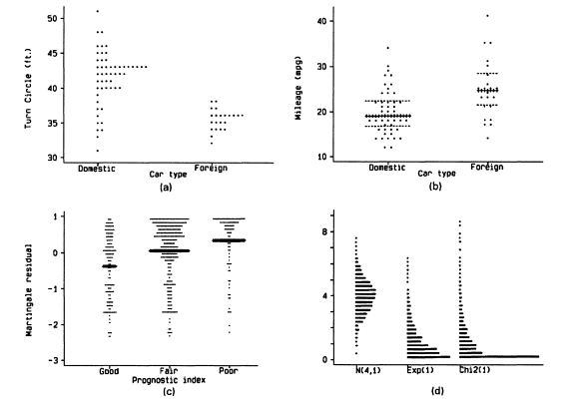
Dot plots cont’d
Rules:
(1) Every data point has a corresponding dot
(2) All dots are of the same size
(3) Dots are not merged, blurred, stretched, or squashed

Slide 4
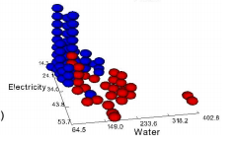
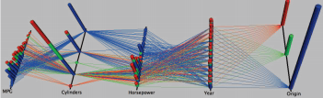
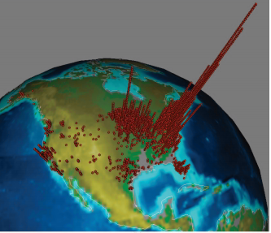
New additions

Slide 5
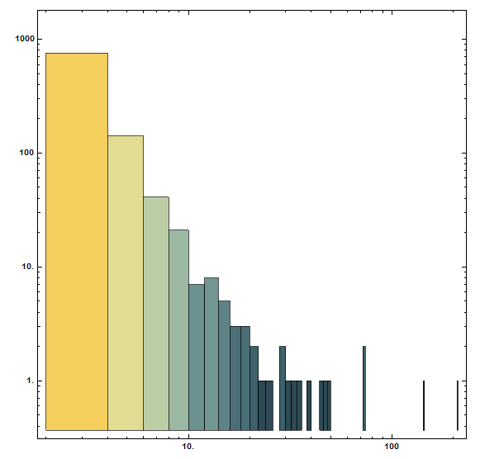
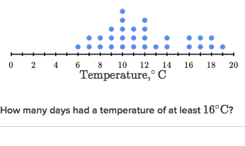
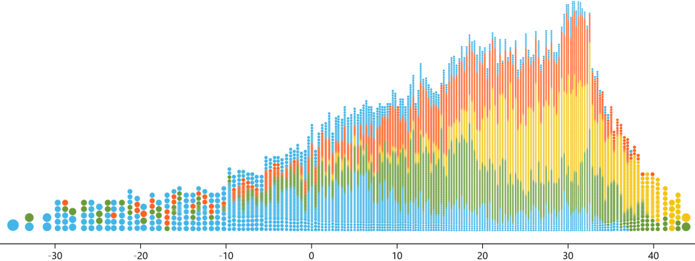
Evolution
Conventional dot plot
Non linear dot plots
Logarithmic histogram
Constant dot size
Typically applied to show the frequency distribution of small datasets
Allow for dots of varying size
Dot size decreases when multiple data points are close to each other. This can be taken to the extreme: keep the column height constant but only adapt the dot size
Columns with a large number of samples are reduced in height

Slide 6
Non linear plot
The diameter has to be varied in the same plot: the higher the dot column, the smaller the rendered symbols.
Leading to a nonlinear modification in column height and width, which is not very intuitive to interpret - In a histogram with nonlinear scaling, we would only have to measure the height and know the transformation function in order to calculate the represented value.
With nonlinear dot plots, we also have to factor in varying column widths, making the computation of displayed value densities more difficult
However, the total size of the plot can be reduced, while retaining large dots for outliers. The decrease in height also provides enough flexibility to bring the output closer to the optimal aspect ratio

Slide 7
Achieved by:
Scaling dot size according to the height of the dot column
Using:
two-way sweep algorithm
that traverses the data value range
(horizontal axis of the diagram)
in both directions
Advantages:
Guarantees a dense and symmetrical layout
Nonlinear scaling for high dynamic ranges
An improved rendering method for dot plots that allows us to remove aliasing artifacts at high dot densities by low-pass filtering along dot columns.
Most of the existing binning approaches lead to an (adaptive) partitioning of the space of data values, whereas nonlinear dot plots differ in the sense that they leave potentially empty space between columns of dots
aliasing is an effect that causes different signals to become indistinguishable

Slide 8
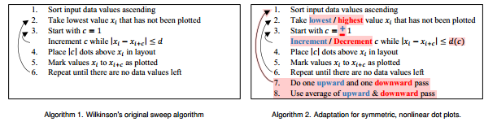
Algorithm
Two sweeps—one in each direction—and combine their
results by averaging.
The arithmetic mean can be applied to the
column’s positions directly and their height (number of dots)
with the slight modification above.
The rules we imposed on the dot diameter guarantee that
both sweeps return the same number of stacks
Both passes must return the same number of columns
Single-sweep approach works very well for a constant dot size
Issues when the data value density decreases along the sweep direction - shrinking dot size (during the sweep) should have an impact on which dots should be included in, or excluded from, a column
When the density increases along the sweep direction, the columns become narrower. Therefore, a second column will not be as wide as the first one and there will not be any overlap between them.
Notes:
that produces intermediate dot plots by traversing the data domain in upward and downward directions; these intermediate layouts are combined to obtain the final plot.

Slide 9


Algorithm

Slide 10
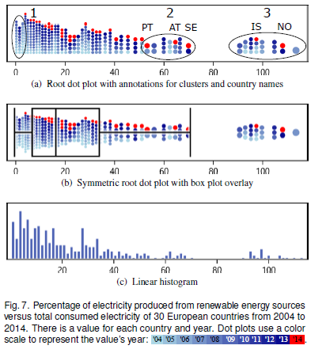
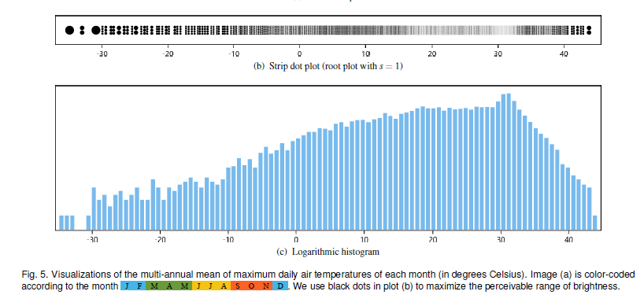
Review panel
Four experts from the field of visualization and computer graphics -- PhD students
Focused on the visualization -linear dot plots and histograms, nonlinear dot plots, and logarithmic histograms
2.
3.

Slide 11
Dataset 3
Axis-dependent accelerations of people falling, measured with smartphone devices- 812 samples.
All plots were rendered in black
All experts recognized a sharp peak
An expert with a pronounced background in statistics noticed the connection between dot plots and histograms, and found the analogy between dot stacks and narrow bins in high sample frequency areas.
In low-density areas, the number of stacks and bars did not match. This was due to the bin limits that separated samples into a bar each, while nonlinear dot plots joined multiple values into low stacks.
Everyone noticed the lack of perceivable bars in low-frequency areas in linear histograms (due to rasterization),
Some were able to discern individual circles in linear dot plots.
Dataset 2
The energy data set
Dot plots were colored
To identify how many countries were represented- to check the understanding of a single dot and the color scale
One expert with much experience in statistics made the connection himself: the number of countries
Able to identify the outliers
The small difference between printed colors and the plot’s small size did not allow them to compare individual dots and come to the conclusion that the cluster always contained two dots per year.
Dataset 3
Temperature data showing minimum daily temperatures
the dot plots were also colored, whereas histograms remained black.
The experts should determine the 25, 50, and 75 percentiles in each plot separately.
Everyone reported that it was much easier with linear representations than with nonlinear ones, as they had to compensate representational distortions.
Two experts with a background in statistics were able to compensate the distortions more effectively and arrived at virtually the same results for each visualization.

Slide 12
Conclusions
Combine the advantages of conventional dot plots and nonlinear scaling known from log-scale histograms.
To visualize countable data samples for data sets with a large range of frequencies
Aesthetically pleasing, especially when combined with color map-ping.
The nonlinear dot plot because outliers were better visible, the single data points are drawn as large dots in areas of few data points.
The nonlinear representation allows for identifying and counting outliers.
However, there is the drawback of nonlinear projections, as they introduce distortions for which the observer has to compensate.
The experts were intrigued by the possibilities of color mapping and counting individual data samples, and mentioned that it allowed for the extraction of more details from the visualizations.

