Slide 1
Timelines Revisited: A Design Space and Considerations for Expressive Storytelling
authored by
Matthew Brehmer, Bongshin Lee, Benjamin Bach, Nathalie Henry Riche, and Tamara Munzner
Presented by
kyle Hemsley

Slide 2
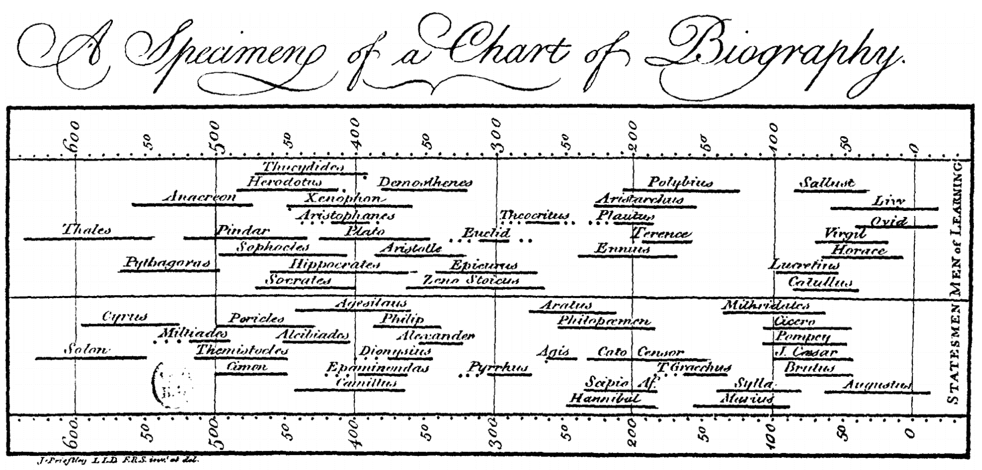
Timelines - Background
One of the oldest forms of data visualization
Most timelines based on design from 1700s by Joseph Priestly

Slide 3
Timelines - Explored
Problem: Timelines can take many forms beyond the basics
Comparison between them is visually difficult
Classification and discussion are also a challenge
Proposed Solutions:
Use smooth, staged animations to transition between timelines
Animated transitions maintain data context
Tailor timeline to a predestined narrative point
This paper is for design and storytelling, not data science
Classify timelines along three dimensions:
Representation, Scale, Layout

Slide 4
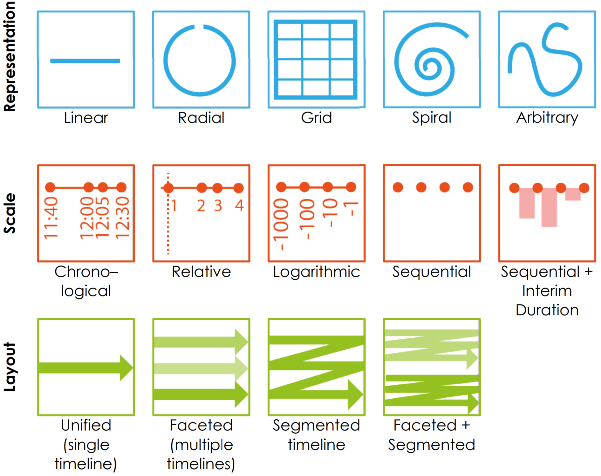
Three-Dimension Classification Glyphs
Representation vs Layout
Layman would probably mistake terminology
Representation is the overall shape
Layout is the implementation
Faceted vs Segmented
Faceted splits on categories
Segmented splits on defined eras
Beware Logarithmic Scale
Generally poor user understanding

Slide 5
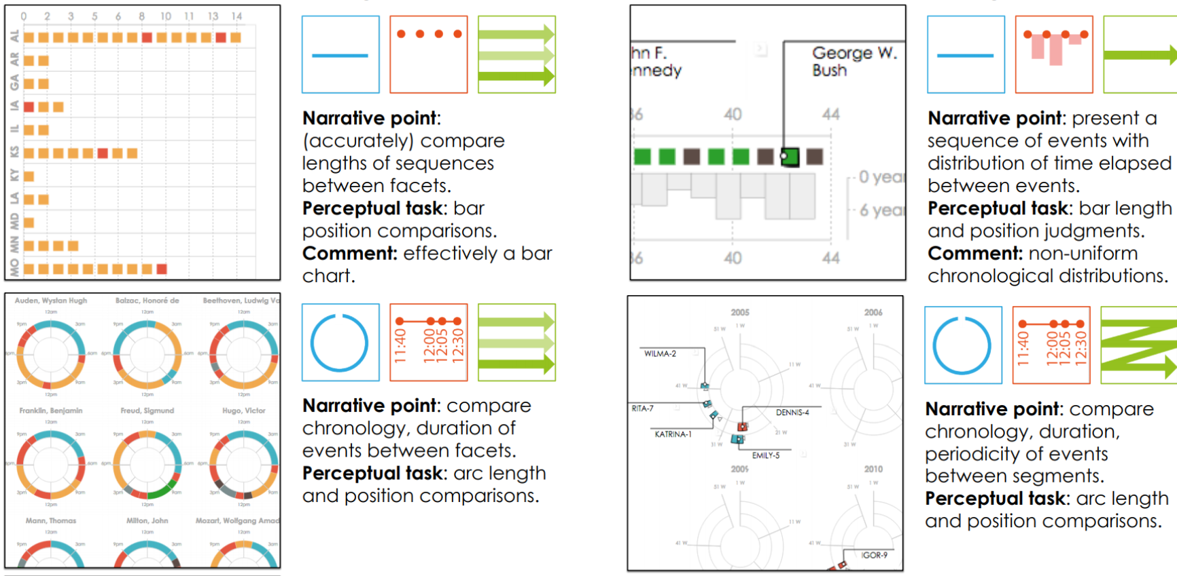
Three-Dimension Classification w/ Fairly Simple Timelines

Slide 6
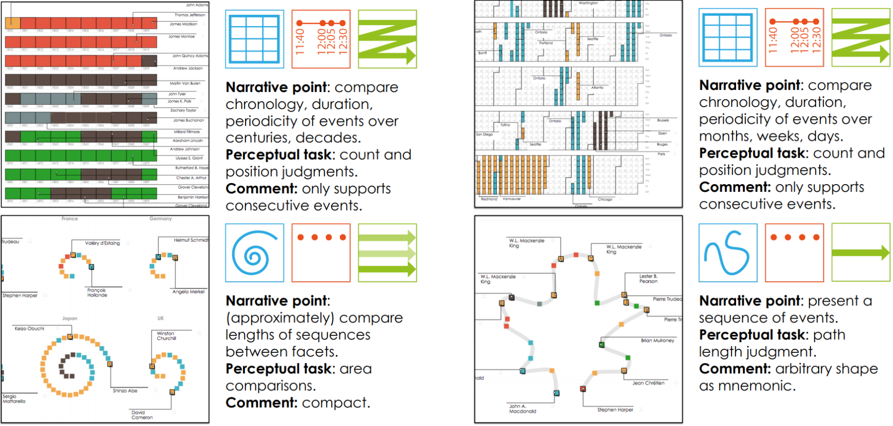
Three-Dimension Classification w/ More Complex Timelines

Slide 7
Timelines - Analysis
Authors looked at hundreds of timelines to develop dimensions
Found only 18 “viable” designs
96% of sample timelines fit into one
73% of sample timelines use a linear representation
Produced two original ”viable” designs for a total of 20
Some designs are redundant but still considered “viable”
This is a design paper!
Redundant designs have aesthetic pros and cons

Slide 8
Timelines – Storytelling
Show or hide data points or timeline elements over time
Reduces perceived complexity
Interaction: show / hide data points & timeline elements based on zoom
When visually moving data around, use chunks!
Easier for the eye to follow
Recommend chunking on proximity
Timeline Dimension Shifts:
Should only change one at a time
Should have specific goal in mind

Slide 9
Timelines - Conclusions
Timeline dataset:
Printed timelines in academia and newspapers
Modern web-presentation timeline frameworks
Future research:
Animated transitions at length
Validate or refute three-dimensional classification system
Applications in data science (outside scope)

Slide 10
Questions
And maybe answers

