Slide 1
An Intelligent System Approach for Probabilistic Volume Rendering using Hierarchical 3D Convolutional Sparse Coding
Authors : Tran Minh Quan, Student Member, IEEE, Junyoung Choi, Student Member, IEEE, Haejin Jeong, Student Member, IEEE, and Won-Ki Jeong, Member, IEEE
Presented By : Thirumala Reddy Potlapati (U55049337)

Slide 2
Overview
What is the problem?
Introduction
Proposed Approach
Experimentation and Results
Conclusions

Slide 3
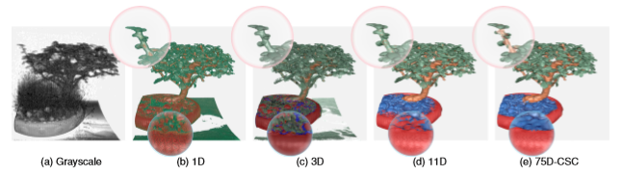
What is the problem?
Data containing noise and anisotropic shapes are difficult to render in intensity based rendering model.
Now a days conventional methods are able to render for most of the cases but with noise disturbances they are not accurate.

Slide 4
Introduction
Transfer Function Design
Learning Based Volume Rendering
Dictionary Learning and Sparse Coding

Slide 5

Convolutional Sparse Coding
CSC is an alternative to Dictionary Learning which build the dictionary with convolutional filters instead of local patches.
CSC for 2D images:
For a given image ‘s’, we can find the best approximation from the summation of response maps ‘∑r_{k}’. This reverse problem can be solved if we impose a constraint that each response map ‘r_{k}’ is the result of convolution between a ﬁlter (or atom) ‘d_{k}’ and its associated sparse map ‘x_{k}’. When ‘l_{p}’ non-linear norm applied to ‘x_{k}’ we get a set of ‘d_{k}’ and ‘x_{k}’. By convolving the filter and sparse maps we can compute back the response map ‘r_{k}’.

Slide 6
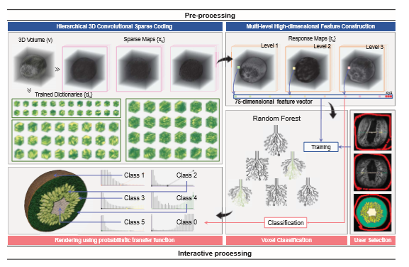
Proposed Approach

Slide 7

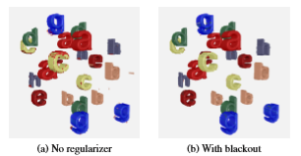
Step 1: Generating 3D Dictionary using 3D CSC
Training 3D Atoms using 3D CSC :
Here 2D CSC model is extended to 3D model to apply for volume rendering. The main idea is same as the previous equation but here it is a 3D image ‘v’. To simply the notations like ‘k’ we can add Fourier transformation to get the following equation.
Improving the Dictionary using Blackout Regularizer :

Slide 8
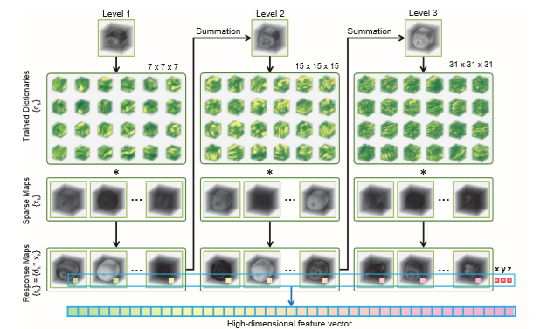
Step 2: Constructing High-dimensional Feature Vectors using Hierarchical CSC

Slide 9
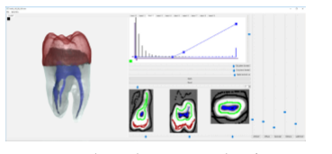
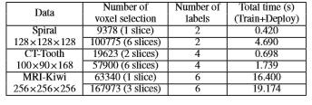
Step 3: Voxel Classiﬁcation using High-dimensional Feature Vectors
Regretion :
Classification :

Slide 10

Step 4: Rendering Multi-labeled Volume using Probabilistic Transfer Function
To obtain the ﬁnal rendering, the ray casting algorithm is employed to project the entire view frustum on to the two-dimensional screen. Along each ray, color and opacity values are sampled and combined using front-to-back composition as follows:
where v.Color and v.Alpha are the color and opacity at the sampling location ‘v’.
This probabilistic 1D transfer function allows more ﬂexible, ﬁne-tune control of intra-label color-alpha value assignment. In addition, since we assign a curve in the 1D transfer function that smoothly interpolates the probability values, partial volume effects (or blocky artifacts) can be effectively reduced.

Slide 11
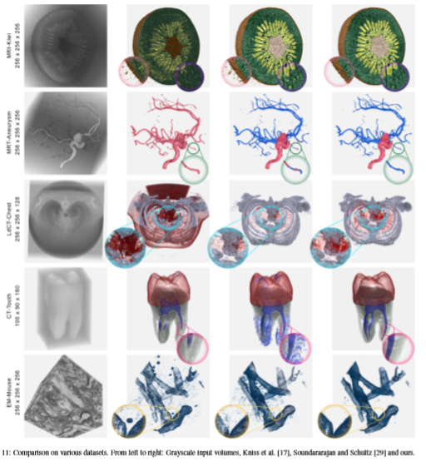
Experiment 1 :

Slide 12
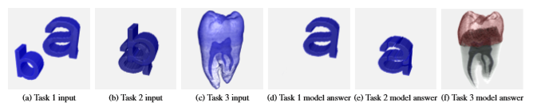
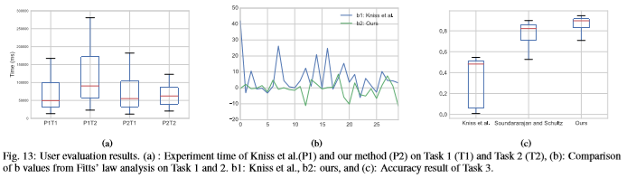
Experiment 2:

Slide 13
Conclusion :
In this paper, they introduced a novel interactive volume rendering framework that leverages machine learning to accurately classify voxels. They presented for the ﬁrst time 3D volume rendering of learning-based multi-scale features that do not rely only on voxel intensity; thus, the proposed method is more robust to noise and is highly discriminative for fuzzy boundaries that results in superior rendering quality.
Limitations:
This proposed method has a limitation, that is the running time for the
dictionary learning and high-dimensional feature construction. Although this
task needs to be performed only once during pre-processing this step
requires approximately 30 minutes to complete on a single CPU core and 10
minutes with GPU acceleration

