Slide 1
Podium: Ranking Data using Mixed-Initiative Visual Analytic
Emily Wall, Subhajit Das, Ravish Chawla, Bharath Kalidindi, Eli T.Brown. And Endert

Slide 2
Mixed-initiative
A computer-human interaction in which either the computer or the human can take initiative and decide what to do next.

Slide 3
Why ?
Importance: Ranking and ordering data points is really important for people to make decisions.
Existed application is not so good for users to rank data points based on their reference.

Slide 4
So this paper present a visual analytic application and develop a prototype system
Podium
Which allows users to drag rows in the table to rank order data points based on their perception of the relative value of the data

Slide 5
What?
A multi-attribute ranking prototype, Podium, that weight attributes based on users’ subjective preferences for data points;
A technique for generating constraints for ranking SVM based on user interactions;
Two usage scenarios to demonstrate how the technique work.

Slide 6
How?
Multi-Attribute ranking visualizations:
It allows users to generalize their knowledge and opinions about a subset of data points and apply it to rank the complete dataset.

Slide 7
How?
Machine Learning:
Learning to rank is a well-explored problem defined in machine leaning.
It is typically approached from one of three perspectives: pointwise, pairwise and listwise.

Slide 8
How?
Machine Learning:
Based on the paper: T.Liu Learning to Rank for Information Retrieval.
Pairwise approach and Ranking SVM

Slide 9
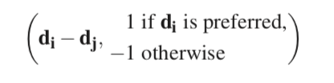
How?
Firstly, we generate labeled data using the points with which the user has interacted by dragging to a new position or clicking on.
Equation:
With this equation, we get a two-class classification problem.

Slide 10
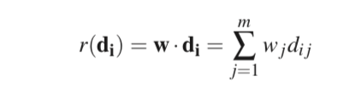
Constraints
input
Ranking SVM
Training model
Ranking SVM
Weight vector

Slide 11
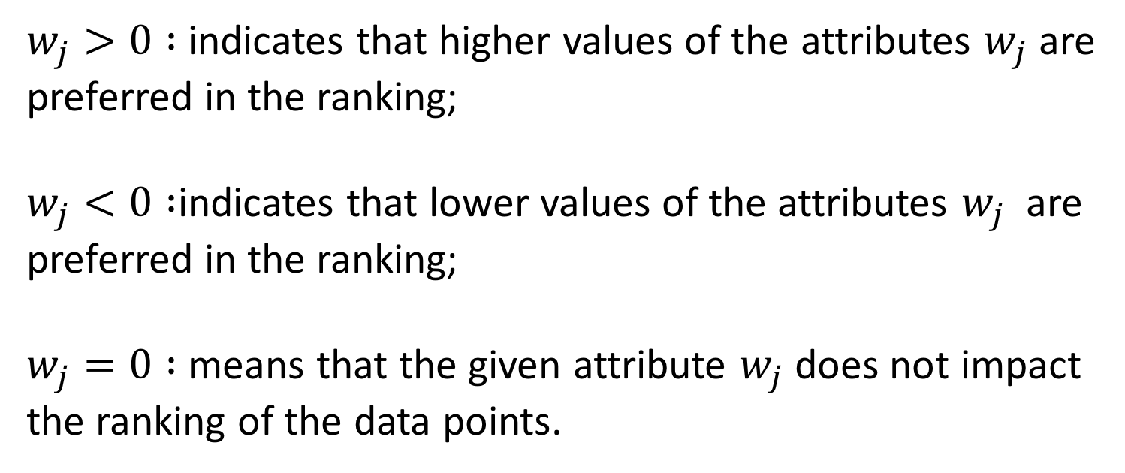
Weights:
$w_{j}>0 :$ indicates that higher values of the attributes $w_{j}$are preferred in the ranking;
$w_{j}<0 :$indicates that lower values of the attributes $w_{j}$ are preferred in the ranking;
$w_{j}=0 :$ means that the given attribute $w_{j}$ does not impact the ranking of the data points.

Slide 12
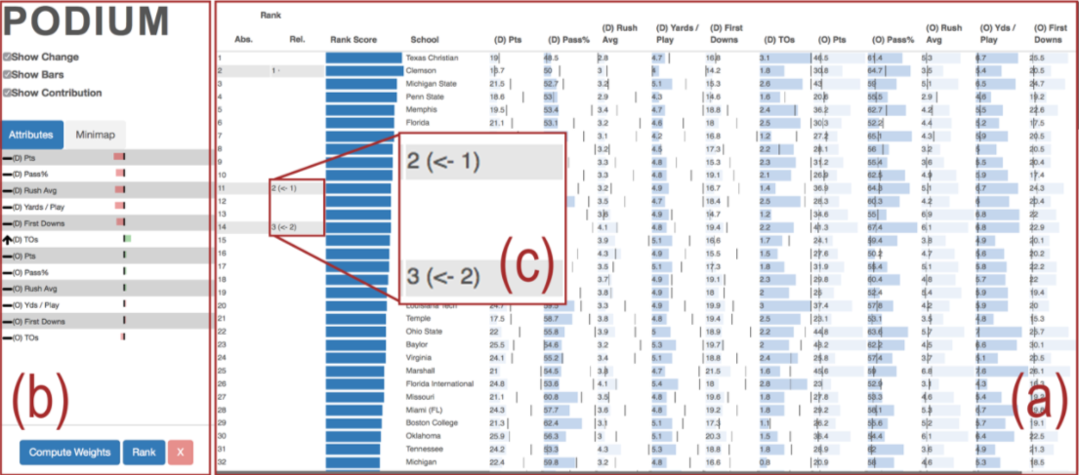

Slide 13
results
4 participants who are experts in information visualization
All participants believe the holistic approach to ranking is very useful and prompted reflection of their own preferences.
Derived weight vector allows them to see a quantitative representation of attributes that they valued.

Slide 14
limitations:
Podium cannot include an exploration of humans’ cognitive abilities to make some judgments in the context of multi-attribute ranking systems.
Current implementation of Podium is its reliance on purely numerical data, categorical attributes are not presently supported.

Slide 15
Thank you!

