Slide 1
Voila: Visual Anomaly Detection and Monitoring with Streaming Spatiotemporal Data
Authors: Nan Cao, Chaoguang Lin, Qiuhan Zhu, Yu-Ru Lin, Xian Teng, Xidao Wen

Slide 2
What is Voila?
Voila (visual analysis of spatiotemporal data) is a visual analytics system and framework for interactively detecting anomalies in spatiotemporal data collected from a streaming data source
Real-world applications
Online monitoring
Data streaming (i.e. constant changing weather patterns as a data stream)
Near real-time
Heavy emphasis on use in public safety
Anomaly highlighting
User input taken into account

Slide 3
Challenges and Proposal

Slide 4
Challenges: Anomaly Detection
Approaches have been made (list is non-exhaustive)
Many produce (useful) numeric anomalies (i.e. the “outlierness”) but do not offer much in terms of interpretation
What is “abnormal”?
Lack capacity to deal with multi-way features, such as time and space
Recent proposals: tensor based approach
Almost all assume stable patterns (relatively) and decomp can be done in batch process
Cannot adapt to streaming data, where normal patterns can and do change over time

Slide 5
Challenges: Visual Anomaly detection
Major issues:
Lack of clear boundary between normal and abnormal
Difficult in obtaining labeled data for training and verifying models
Human input is usually required in guiding the system to produce meaningful results more efficiently
Recently proposed: system for detecting the spread of rumors

Slide 6
System overview
Adaptivity
Real-time or near real-time analysis
Their system is near-real time
Interpretability
Intuitive designs to discover abnormal patterns of “when, where, and what” might happen
Interactivity
Take in user input during analysis to produced refined analysis in real-time

Slide 7
Anomalous pattern extraction

Slide 8

Data model and transformation
A LOT of math
Tensor: mathematical representation of a multi-dimensional array
Scalars, vectors, and matrices to higher dimensions
Representation: New York City taxi-trip data (2014-2015)
100M taxi trips within Manhattan area
Partition of area into grids of 311 equal regions (2 x 2 km²)
Over 720 tensors
Latent pattern detection:

Slide 9
Voila UI and features

Slide 10
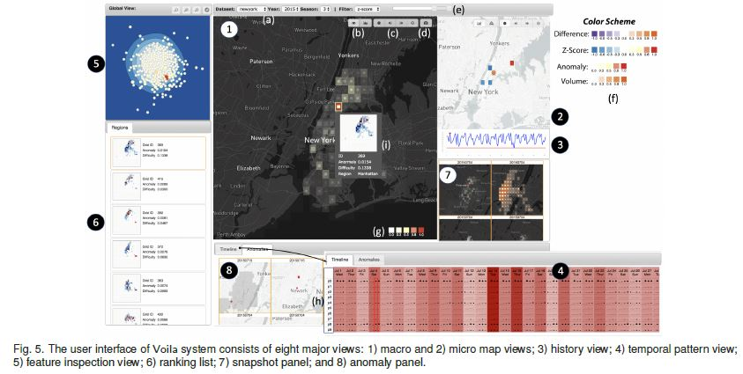

Slide 11

Macro map view
Geographical map overlaid with equal sized grids
Overview of anomalous information in heatmap form
Visual cues for “interesting region”
2 modes: anomaly detection mode and context mode
User feedback: proposal uses Bayesian approach and human judgement to update real-time
Bayes’ theorem to calculate probability of an event:
$P\left(A | B\right)=P\left(B | A\right)P(A)/P(B)$
Or, probability of event A occurring because of some event B related to A

Slide 12
Micro map view
Shows raw data and relevant stats of selected region
Relationship between focal region and remaining regions
Heatmap generated centered on focal region
Colors represent strength of relationships
Relationships:
Raw (in or out flow)
Expected flow
Deviated flow

Slide 13
interactions
Anomaly Inspection
Snapshot Capturing
Context Switching
Show different info via buttons
Filtering
Dynamic Zooming and Panning
Highlight, Link, Brush
Mouse-over highlighting

Slide 14
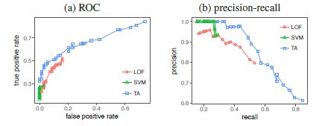
Evaluation
Effectiveness based on: quantitative evaluation and usability and usefulness
Both were conducted based on New York City taxi-trip data
Quantitative:
12 annotators to label anomaly incidents
300 potential -> golden list of 96 incidents
High true positive rates, false positives remaining low
Higher precision at low recall conditions

Slide 15
Evaluation (cont.)
Case study with domain expert
High expertise in public safety, no prior knowledge of incidences
Session:
Intro to system, dataset, and key features (30 min)
Discovery (60 min)
Identify anomalies
Pattern exploration
Feedback

Slide 16
Evaluation (cont.)
Expert quickly found interesting items:
Pattern of weekend parties
Everyday routines (rush hour traffic)
Anomalies:
Irregular taxi traffic (against historical values) with a fire station nearby
Conjecture: fire incident in focal region, verified as gas explosion incident
Potential anomalies:
Suspicious region discovered as park with numerous anomalous behavior
Verified as regular fishing contest; marked normal (human interaction)
Second region: irregular event (same day); identified as public concert)

Slide 17
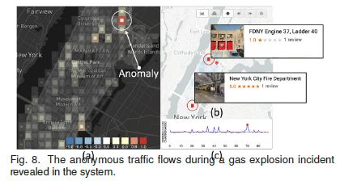
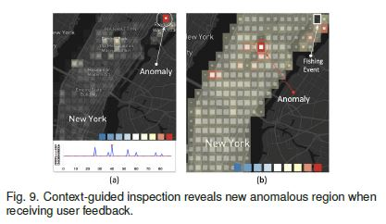
UI of voila (anomalies)

Slide 18
User Feedback

Slide 19
System
Expert impressed by design
Lots of images and video from security cameras, struggle to important events from large amounts of data
Easy to identify warning signs from big data
Very comprehensive but overwhelming at first, suggested tutorial for intro

Slide 20
Visualization
Fairly easy to comprehend and helped to discover patterns
Updating rules was complicated
History view useful in eliminating false positives
Z-map is a little less useful (stats)
Expected patterns was VERY useful

Slide 21
Interaction
Ranking of potential anomalies is “new and smart”
With big data, option to stop looking would be useful
Does not support fact checking
Time was spent to verify the events
Could be made more powerful with added event search

Slide 22
Usefulness and applicability
Could be effectively used predict events before they occur
New Year’s Eve in Shanghai (2015)
Stampede, 36 killed, 49 injured
Could have been used to predict anomalous traffic flow hours before
Incident could have been prevented
Suggestion of fine-grain temporal data input (minute-by-minute) and incorporate as many data solutions as possible

Slide 23
Questions?

