Slide 1
TACO: Visualizing Changes in Tables Over Time
BY: Christina Niederer, Holger Stitz, Reem Hourieh, Florian Grassinger, Wolfgang Aigner, and Marc Streit
PRESENTATION BY: CAMILO SARABIA

Slide 2
Understanding tabular data is essential
Have you ever compared tables?
Tables can change in structure and content over time
Understanding Tabular Data is essential
Understanding changes is a challenging task
TACO (Table Comparison) is a comparison tool that visualizes differences in-between multiple tables on various levels of details

Slide 3
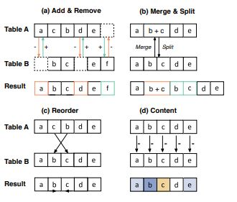
Methods
TACO is focused on Quantitative homogeneous tables
There are 4 different types of changes:
Structural Changes, Content changes, Reorder changes, Merge/split changes.

Slide 4
Based on these changes, there are a number of user tasks that Taco needs to address.
There are 4 main tasks:
T1: Identify the types of changes
T2: Compare multiple table versions over time
T3: Compare one table at two particular time points
T4: Present raw data tables and meta-data

Slide 5
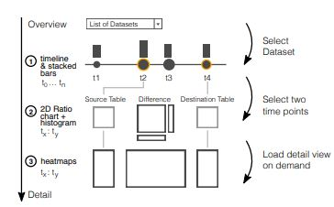
Taco allows multiple levels of details
Level 1: Change overview timeline
Level 2: aggregated pairwise comparison
Level 3: Detailed pairwise comparison

Slide 6
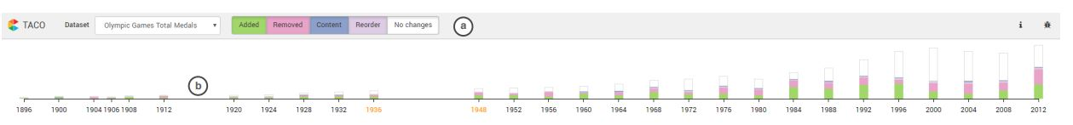
SUMMER OLYMPIC GAMES
Rows = Countries, Columns = Disciplines

Slide 7
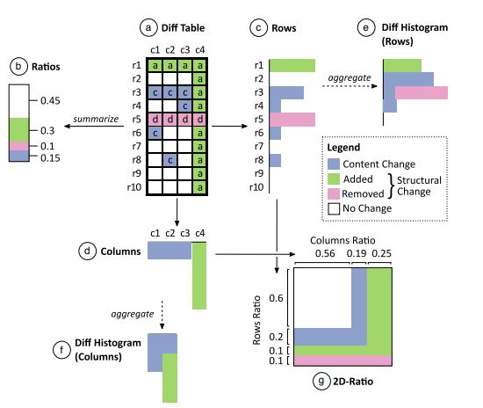
For level 2:

Slide 8
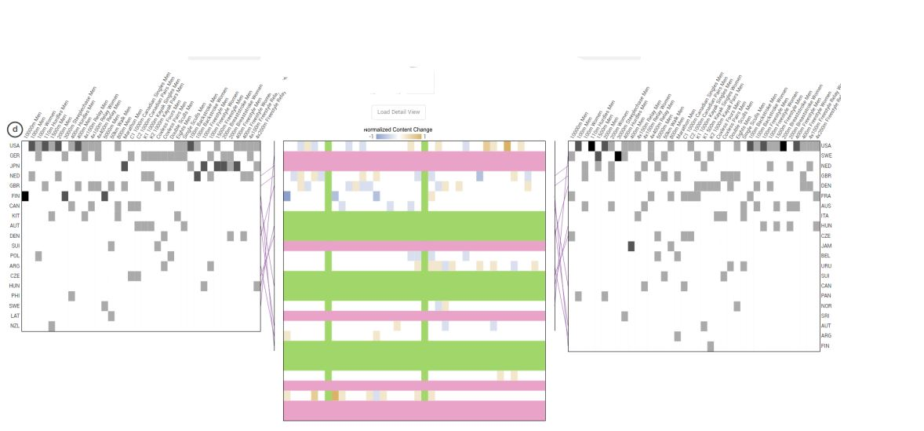
For Level 3:

Slide 9
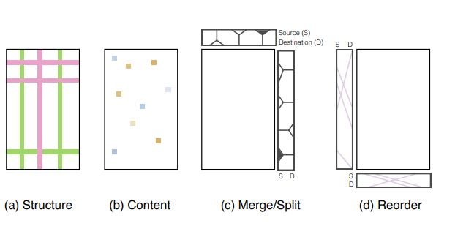
Additonal encodings

Slide 10
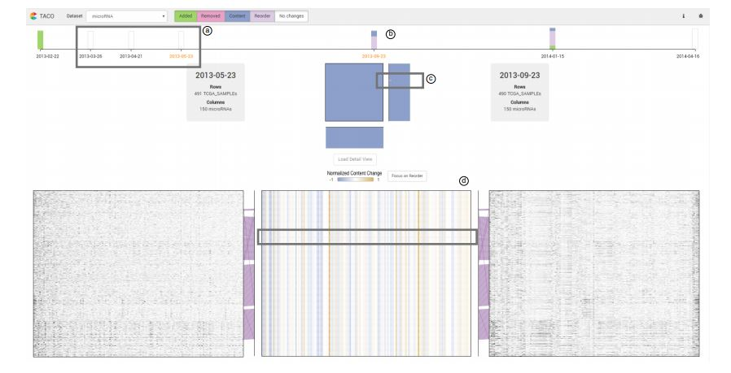
CANCER GENOMICS
Rows = Patients, Columns = Genes

Slide 11
conclusion

