Slide 1
Bubble Treemaps for Uncertainty Visualization
Jochen Gortler, Christoph Schulz, Daniel Weiskopf
Presented by: Nikolai Fetisov

Slide 2
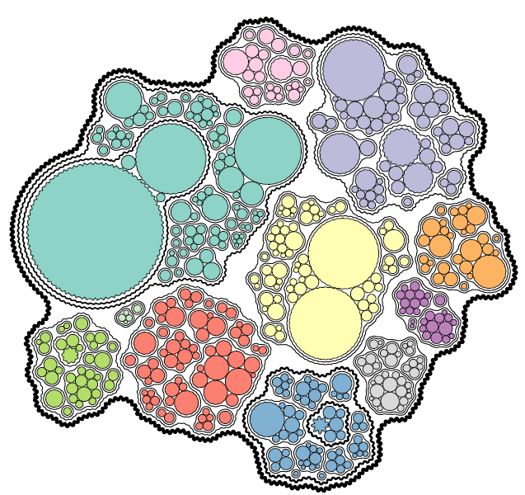
Bubble Treemap
Used for visualizing hierarchical data with uncertainty.
E.g. stock prices
Shows uncertainty at each level of the hierarchy
Has advantages and disadvantages in comparison to other treemap approaches, such as Square Treemap or Circular Treemap

Slide 3
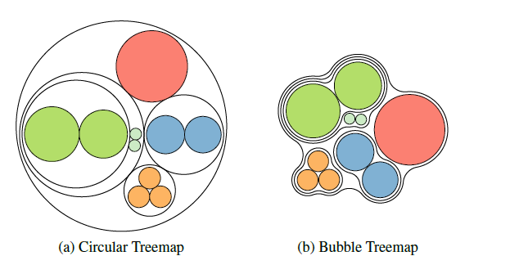
Hierarchical Data and Treemaps
Hierarchical data plays a significant role in data visualization
Many methods were developed to visualize it
A canvas is divided according to relative sizes of sub-hierarchies
Treemaps are compact and scalable representations
Still, some treemap methods waste too much space
E.g. Circular Treemap
Tradeoff between compactness and visual features

Slide 4
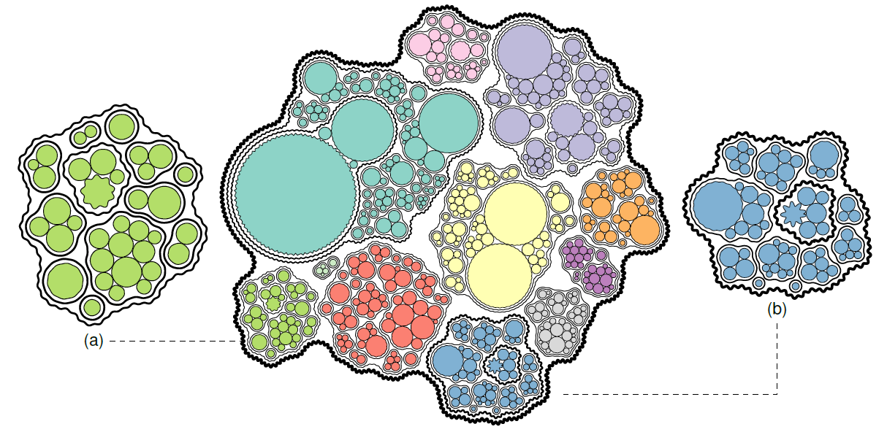
S&P 500 Index Bubble Treemap
Data divided into sectors and companies
Each circle represents a stock
Area is proportional to stock mean closing price
The boundary represents standard deviation
Uncertainty arises from one week of stock data in November 2016

Slide 5
Visualizing Uncertainty

Slide 6
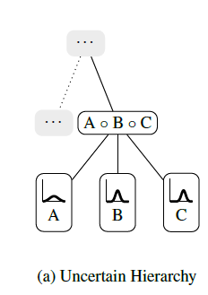


Uncertainty Calculation
Each stock price has an uncertainty, which is represented by standard deviation of its Probability Density Function (PDF)
Expected value and standard deviation are calculated as follows:
Expected value is represented by circle area on the visualization

Slide 7
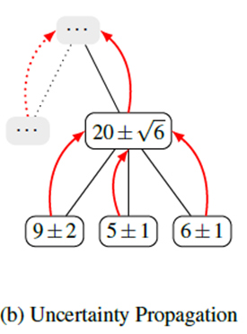

Uncertainty Propagation
Uncertainty is propagated by adding up expected values and aggregating standard deviation using Euclidian norm

Slide 8
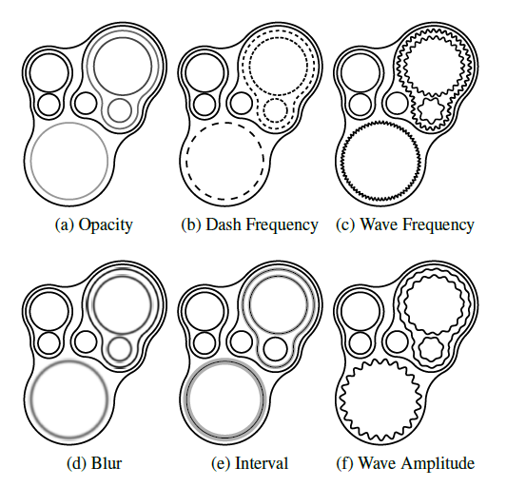
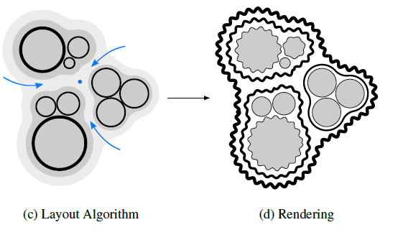
Uncertainty Visualization
The visualization is done in two steps
Creating treemap layout
Visualizing uncertainty

Slide 9
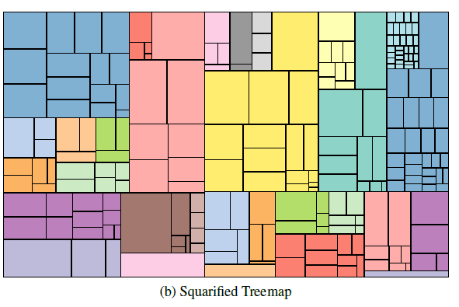
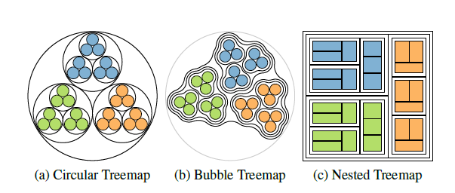
Advantages of Bubble Treemap
Hierarchy is easier to see in comparison to some other treemap approaches, such as Square Treemap
Space is used more efficiently in comparison to Circular Treemaps
Colors are not used to encode variables, leaving freedom for using them to improve visuals
Easy to see uncertainty with chosen representation (waves)

Slide 10
Disadvantages of Bubble Treemap
Not space optimal in some cases.
Square Treemaps on the other hand are space optimal
The aggregate value (area) is not properly reflected
Significant computational complexity
O(n²)

Slide 11
Acknowledgments
All images and information are from “Bubble Treemaps for Uncertainty Visualization” paper
Jochen Gortler, Christoph Schulz, Daniel Weiskopf, Member, IEEE Computer Society, and Oliver Deussen

