Slide 1
Doccurate: A Curation-Based Approach for Clinical Text Visualization
Nicole Sultanum, Devin Singh, Michael Brudno,
and Fanny Chevalier
Presented By: Vijay Singh Chauhan

Slide 2
Agenda
Introduction
Current approach and Challenges
Proposed new approach
Doccurate Interface and Design
Evaluation Study and Outcomes
Conclusion

Slide 3
Introduction
Overview of Patient’s medical history
Contextual Factors
Large Clinical Documents and Time Crunch
Skimming of Documents and Risks Associated
Arrival of Data Visualization and text summarization

Slide 4
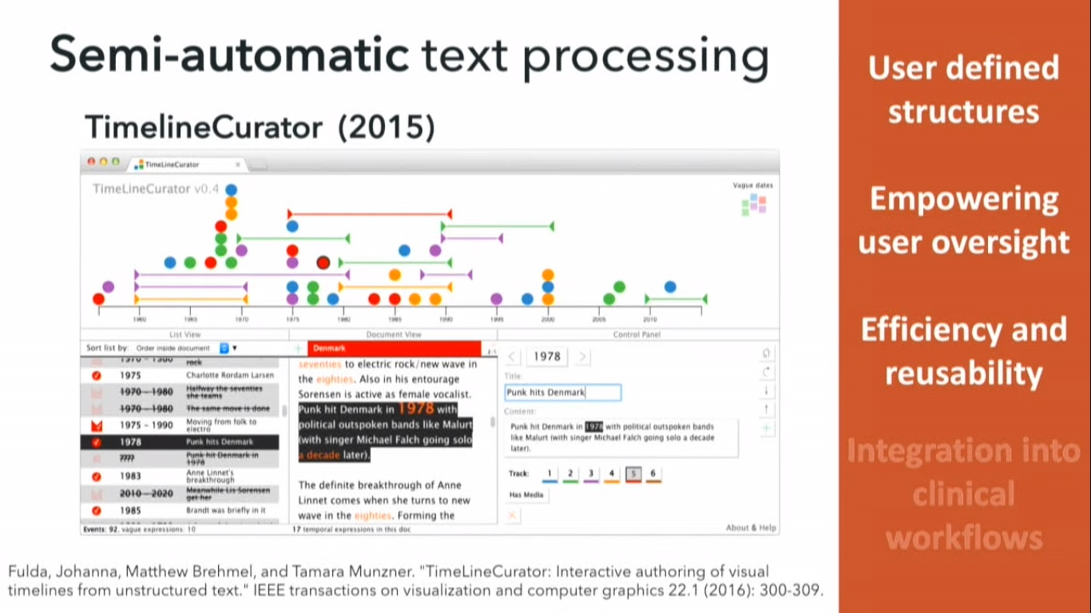

Slide 5
Challenges
Superfluous information
User Customization
Special Needs ( Medical Taxonomy)
Low adoption rate
Automation mistakes
Constant validation required
Lack of trust

Slide 6
Doccurate
Preserve the original text
Provide information in different levels of granularity
Support user-driven customization
Convey time and progression
Support content faceting

Slide 7
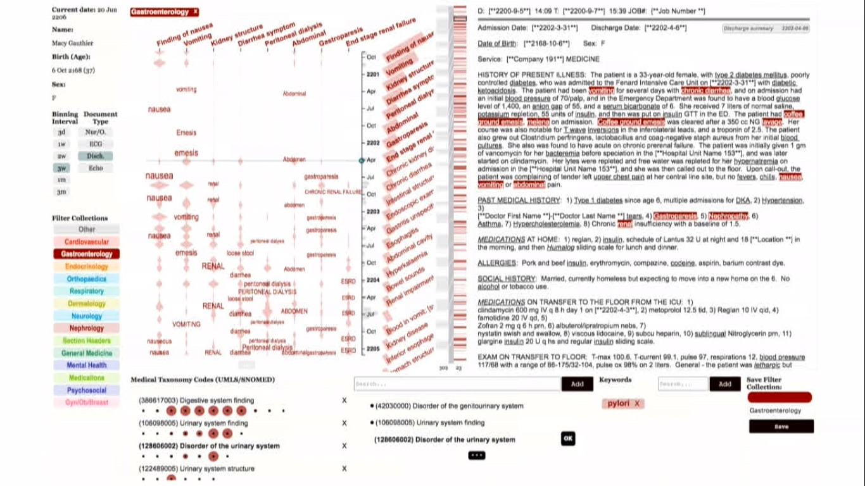

Slide 8
Interface and Design
Control Panel (Panel A)
Time Line (Panel B)
Text Panel (Panel C)
Curation Panel (Panel D)

Slide 9
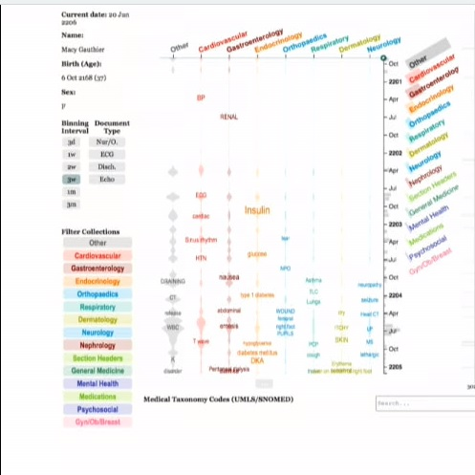
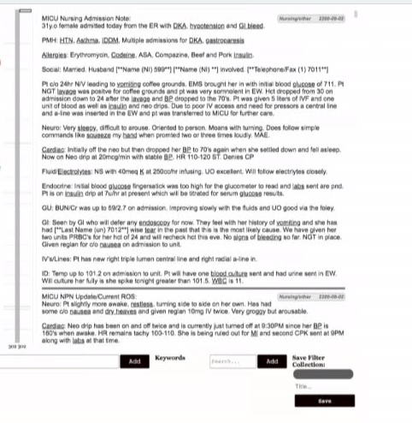
Control Panel & Text Panel

Slide 10
Evaluation Study & Outcomes
Curation Workflow
Curation Structures
Automation Transparency
Efficiency
Comprehensiveness

Slide 11
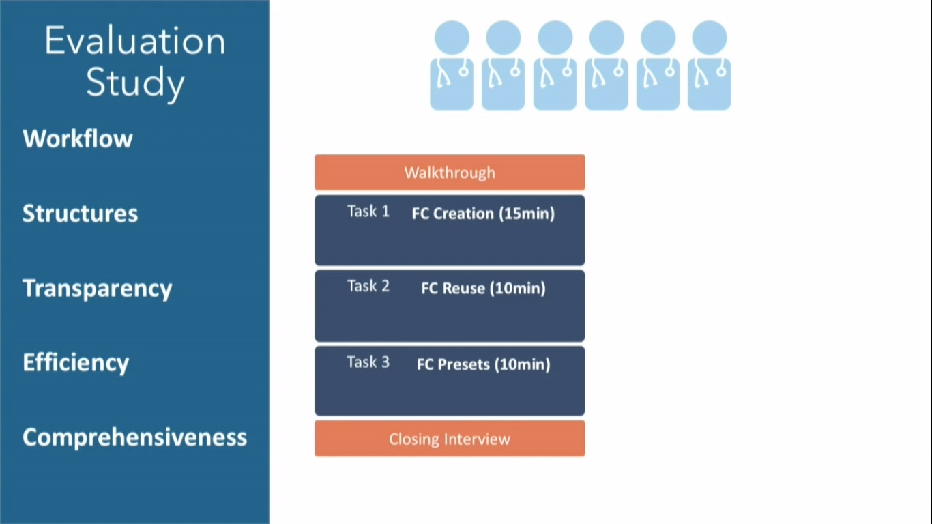

Slide 12
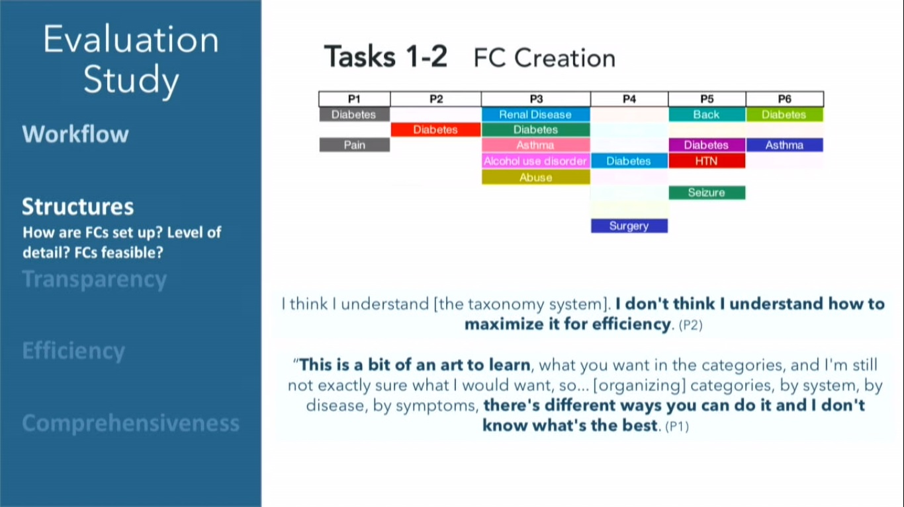

Slide 13
Conclusion
A thorough assessment of a curation based approach for physicians to visualize and peruse clinical text.

Slide 14
Video
https://vimeo.com/300470083

Slide 15
Q&A

