Slide 1
A Visual Analytics Framework for Spatiotemporal Trade Network Analysis
By: Wang et al
Presented By: Mark Boger

Slide 2
The Problem
Increasing connectedness among regions of the world.
Localized disruptions are exported to distant countries
Hazards generally focus on local impact
Researchers and stakeholders need tools
Anomalies
Correlations
The data is complex
Multivariate
Spatiotemporal
Huge amount
Notes:
Floods and droughts (monsoons of Southeast Asia -> St. Kitts in the Caribbean and Congo in Africa both rely on Thailand for over 95% of their imported rice, it significant disruption in Thailand's agricultural production could have a dire impact on food security thousands of miles away.)
Don’t consider the connectedness of the network

Slide 3
Contributions
Identification of design requirements for exploratory visual analysis
Novel triad analysis
Integration of space, time and network analysis
Notes:
the exploratory visual analysis of global trade and regional unrest as elicited from our partners in political science and sustainability, as well as recent literature on global trade analysis
exploring network dependencies to identify possible relationships between trade network structures and other measures of interest
support the linked analysis of trade network data and conflict events through anomaly detection and correlation analysis across imports, exports and triadic structures.

Slide 4
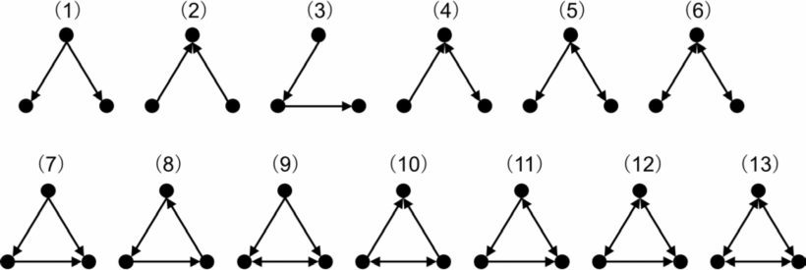
Triadic Analysis
Anomaly detection
Correlation analysis
Clustering
Similarity Comparisons
Notes:
A triad is a three-node directed subgraph
triads are the smallest structures within a network that exhibit truly social characteristics
long been a standard methodology in the study of networks [25], particularly with regard to properties such as structural balance and transitivity.
triads are a logical starting point for directed networks because the relatively small number of possible configurations are manageable for exploratory analysis

Slide 5
Visual Analytics Framework
Country-product matrix
Highlights correlations and anomalies for country/item pairs
Time series view
Trends and anomalies in trade and stability measures
Choropleth map
Along with multiple small choropleth maps
Compare trade profiles
Clustering and scatterplot view
Explore similarities between trade profiles
Compare trade profiles to stability measures
Trade diffusion graph

Slide 6
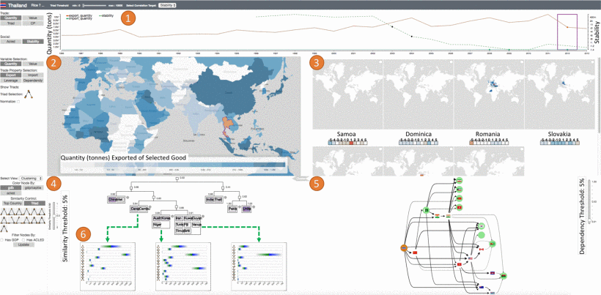
Notes:
1 - anomaly time seras
2 - choropleth view (3) multiple smaller maps
4 - clustering view (6) configured to show average triad distributions
5 - trade diffusion graph

Slide 7
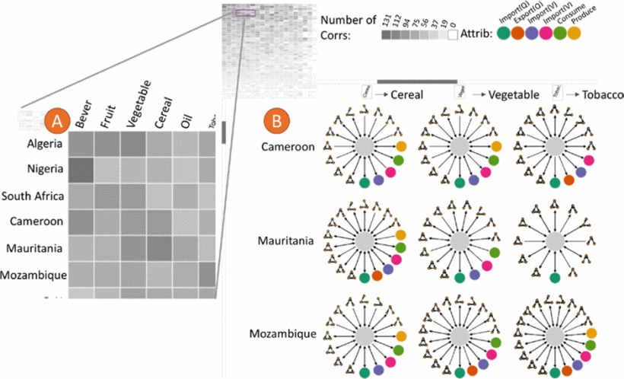
Notes:
This matrix view consists an abstract view (Fig. 3A) and a detail view (Fig. 3B).
The color of the cell represents the total number of correlations, the darker, the higher.
A snapshot of the whole matrix is displayed on the top left corner to help keep track of the current location within the matrix
Pearson's correlation coefficients for leads/lags between −5 and 5. (measure of the linear correlation between two variables X and Y.)
The trade attributes with correlations are displayed in a circular layout surrounding the stability measure (colored in gray). The arrows connecting them indicate the directions of the correlations: if the correlation occurs when the trade attribute lags the stability measure, the arrow points from the trade attribute to the stability measure.

Slide 8
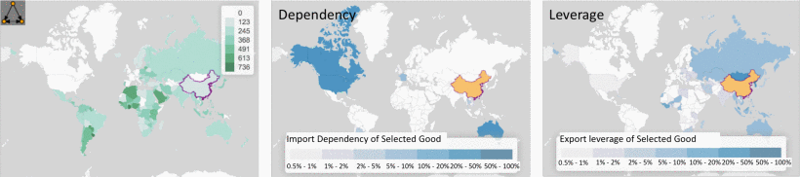
Notes:
The main choropleth map can be used to visualize triad, trade quantity/value, and country dependency/leverage. Examples show the triad distribution (left), China's dependency (middle), and China's leverage (right) in cereal network.
the selected country is highlighted in orange and all other countries on the map are colored using a sequential color scale based on the selected measure (trade quantity/value or triad)
Triads are visualized by the sum of the triad counts in the selected types (out of the 13 types) associated with each country in the food network.
Trade Quantity is given in tons.
Trade Value is given in dollars.
Trade dependency is derived from trade quantity and trade value.
small multiple maps view will display all other countries that have an anomaly in the same year with the same attribute.

Slide 9
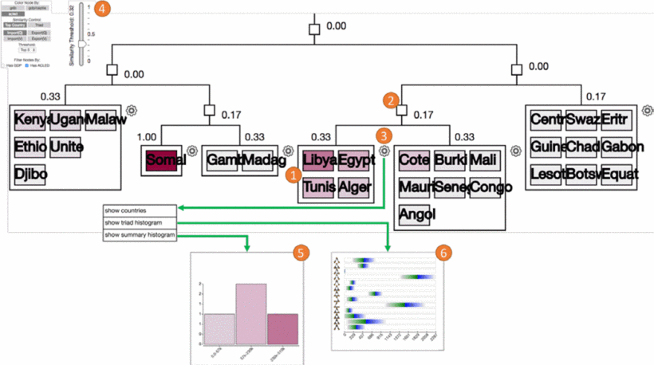
Notes:
Clustering utilizes partner similarity or triad similarity. when using positional triad configurations, the country's triad profile is a 13×1 vector where each entry represents one frequency. The triad similarity of two countries is then defined as the vector similarity of their triad profiles (euclidean distance). T1 A T2 (partner)
1 - Countries in clusters are grouped by box
2 - internal nodes collapse children
3 - different view options (5, 6)
4 - Adjust similarity threshold
5 - Histogram of stability measure
6 - compare mean and standard deviation of every triad configuration

Slide 10
Case Studies
Sustainability
Food insecurity
Political instability
Focus on the “Political Stability and Absence of Violence/Terrorism” governance index
Environmental factors
Sustained drought

Slide 11
Results
Provides unique capabilities for hypothesis generation
Anomaly detection
Clustering
Small multiple anomaly view
Could not test the hypothesis
Only supports exploratory data analysis
Needs more testing

Slide 12
Conclusion
Focus on improving the overview
Add more analytic methods
Limitations in choropleth maps
The amount of data limits functionality
Can’t identify spurious correlations
Can’t justify or exclude explanations
Notes:
R1 The framework needs to provide an overview for the expert to start their analysis given the sheer number of possible networks, each of them can be centered on many possible countries. This overview needs to visualize patterns detected from the networks and the possible relationships between the network and local instability to help the expert select the data needed to be explored.
R2 Explorations of a trade network should be supported for the investigation of different trade measures, e.g., imports, exports, and reliance, and the structure of country's local network topologies.
R3 The framework needs the capability to show the possible influence between countries on their trade network. This is important to analyze the impact of food shortage on the network, and how such impact could further link to a country's stability disruption.
R4 Statistical analysis, such as correlation analysis and anomaly detection, should be integrated to assist the expert in generating and verifying hypotheses.
R5 The framework needs to retrieve similar countries based on the selected anomaly, and allow the expert to compare the trade networks involved with these countries. Supporting this is critical for the expert to generalize their findings.
l stability measures (e.g., national economic development measures and regional conflicts) collaborators

Slide 13
Bibliography
Wang, Hong, et al. "A Visual Analytics Framework for Spatiotemporal Trade Network Analysis." IEEE transactions on visualization and computer graphics 25.1 (2019): 331-341.

