Slide 1
SMARTexplore: Simplifying High-Dimensional Data Analysis through a Table-Based Visual Analytics Approach
Authors : M. Behrisch, S. Schmid, S. Butscher,
D. R. Wahl, K. Villinger, B. Renner, H. Reiterer, and D. A. Keim
Presented By: Vijay Chauhan

Slide 2
High Dimensional Data Analysis
Categorical Data
Numerical Data
Binary Data
Clusters
Correlations
Complex Patterns

Slide 3
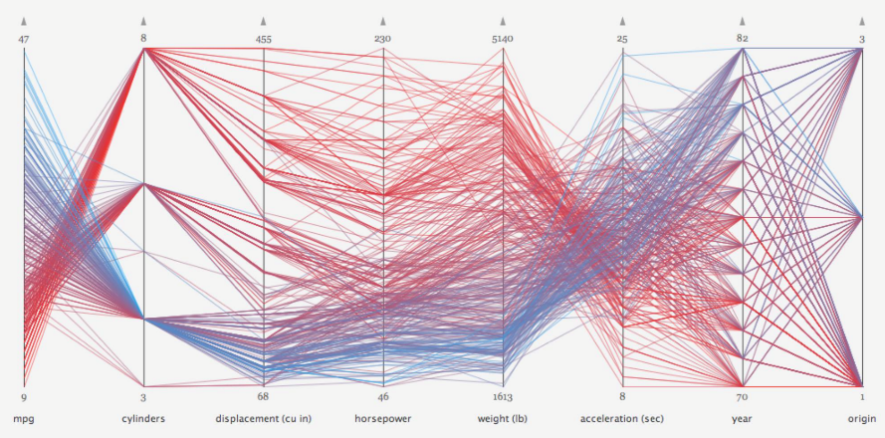
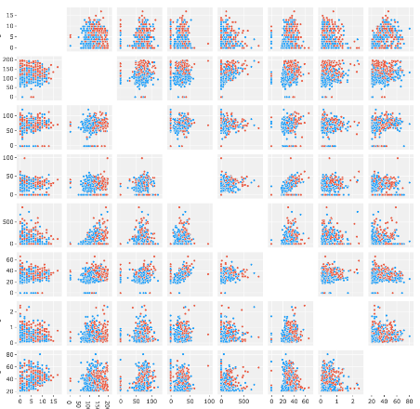
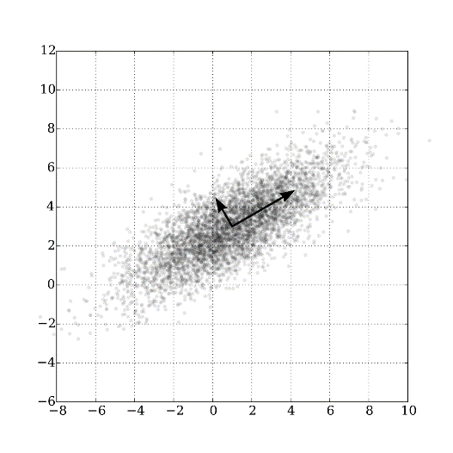
Visualizations for High-dimensional Data
Parallel Coordinates
Scatter Plot (Matrix)
Projection

Slide 4
SMARTexplore
Automatic handling and aggregation of mixed data types
Simplification of complex data transformations
Automatic pattern identification and highlighting
Automated reliability analysis (of visual patterns

Slide 5
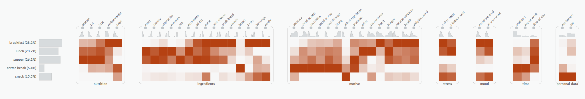
Example

Slide 6
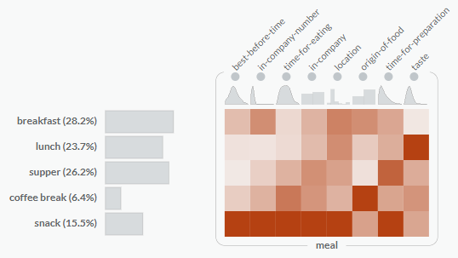
Color Mapping

Slide 7
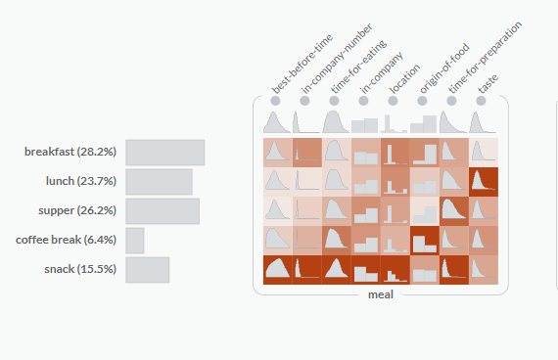
Adding Overlays

Slide 8
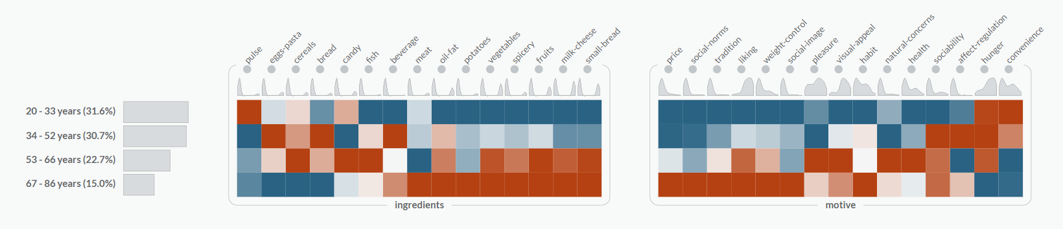
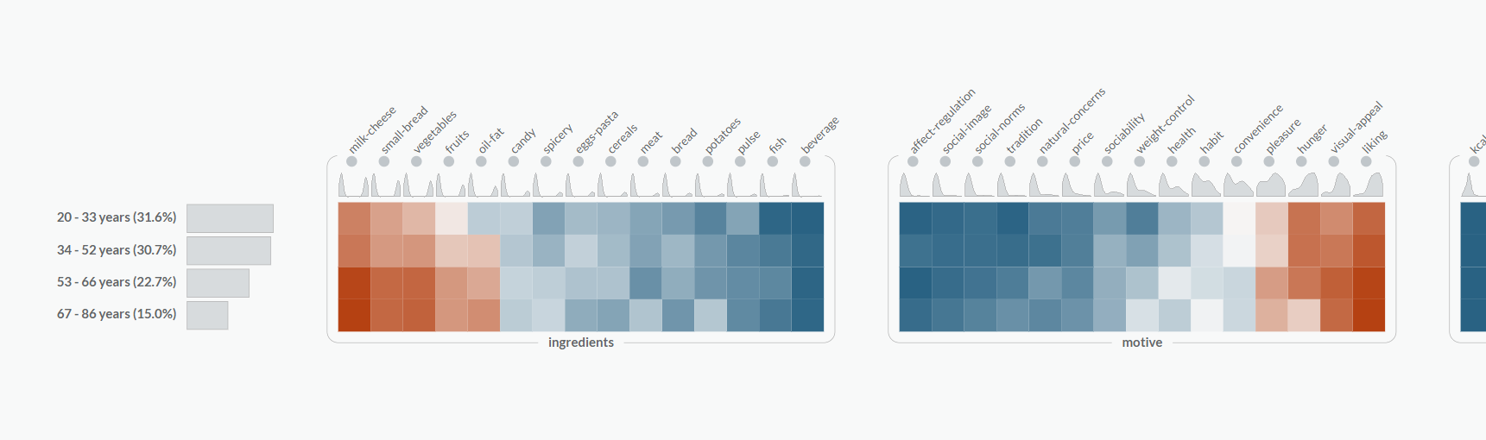
Data Normalization
Dimension
Subspace

Slide 9
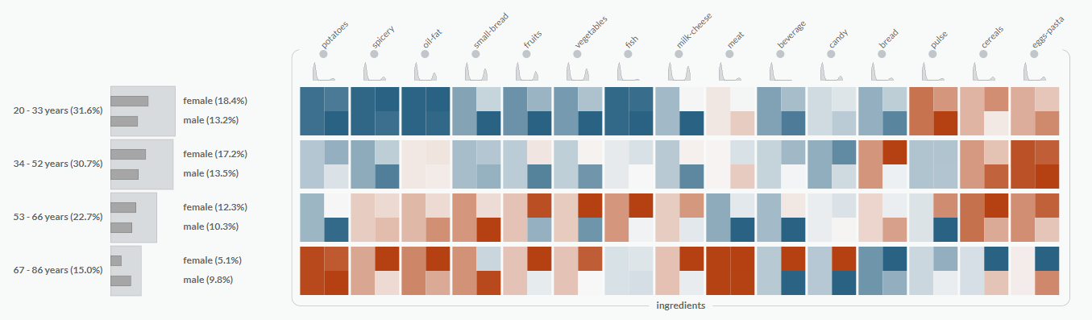
Similarity Detection

Slide 10
Stacked SMARTable

Slide 11
Stacked SMARTable

Slide 12
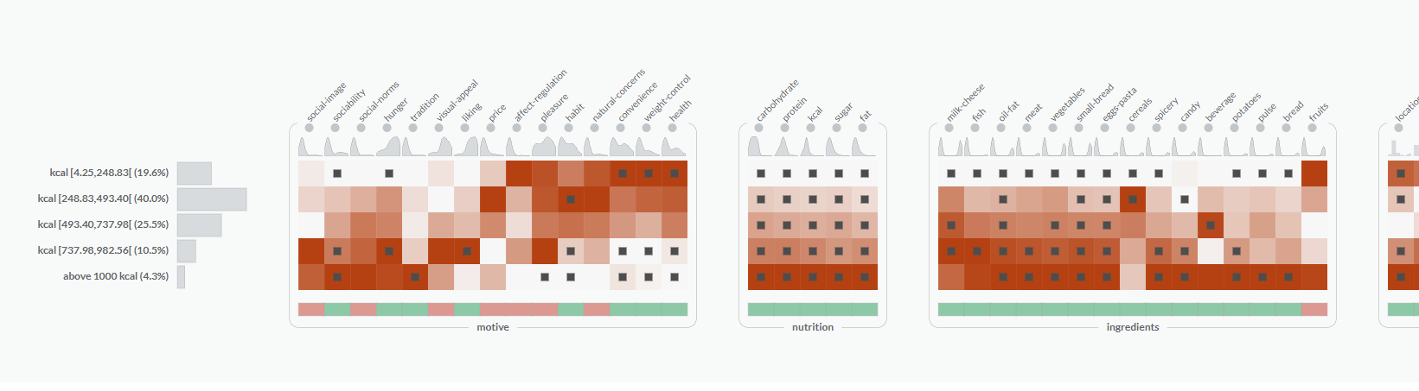
Statistical Significance

Slide 13
Conclusion
A fully functional table-based visual analytics technique that combines automatic analysis with user guided- and purely interactive exploration.

Slide 14
Demo
https://smartexplore.dbvis.de/

Slide 15
Q&A

