Slide 1
RegressionExplorer: Interactive Exploration of Logistic Regression Models with Subgroup Analysis
By: Dennis Dingen, Marcel van ’t Veer, Patrick Houthuizen, Eveline H. J. Mestrom, Erik H.H.M. Korsten, Arthur R.A. Bouwman, and Jarke van Wijk
Presented by: Mark Boger

Slide 2
The Problem
Logistic Regression
Popular model to explore relationships
Requires domain expertise
Time constraint
Model building focus less on interactive dynamic subgroup selection and visualization
Sub-group analysis
Integrate only basic statistics
Notes:
Stepwise models

Slide 3
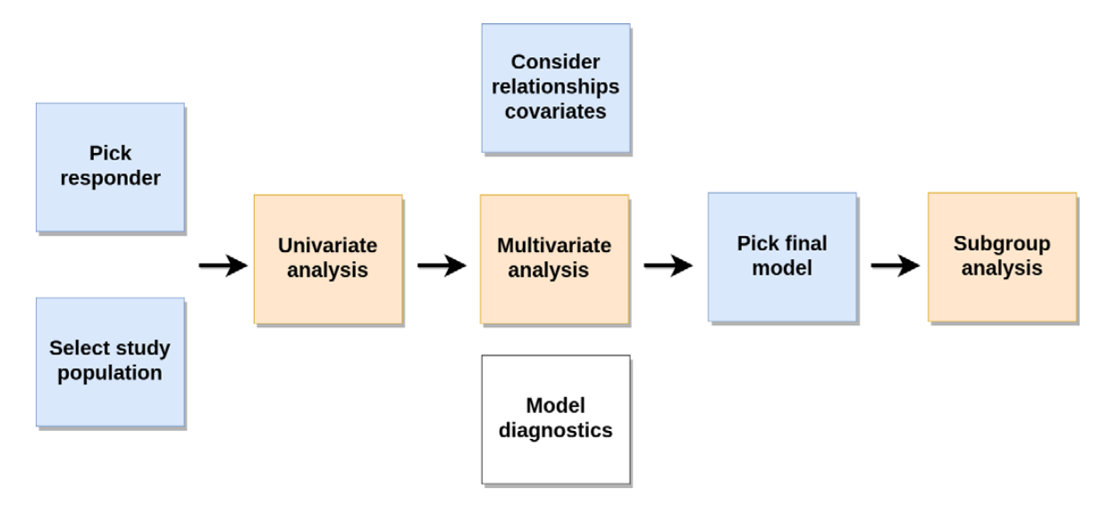
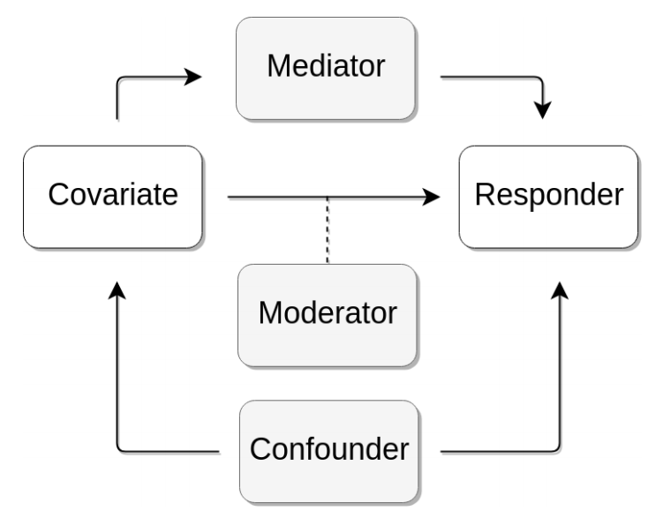
Workflow and variable relationships

Slide 4
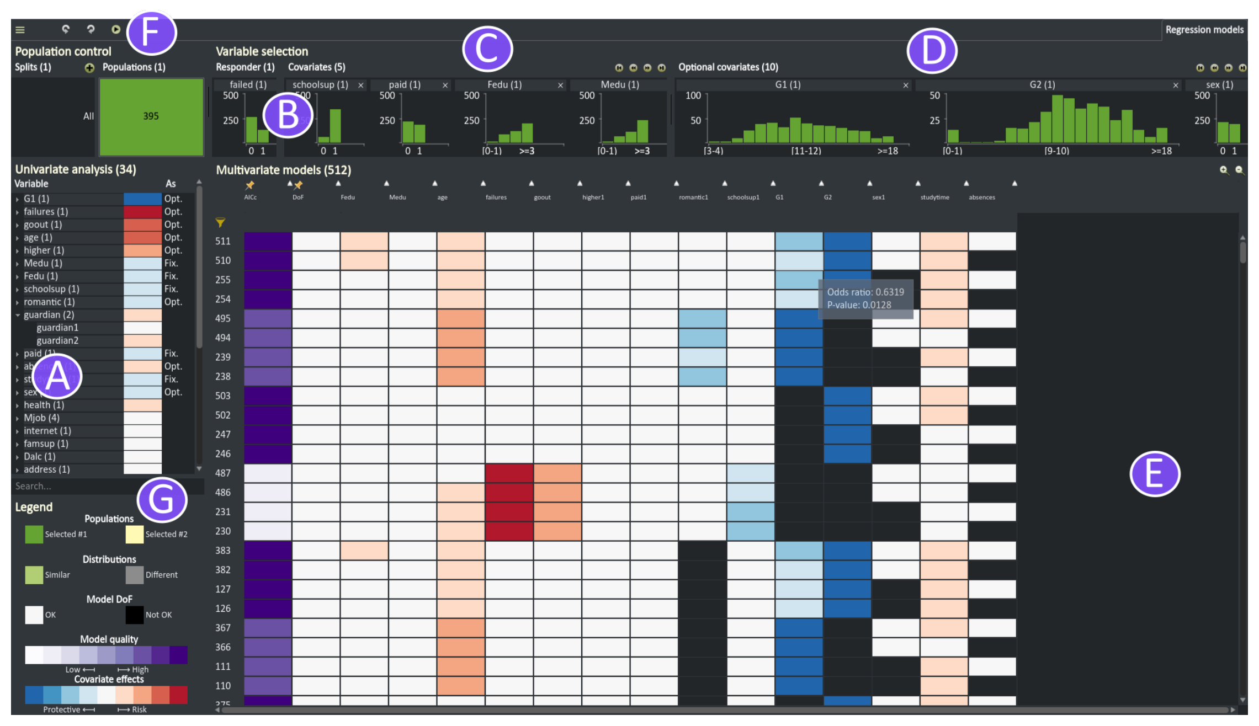
Notes:
(A) Univariate analysis panel;
(B) Responder drop panel;
(C) Fixed covariates drop panel;
(D) Optional covariates drop panel;
(E) Matrix containing all generated multivariate models;
(F) Population control panel;
(G) Legend.
Degrees of freedom - is the number of values in the final calculation of a statistic that are free to vary.
Akaike Information Criterion - is an estimator of the relative quality of statistical models for a given set of data. Given a collection of models for the data, AIC estimates the quality of each model, relative to each of the other models. Thus, AIC provides a means for model selection.

Slide 5
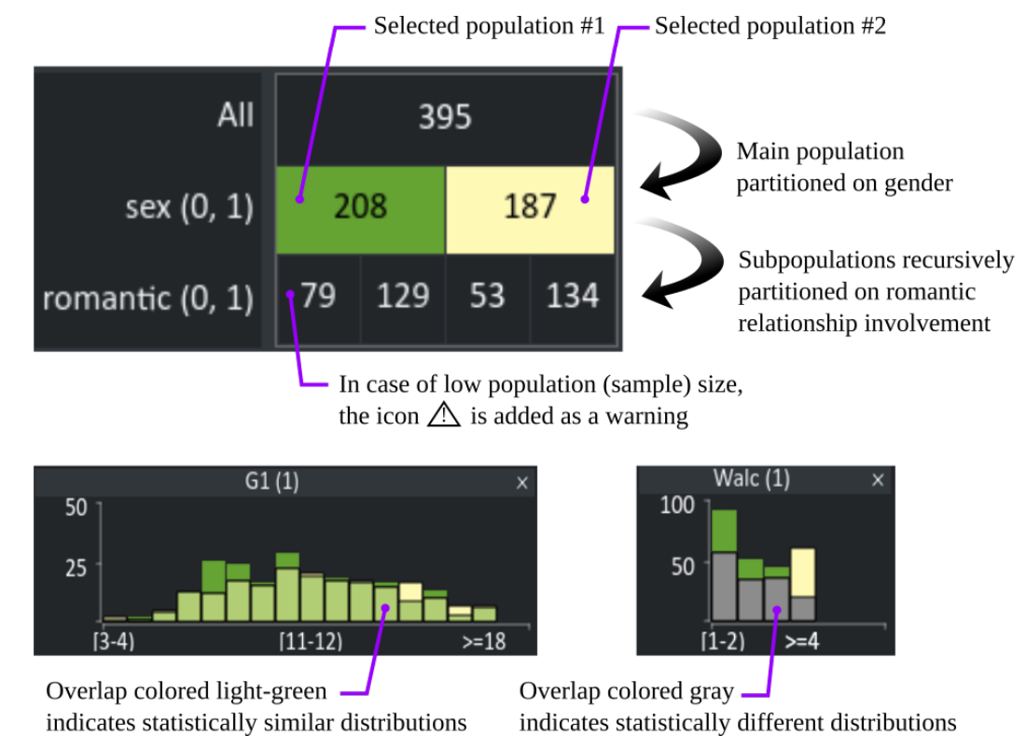

Slide 6
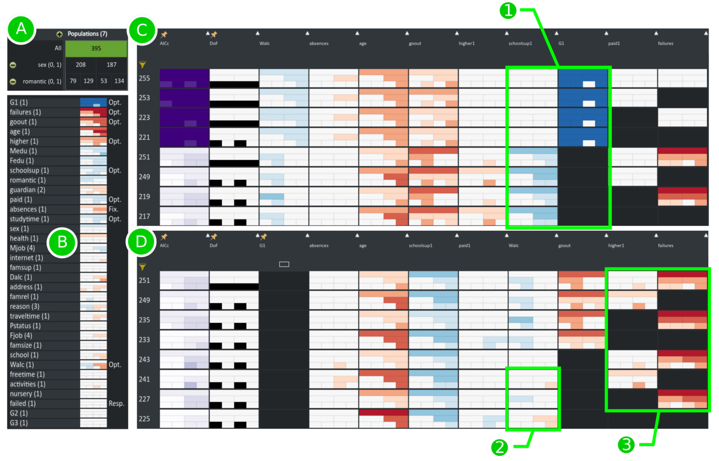
Notes:
(A) The subpopulations are generated by splitting on gender and active romantic involvement;
(B) Univariate analysis for subpopulations;
(C, D) The first and second part of the multivariate analysis.
(1, 2, 3) Indication of a mediation, moderation and confounding effect, respectively.

Slide 7
Trials
Researchers studying potential impact factors
Given an interactive tutorial
~15 minutes
Small demonstrations
First author available for clarification
Lasted ~1 hour

Slide 8
Trial results
Most time was spent on interpreting the result
Iteration time took ~10 minutes
Reordering and filtering of the columns needed training
Adding splits in populations needed training

Slide 9
Conclusions
Regular notebook we could interactively deal with about 12 optional covariates
Limits on the amount of sub-groups you can consider at once
No magnitude (odds ratio)
Can look through hundreds to thousands of models

Slide 10
Bibliography
Dingen, Dennis, et al. "RegressionExplorer: Interactive exploration of logistic regression models with subgroup analysis." IEEE transactions on visualization and computer graphics 25.1 (2019): 246-255.

Slide 11
Q/A

