Slide 1
CIS 4930/6930-002 Data Visualization
FILTERING & AGGREGATION
Paul Rosen
Assistant Professor
University of South Florida
slides credits Miriah Meyer (U of Utah)

Slide 2
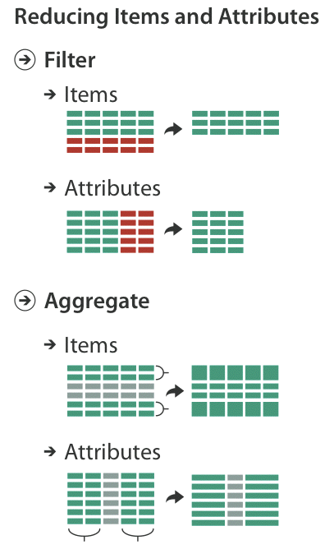
Today
filtering & aggregation

Slide 3
why reduce?

Slide 4
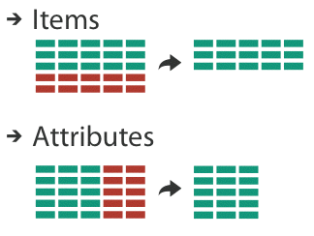
filter
elements are eliminated
dynamic queries
coupling between encoding and interaction so that user can immediately see the results of an action

Slide 5
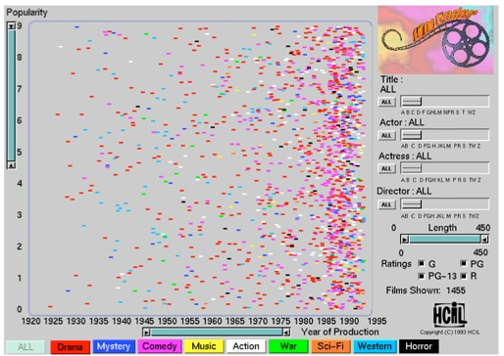
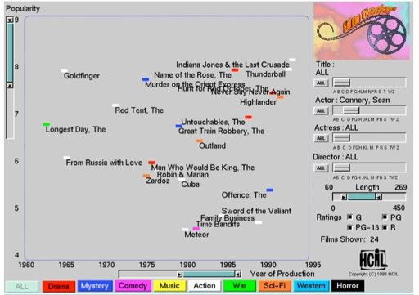
ITEM FILTERING
Ahlberg 1994

Slide 6
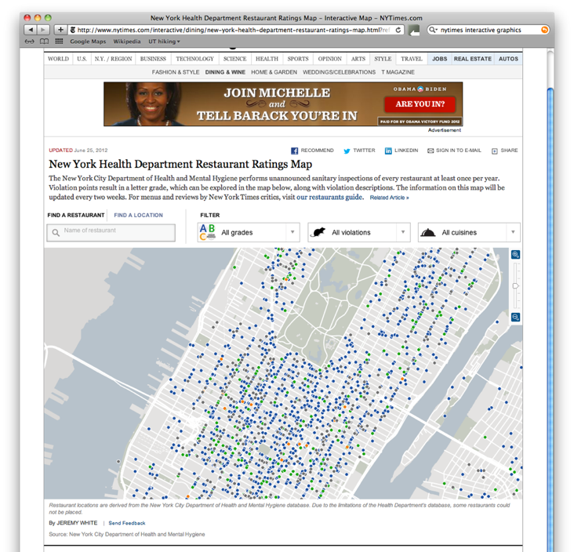

Slide 7
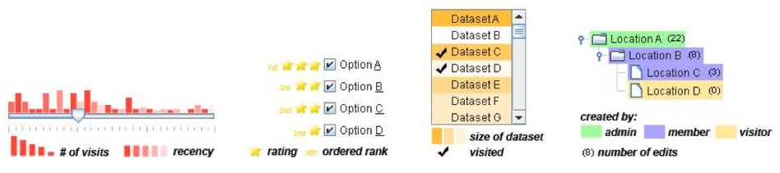
scented widgets
information scent: user gets sense of data
GOAL: lower the cost of information forging through better cues
Willett 2007

Slide 8
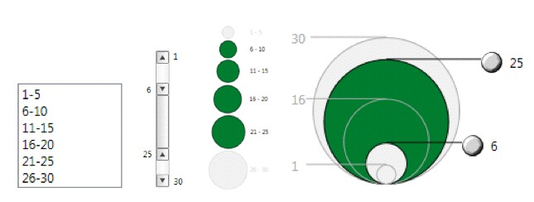
interactive legends
controls combining the visual representation of static legends with interaction mechanisms of widgets
define and control visual display together
Riche 2010

Slide 9
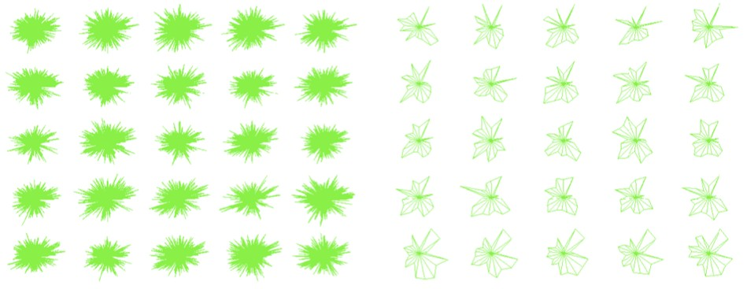
ATTRIBUTE FILTERING
Wang 2003

Slide 10
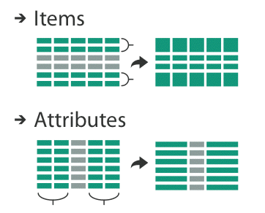
aggregate
a group of elements is represented by a new derived element that stands in for the entire group

Slide 11
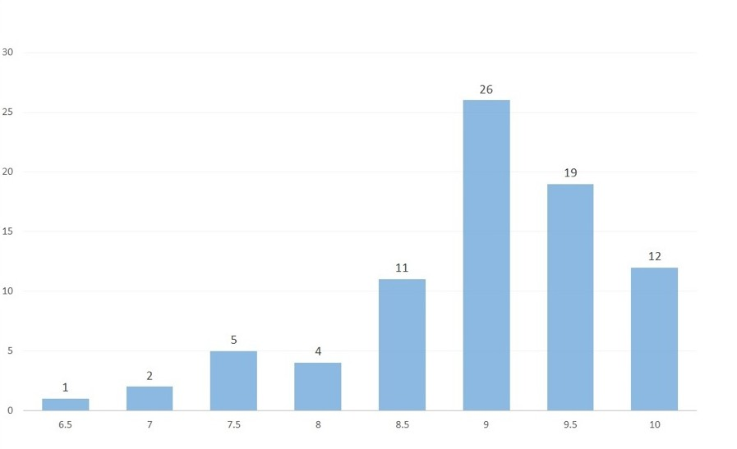
item aggregation
histogram
number of students
score

Slide 12
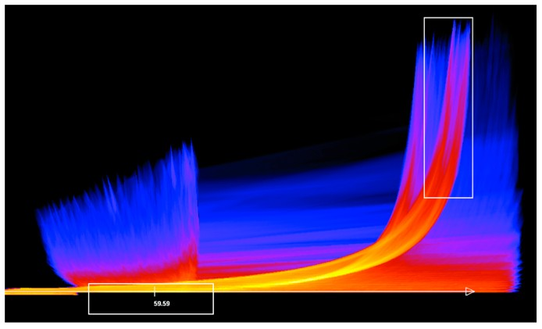
item aggregation
continuous scatterplot
Bachthaler 2008

Slide 13
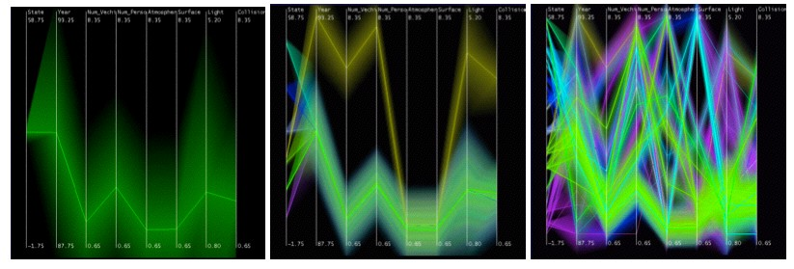
item aggregation
hierarchical parallel coordinates
Fua 1999

Slide 14
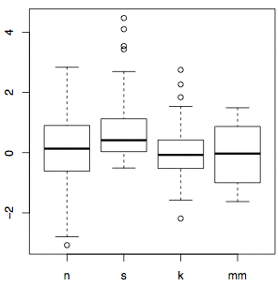
item aggregation
box plot

Slide 15
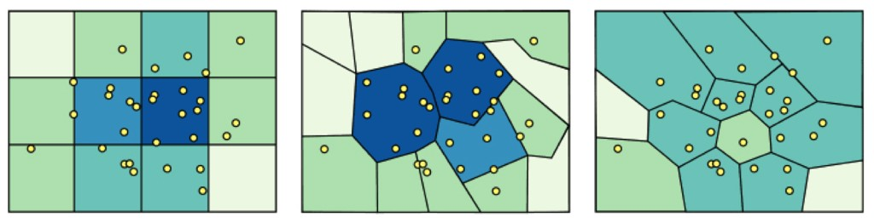
spatial aggregation
modifiable areal unit problem
in cartography, changing the boundaries of the regions used to analyze data can yield dramatically diﬀerent results

Slide 16
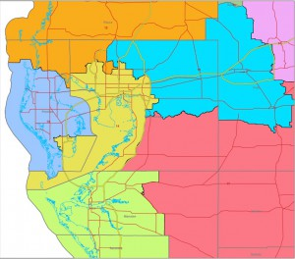
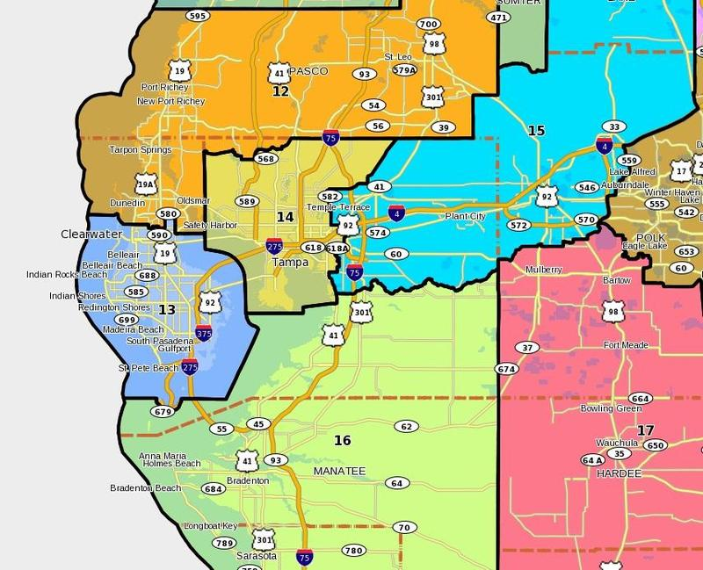
Congressional Districts
2014
Proposed 2015

Slide 17
attribute aggregation
group attributes and compute a similarity score across the set
dimensionality reduction to preserve meaningful structure

Slide 18
Similarity scores
correlation
measure of similarity between 2 or more attributes
many variants—pearson, rank, multi-way, etc.
regression
fit a model to the data
measure the quality of fit (i.e. R²)

Slide 19
Where do we go from here?
Big Data 5 V’s – Variety, Velocity, Volume, Value, and Verasity
Large & high-dimensional (multi-attribute) data
Solutions: statistics and probability, data mining and machine learning, and computational topology

