Slide 1
CIS 4930/6930-002 Data Visualization
Histograms & Correlation
Paul Rosen
Assistant Professor
University of South Florida
.

Slide 2
Histograms
Bar chart-based visualization that allows evaluating distribution of values.

Slide 3
Given: X={x₀,…,x_{n}}
Select: k bins
bin_{i}=k * (x_{i} – min X) / (max X – min X)

Slide 4
X={1,2.5,3,4}
k = 3

Slide 5
X={1, 2.5, 3, 4}
k = 3
1
2
3
4

Slide 6
X={1,2.5,3,4}
k = 3
bin_{i} = floor( k * (x_{i} – min X) / (max X – min X) )
1
2
3
4

Slide 7
X={1,2.5,3,4}
k = 3
bin_{i} = floor( 3 * (x_{i} – 1) / (4 – 1) )
1
2
3
4

Slide 8
X={1,2.5,3,4}
k = 3
1 -> floor( 3 * (1 – 1) / (4 – 1) ) = Bin 0
1
2
3
4

Slide 9
X={1,2.5,3,4}
k = 3
2.5 -> floor( 3 * (2.5 – 1) / (4 – 1) ) = Bin 1
1
2
3
4

Slide 10
X={1,2.5,3,4}
k = 3
3 -> floor( 3 * (3 – 1) / (4 – 1) ) = Bin 2
1
2
3
4

Slide 11
X={1,2.5,3,4}
k = 3
4 -> floor( 3 * (4 – 1) / (4 – 1) ) = Bin 3?
1
2
3
4

Slide 12
X={1,2.5,3,4}
k = 3
4 -> floor( 3 * (4 – 1) / (4 – 1) ) = Bin 2
1
2
3
4

Slide 13
X={1,2.5,3,4}
k = 3
1
2
3
4

Slide 14
Pearson Correlation Coefficient
A measure of the linearity between 2 sets

Slide 15
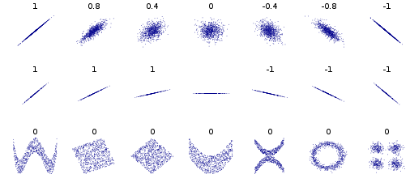

Slide 16
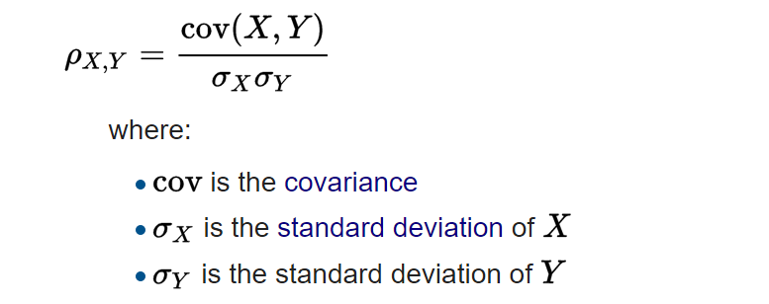

Slide 17
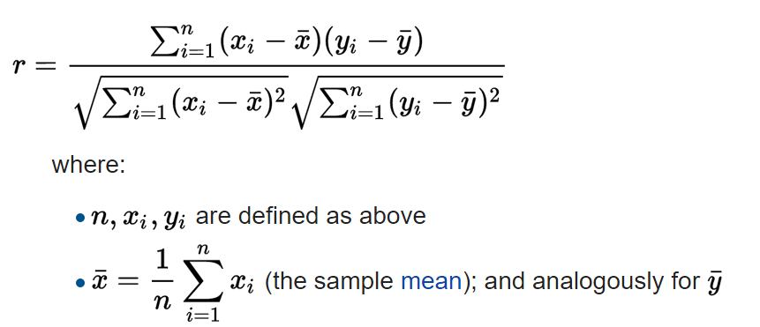

Slide 18
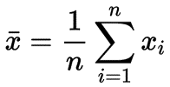

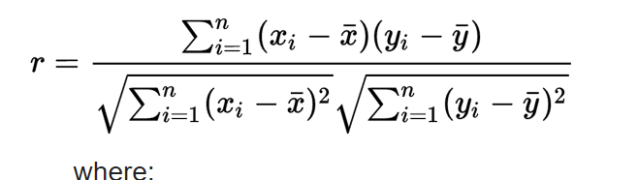



Given: X={x₀,…,x_{n}}, Y={y₀,…,y_{n}}
Calculate mean(X), mean(Y), stdev(X), stdev(Y)
mean(X) =
stdev(X) = =
$$\sqrt{\frac{1}{n}\sum{{\left(x_{i}−\overline{x}\right)}^{2}}}$$
$$\frac{1}{n}$$

Slide 19
X={1,2.5,3,4.5}
Y={2,2.5,3.5,4}
mean(X) = 2.75, mean(Y) = 3
stdev(X)= sqrt( (1-2.75)² + (2.5-2.75)² + (3-2.75)² + (4.5-2.75)² / 4 ) = 1.25
stdev(Y)= sqrt( (2-3)² + (2.5-3)² + (3.5-3)² + (4-3)² / 4 ) = 0.79

Slide 20

X={1,2.5,3,4.5}
Y={2,2.5,3.5,4}
mean(X) = 2.75, mean(Y) = 3
stdev(X)= 1.25, stdev(Y)= 0.79
Covariance(X,Y) =
= 1/4 * (1-2.75)(2-3) + (2.5-2.75)(2.5-3) +
(3-2.75)(3.5-3) + (4.5-2.75)(4-3)
= 3.75 / 4 = 0.94
$$\frac{1}{n}$$

Slide 21
X={1,2.5,3,4.5}
Y={2,2.5,3.5,4}
mean(X) = 2.75, mean(Y) = 3
stdev(X)= 1.25, stdev(Y)= 0.79
Cov(X,Y)= 0.94
r = 0.94 / (1.25 * 0.79) = 0.95

Slide 22
Spearman Rank Correlation
X={1, 2.5, 3, 4.5}
Y={2, 3.5, 2.5, 4}
X’ = rank(X)
Y’ = rank(Y)
SRC = PCC( X’, Y’ )

Slide 23
X={1, 2.5, 3, 4.5}
X Sorted {1, 2.5, 3, 4.5}
X’ = rank(X)
X’ = { rank(1), rank(2.5), rank(3), rank(4.5) }
X’ = { 1, 2, 3, 4 }

Slide 24
Y={2, 3.5, 2.5, 4}
Y Sorted {2, 2.5, 3.5, 4}
Y’ = rank(Y)
Y’ = { rank(2), rank(3.5), rank(2.5), rank(4) }
Y’ = { 1, 3, 2, 4 }

