Slide 1
CIS 4930/6930-002 Data Visualization
Force Directed Layouts
Paul Rosen
Assistant Professor
University of South Florida

Slide 2
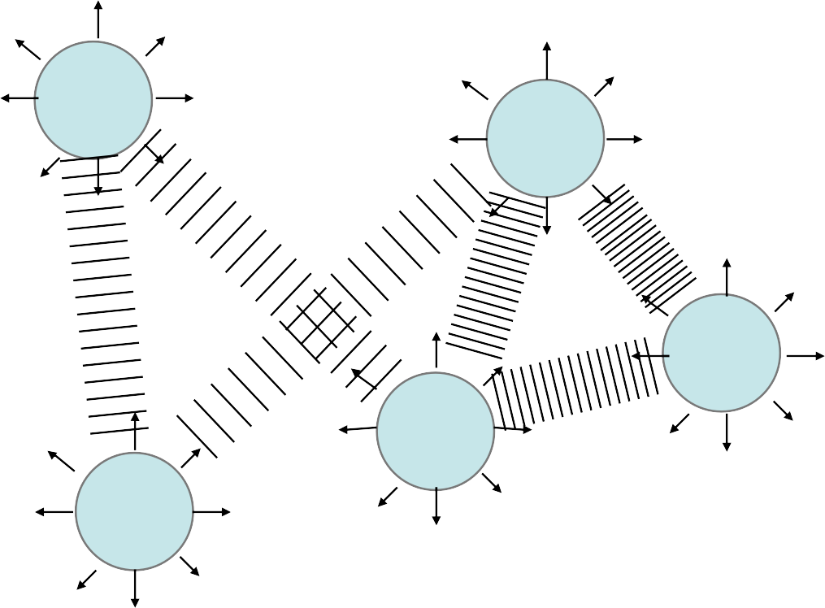
FORCE-DIRECTED
many variations, but usually physical analogy of repulsion and attraction
Generally…
edges = springs
nodes = repulsive particles
Requires an iterative calculation, should be updated each time the draw loop is called

Slide 3
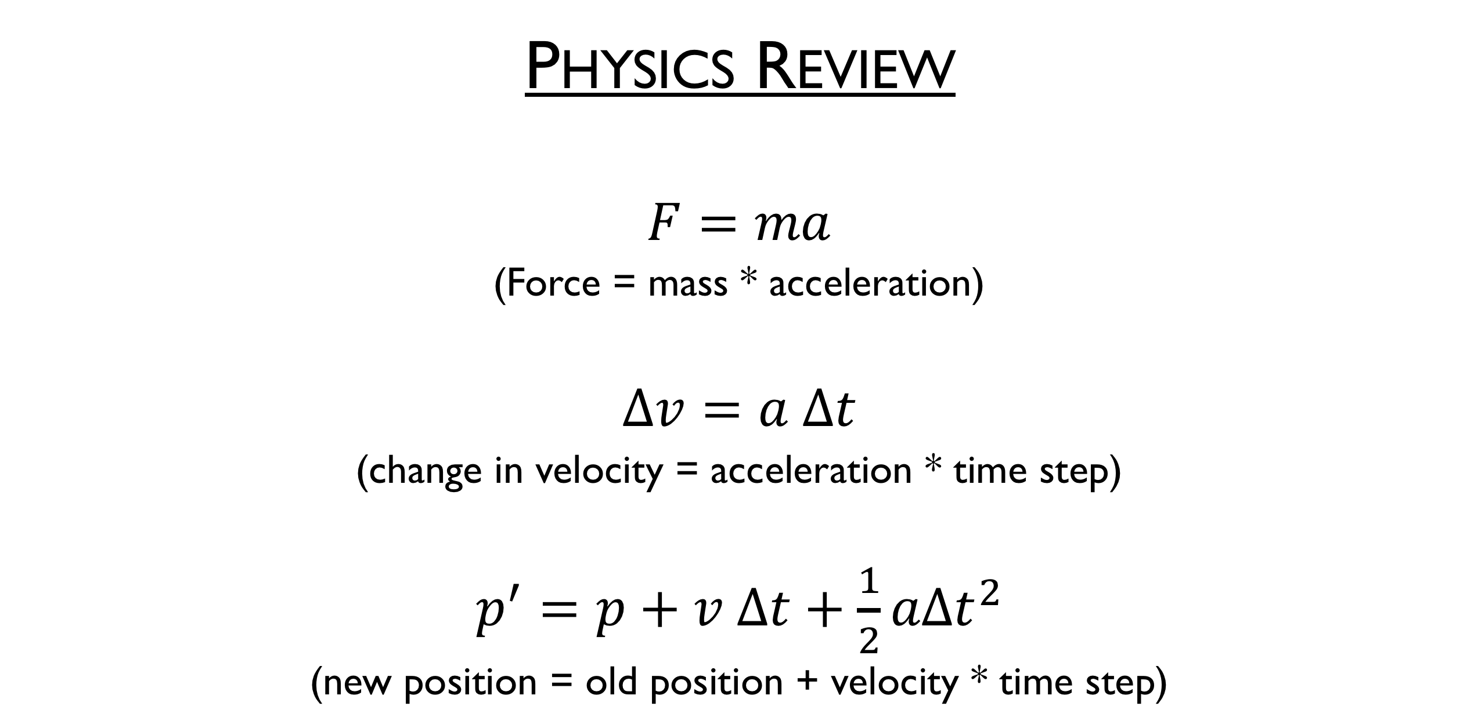
Physics Review
$F=ma$
(Force = mass * acceleration)
$Δv=a Δt$
(change in velocity = acceleration * time step)
$p^{′}=p+v Δt+\frac{1}{2}aΔt^{2}$
(new position = old position + velocity * time step)

Slide 4
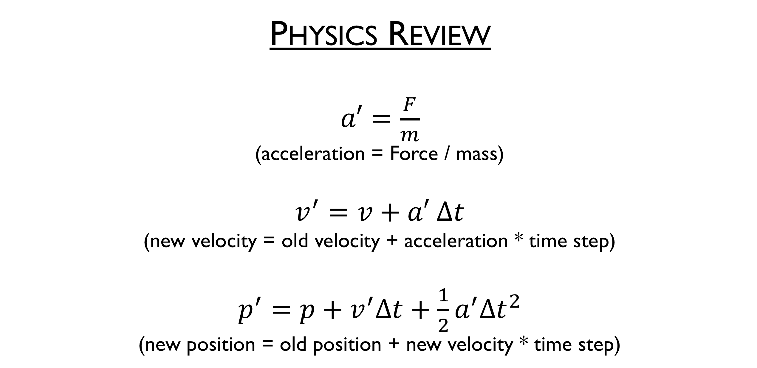
Physics Review
$a′=\frac{F}{m}$
(acceleration = Force / mass)
$v^{′}=v+a′ Δt$
(new velocity = old velocity + acceleration * time step)
$p^{′}=p+v^{′}Δt+\frac{1}{2}a^{′}Δt^{2}$
(new position = old position + new velocity * time step)

Slide 5
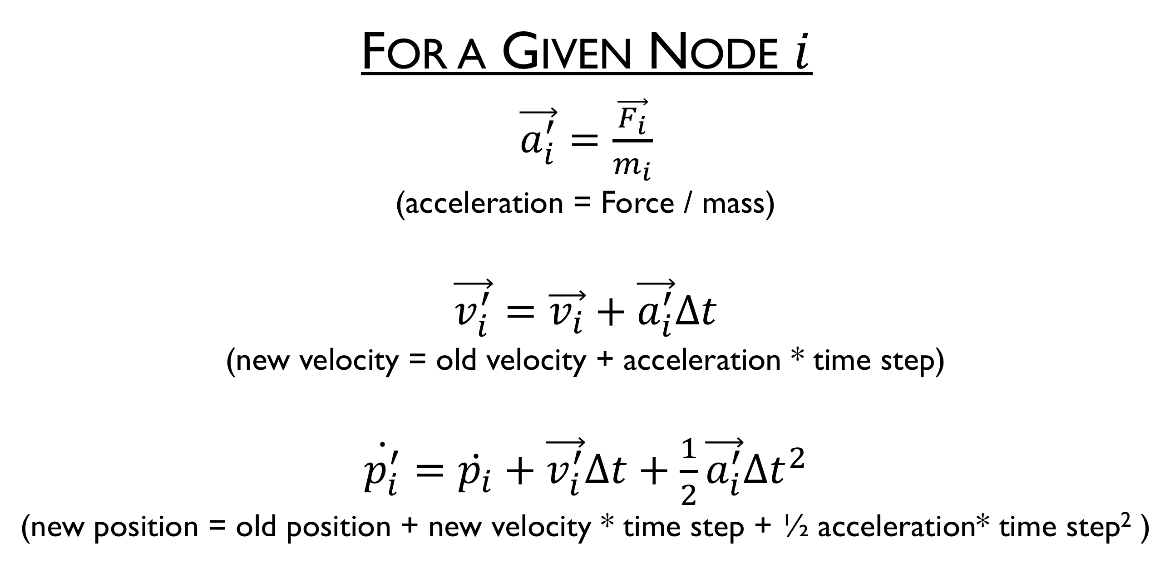
For a Given Node $i$
$\vec{a_{i}^{′}}=\frac{\vec{F_{i}}}{m_{i}}$
(acceleration = Force / mass)
$\vec{v_{i}^{′}}=\vec{v_{i}}+\vec{a_{i}^{′}}Δt$
(new velocity = old velocity + acceleration * time step)
$\dot{p_{i}^{′}}=\dot{p_{i}}+\vec{v_{i}^{′}}Δt+\frac{1}{2}\vec{a_{i}^{′}}Δt^{2}$
(new position = old position + new velocity * time step + ½ acceleration* time step² )

Slide 6

What values do we set for…
time step $Δt$ ?
initial position $p_{i}$ ?
initial velocity $v_{i}$ ?
mass $m_{i}$ ?
Force $F_{i}$ ?

Slide 7
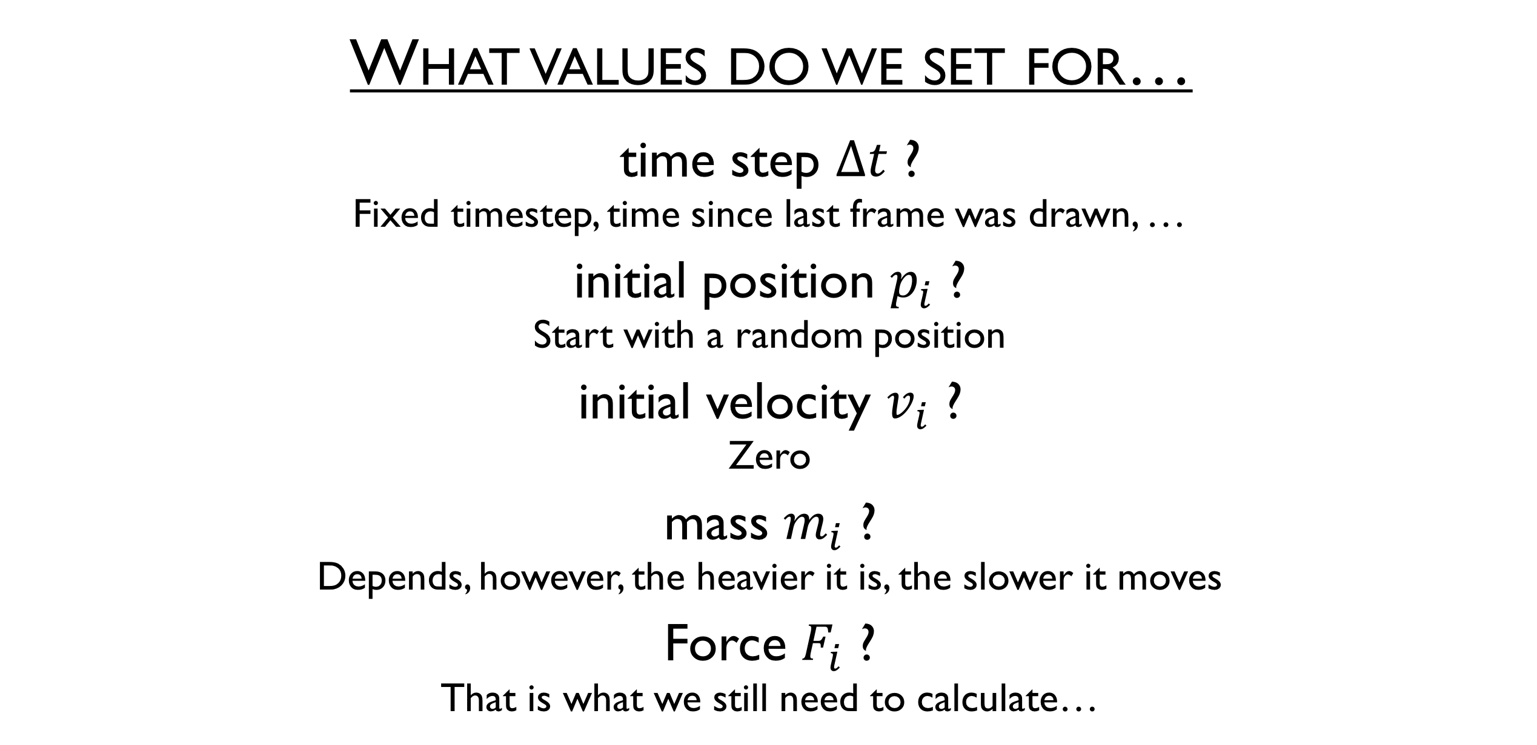
What values do we set for…
time step $Δt$ ?
Fixed timestep, time since last frame was drawn, …
initial position $p_{i}$ ?
Start with a random position
initial velocity $v_{i}$ ?
Zero
mass $m_{i}$ ?
Depends, however, the heavier it is, the slower it moves
Force $F_{i}$ ?
That is what we still need to calculate…

Slide 8
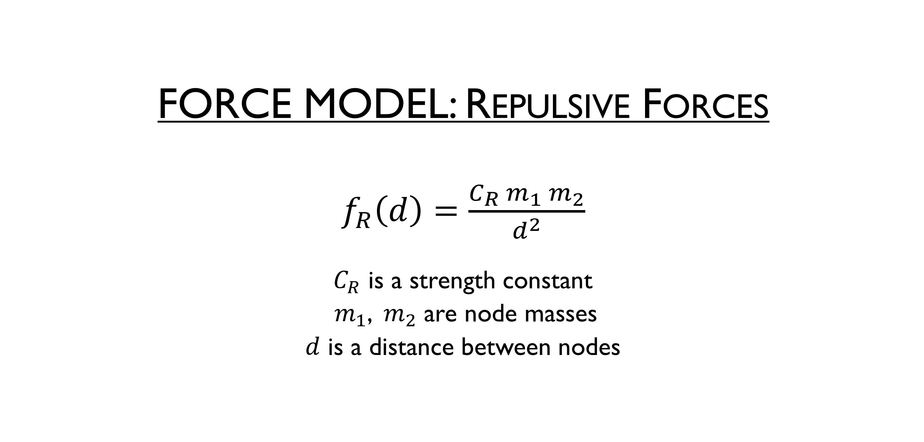
FORCE MODEL: Repulsive Forces
$f_{R}\left(d\right)=\frac{C_{R}{ m}_{1}{ m}_{2}}{d^{2}}$
$C_{R}$ is a strength constant
${ m}_{1}$, ${ m}_{2}$ are node masses
$d$ is a distance between nodes

Slide 9
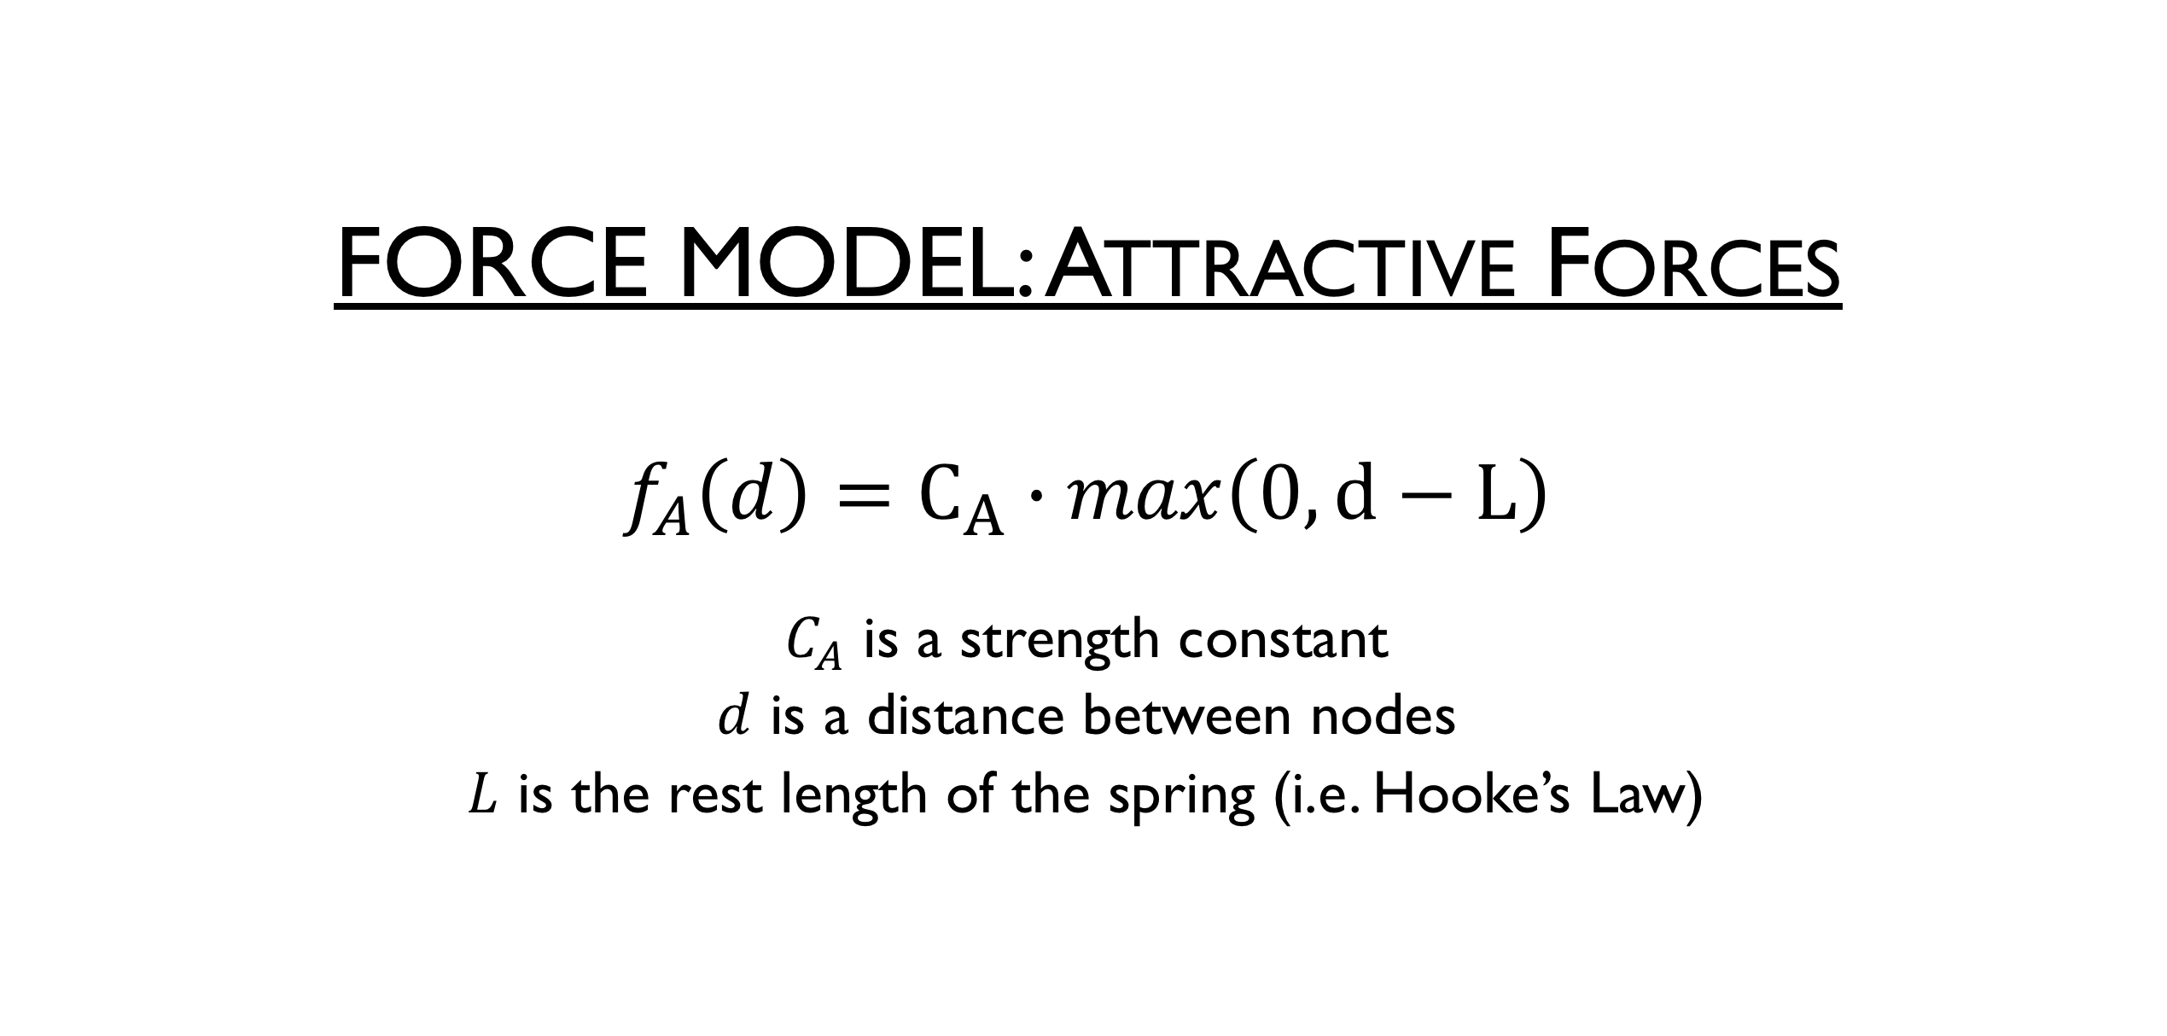
FORCE MODEL: Attractive Forces
$f_{A}\left(d\right)=C_{A}∙max\left(0,d−L\right)$
$C_{A}$ is a strength constant
$d$ is a distance between nodes
$L$ is the rest length of the spring (i.e. Hooke’s Law)

Slide 10
FORCE MODEL
Every node feels repulsion to every other node

Slide 11
FORCE MODEL
Only connected nodes feel attracted

Slide 12

What values for…
Repulsive constant $C_{R}$ ?
Attractive constant $C_{A}$ ?
Rest length of the spring $L$ ?

Slide 13
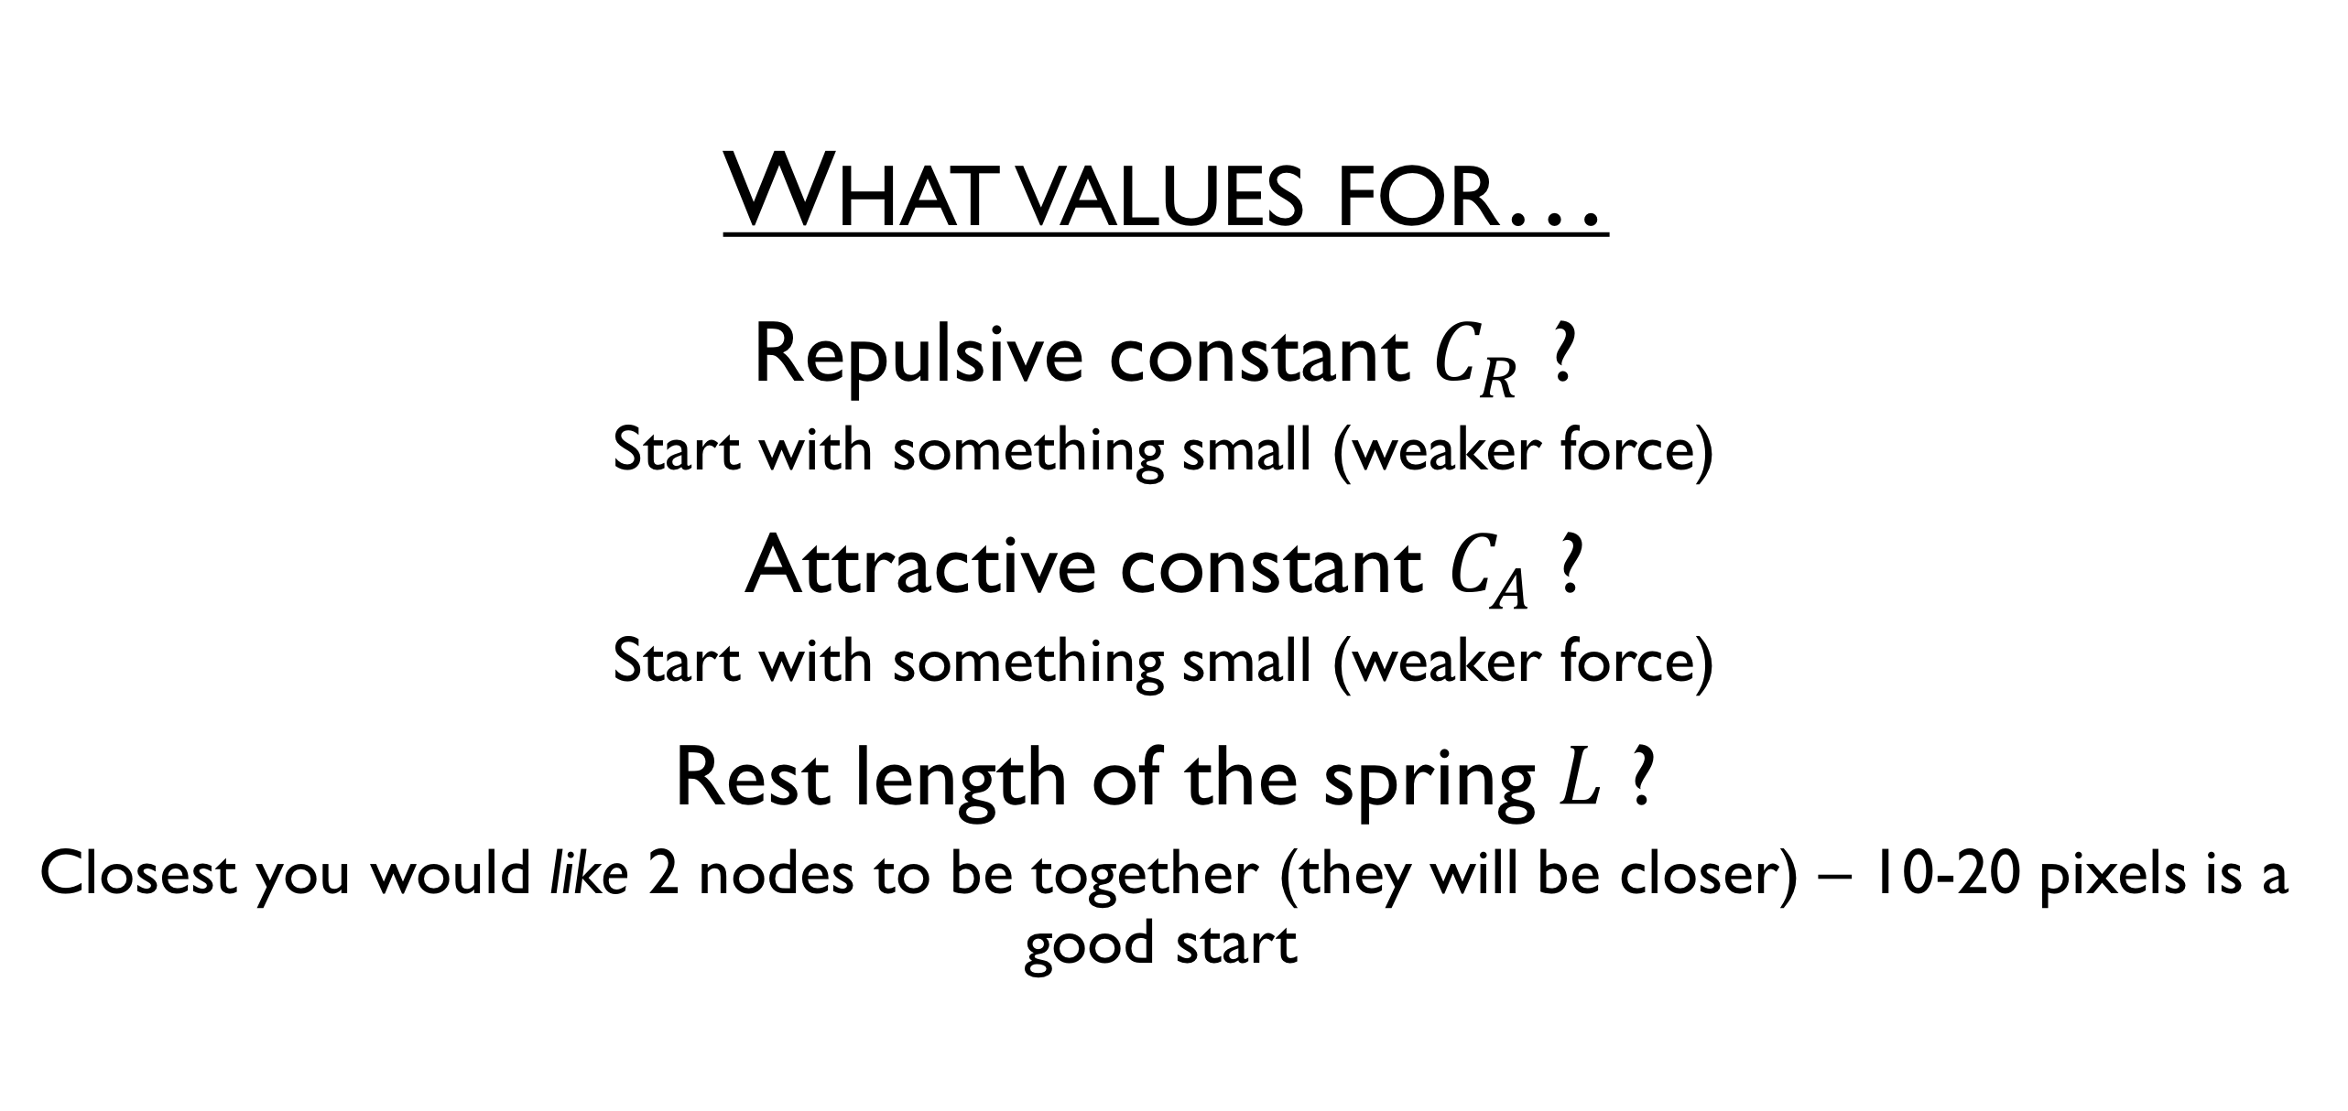
What values for…
Repulsive constant $C_{R}$ ?
Start with something small (weaker force)
Attractive constant $C_{A}$ ?
Start with something small (weaker force)
Rest length of the spring $L$ ?
Closest you would like 2 nodes to be together (they will be closer) – 10-20 pixels is a good start

Slide 14
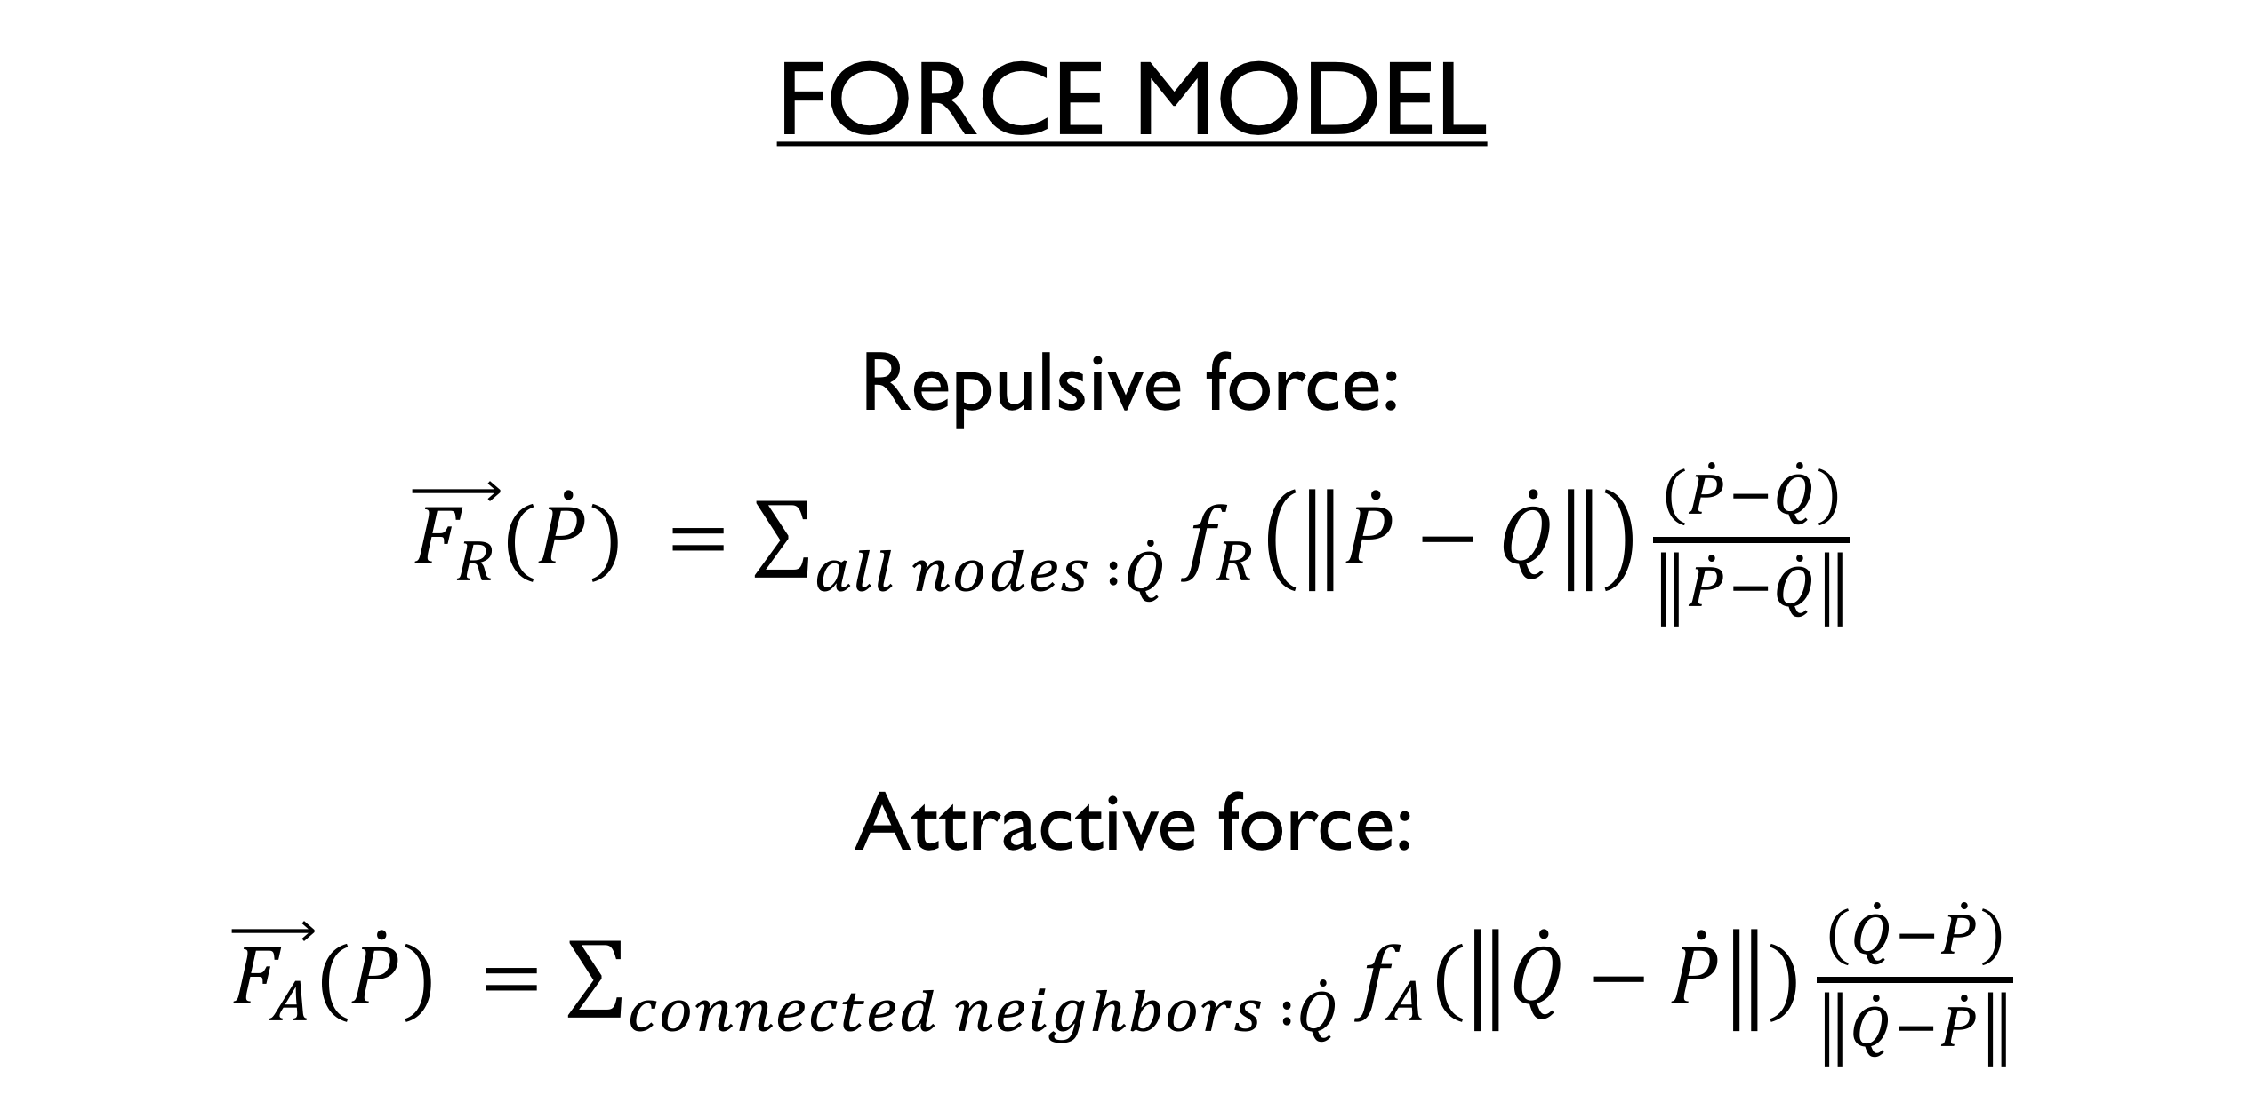
FORCE MODEL
Repulsive force:
$\vec{F_{R}}(\dot{P}) =\sum_{all nodes :\dot{Q}}{f_{R}\left(\left\|\dot{P}−\dot{Q}\right\|\right)\frac{\left(\dot{P}−\dot{Q}\right)}{\left\|\dot{P}−\dot{Q}\right\|}}$
Attractive force:
$\vec{F_{A}}(\dot{P}) =\sum_{connected neighbors :\dot{Q}}{f_{A}(\left\|\dot{Q}−\dot{P}\right\|)\frac{\left(\dot{Q}−\dot{P}\right)}{\left\|\dot{Q}−\dot{P}\right\|}}$

Slide 15
ALGORITHM
start from random layout
(draw) loop:
Calculate forces (you need to do this)
Update acceleration (done for you)
Update velocity (done for you)
Update position (done for you)
Draw the graph (you need to do this)

Slide 16
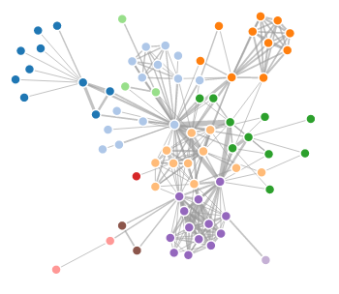
http://bl.ocks.org/mbostock/4062045

Slide 17
FORCE DIRECTED
+ very flexible, aesthetic layouts on many types of graphs
+ can add custom forces
+ relatively easy to implement
http://bl.ocks.org/mbostock/4062045

Slide 18
FORCE DIRECTED
- repulsion loop is O(n²) per iteration
can speed up to O(n log n) using quadtree or k-d tree
- prone to local minima
can use simulated annealing
- doesn’t work well on highly connected (low diameter) graphs
http://bl.ocks.org/mbostock/4062045

Slide 19
Ideas to make it better
Add extra forces, such as repulsion from the boundary or attraction to the center of the screen.
Allow overriding node positions using the mouse (dragging vertices)
Allow fixing the position of certain nodes
Other ideas?

Slide 20
How to use MDS for extra credit in project 8
Your input is a weighted graph
We would like to project node positions using MDS
What do we need?
E
C
2
5
4
D
3
1
A
B

Slide 21
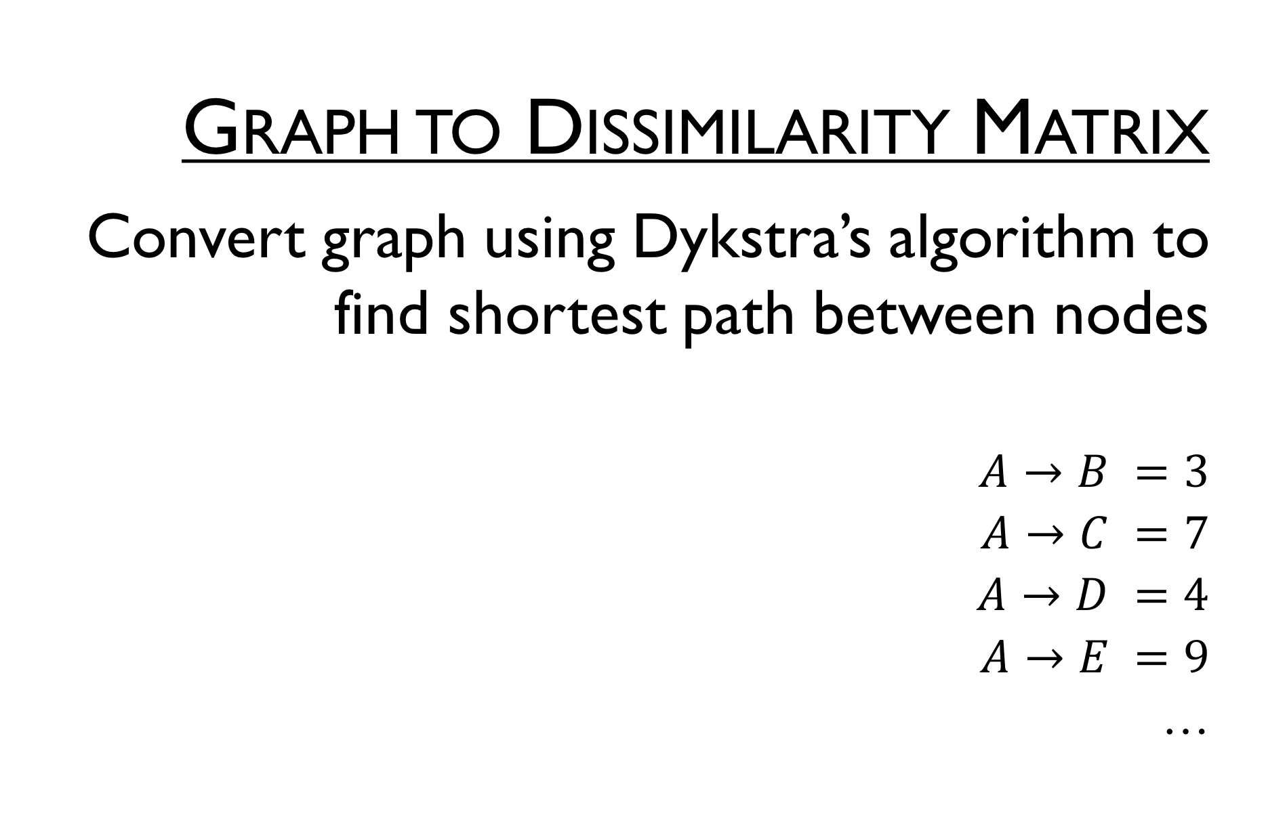
Graph to Dissimilarity Matrix
Convert graph using Dykstra’s algorithm to find shortest path between nodes
$A→B =3$
$A→C =7$
$A→D =4$
$A→E =9$
…
E
C
2
5
4
D
3
1
A
B

Slide 22
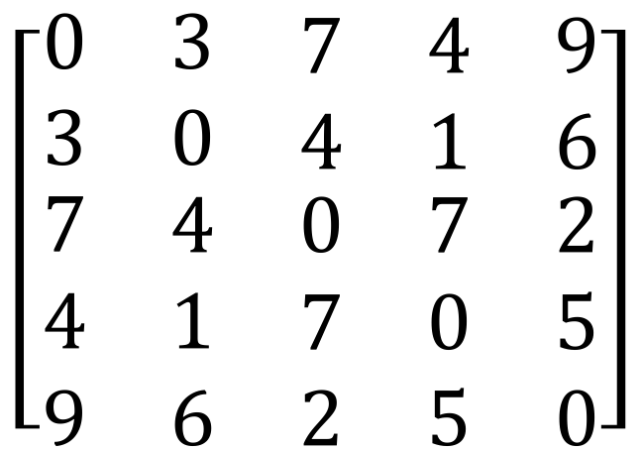
E
Graph to Dissimilarity Matrix
Dissimilarity matrix passed to MDSJ library’s classical MDS function
Returns a list of output positions
Output nodes positions
C
2
5
4
D
3
1
A
B
$$\left[\begin{matrix}0 & 3 & \begin{matrix}7 & 4 & 9\end{matrix} \\ 3 & 0 & \begin{matrix}4 & 1 & 6\end{matrix} \\ \begin{matrix}7 \\ 4 \\ 9\end{matrix} & \begin{matrix}4 \\ 1 \\ 6\end{matrix} & \begin{matrix}0 & 7 & 2 \\ 7 & 0 & 5 \\ 2 & 5 & 0\end{matrix}\end{matrix}\right]$$

Slide 23
E
Drawing the Graph
Node positions can be centered and (uniformly) scaled to fit the output display
Then, draw a normal node-link diagram
C
2
5
4
D
3
1
B
A

