Slide 1
Micropower-Plus

Slide 2
What are power and effect size?
Power: Ability to detect a statistically significant difference between groups
Effect size: Magnitude of difference between two groups
Power is related to effect size and sample size
The larger the effect size the less power you need (can use fewer samples)
The smaller the effect size the more power you need (need to use more samples)

Slide 3
What is effect size in microbiome research?
Researchers often want to know if there are distinct communities present between groups
A PERMONVA can be used to calculate the statistical significance of community differences
Effect size is the percent of the variation explained by the grouping factor (the experimental variable)

Slide 4
Why is knowing the power and effect size important?
Knowing the likely effect size tells you if your experiment has enough samples to be successful

Slide 5
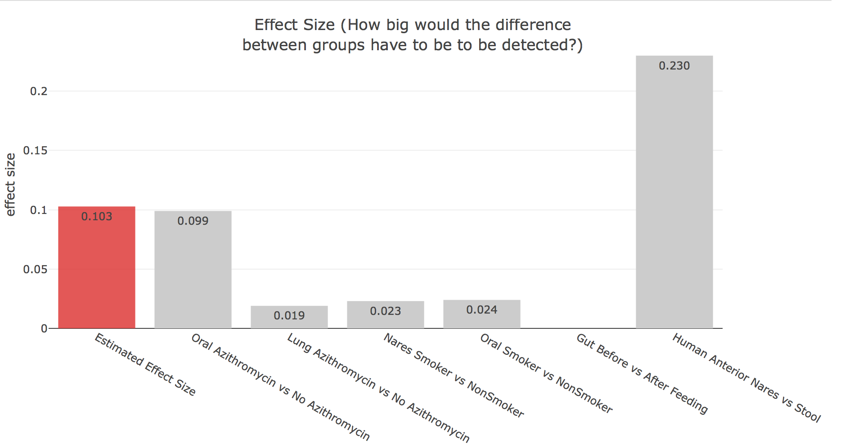
Compare estimated effect sizes to reported effect sizes to determine if sample size is large enough to detect expected effect size

Slide 6
What we did
Added a biologist friendly user interface to the R package Micropower
Micropower allows user to estimate power and calculate effect sizes
This allows people not familiar with coding or the R language to:
Quickly calculate the power needed for their experiment
Calculate the effect size form their experiment

Slide 7
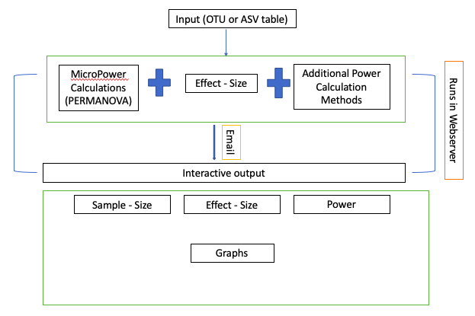
What we did

Slide 8
The team
Omkar Dokur: User interface
Vyoma Sheth: User interface
Francesca Prieto: Literature research and visualizations
Xiangyun (Sherry) Liao: Effect size calculation
Samira Jahangiri: Reference data wrangler
Jenna Oberstaller: Conceptualization, supervisor, chief documentor
Justin Gibbons: Conceptualization, supervisor, calculations

