Slide 1
Relationship between Microbial Diversity and Body Size
Team leaders: Ravi Sharma, Shen Jean Lim
Members: Martin Lynn, Madeline Barrow, Matthew Sumpter, Khandaker Tasnim Huq, Youngchul Kim, Ojas Natarajan

Slide 2
Aim
We will apply unsupervised learning techniques to metazoan data from the Earth Microbiome Project (http://www.earthmicrobiome.org) to discover unexpected clusters of microbial community similarity among metazoans. If time allows, we’ll use other databases to find correlations with other host traits and thus start to explain the existence of these patterns.​
​What is the problem you want to solve?​
Are there generalities about microbial communities across multicellular forms of life? Do particular host traits (e.g., size, diet, life history, and evolutionary history) drive them?​
Why does it matter?​
The scale and dynamic nature of microbial diversity is staggering. Our hope is to reveal general patterns of organization that could serve as a baseline for deeper investigation, as well as a more holistic and ecologically-informed framework for basic rules of organization of symbioses.​

Slide 3
​Why is it challenging?​
The field is fairly new, so sampling of host microbiota diversity is at present fairly sparse. It is currently known that diet, host phylogeny, and few other environmental factors shapes host-microbiome assemblies. However, other potential effects on host-associated microbiomes across species, including size and life history, have been understudied. A comprehensive analysis on drivers of metazoan microbiomes is challenging but can yield new insights on host-microbiome associations.​
Why are you excited about it?​
A broader perspective such as this one can serve as a solid foundation from which more targeted studies can start. The opportunity to gain insight into host-microbe associations across the scope of body size and evolutionary history is also compelling.​
​What do you need to make it happen?​
Appropriate data and expertise in microbiomes, evolutionary biology, machine learning, statistical analysis and computer programming…and luck and $$ wouldn’t hurt.

Slide 4
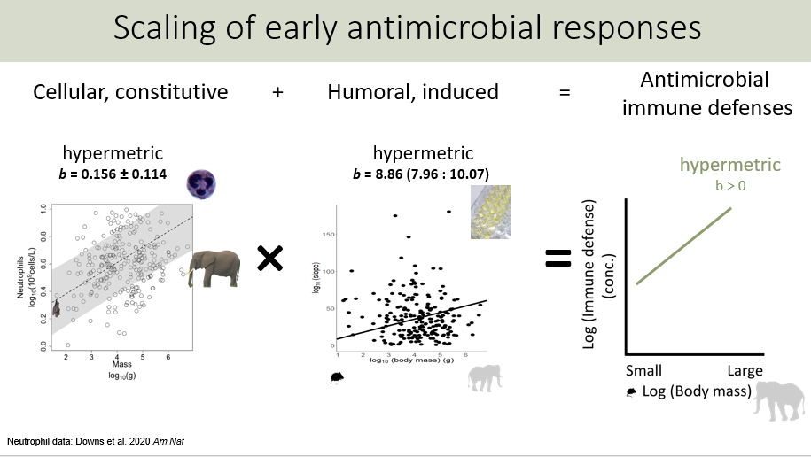

Slide 5
Proposed Workflow
Download and process data from Earth Microbiome Project
Unsupervised clustering
Correlate with metadata (e.g. body size, life history, geographical range)

