Slide 1
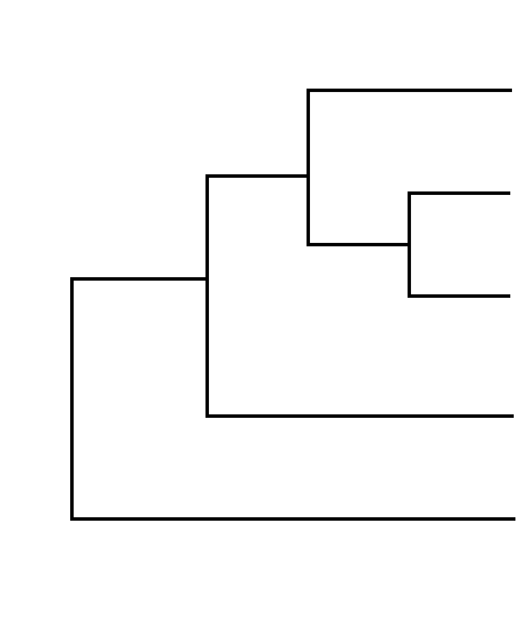

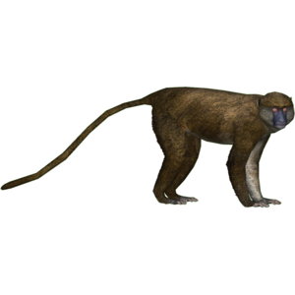
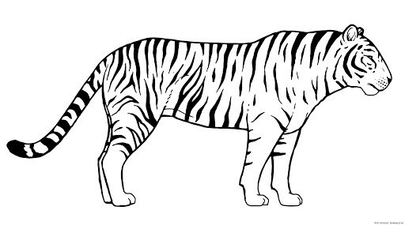


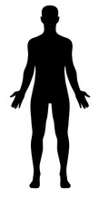
Identifying shifts of SARS-CoV-2 to non-human hosts
Phangorn/raxml?
?
SARS-Cov-2
Phylogenetic
tree
SARS-Cov-2
WG sequence
(sample)
nextalign
?
alignment
ggtree
!
✓
Human-derived
No human-derived
Identify relevant
mutation(s)
Function
3D structure
(gsaid web app)
snpeff

Slide 2
Team
Swamy Rakesh (Lead)
Thomas Keller (Lead)
Celine Atkinson
Alex Cromwell
Vijay Chauhan
Kyle Koller
Soafy
Raul Gonzalez-Pech
Morgan Young

