Slide 1









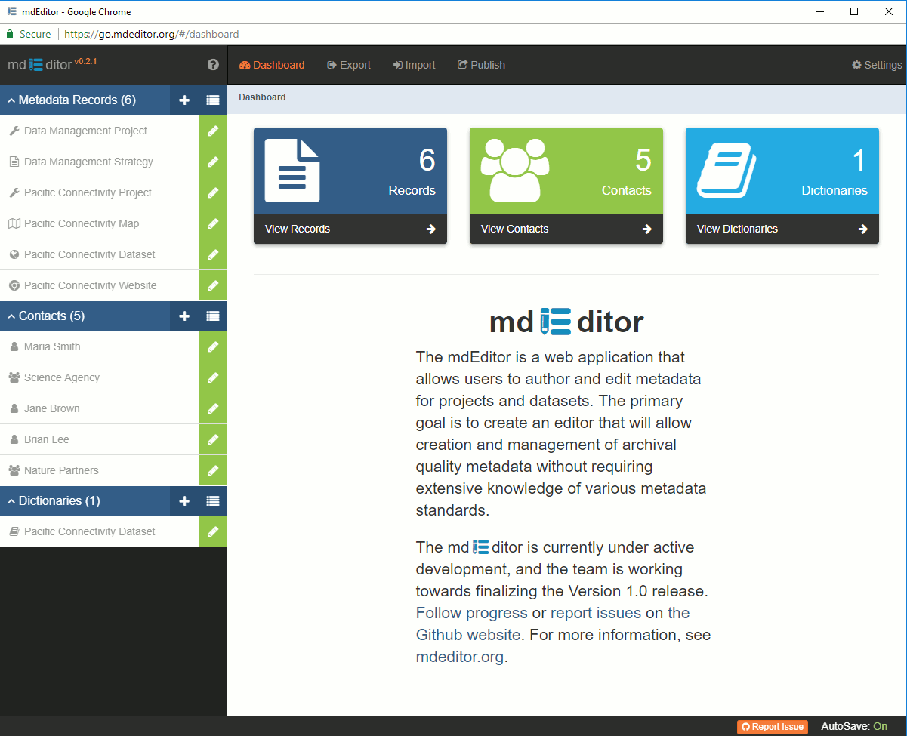

Exports
Web
Accessible Folder
Project
Harvests
Local Repository
Product
Transmits via
Webservice
ScienceBase
Harvests
Exports
Attached
Project Item
Translates
Harvests
Imports
Attached
Science Applications
Science Catalog
Product Item
Exports
Projects &
Products
Imports
Exports
Web application for
authoring and editing
metadata, for both
projects and datasets.
github.com/adiwg/mdEditor
ADIwg standard for encoding project and
data metadata, based on JavaScript Object Notation (JSON).
Open-source application for
translating between supported
metadata formats.
adiwg.org/mdTranlator
The format used to define
ScienceBase item attributes,
based on JavaScript Object
Notation (JSON).
Extensible markup language (XML). The metadata format
supported by Data.gov

Slide 2

ScienceBase
ScienceBase
MicroService
Repository
Publish
Harvests
Attached
Pushes
Project Item
Products
mdTranslator
Translates
USFWS
Science Applications
Science Catalog
Product Item
Harvests
Import
Projects and
Products
Export
mdTranslator
Web application for authoring and editing metadata, for both
projects and datasets.
github.com/adiwg/mdEditor
ADIwg standard for encoding project and data metadata, based on JavaScript Object Notation (JSON).
Open-source application for translating between supported metadata formats.
adiwg.org/mdTranlator
The format used to define
ScienceBase item attributes, based on JavaScript Object
Notation (JSON).
Extensible markup language (XML). The metadata format
supported by Data.gov

Slide 3

How to export Slides as high-quality images
1. Follow instructions here to set file export quality at 300 dpi:
https://learn.microsoft.com/en-us/office/troubleshoot/powerpoint/change-export-slide-resolution
2. Export slides as .png files using File -> Export -> Change File Type
The font used for the MDToolkit logo is PT Sans Narrow
This font is contained in the folder associated with this powerPoint. Here is an image of what it looks like:

Slide 4
REFERENCE ITEMS
These were created in this PowerPoint to maintain a consist visual style throughout the Workflow diagram.
sbJSON
<XML/>

Slide 5
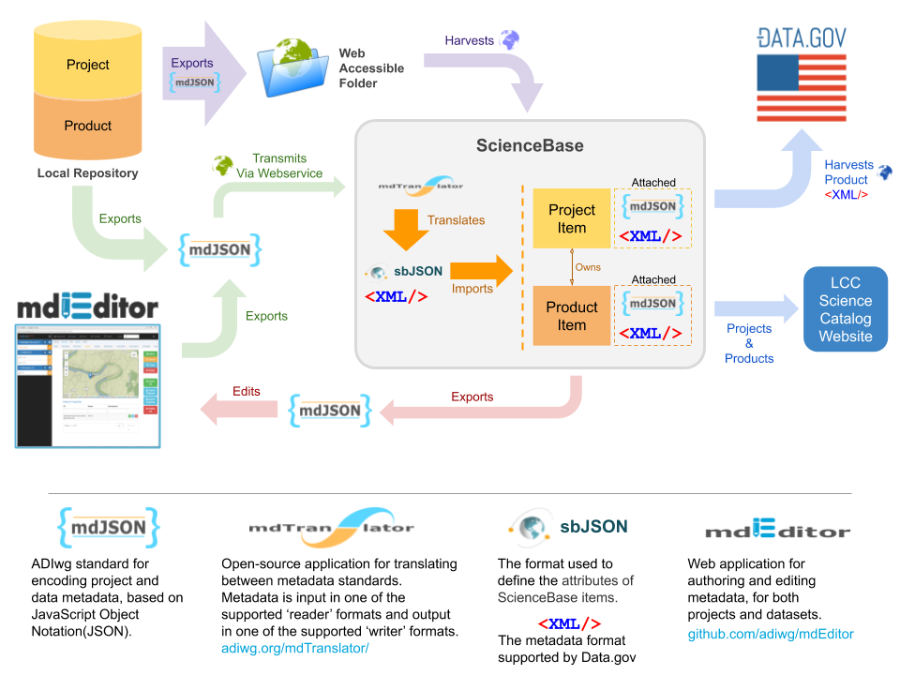
ORIGINAL VERSION

Slide 6
Exports
Web
Accessible Folder
Project
Harvests
Product
Local Repository
Transmits via
Webservice
ScienceBase
Harvests
Exports
Attached
Project Item
Translates
Harvests
Attached
Science Applications
Science Catalog
RECREATED VERSION
Imports
Product Item
Projects &
Products
Exports
Imports
Exports
Web application for
authoring and editing
metadata, for both
projects and datasets.
github.com/adiwg/mdEditor
ADIwg standard for
encoding project and
data metadata, based
on JavaScript Object
Notation (JSON).
Open-source application for
translating between supported
metadata formats.
adiwg.org/mdTranlator
The format used to define
ScienceBase item attributes,
based on JavaScript Object
Notation (JSON).
Extensible markup language
(XML). The metadata format
Supported by Data.gov

