Slide 1
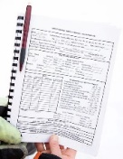















Acquire
QC/Process
Analyze
Report

Slide 2
Acquire
QC/Process
Analyze
Report

Slide 3
Acquire
QC/Process
Analyze

Slide 4
Acquire
QC/Process

Slide 5
Acquire

Slide 7
















R Package
Acquire
QC/Process
Analyze
Report

Slide 8
Acquire
QC/Process
Analyze
Report

Slide 9
Acquire
QC/Process
Analyze
Report

Slide 10
Acquire
QC/Process
Analyze
Report

Slide 11
Acquire
QC/Process
Analyze

Slide 12
Acquire
QC/Process

Slide 13
Acquire
QC/Process

Slide 14
Acquire

Slide 15
Acquire

